Slide 1

Project Title - Seasonal Agriculture Performance Analysis
Student Name - Harsheet Chander Pal
College Name - Kamla Nehru Institute of Technology
AICTE STU ID - STU6a38dc274a4ad1782111271

Slide 2

PROBLEM STATEMENT
Agricultural activities are influenced by seasonal variations in environmental conditions, farming practices, resource availability and market conditions. As a result, agricultural performance may differ from one season to another. However, raw agricultural data does not clearly explain how agricultural performance changes across seasons or what patterns can be observed in different seasonal conditions. The problem is to analyze the given agricultural dataset and investigate seasonal differences in agricultural performance by identifying meaningful patterns, trends, relationships and variations within the available data.

Slide 3
Project Description
Title: Seasonal Agriculture Performance Analysis
Domain: Agricultural Data Analytics
Overview:
This project delivers a comprehensive, data-driven investigation into how agricultural performance—spanning crop productivity, financial returns, resource consumption, and environmental risks—varies across Kharif, Rabi, and Zaid farming seasons. Utilizing a farm-level dataset of 4,000 observations across 8 major agricultural states, the analysis evaluates key seasonal patterns to provide evidence-based insights for optimizing seasonal farm management.
Key Project Highlights:
Data Cleaning & Imputation: Addressed missing values across environmental and yield parameters using group-wise median imputation based on season and crop types.
Statistical & Visual Analytics: Conducted rigorous univariate, bivariate, and multivariate analysis to identify core drivers of yield and profitability.
Core Findings: Highlighted peak productivity in Kharif driven by monsoonal rainfall (5.63 Tonnes/Ha), identified seasonal losses in off-season Zaid farming (-₹24,804.82 average profit), and established the superior efficiency of drip irrigation (6.27 t / 1000m³) over flood irrigation.
Actionable Outcomes: Derived 8 structured insights and provided practical recommendations for micro-irrigation adoption, pest forecasting, and season-specific crop planning.

Slide 4

WHO ARE THE END USERS?
Farmers & Agricultural Producers: Benefit from data-backed guidance on optimal seasonal crop selection, water-efficient irrigation methods, and pest risk awareness to maximize crop yield and prevent seasonal losses.
Agricultural Extension Officers & Advisory Services: Utilize seasonal performance benchmarks and regional profitability patterns to provide evidence-based recommendations and technical support to local farming communities.
Policy Makers & Government Agricultural Departments: Rely on empirical insights—such as state-level profit disparities and seasonal water usage metrics—to design targeted subsidy programs, micro-irrigation schemes, and regional infrastructure investments.
Agri-Business & Supply Chain Managers: Use crop-specific seasonal production totals and price trend data to optimize crop procurement strategies, logistics, storage allocation, and market distribution schedules.
Data Analysts & Academic Researchers: Build upon the clean, structured dataset and exploratory findings to develop predictive machine learning models and micro-climatic crop forecasting tools.

Slide 5

Technology Used
Development Environment:
Google Colab (Jupyter Notebook): Interactive cloud-based environment used for step-by-step code execution, data processing, and document formatting.
Programming Language:
Python 3: Core programming language utilized for data manipulation, statistical analysis, and visual graphics generation.
Data Processing & Analytics Libraries:
Pandas: Used for dataset loading, group-wise median missing value imputation, seasonal aggregation, and tabular data transformation.
NumPy: Used for fast mathematical computations, quantitative calculations, and statistical array operations.
Data Visualization Libraries:
Matplotlib: Primary plotting library used to construct univariate, bivariate, and multivariate layout structures, custom figure sizes, and axis formatting.
Seaborn: Applied on top of Matplotlib to render color palettes, statistical bar plots, distribution KDE plots, boxplots for outlier analysis, and scatter plots.

Slide 6
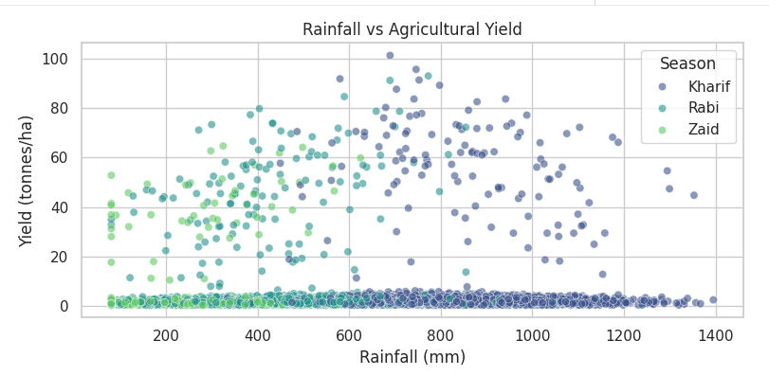
RESULTS
Rainfall vs Agricultural Yield
Key Findings:
Higher yield concentrations (up to 100 tonnes/ha) occur predominantly in the Kharif season (dark blue) where rainfall ranges between 600 mm and 1000 mm.
Rabi (teal) shows moderate yields with lower rainfall, while Zaid (light green) clusters at low rainfall levels (<400 mm) and yields under 50 tonnes/ha.
A dense cluster of low-yield records near 0–5 tonnes/ha exists across all rainfall levels due to crop-type differences (e.g., grains vs. sugarcane).
How It Helps the Project:
Proves that monsoonal rainfall is a primary driver for maximum seasonal productivity.
Helps identify optimal precipitation thresholds needed to achieve peak crop yields without over-irrigating.

Slide 7
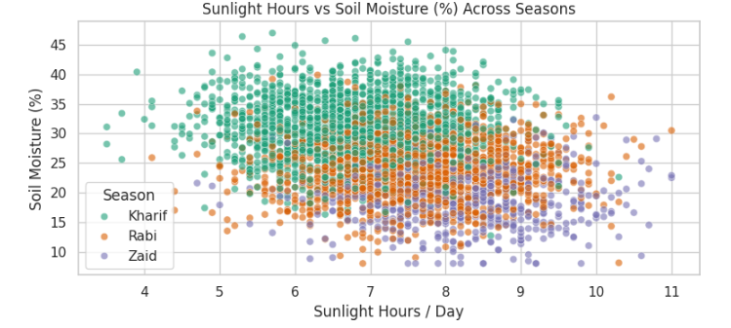
RESULTS
Sunlight Hours vs Soil Moisture (%) Across Seasons
Key Findings:
Kharif (teal) exhibits the highest soil moisture retention (25%–45%) with moderate sunlight (5–8 hours/day).
Zaid (purple) shows the lowest soil moisture levels (10%–25%) alongside the highest daily sunlight exposure (8–11 hours/day).
Rabi (orange) sits in the middle, balancing moderate sunlight and mid-range soil moisture.
How It Helps the Project:
Highlights severe evapotranspiration and soil drying during summer (Zaid), justifying the need for mulching and moisture-retention techniques.
Explains why summer cultivation incurs higher irrigation demands and lower crop resilience.

Slide 8
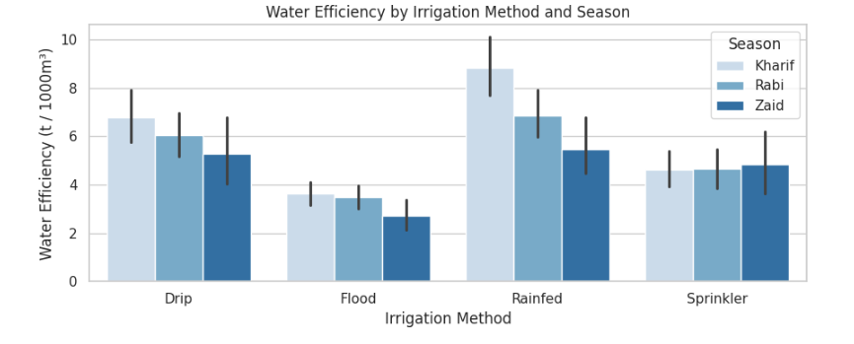
RESULTS
Water Efficiency by Irrigation Method and Season
Key Findings:
  Rainfed systems achieve the highest water efficiency during Kharif (~9 tonnes/1000m³) because natural rainfall provides water without operational pumping.
  Drip Irrigation maintains high, stable water efficiency across all seasons (~5–7 tonnes/1000m³).
  Flood Irrigation records the lowest efficiency across all seasons (<4 tonnes/1000m³), especially in Zaid (~2.5 tonnes/1000m³).
How It Helps the Project:
  Provides empirical proof that transitioning from flood to drip irrigation significantly improves water productivity.
  Directly supports the policy recommendation to subsidize micro-irrigation systems for summer farming.

Slide 9
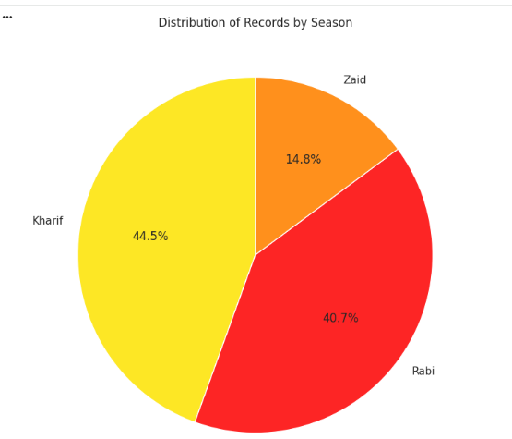
RESULTS
Distribution of Records by Season
Key Findings:
  Kharif comprises the largest share of total farm records at 44.5%.
  Rabi accounts for 40.7% of dataset observations.
  Zaid represents the smallest proportion at only 14.8%.
How It Helps the Project:
  Establishes dataset balance and confirms that farming activity drops sharply during the summer off-season.
  Provides baseline context for evaluating overall sample representation across cropping cycles.

Slide 10
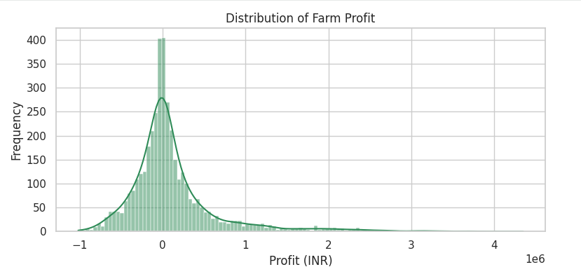
RESULTS
Distribution of Farm Profit
Key Findings:
  Profit distribution is heavily right-skewed, centered near ₹0 INR with a sharp peak.
  Significant negative values (losses down to -₹1,000,000 INR) exist, while extreme high-performing farms reach profits up to ₹4,000,000 INR.
How It Helps the Project:
  Demonstrates high economic variance across farms, proving that median values are better indicators of typical returns than overall averages.
  Highlights financial risk exposure in farming and identifies the presence of commercial outliers.

Slide 11
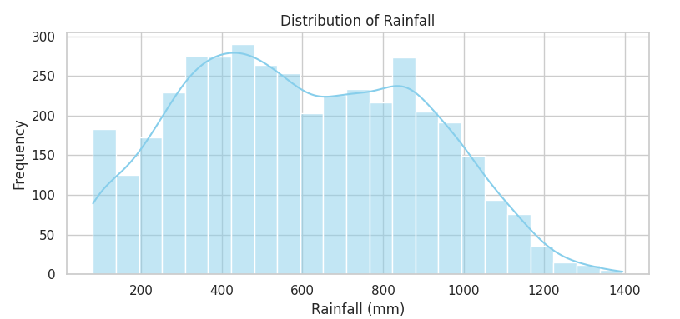
RESULTS
Distribution of Rainfall
Key Findings:
  Bimodal precipitation distribution with primary peaks around 400–500 mm and 800–900 mm.
  Rainfall spans from under 100 mm up to 1400 mm across all recorded locations.
How It Helps the Project:
  Confirms distinct climate zones within the dataset (semi-arid vs. heavy monsoon regions).
  Serves as a baseline for categorizing regional water availability and risk levels.

Slide 12
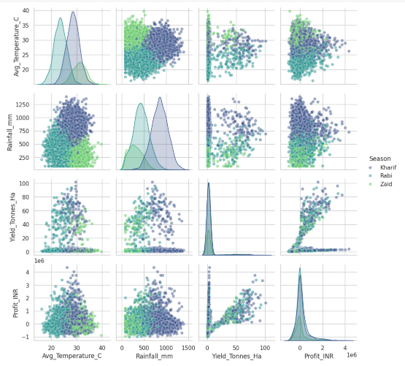
RESULTS
Pair Plot of Environmental & Performance Metrics by Season
Key Findings:
  Distinct Seasonal Microclimates: Diagonal KDE density plots show clear seasonal separation—Rabi (teal) centers on lower temperatures (~23°C), Kharif (blue) peaks at high rainfall (~850 mm), and Zaid (green) forms a high-temperature (~31°C), low-rainfall (~300 mm) profile.
  Strong Yield–Profit Correlation: The scatter plot at row 4, column 3 reveals a direct positive relationship between Yield Tonnes Ha and Profit_INR across all seasons, demonstrating that higher crop tonnage per hectare is the strongest driver of farm commercial success..
How It Helps the Project:
  Provides a comprehensive 360-degree overview of how key environmental variables (Avg. Temperature(C), Rainfall(mm) simultaneously influence core agricultural outcomes (Yield Tonnes Ha, Profit INR).
  Validates the need for season-specific crop management strategies by demonstrating that climatic conditions differ significantly across cropping cycles.

Slide 13
Future scope
1. Machine Learning & Predictive Modeling
Yield & Profit Forecasting: Train supervised machine learning regression models (e.g., Random Forest, XGBoost) to predict farm yield and net profit before planting based on early seasonal climate forecasts.
Optimal Crop Recommendation Engine: Build a classification model that recommends the most suitable crop variety for a given farm based on local soil pH, expected rainfall, and historical regional pricing.
2. Integration of Real-Time Geospatial & Remote Sensing Data
Incorporate Satellite Imagery (e.g., NDVI - Normalized Difference Vegetation Index) and real-time IoT soil sensor data to monitor crop health, soil moisture, and evapotranspiration live during the season.
3. Climate Change Risk & Scenario Analysis
Perform predictive stress testing to model the impact of rising global temperatures (+1.5°C to +2.0°C) and erratic monsoon patterns on regional agricultural productivity and farm economic viability over the next decade.
4. Interactive Dashboard & Farmer Advisory Platform
Deploy the analytical insights into an interactive web/mobile dashboard (using Streamlit, Dash, or Power BI) to provide actionable advisory reports directly to farmers and extension officers.

Slide 14
GitHub Link
https://github.com/HarsheetHCP/Seasonal_Agriculture_Performance_Analysis.git

Slide 15

VOIS Course completion certificate
Course name- Data Visualization

Slide 16
Thank you
.
.

