Slide 1


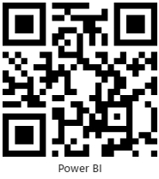

Food And Beverage Sales Analysis
Group-1:
Sowmya Bathula
Sri Harshetha Amaravadi
Yamini Durga Loya
Velangani Joshita Lavanya Dudla
View in Power BI
Last data refresh:
3/1/2024 8:30:44 AM UTC
Downloaded at:
3/1/2024 9:33:44 AM UTC

Slide 2
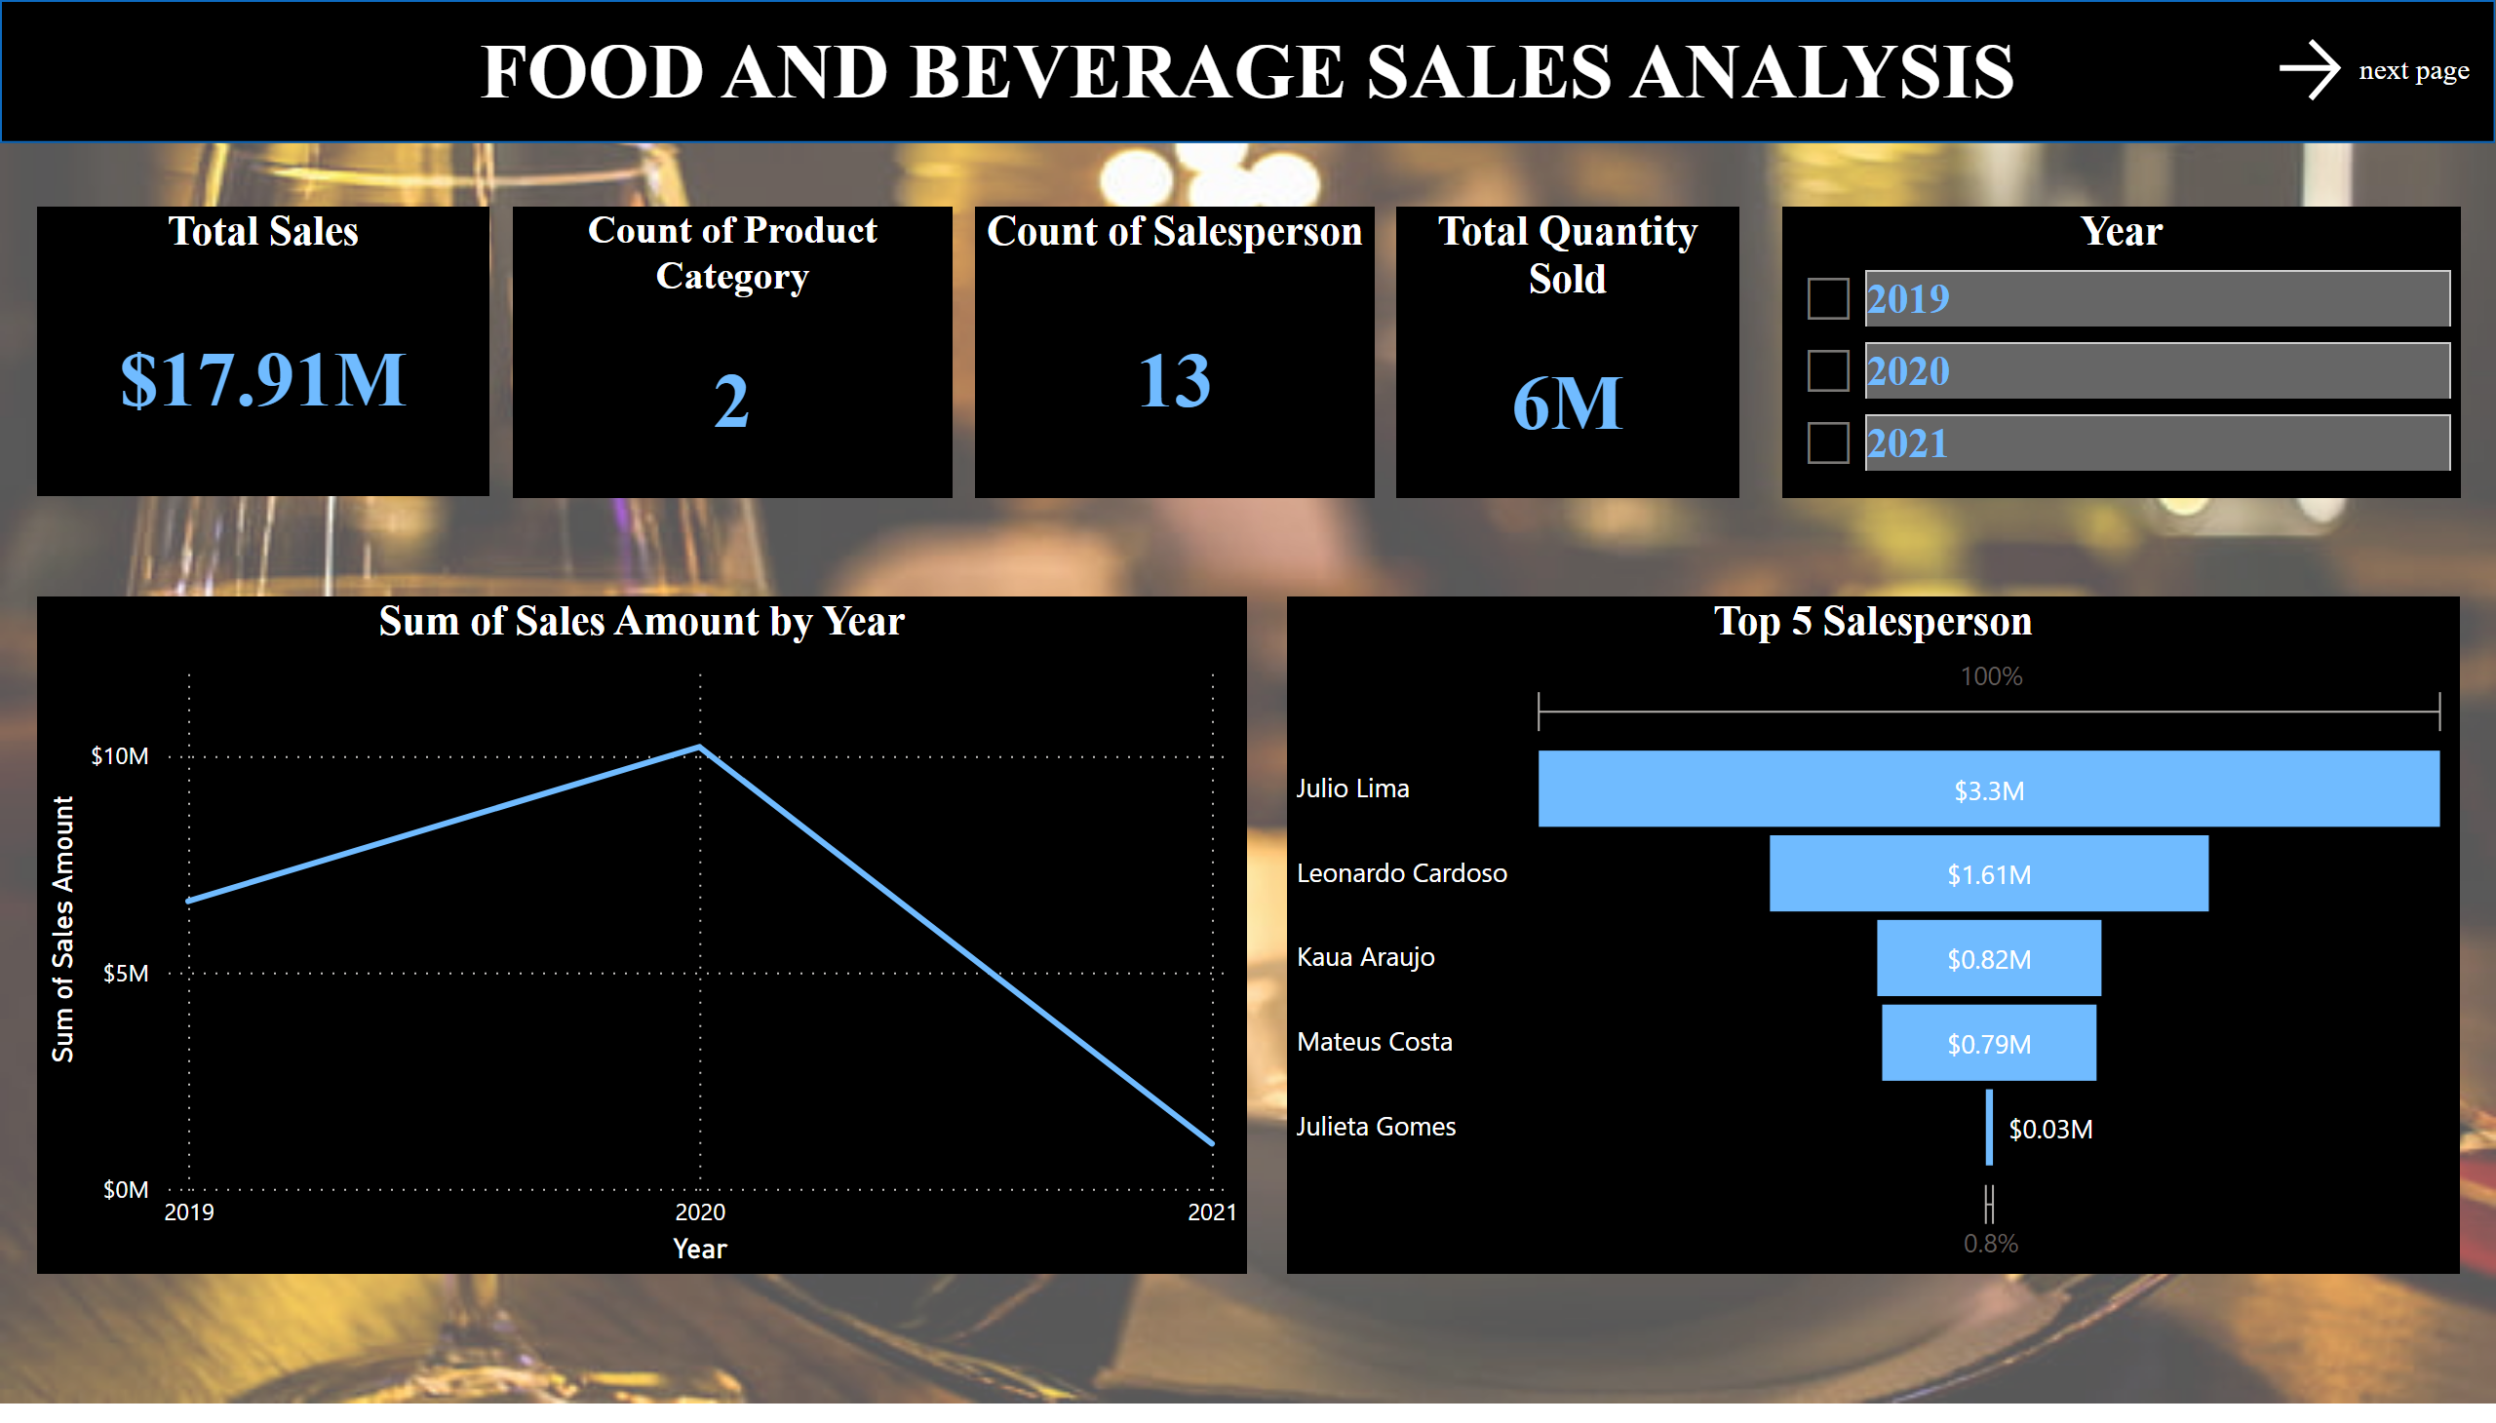
Summary
Notes:
shape
No alt text provided
Total Sales
No alt text provided
Count of Product Category
No alt text provided
Total Quantity Sold
No alt text provided
next page
No alt text provided
Top 5 Salesperson
No alt text provided
lineChart
No alt text provided
Count of Salesperson
No alt text provided
Year
No alt text provided

Slide 3
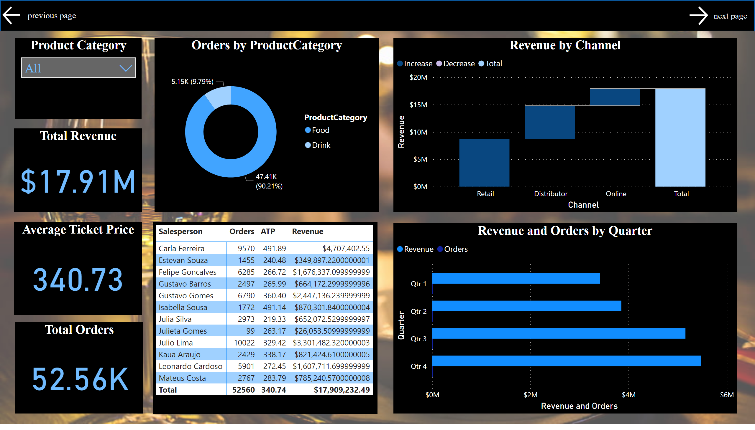
Revenue & Orders
Notes:
Total Revenue
No alt text provided
shape
No alt text provided
next page
No alt text provided
actionButton
No alt text provided
Average Ticket Price
No alt text provided
Product Category
No alt text provided
pivotTable
No alt text provided
Orders by ProductCategory
No alt text provided
waterfallChart
No alt text provided
Total Orders
No alt text provided
clusteredBarChart
No alt text provided

Slide 4
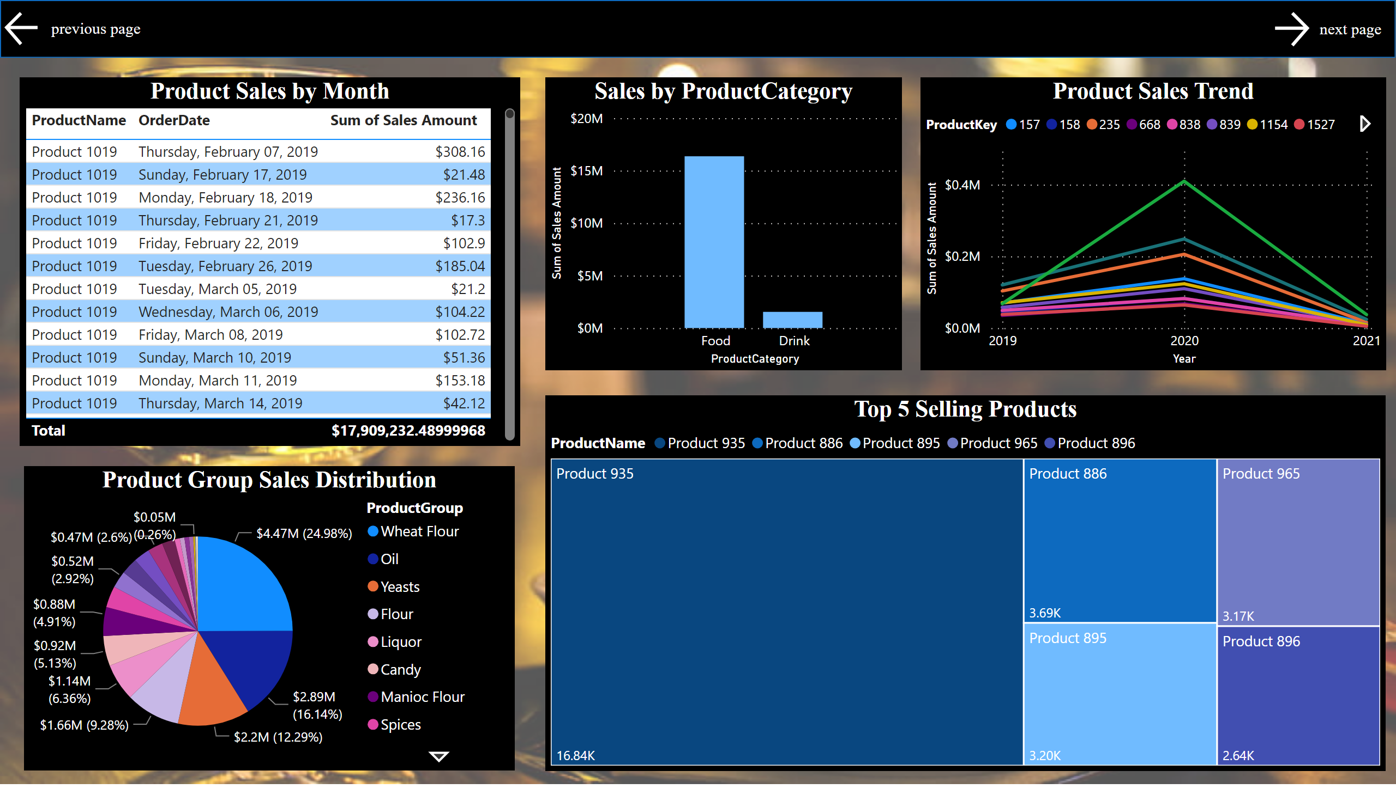
Product Analysis
Notes:
Top 5 Selling Products
No alt text provided
Product Sales Trend
No alt text provided
shape
No alt text provided
next page
No alt text provided
actionButton
No alt text provided
Sales by ProductCategory
No alt text provided
Product Group Sales Distribution
No alt text provided
Product Sales by Month
No alt text provided

Slide 5
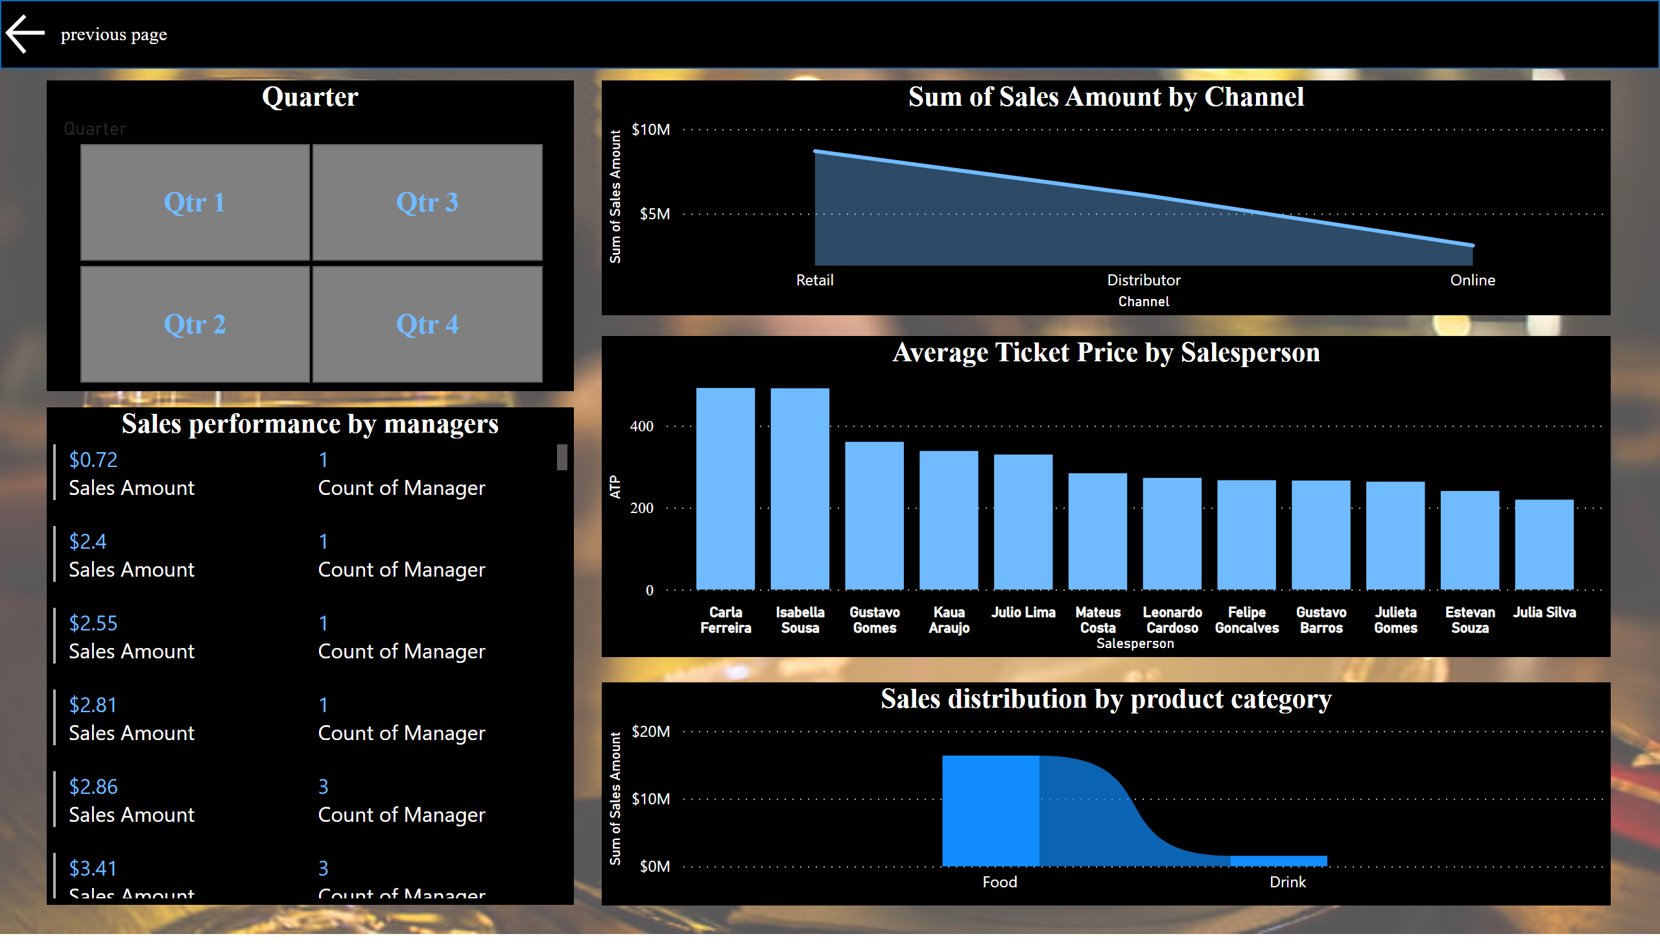
Sales Performance
Notes:
shape
No alt text provided
actionButton
No alt text provided
Sales distribution by product category
No alt text provided
Quarter
No alt text provided
Sales performance by managers
No alt text provided
stackedAreaChart
No alt text provided
Average Ticket Price by Salesperson
No alt text provided

