Slide 1
Test Rigor AI Based Automation Tool

Slide 2
About Test Rigor
AI-powered test automation tool
Supports:
Web
Mobile
Desktop
API testing
Uses plain English test cases

Slide 3
Objective
To automate test cases for Instagram Story post feature
To evaluate tool compatibility with dynamic UI
To understand limitations of AI-based automation tools

Slide 4
Instagram Story Post Feature
Allows users to:
Capture photos/videos
Upload media from gallery
Apply filters, stickers, text
Post content as a story
Highly interactive and gesture-based UI

Slide 5
Test Scope
App launch
Login functionality
Navigation to home page
Navigation to story section

Slide 6
Why test Rigor Cannot Automate This
testRigor works best with:
Stable UI elements
Buttons, text fields, links
Instagram Story:
Is gesture-heavy
Uses camera & animations
Is restricted against bots
Hence, automation is not supported

Slide 7
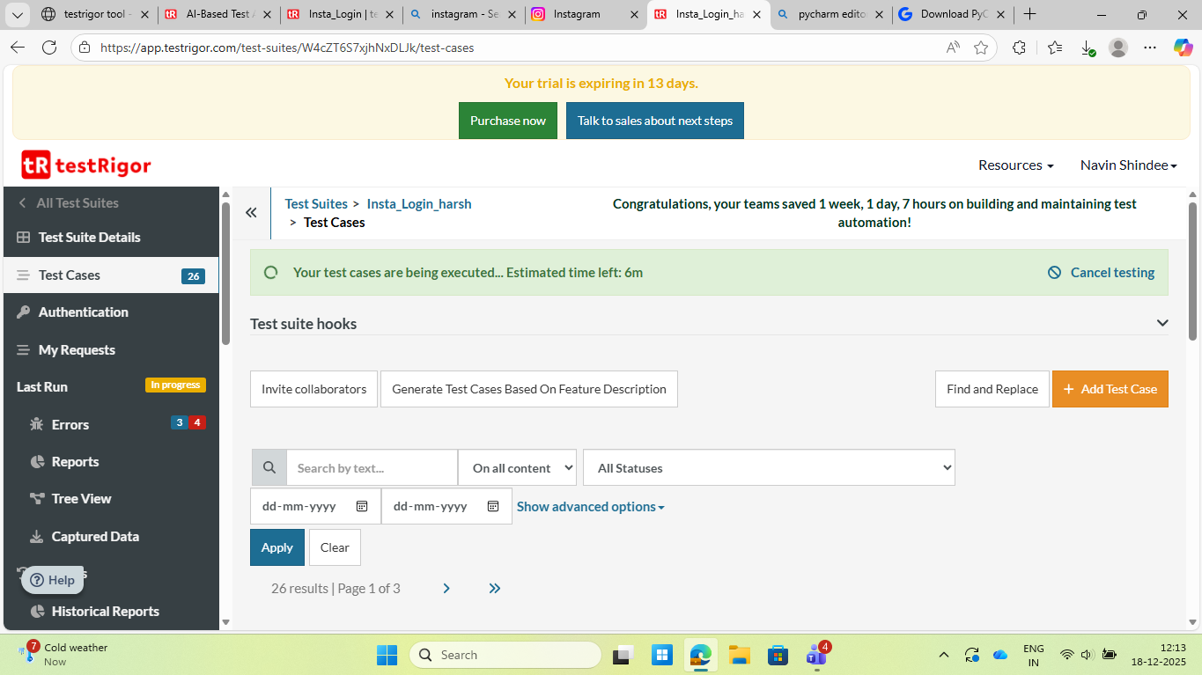
Why test Rigor Cannot Automate This
testRigor works best with:
Stable UI elements
Buttons, text fields, links
Instagram Story:
Is gesture-heavy
Uses camera & animations
Is restricted against bots
Hence, automation is not supported

Slide 8
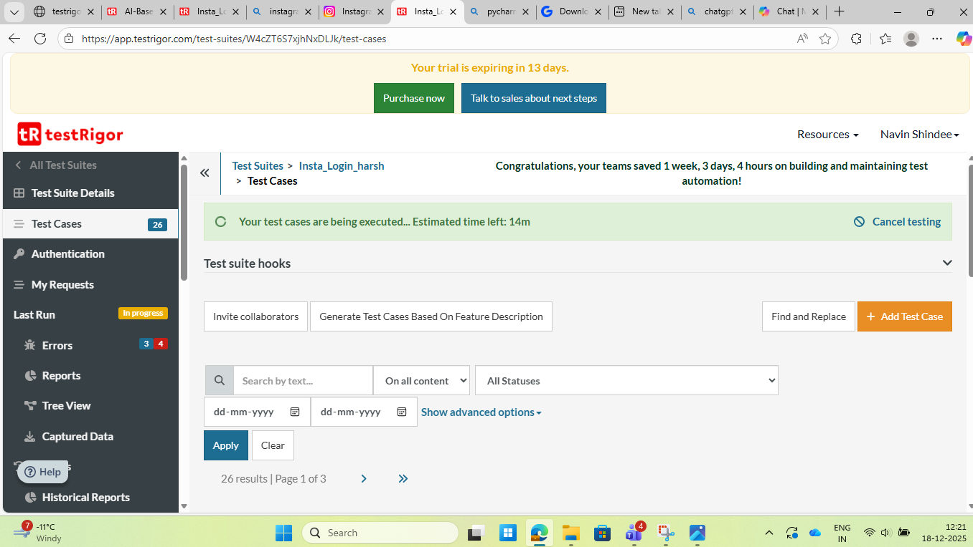
Why test Rigor Cannot Automate This
testRigor works best with:
Stable UI elements
Buttons, text fields, links
Instagram Story:
Is gesture-heavy
Uses camera & animations
Is restricted against bots
Hence, automation is not supported

Slide 9
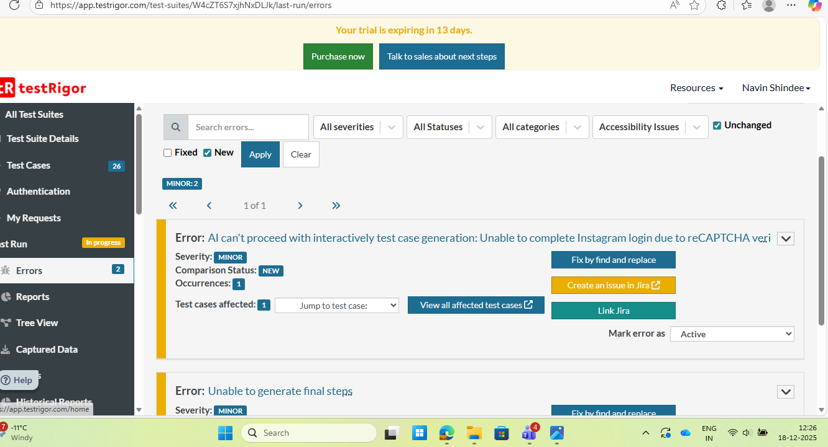
Why test Rigor Cannot Automate This
testRigor works best with:
Stable UI elements
Buttons, text fields, links
Instagram Story:
Is gesture-heavy
Uses camera & animations
Is restricted against bots
Hence, automation is not supported

Slide 10
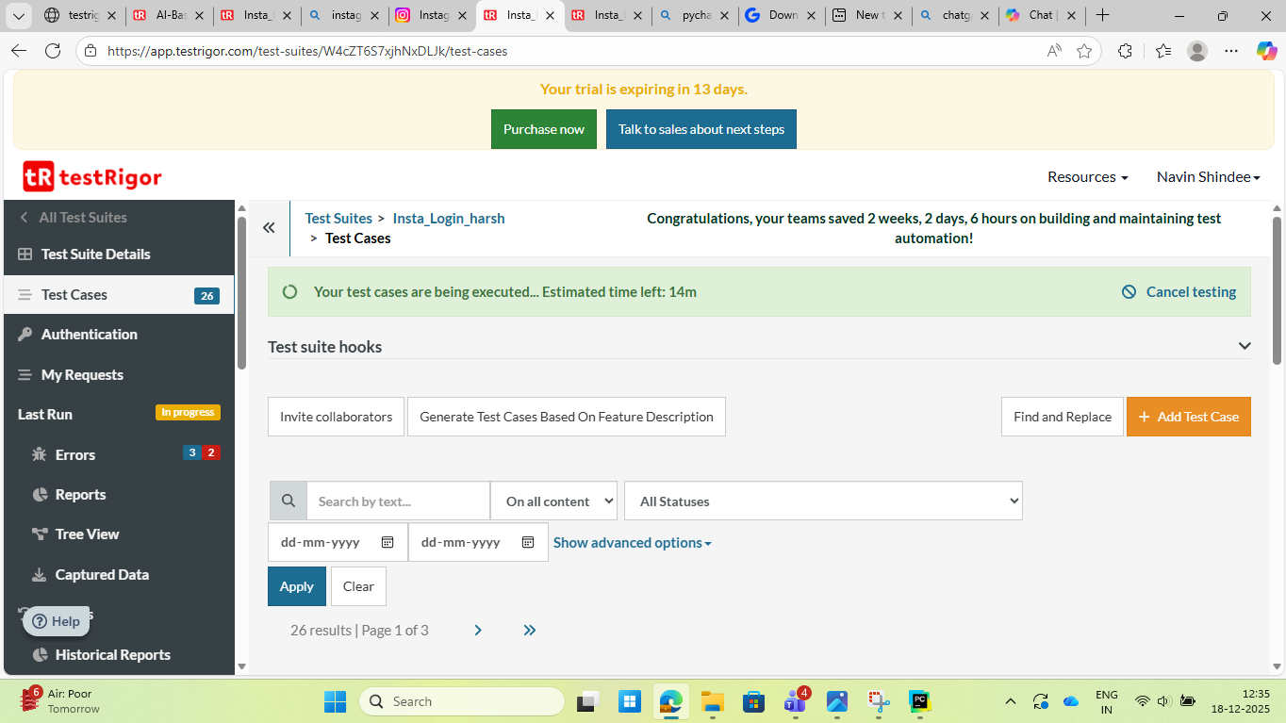
Why test Rigor Cannot Automate This
testRigor works best with:
Stable UI elements
Buttons, text fields, links
Instagram Story:
Is gesture-heavy
Uses camera & animations
Is restricted against bots
Hence, automation is not supported

Slide 11
THANK YOU

