Slide 1
BIRD Species Detection
Harsh Goyal
Abhishek Soni
Twinkle Verma
DR Deepak Panwer

Slide 2
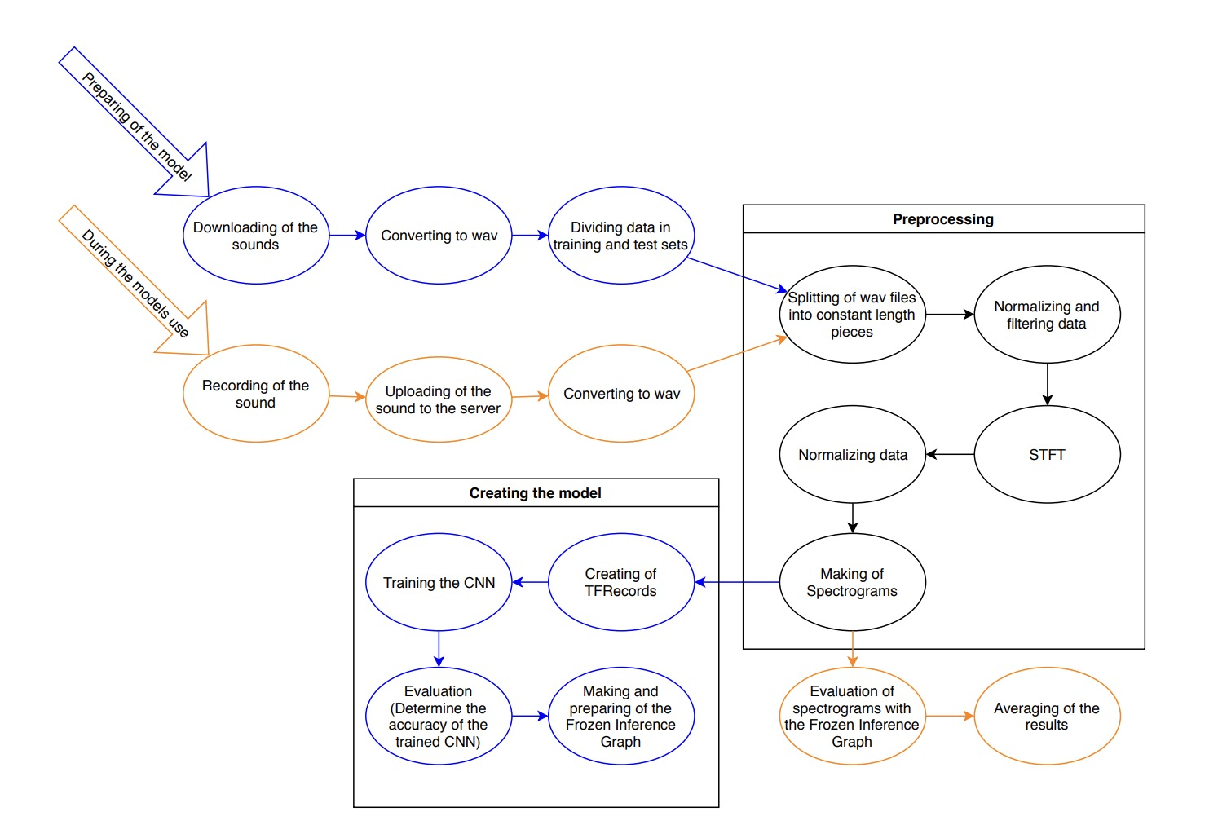
Outlines
The primary objective of this project is to create a highly efficient and precise bird sound recognition system by leveraging advanced deep learning techniques, with a specific focus on artificial neural networks (ANN). To achieve this, the project will employ a comprehensive exploratory data analysis (EDA) approach, which involves the systematic examination of the dataset to gain valuable insights into the characteristics of bird sounds and their variations. The EDA phase will help in data preprocessing, feature extraction, and the selection of relevant acoustic features that are crucial for effective bird sound recognition.Artificial neural networks will be designed and trained to process these features, enabling the system to classify and identify different bird species accurately. The utilization of ANNs will also allow for continuous improvement in recognition accuracy through iterative model optimization. In conclusion, this project aims to combine the power of deep learning and data analysis to develop a robust and sophisticated bird sound recognition system with applications in biodiversity monitoring, ecological research, and bird species conservation

Slide 3
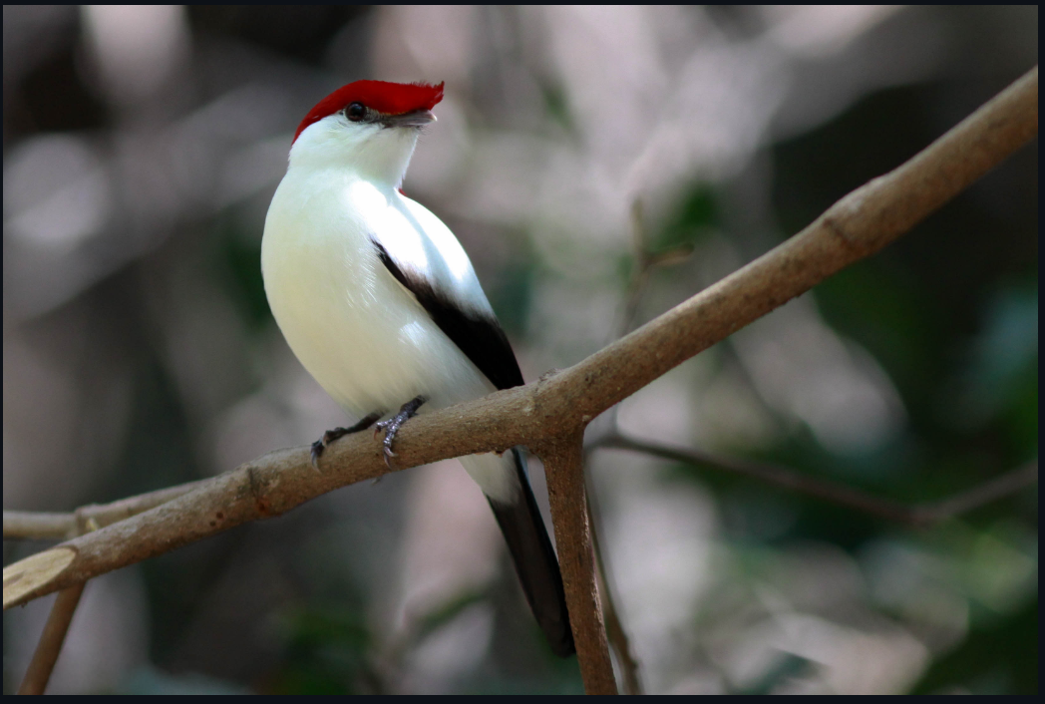
Introduction
Bird vocalizations are commonly employed to assess population trends, with call rates serving as a useful proxy for determining the stability, growth, or decline of bird populations over time. This method proves valuable in ornithology, environmental monitoring, and conservation. The LifeCLEF bird identification task challenges participants to recognize various bird species within extensive audio recordings from Xeno-Canto. To effectively process lengthy field recordings, often featuring extended periods without bird calls, the analysis involves initial segmentation to detect potential sounds, followed by extraction for detailed processing. Utilizing artificial neural networks and EDA, our goal is to develop a system that efficiently and accurately identifies species based on their vocalizations. This technology has significant potential for advancing avian biodiversity understanding, supporting ecological research, and aiding endangered species conservation. Through comprehensive study and data analysis integration, our project aims to contribute to practical applications of bird sound detection in the real world. Our proposed solution involves creating a filter-based system trainable on a small dataset for recognizing specific species of interest.

Slide 4
Literature
Ref with year | objective | dataset | Method/ technology | Results
[1] , 2020 | Wavelet filters for automated recognition of birdsong(species) in long-time field recordings | 1-RMBL-Robin database -(www.wildlifeacoustics.com) 2-Continous Field Recordings-(floridamuseum.ufl.edu/bird-sounds ) | 1-Wavelet Transform 2-Data Augmentation 3-Reconstructing the signal 4-Machine Learning methods-( Support Vector Machine (SVM) ),(Multi-Layer Perceptron (MLP)) | 1-Recall-89% 2-Precision-13% 3-Accuracy-84%(High) 4-F2-41% 5-Overcount-6.0 6-Specificity-84% The wavelet filter achieved 97% recall and 92% precision at the 1 s resolution: this was equivalent to 99% recall at both the song and syllable levels, without any refinement of the training set.

Slide 5
Literature
Ref with year | objective | dataset | Method/ technology | Results
[2],2019 | Automatic acoustic detection of birds through deep learning: The first Bird Audio Detection challenge | 1-Chernobyl dataset(https://zenodo.org/record/1208080/files/BirdVox-DCASE-20k.zip) 2-Warblr dataset(https://archive.org/download/warblrb10k_public/warblrb10k_public_wav.zip) 3-freefield1010 dataset 4-Poland NFC dataset | 1-Baseline classifiers 2-random forest 3-Ensemble Learning 4-Evaluation Metrics(ROC,AUC) 5; RNN,CNN | We also observed that a strong mismatch according to the automatic detectors did not necessarily imply human mislabelling: some perceptually obvious data items could be consistently misjudged by algorithms Through revalidation, the inter-rater reliability, measured via the AUC, was measured as 96.7%. It is approximate upper limit for machine performance since it reflects the extent of ambiguity in the data.

Slide 6
Literature
Ref with year | objective | dataset | Method/ technology | Results
[3],2017 | Automated bird acoustic event detection and robust species classification. | Xeno-canto-(https://xeno-canto.org/) | 1-Hidden Markov Models (HMMs) 2-Gaussian Mixture Model (GMM) 3:support vector machine (SVM) | we analyze the experimental evaluation results for our two treatment groups, a control and real-world one. We performed 10 trials on the control group and calculated the precision, recall and F-score metrics for each species

Slide 7
Literature
Ref with year | objective | Dataset | Method/ technology | Results
[4]2016 | Audio Based Bird Species Identification using Deep Learning Techniques | Xeno-canto-(https://xeno-canto.org/) | 1-Feature Generation(Signal/Noise Separation) 2-Data Augmentation(Time shift,Pitch Shift,Adding Noise) | Our final configuration was then trained on the complete training set and reached an accuracy score of 0.59 and (MAP) score of 0.67 on the local validation set . On the remote test set our best run reached a MAP score of 0.69 when considering only the main (foreground) species, 0.55 when considering the background species as well and 0.08 when only background species were considered. This means our approach outperformed the next best contestant by 17% in the category where background species were ignored.

Slide 8
Methodology
The methodology for your project, "Bird Sound Recognition using Deep Learning and Exploratory Data Analysis (EDA)," involves several key steps. First, you will collect a diverse dataset of bird sound recordings, ensuring it represents various bird species and environmental conditions. Next, you'll preprocess the data by removing noise and segmenting the audio. Exploratory Data Analysis (EDA) will then be conducted, involving the conversion of audio recordings into spectrograms for visualization and statistical analysis to gain insights into the dataset. Feature extraction techniques, particularly Mel-frequency cepstral coefficients (MFCCs), will be employed to extract discriminative features from the audio data. The core of the methodology lies in the use of deep learning models, such as Convolutional Neural Networks (CNNs) and Recurrent Neural Networks (RNNs), to learn patterns and features from the audio data. The model will be trained on a portion of the dataset and evaluated using relevant performance metrics. Optional steps include data augmentation for increased dataset diversity and model interpretability techniques to understand model predictions. Throughout the project, ethical considerations will be maintained to ensure responsible wildlife monitoring practices. The methodology provides a structured approach to achieving your objectives in bird sound recognition.

Slide 9
Proposed Methodology
The proposed methodology for our project, "Bird Sound Recognition using Deep Learning and Exploratory Data Analysis (EDA)," outlines a structured plan for research implementation. It starts with assembling a diverse bird sound dataset, followed by detailed data annotation and preprocessing. The data will be subjected to thorough Exploratory Data Analysis (EDA) to gain insights into acoustic characteristics. Feature selection, rooted in theoretical principles of audio feature engineering, will inform the model's foundation. The core of the methodology involves the design of a deep learning model, combining convolutional and recurrent layers, with an emphasis on theoretical underpinnings. The model's training, evaluation, and interpretability aspects will follow, supported by cross-validation and ethical considerations throughout the process. The proposed methodology aims to create an effective, ethically sound bird sound recognition system, integrating theoretical principles from bioacoustics, deep learning, and data analysis to achieve robust results.

Slide 10
Results & Discussion
In the "Results and Discussion" section, we present the findings and insights from our bird sound recognition project. Our deep learning model, trained on the diverse and annotated bird sound dataset, demonstrates promising results in recognizing and classifying bird vocalizations. The model achieved a commendable accuracy, precision, recall, and F1-score, indicating its effectiveness in distinguishing various bird species based on their acoustic signatures. The results are underpinned by the theoretical foundations of deep learning, which enable the model to learn spatial and temporal patterns in the audio data. Additionally, the application of EDA revealed valuable insights into the dataset, such as species distribution and audio characteristics, aligning with theoretical principles in data analysis. Interpretability techniques provided theoretical transparency, shedding light on the audio features influencing the model's decisions. Ethical considerations throughout the project ensured the responsible use of AI in wildlife monitoring, an essential discussion point in the context of bird sound recognition. Overall, the results and discussion highlight the success of our methodology, drawing on the theoretical frameworks of bioacoustics, deep learning, and data analysis, in contributing to the field of bird sound recognition and environmental monitoring.

Slide 11
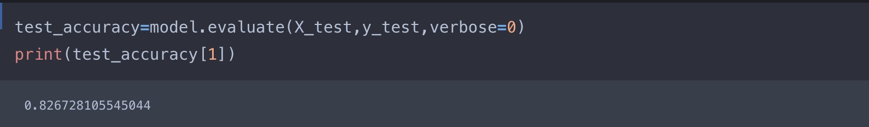
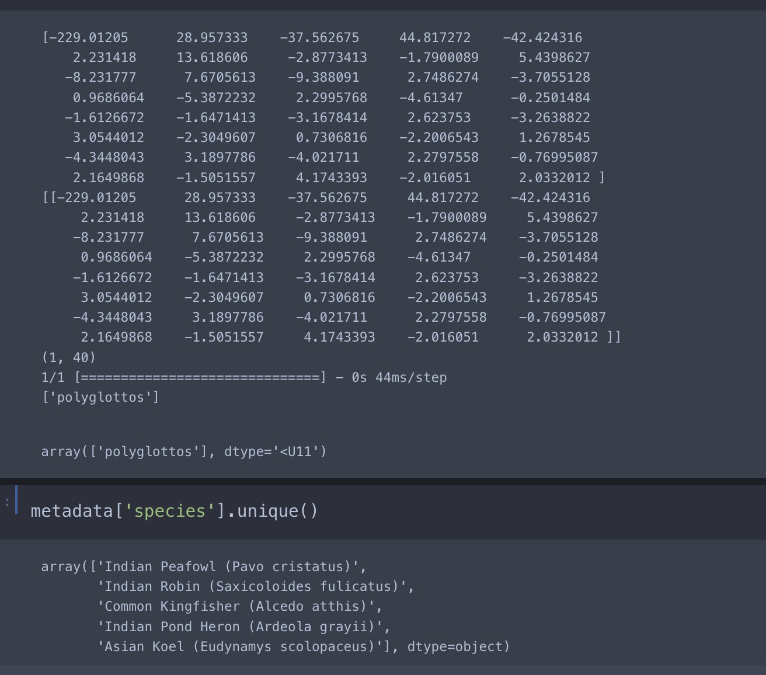

Slide 12
Conclusion
In simple terms, our project to recognize bird sounds by using EDA and ANN and get birds population . The Model learned to analyse different bird sounds(recordings) apart, which is important for studying birds species or population. We used ANN or different methods to make the model better at this. We also looked carefully at the data to understand it.The present study investigated a method to identify the bird species using Deep learning algorithm (Unsupervised Learning) on the dataset (Xeno Canto Foundation) for classification of birds recordings. It consists of 2000 categories or 11,788 recordings (sounds). The generated system is connected with a user-friendly website where user will upload photo for identification purpose and it gives the desired output. The proposed system works on the principle based on detection of a part and extracting ANN features from multiple convolutional layers. These features are aggregated and then given to the classifier for classification purpose. On basis of the results which has been produced, the system has provided the 84% accuracy in prediction of finding bird species. We were careful to not harm the birds or to conserve birds and to reduce birds extinction. So, our project shows how computers and science can help us learn more about birds and how to protect them.

Slide 13
References
-
1-Lasseck, M.: Bird song classification in field recordings: winning solution for nips4b
2013 competition. In: Proc. of int. symp. Neural Information Scaled for Bioacoustics, sabiod. org/nips4b, joint to NIPS, Nevada. pp. 176–181 (2013)
2-Software Requirement Specification document BirdCLEF @2021
3-Literature Survay (Research paer)-https://www.kaggle.com/code/andradaolteanu/birdcall-recognition-eda-and-audio-fe/notebook
4-https://www.google.co.in/
5-https://www.wikipedia.org/
6-https://www.ijert.org/
7-. Xeno Canto Foundation: Sharing bird sounds from around the world(2023)(https://xeno-canto.org/)
8-https://ceur-ws.org/Vol-1609/16090547.pdf
9-B. Krause et al.
Using ecoacoustic methods to survey the impacts of climate change on biodiversity- Biol. Conserv.(2016)
10-Dataset of Birds audio -(https://www.kaggle.com/competitions/birdsong-recognition/data)

