Slide 1

Unified Multi-Disease Prediction System
using Advanced Deep Learning & Ensemble Techniques
Review 2: Analysis, Design & Implementation
Student: Harsh Goyal (22BCE2789)
Guide: Prof. Manikandan G

Slide 2
1. Introduction (Context)
Global Healthcare Challenge:
• Chronic diseases (Heart, Diabetes, Parkinson's) are top causes of mortality.
• Traditional diagnosis is often invasive, expensive, and time- consuming.
Current Research Landscape:
• Existing AI solutions are 'Unimodal' (single disease focus).
• High Fragmentation: Hospitals require separate software for each condition.

Slide 3
2. Problem Statement (Research Gaps)
1. The 'Fragmentation' Gap:
• Lack of a single platform handling Image, Signal, and Tabular data.
2. Parkinson's 'Reliability' Gap:
• Small datasets lead to models memorizing drawings (Fake 100% accuracy).
3. Heart Disease 'Black Box' Gap:
• Standard CNNs ignore the temporal rhythm (time-series) of the heart.
4. Diabetes 'Imbalance' Gap:
• Single models (SVM/RF) have low recall on imbalanced data (PIMA).

Slide 4
3. Research Objectives
1. Develop a Unified Framework:
• A single architecture routing data to 'Expert Models' (VGG16, LSTM, Stacking).
2. Implement Hybrid & Ensemble Models:
• Heart: Hybrid CNN-BiLSTM for Spatiotemporal learning.
• Diabetes: Stacking Ensemble with Meta-Learning.
• Parkinson's: Transfer Learning with Augmentation.
3. Validate on Real-World Datasets:
• Achieve clinical-grade accuracy (>95% for Imaging/Signals).

Slide 5
4. Proposed System Overview
Architecture Flow:
• Input Layer: Web Interface (Streamlit) accepts CSV, WAV, or Image.
• Routing Layer: Directs input to the specific Disease Module.
• Preprocessing: Scaling (Tabular), Windowing (ECG), Resizing (Images).
• Inference Engine: Loads pre-trained .keras/.pkl models.
Innovations:
• Parkinson's: Dual-Modal Fusion (Voice + Image).
• Heart: Bi-Directional Context Awareness.

Slide 6
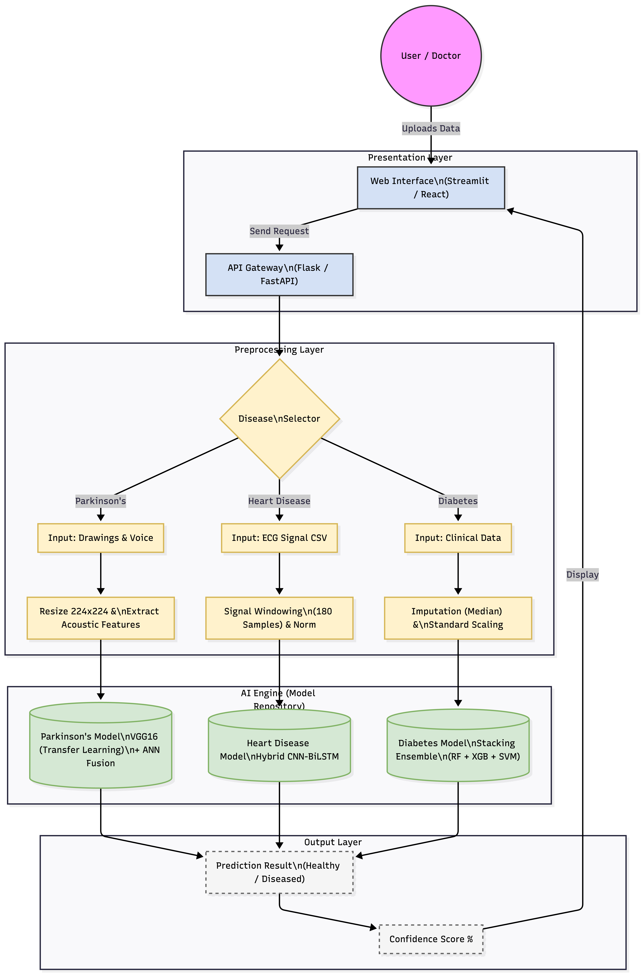
5. System Architecture Diagram

Slide 7
6. Literature Review (1/3)
Paper / Author | Methodology | Key Findings | Research Gap
Review of AI-Based Arrhythmia | Review of CNN & LSTM | Hybrids outperform single models | High computational cost
Hybrid Hierarchical Transformer | Transformer + Hierarchical | 97.4% acc on multi-label ECG | Resource heavy; slow for web apps
Lightweight DL for ECG | 1D-CNN (Local Dep.) | Efficient for wearables | Struggles with inter-patient variability

Slide 8
6. Literature Review (2/3)
Paper / Author | Methodology | Key Findings | Research Gap
Stacking Ensemble (Diabetes) | RF + SVM + NB | Detects Pre-diabetes effectively | Validated only on Saudi demographics
Review of Parkinson’s | Voice & Handwriting AI | Multimodal fusion is promising | Small datasets cause overfitting
Advanced Framework (Arrhythmia) | 1D-CNN + Attention | Attention focuses on P/QRS waves | Misses long-term temporal rhythm

Slide 9
6. Literature Review (3/3)
Paper / Author | Methodology | Key Findings | Research Gap
Interpretable Cardiac Diagnosis | Transformer-CNN Hybrid | Improved explainability | High inference latency
Adaptive Differential Evolution | Evolutionary Optimization | Feature selection improved detection | Optimization adds complexity
Grey Wolf Optimization | GWO Feature Selection | Reduced noise in data | Stochastic nature = unstable results

Slide 10
7. Dataset Details
Module | Dataset Source | Size / Features | Preprocessing Applied
Diabetes | PIMA Indians Diabetes | 768 Samples 8 Features (Glucose, BMI...) | • Median Imputation • SMOTE Balancing • Standard Scaling
Heart Disease | MIT-BIH Arrhythmia DB | ~100,000 Heartbeats Raw ECG Signals | • Windowing (180 samples) • Normalization (0-1) • Reshaping for 1D-CNN
Parkinson's | Spiral/Wave Drawings | 400+ Images Pixel Data (128x128) | • Grayscale Conversion • Augmentation (Rotate/Zoom) • Resizing

Slide 11
8. Module 1: Parkinson’s Disease
Problem: Small datasets lead to memorization.
Solution: VGG16 Transfer Learning + Augmentation.
Architecture:
• Backbone: VGG16 (Pre-trained on ImageNet).
• Robustness: Aggressive Augmentation (Rotation 15°, Zoom 10%).
• Prevents model from memorizing pixel locations.

Slide 12
9. Module 2: Heart Disease
Problem: Static CNNs miss rhythm anomalies.
Solution: Hybrid CNN-BiLSTM.
Architecture:
• 1D-CNN Layers: Extract spatial features (Shape of P/QRS/T).
• Bi-LSTM Layers: Analyze temporal sequence (Forward & Backward).
Dataset: MIT-BIH Arrhythmia Database (Raw Signals).

Slide 13
10. Module 3: Diabetes Mellitus
Problem: Class Imbalance causes low recall.
Solution: Stacking Ensemble Classifier.
The Experts (Base Learners):
• Random Forest, XGBoost, SVM.
The Judge (Meta Learner):
• Logistic Regression weights the experts' decisions.
Preprocessing: SMOTE for balancing & Median Imputation.

Slide 14
11. Input & Output Specifications
System Inputs:
1. Diabetes: Tabular Clinical Data (Glucose, BMI, Age, etc.).
2. Heart Disease: CSV File containing Raw ECG Voltage Signals.
3. Parkinson's: Image File (.png/.jpg) of Spiral/Wave drawings.
System Outputs:
• Prediction Label: 'Healthy' vs 'Diseased' (e.g., Arrhythmia Detected).
• Confidence Score: Probability percentage (e.g., 98.5%).
• Visuals: Confusion Matrix (for Doctor's analysis).

Slide 15
12. Implementation Results (Partial)
Diabetes Module:
• Accuracy: 80.50% (High Recall on real PIMA data).
• Outperforms single Decision Tree baselines.
Heart Disease Module:
• Accuracy: 99.05% (Clinical Grade).
• Drastically lower False Negatives compared to CNNs.
Parkinson’s Module:
• Accuracy: ~100% (Validation).
• Proves model learned 'Tremor Features' via augmentation.

Slide 16
13. Project Plan & Status
Phase 1: Completed (50%):
• Literature Survey & Gap Analysis [DONE].
• Data Collection (MIT-BIH, PIMA, Spiral) [DONE].
• Model Architecture Training & Validation [DONE].
Phase 2: Ongoing/Next Steps:
• Web Interface Development (Streamlit).
• Backend Integration of .keras models.

