Slide 1
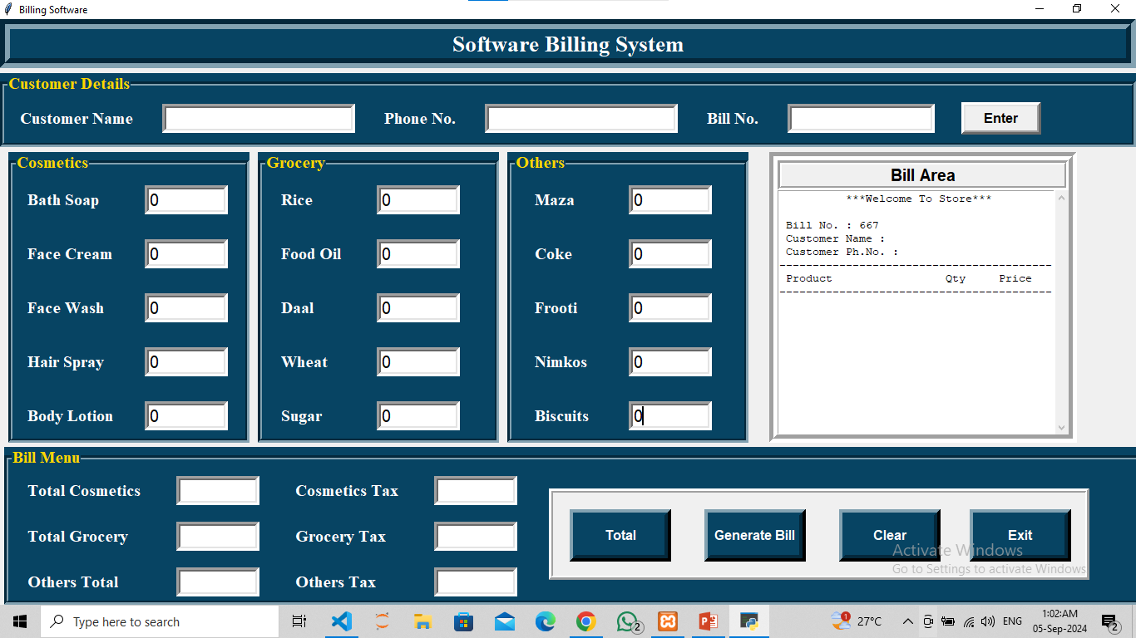
Billing System
Using Tkinter for Graphical user interface.
Used Random module for Random bill number.
Connected Databse with MySQL using Pymysql.
Used message box from Tkinter for Pop-Ups Error box

Slide 2
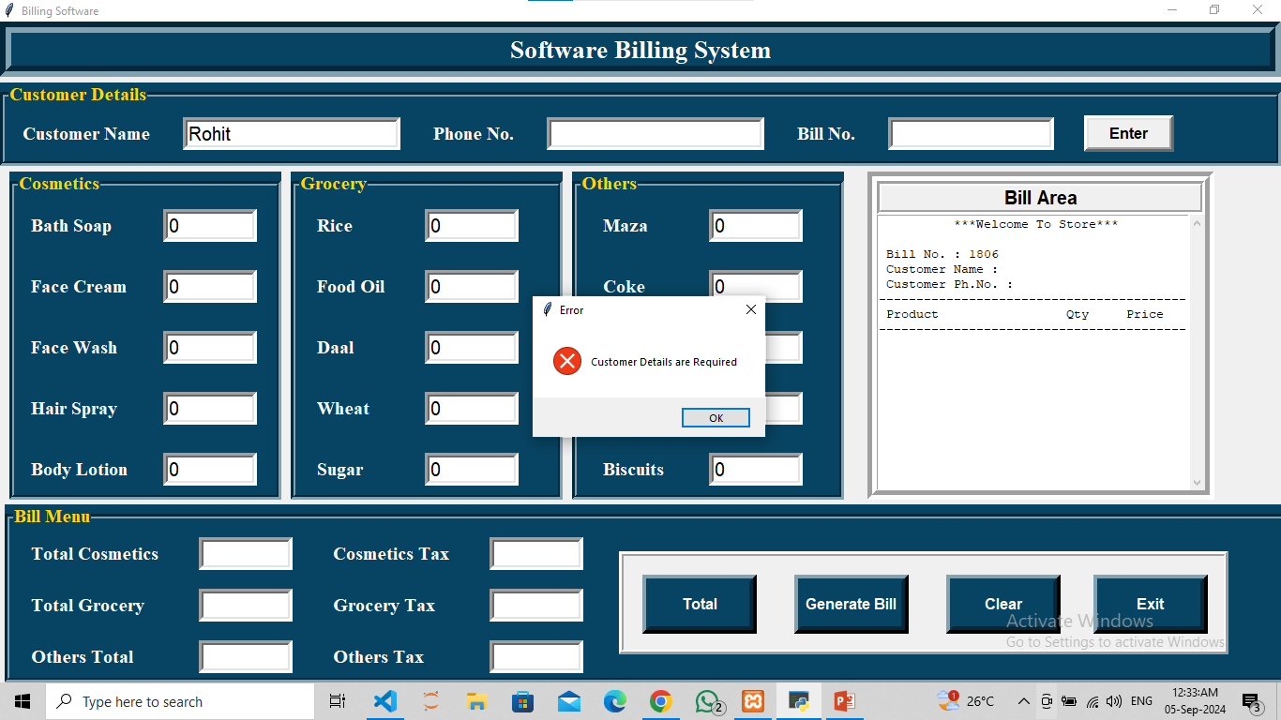
Without user details user can’t generate Bill
As well as without Purchase item and for 0 Total.
User will get pop-up box

Slide 3
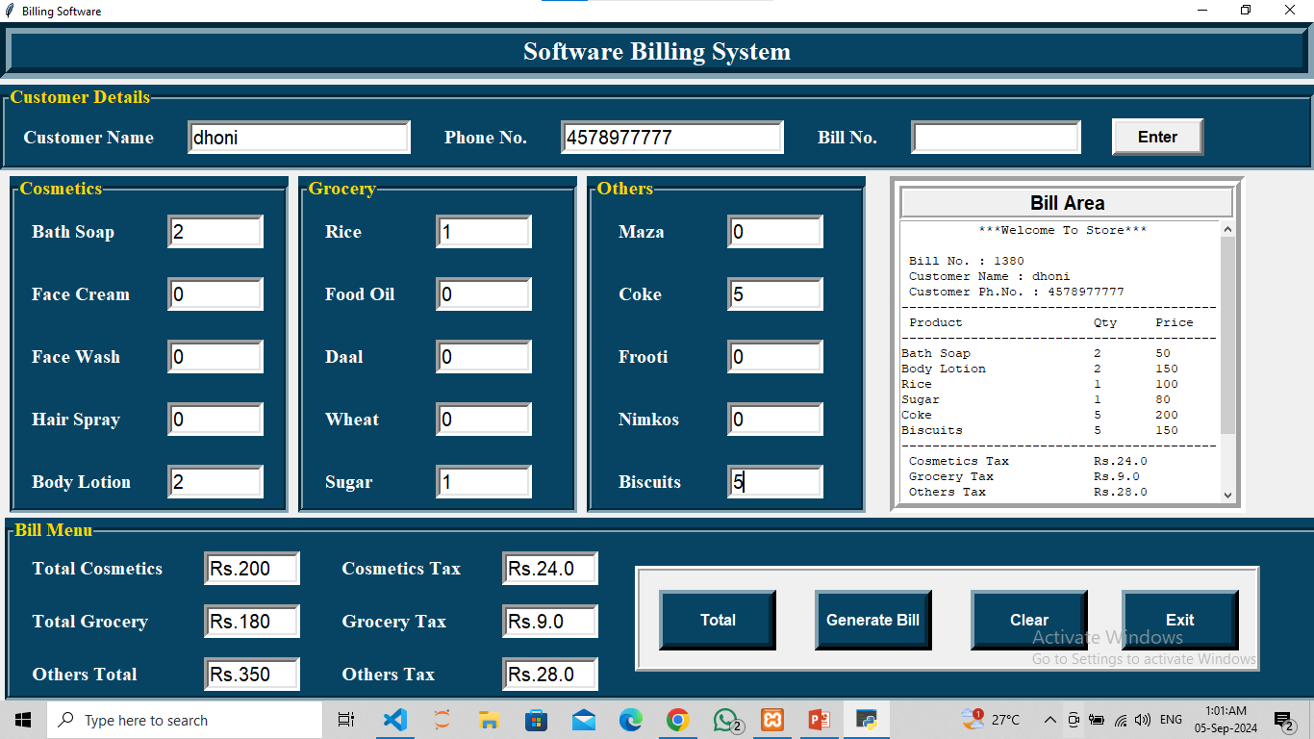
After filling all the required field user will get bill in Bill area.
And user will get asked if he/she wants to save the bill in computer if yes file will save in BillNum.txt form using OS module.

Slide 4

User can search using Bill no. Entry field if bill number exists user will get bill if invalid bill no user will get pop-up error for invalid entry.

Slide 5
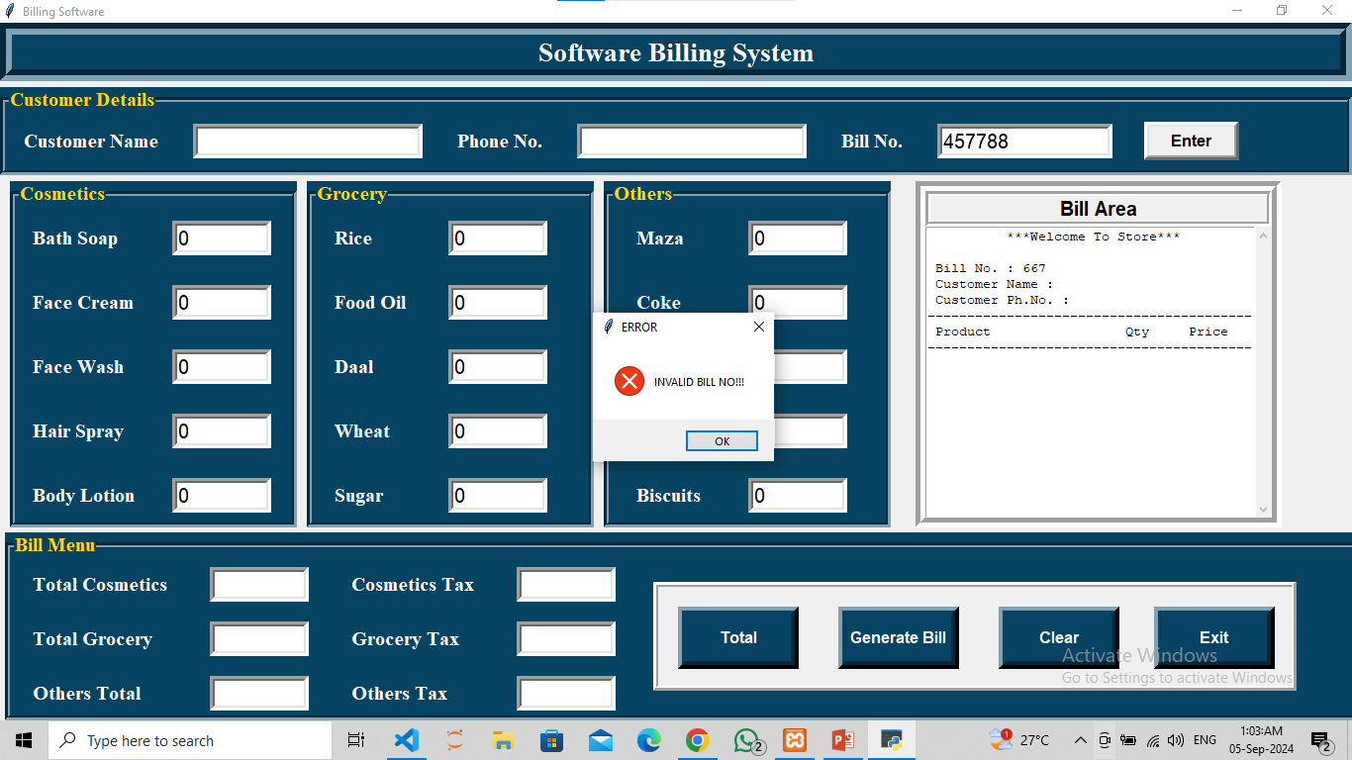

Slide 6
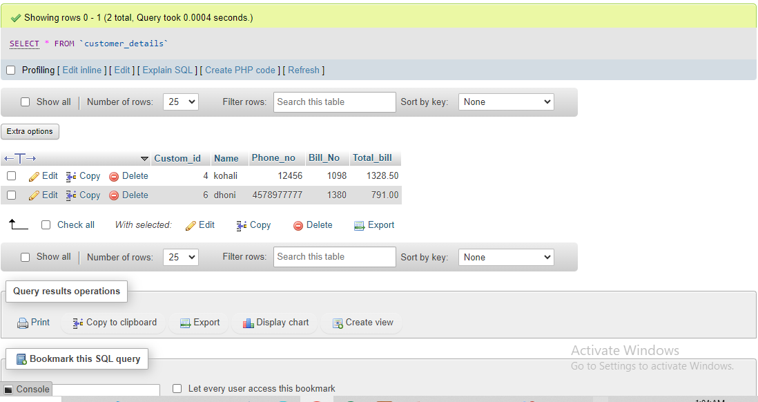
All the user data of bill no and total will be stored in mysql database

