Slide 1


CORE TECHNOLOGIES USED
• Framework: ASP.NET Core 10.0 MVC (C#)
• Database: MySQL Server (Port 3306)
• ORM Tool: Entity Framework Core 9.0
• Security: BCrypt Password Hashing & Role Login
• Reports: QuestPDF (PDF) & CSV Export
• User Interface: Modern Responsive Theme (Bootstrap 5.3)
ACADEMIC YEAR • 2026–2027
HomeLedger
A Web Application for Managing Family Income, Expenses, and Savings Together
PROJECT PRESENTATION DETAILS
Presented By: Harshiddh Rana Project Guide: Prof. Anjali Nimavat (Assistant Professor)
Department: BCA (Honours) Sem 7 In-Charge: Prof. DevrajSinh Jadav (Principal In-Charge)
Institution: Navgujarat BCA College, Gandhinagar Affiliated To: Gujarat University, Ahmedabad

Slide 2
01 / HOUSEHOLD CHALLENGES
Common Financial Problems in Families
Why managing family money is difficult without a centralized system:
[ 01 / SCATTERED MONEY ]
Multiple Earners & No Common View
• Family members earn separately (jobs, business) but do not share one single dashboard.
• Head of the family cannot see total money left at the end of the month.
• Cash spending and online UPI payments easily get forgotten without daily tracking.
[ 02 / UNNOTICED OVERSPENDING ]
No Budget Limits or Warnings
• Daily expenses (groceries, bills, shopping) happen without monthly category limits.
• Families only realize they overspent after their bank balance is almost finished.
• No visual warning bars to alert family members when limits are reached.
[ 03 / LOANS & UDHAR ]
Forgotten Loans & Unclear Records
• Money given to friends ('Lene Hai') or borrowed ('Dene Hai') is kept in diary or memory.
• Partial repayments are easily forgotten, creating confusion and awkward disputes.
• No proof or history of who paid how much and on what date.

Slide 3
02 / THE HOMELEDGER PARADIGM
The Solution: What is HomeLedger?
One simple website to track all family income, expenses, and debts in one place.
MAIN HIGHLIGHTS
Built for Indian Families
HomeLedger replaces messy diaries and scattered excel sheets with a clean, easy-to-use website. It brings all earning family members together to record transactions, sets monthly budget limits, tracks informal loans (Udhar), and keeps data safe with simple 1-click backups.
★ 100% — Full Visibility of Family Money
★ 14 — Easy and Useful Modules
★ 0-Loss — Safe JSON Database Backup & Restore
[ FAMILY COLLABORATION ] Multi-User Family Access
Admin (Head of Family) manages budgets and members. Other family members log their own daily expenses and earnings.
[ AUTOMATED BILLS ] Fixed Incomes & Monthly Bills
Automatically adds monthly salary and regular bills (like WiFi, electricity, tuition fees) on their set due dates.
[ UDHAR TRACKER ] Simple Loan & Debt Tracker
Clear tracking of money given to others ('Lene Hai') and money borrowed ('Dene Hai') with payment history and proofs.

Slide 4
03 / OBJECTIVES & SCOPE
Main Objectives of the Project
What we want to achieve with this system:
[ GOAL 01 ]
All Family Money in One Place
Combine different bank accounts, cash, and incomes into a single simple dashboard so everyone knows the total balance.
[ GOAL 02 ]
Control Monthly Expenses
Set monthly spending limits for categories like Food, Utilities, and Shopping with progress bars to stop overspending.
[ GOAL 03 ]
Track Loans and Udhar Easily
Keep clear records of money borrowed or lent with person name, dates, notes, and partial payments history.
[ GOAL 04 ]
Easy Reports & Safe Backups
Download clean PDF and CSV reports for any month, and backup all family data with a single click.

Slide 5
04 / ARCHITECTURE & STACK
System Architecture (3-Tier MVC Design)
How the system is structured using standard 3-tier MVC architecture:
[ 1. USER INTERFACE TIER ] • Frontend (What the User Sees)
• Technologies: Razor Views (.cshtml), HTML5, CSS3, JavaScript, jQuery
• Styling: Bootstrap 5.3 framework with custom dark HUD cyberpunk theme
• Responsiveness: Works smoothly on mobile phones, tablets, and desktop computers
[ 2. BUSINESS LOGIC TIER ] • Backend C# Controllers & Business Rules
• Core Logic: Controllers handle Income, Expenses, Budgets, Loans, and Reports
• Calculations: Calculates real-time balances and checks if monthly budget limits are crossed
• User Security: BCrypt password hashing and Anti-Forgery tokens protect against attacks
[ 3. DATABASE TIER ] • Data Storage & Backup Engine
• Database: MySQL Server (Port 3306) with 11 relational tables
• ORM Tool: Entity Framework Core (Pomelo) for easy database operations in C#
• Backup Engine: Exports all database tables into a single JSON file for safe recovery

Slide 6
05 / FUNCTIONAL MODULES
Core System Modules Overview (14 Modules)
Complete list of all 14 features developed in this project:
[ MODULE M1 ] User Login & Roles: Secure login for Admin and Family Members using BCrypt hashing.
[ MODULE M2 ] Main Dashboard: Shows total balance, income, expenses, and loans at a glance.
[ MODULE M3 ] Family Members: Add and manage family members with relationships (Head, Wife, Son).
[ MODULE M4 ] Income Management: Record salary, rental income, and gifts with PDF and CSV export.
[ MODULE M5 ] Expense Tracking: Record daily expenses with category, date, and receipt notes.
[ MODULE M6 ] Categories: Custom categories with colors and icons for easy sorting.
[ MODULE M7 ] Monthly Budgets: Set spending limits with progress bars to prevent overspending.
[ MODULE M8 ] Recurring Incomes: Automatically adds fixed incomes like monthly salary on set days.
[ MODULE M9 ] Recurring Bills: Automatically tracks regular bills like WiFi, electricity, tuition fees.
[ MODULE M10 ] Savings Goals: Set target amounts like Emergency Fund or Vacation with progress %.
[ MODULE M11 ] Udhar (Debt) Ledger: Track 'Lene Hai' and 'Dene Hai' with partial payments.
[ MODULE M12 ] Bill Reminders: Alerts for upcoming due dates so late payment penalties are avoided.
[ MODULE M13 ] Reports & Analysis: Monthly breakdown charts and annual cashflow summaries.
[ MODULE M14 ] Database Backup: Single-click JSON backup and instant restore feature.

Slide 7
06 / MULTI-MEMBER ROLES & SECURITY
Multi-User Access & Security Steps
How family members use the system safely and privately:
[ STEP 01 ]
Family Registration
The head of the family creates an account with Family Name, a unique Family ID, and master password.
✔ Outcome: Family Account Ready
[ STEP 02 ]
Add Family Members
The Admin adds other family members (Self, Wife, Son, Daughter) with their names and contact details.
✔ Outcome: Profiles Created
[ STEP 03 ]
Separate Logins
Admin logs in for full control; other family members log in to record their individual expenses and earnings.
✔ Outcome: Organized & Private
[ STEP 04 ]
Password Safety
Passwords are securely encrypted with BCrypt; session cookies keep user data protected at all times.
✔ Outcome: 100% Safe Data

Slide 8
07 / BUDGET & CASHFLOW ENGINE
Smart Budgeting & Automated Bills
Helping families save money and pay bills on time:
[ AUTOMATIC INCOMES & BILLS ]
Recurring Transactions
• Automatically records monthly salary on payment day without manual typing.
• Sets reminders and records regular bills like WiFi, electricity, and school fees.
• Saves time and prevents missing payment deadlines.
[ MONTHLY BUDGET LIMITS ]
Category Spending Caps
• Set monthly spending limits for each category (e.g. Groceries ₹10,000, Dining ₹3,000).
• Color-coded progress bars show how much budget has been used so far.
• Gives clear visual warning before a family member exceeds the limit.
[ SAVINGS GOALS ]
Saving for Future Targets
• Create goals like 'Emergency Fund' or 'New Vehicle'.
• Displays clear progress bar showing how much is saved and how much is left.
• Encourages family members to save money together for big milestones.

Slide 9
08 / BILATERAL UDHAR & DEBT WORKFLOW
Udhar (Loan) Management Workflow
A simple 4-step process to track money given to or borrowed from others:
[ STEP 1 ]
Add Loan Entry
Enter the person's name, choose 'Lene Hai' (Receivable) or 'Dene Hai' (Payable), and enter the amount.
✔ Status: Loan Recorded
[ STEP 2 ]
Add Notes & Proof
Write the reason for the loan (e.g. medical emergency) and optionally upload receipt image.
✔ Status: Proof Attached
[ STEP 3 ]
Record Repayments
Easily record partial payments whenever money is returned; remaining balance updates automatically.
✔ Status: Balance Updated
[ STEP 4 ]
Mark Completed
When the remaining amount reaches ₹0, the loan status automatically changes from 'Pending' to 'Completed'.
✔ Status: Fully Settled

Slide 10
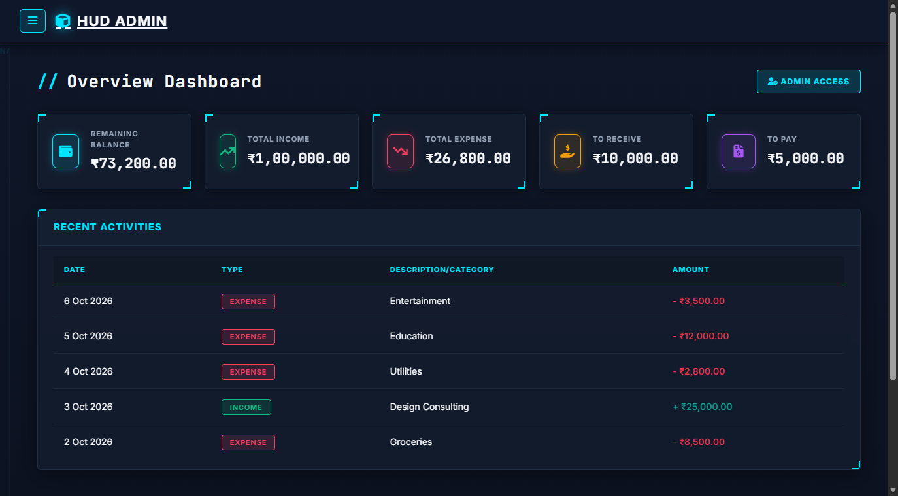
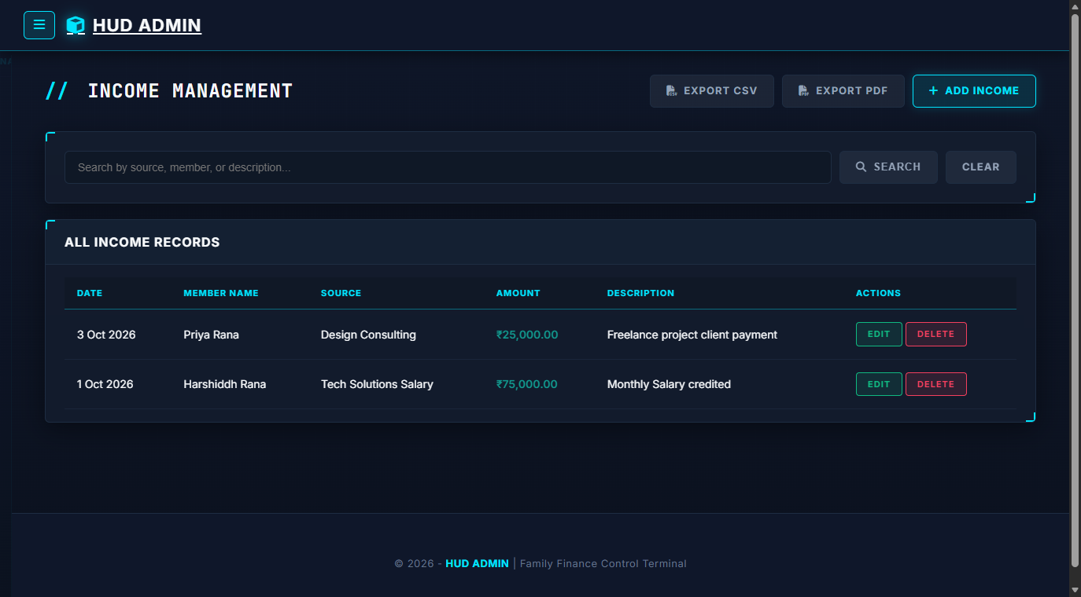
09 / OPERATIONAL INTERFACE
System Screenshots: Dashboard & Income
Modern dark user interface designed for easy everyday use:
FIGURE 9.1: MAIN FINANCIAL DASHBOARD
Displays 5 summary cards: Current Balance, Total Income, Total Expenses, Money to Receive, and Money to Pay, along with recent activity stream.
FIGURE 9.2: INCOME MANAGEMENT PAGE
Clean table showing all income records with member name, search filter, and quick buttons to export PDF and CSV reports.

Slide 11
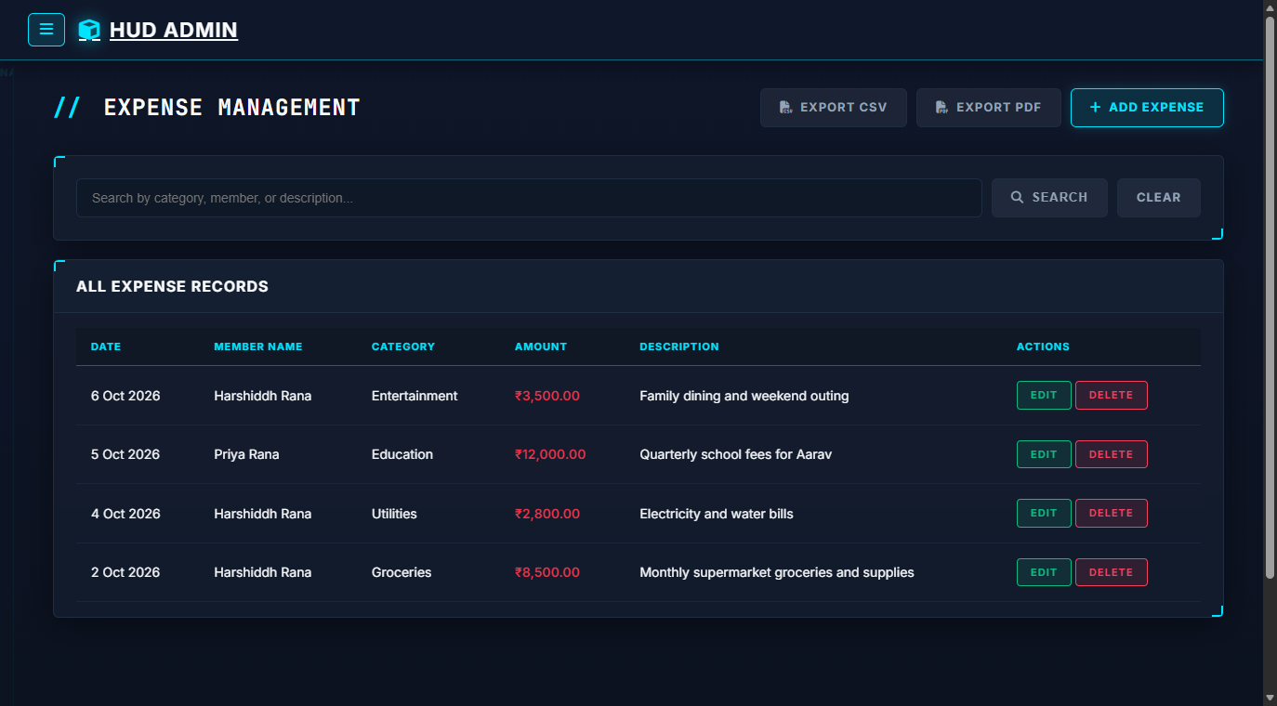
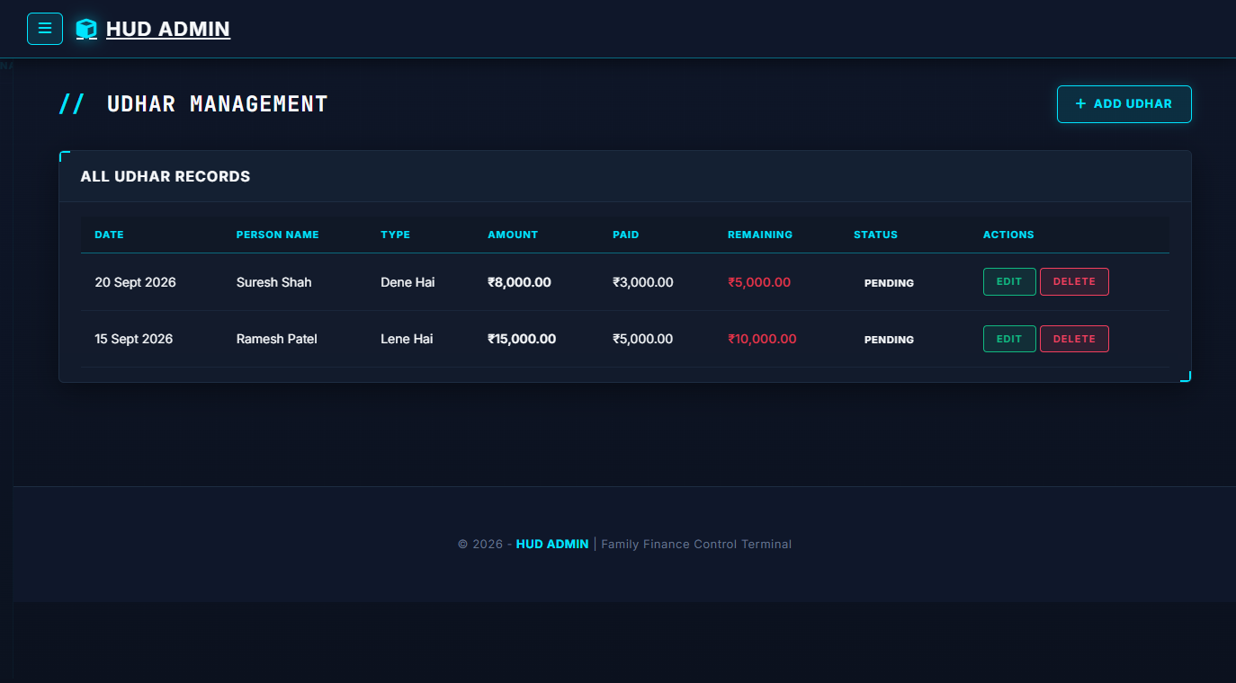
10 / OPERATIONAL INTERFACE
System Screenshots: Expenses & Udhar
Clear screens for tracking daily spending and friendly loans:
FIGURE 10.1: EXPENSE TRACKING PAGE
Lists all daily expenses with category badges, notes, and instant balance updates when a new expense is saved.
FIGURE 10.2: UDHAR (LOAN) LEDGER PAGE
Shows pending loans with clear green and red badges for 'Lene Hai' vs 'Dene Hai' and remaining amounts.

Slide 12
11 / EVALUATION & FEASIBILITY
Feasibility Study & Current Limitations
Why this project is practical and areas for future improvement:
FEASIBILITY STUDY VALIDATION
✔ Technical Feasibility: Built with ASP.NET Core MVC and MySQL. Runs fast, reliable, and error-free on any Windows or Linux computer.
✔ Economic Feasibility: Zero licensing costs because only open-source software (Free .NET SDK, MySQL Community) is used. Saves money for families.
✔ Operational Feasibility: Very simple user interface that any family member can learn to use in just 5 minutes without any special training.
CURRENT PROJECT LIMITATIONS
⚠ Manual Bank Entry: Users enter transactions manually. Direct bank API link is not connected yet to keep it simple and free.
⚠ Single Currency (INR): System currently works with Indian Rupees (₹); foreign currency conversion can be added in future versions.
⚠ Requires Server Connection: Must be opened through browser connected to the local or cloud web server.
⚠ Photo Proofs are Manual: Receipts are uploaded as images; automated receipt text scanner (OCR) is planned for next update.

Slide 13
12 / STRATEGIC ROADMAP
Future Scope & Enhancements
Features planned to make HomeLedger even more powerful in future versions:
🌟 MAIN FUTURE FEATURE
AI Financial Assistant & Spend Prediction
• Balance Prediction: Predicts how much money will remain at month-end based on past spending habits.
• Spending Alerts: Automatically alerts if extra money is being spent on shopping or food.
• Smart Saving Tips: Gives useful suggestions to help the family save an extra 10% to 20% every month.
[ MOBILE APP ] Android & iOS App
Dedicated mobile app for quick expense logging on smartphones.
[ BANK & UPI SYNC ] Direct Bank Account Sync
Connect directly with UPI and bank statements for automatic data entry.
[ BILL SCANNER ] Smart Receipt Scanner (OCR)
Take a photo of grocery bill and let system read the amount automatically.
[ WHATSAPP ALERTS ] WhatsApp Bill Reminders
Send bill payment reminders and budget warnings directly on WhatsApp.

Slide 14
13 / SUMMARY & CONCLUSION
Summary & Conclusion
How HomeLedger helps modern families achieve financial peace of mind:
[ BETTER SAVINGS ]
Smart Money Habits
Helps families save regularly by setting clear budgets and cutting down unnecessary expenses.
[ NO CONFUSION ]
Peaceful Family Finances
Multi-member logins and clear loan tracking remove arguments about who spent what and who owes money.
[ SAFE & RELIABLE ]
Never Lose Financial Data
Built on solid .NET architecture with easy 1-click database backups to keep family records safe forever.
THANK YOU • QUESTIONS & DISCUSSION
Family Finance Management System (HomeLedger) | ASP.NET Core 10.0 MVC | MySQL
Presented By: Harshiddh Rana | Project Guide: Prof. Anjali Nimavat | Navgujarat BCA College, Gandhinagar

