Slide 1
MiddleWare
A function that sit between an incoming request and the final response handler in an application
Middleware functions have access to the request, response and the next function (next) in the request-response cycle
They are commonly used as :
Logging requests
Authentication & authorization
Parsing request bodies (JSON, URL-encoded data)
Error handling
Modifying requests and responses

Slide 2
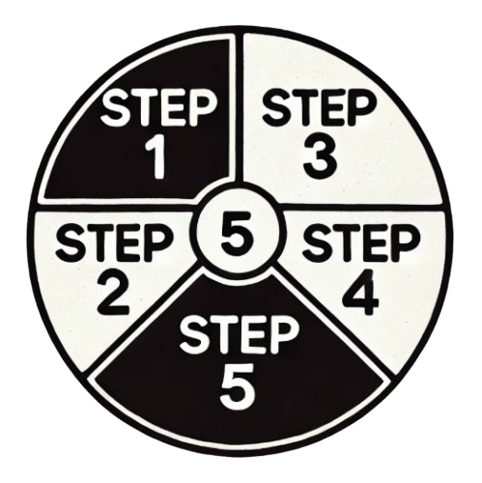
MiddleWare Process
When a client sends an HTTP request, it first reaches the middleware pipeline
After passing through all middleware components, the final HTTP response is sent back to the client
The request passes through multiple middleware components one by one
The response moves back through the middleware pipeline in reverse order
If no middleware short-circuits the request, it reaches the final endpoint

Slide 3
Middleware Cautions
Always Call next()
If you forget to call next(), the request will hang indefinitely
If next() is called multiple times, it may trigger unexpected behavior
Order of Middleware Matters
Middleware is executed in the order it is defined
Incorrect ordering can cause unintended behavior
Be Careful with Global Middleware
Applying middleware globally affects all routes, which might not be intended
Apply middleware only where needed for better efficiency

Slide 4
Middleware Cautions - Cont..
Avoid Overuse of Middleware
Too many middleware layers slow down requests
Optimize by combining functionalities where possible
Avoid Blocking the Event Loop
Middleware should be non-blocking to ensure smooth performance
Avoid synchronous operations like heavy computations inside middleware
Be Careful with Third-Party Middleware
Always review third-party middleware before using it
Avoid outdated, unmaintained, or insecure packages

Slide 5
MiddleWare Types
Middleware Type | Purpose
Built-in Middleware | Predefined middleware like UseRouting(), UseAuthentication()
Custom Middleware | Custom classes for processing requests (UseMiddleware<T>())
Inline Middleware | Middleware written directly in Program.cs
Terminal Middleware | Ends request processing (app.Run())
Conditional Middleware | Applies middleware based on conditions (UseWhen())

Slide 6
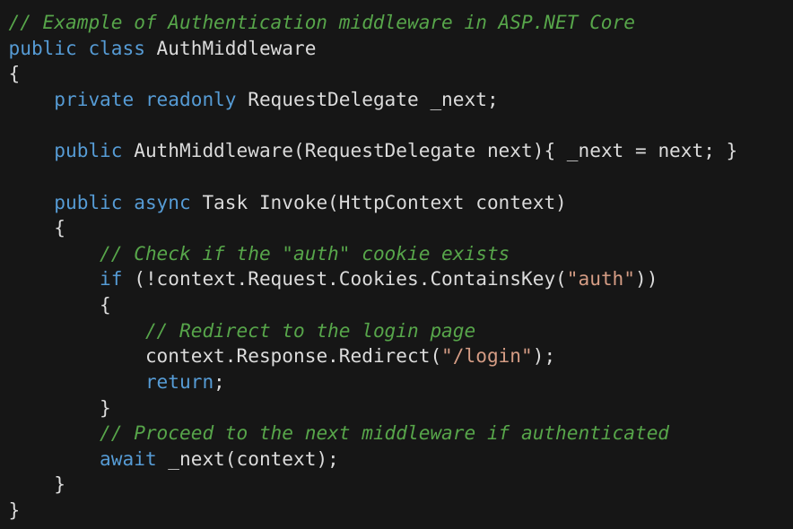
Middleware Example - Authentication MW
When there is no cookie named “auth” exists, which means user is not authorized yet, hence following middleware redirect user to /login

Slide 7
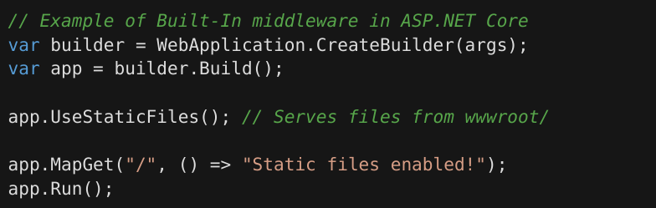
Middleware Example - Built-In MW - UseStaticFiles()
A middleware which serves CSS, JS, images, and other static files

Slide 8
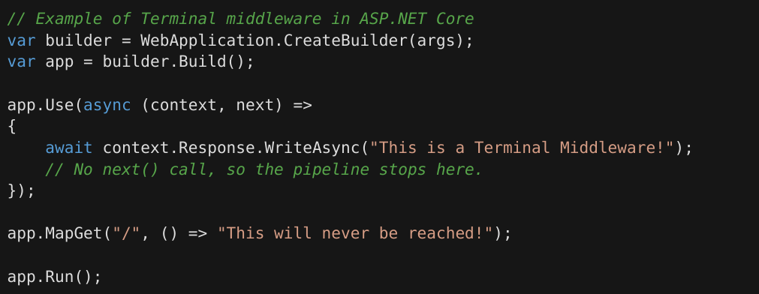
Middleware Example - Terminal MW
No next() executed, following middleware always stops execution after returning a response

Slide 9
Resources
https://learn.microsoft.com/en-us/aspnet/core/fundamentals/middleware
https://theonetechnologies.com/blog/post/middleware-in-net-core-application
https://medium.com/@shubhadeepchat/net-core-middleware-explained-8c21bf646700

