Slide 1



Dr. N.G.P. INSTITUE OF TECHNOLOGY, Coimbatore- 48
(An Autonomous Institution)
Approved by AICTE, New Delhi & Affiliated to Anna University, Chennai
Recognized by UGC & Accredited by NAAC & NBA (BME, CSE, ECE, EEE & Mechanical)
Dr.N.G.P. Nagar - Kalapatti Road, Coimbatore, -641048, Tamilnadu, India.
Phone: 0422-2629362 | Fax: 0422-2629 | info@drngpit.ac.in | www.drngpit.ac.in
Digital Noticeboard and Event Management System
Team Leader:
Register Number
HARSHINI
710722104032
Team Members:
Register Number
PRIYADHARSHINI P
710722104075
NITHYA SHREE A
710722104069
GOWSIKA K
710722104028

Slide 2







PROBLEM STATEMENT
Digital Noticeboard and Event Management System
PROPOSED SOLUTION
02
03
04
01
Digital notice boards in lounge areas
Students can enroll in events via QR codes
Real-time updates on events
Event analytics dashboard

Slide 3







MODULE DESCRIPTION
MODULE 1
MODULE 2
External digital boards display:
Streamlines event management by:
Upcoming intra-college events
Achievements,
Placements
Monitoring participant counts,
Verifying IDs for entry,
Tracking attendance during events.
Block-vise digital notice boards display:
.
Improves event organization by:
getting Feedback from participants
conducting post- event surveys
Department-specific events
Inter college event brochures
QR codes for event registration

Slide 4






IMPACTS
Enhanced Communication
Ensures that all students are aware of the various events conducted in the college
BENEFITS
Easier student registration
QR code makes it easier for students to register in the vents
Increased Student Engagement
Enables students to utilize the opportunities to showcase their talents
Efficient event management
Helps event organizers to manage the event using the dashboards.
Measuring event success
The event analysis dashboard helps analyze the event succes

Slide 5

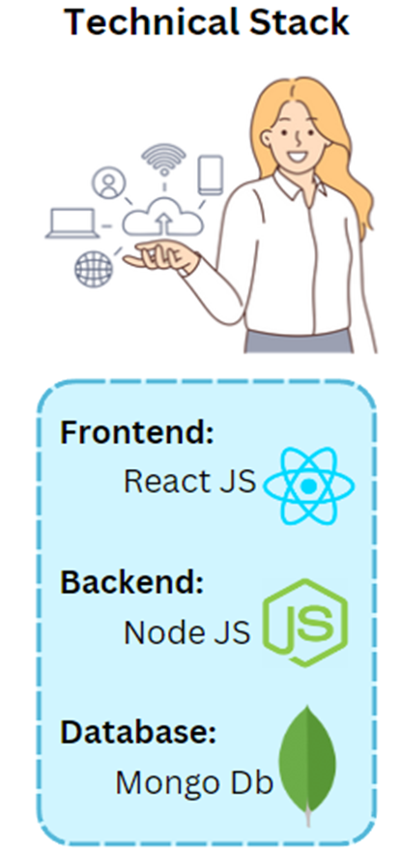










ARCHITECTURE:
Inter and Intra College Events
QR Code
Digital Board
College
Achivements
MODULE 1 :
Placements Details
Website
BillBoard
Intra-College
Events Brochure
Utilized by Organizers
MODULE 2 :
Feedback
Website
Dashboard

Slide 6

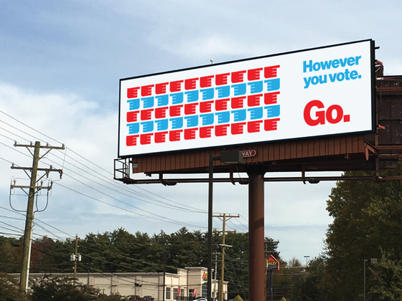


COST ESTIMATION
Digital Billboards
No: 1
Size:30 feets
Digital display screen:5000/feet
Unipole hoarding structure:2 lakhs
Estimation:3.5 lakhs
Digital Signage
No: 4
SIZE:43 inches
Cost/Product:30,000
Estimation:1.2lakhs
Implementation:
event dashboard

