Slide 1


SMART INDIA HACKATHON 2024
Problem Statement ID –1656
Problem Statement Title-
Theme-Travel & Tourism
PS Category- Software
Team ID-
Team Name (Registered on portal)
Development of a mobile application to provide recreational suitability information of beach locations across India.

Slide 2
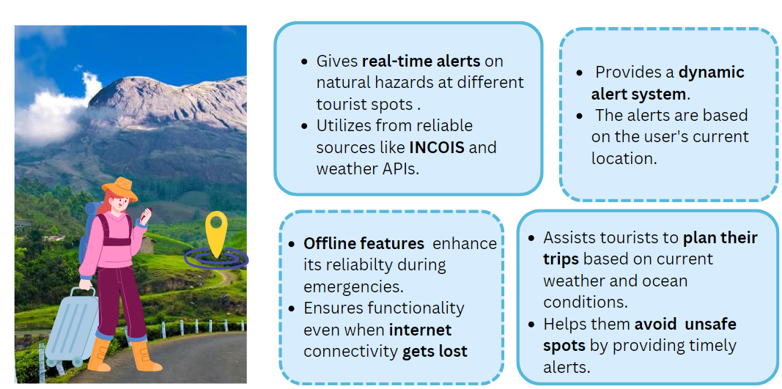
EXPLORESECURE
Teen Techies

Slide 3
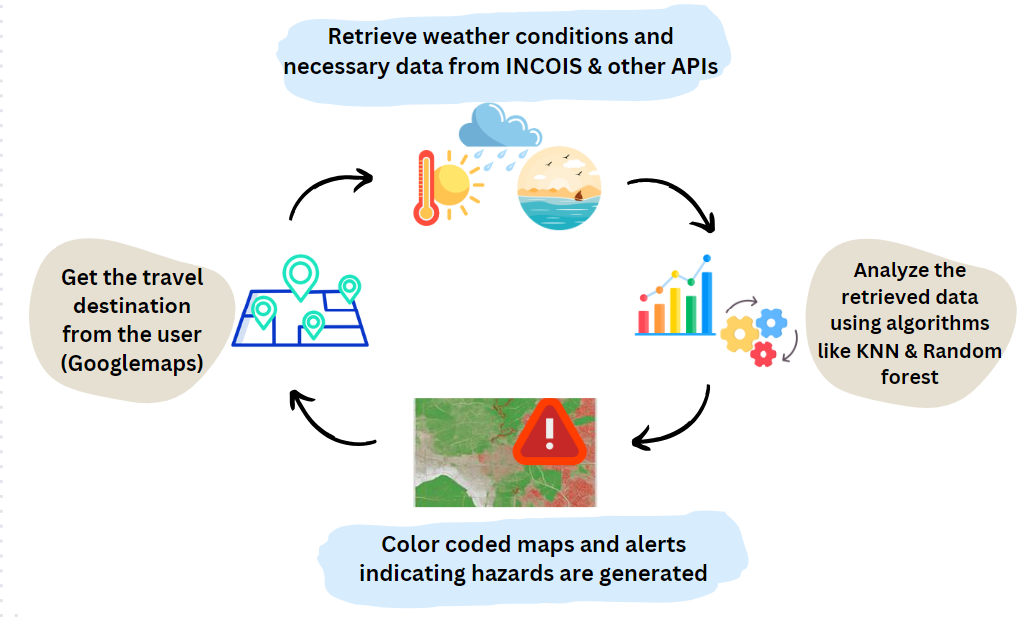

TECHNICAL APPROACH
Teen Techies

Slide 4
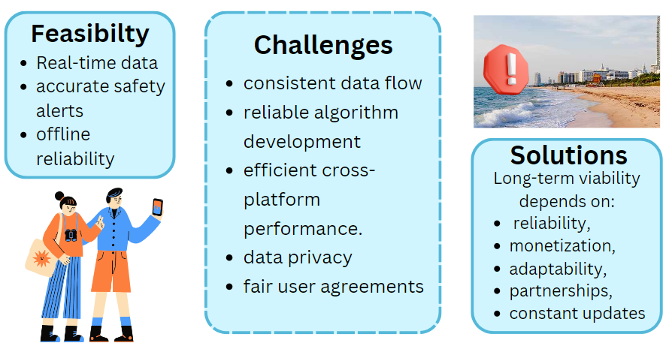
FEASIBILITY AND VIABILITY
Teen Techies

Slide 5
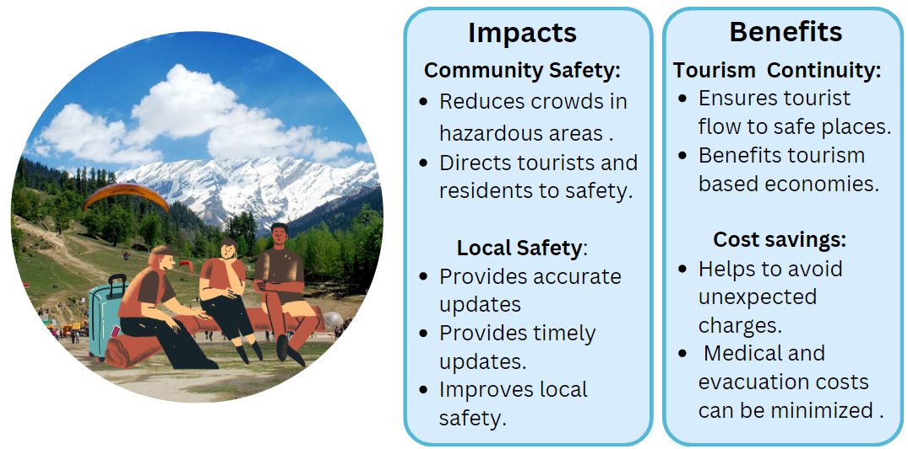
IMPACT AND BENEFITS
Teen Techies

Slide 6
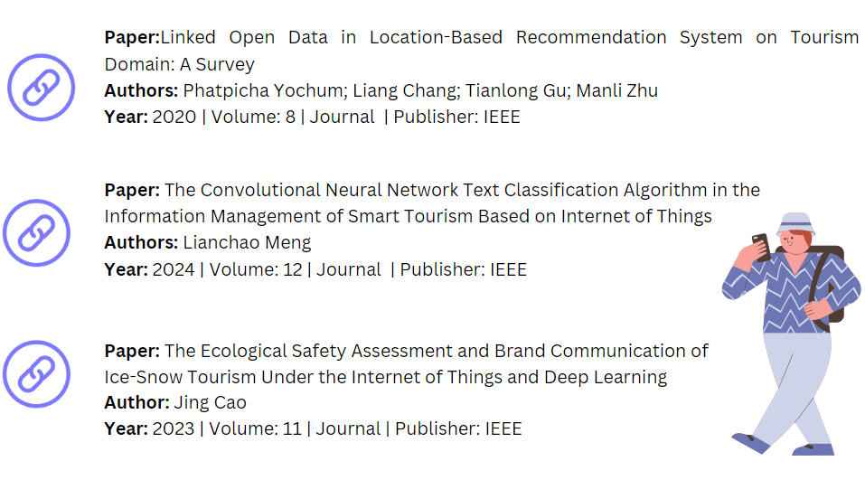
RESEARCH AND REFERENCES
Teen Techies

