Slide 1

Food Trends Analysis & Customer Insights
Presented by:
Harshika Kalsani
Saimeghana Illa
Tandyana Sarvani
Sri Varshini S
Narendra Reddy CH

Slide 2
Agenda
Project Overview
  Data Sources & Data Model
  Sentiment Analysis Dashboard
  Product Insights Dashboard
  Customer Segmentation Dashboard
  Strategy & Innovation Dashboard
  Key Findings & Conclusion

Slide 3
Introduction
To understand current food trends and customer preferences
To analyze customer feedback and opinions using data
To identify key factors that influence food choices
To visualize insights clearly through interactive dashboards
To support better, data-driven decision making

Slide 4
Project Overview
Analyze customer feedback to understand food trends and preferences
  Apply sentiment analysis to evaluate customer perception
  Develop interactive Power BI dashboards for decision-making

Slide 5
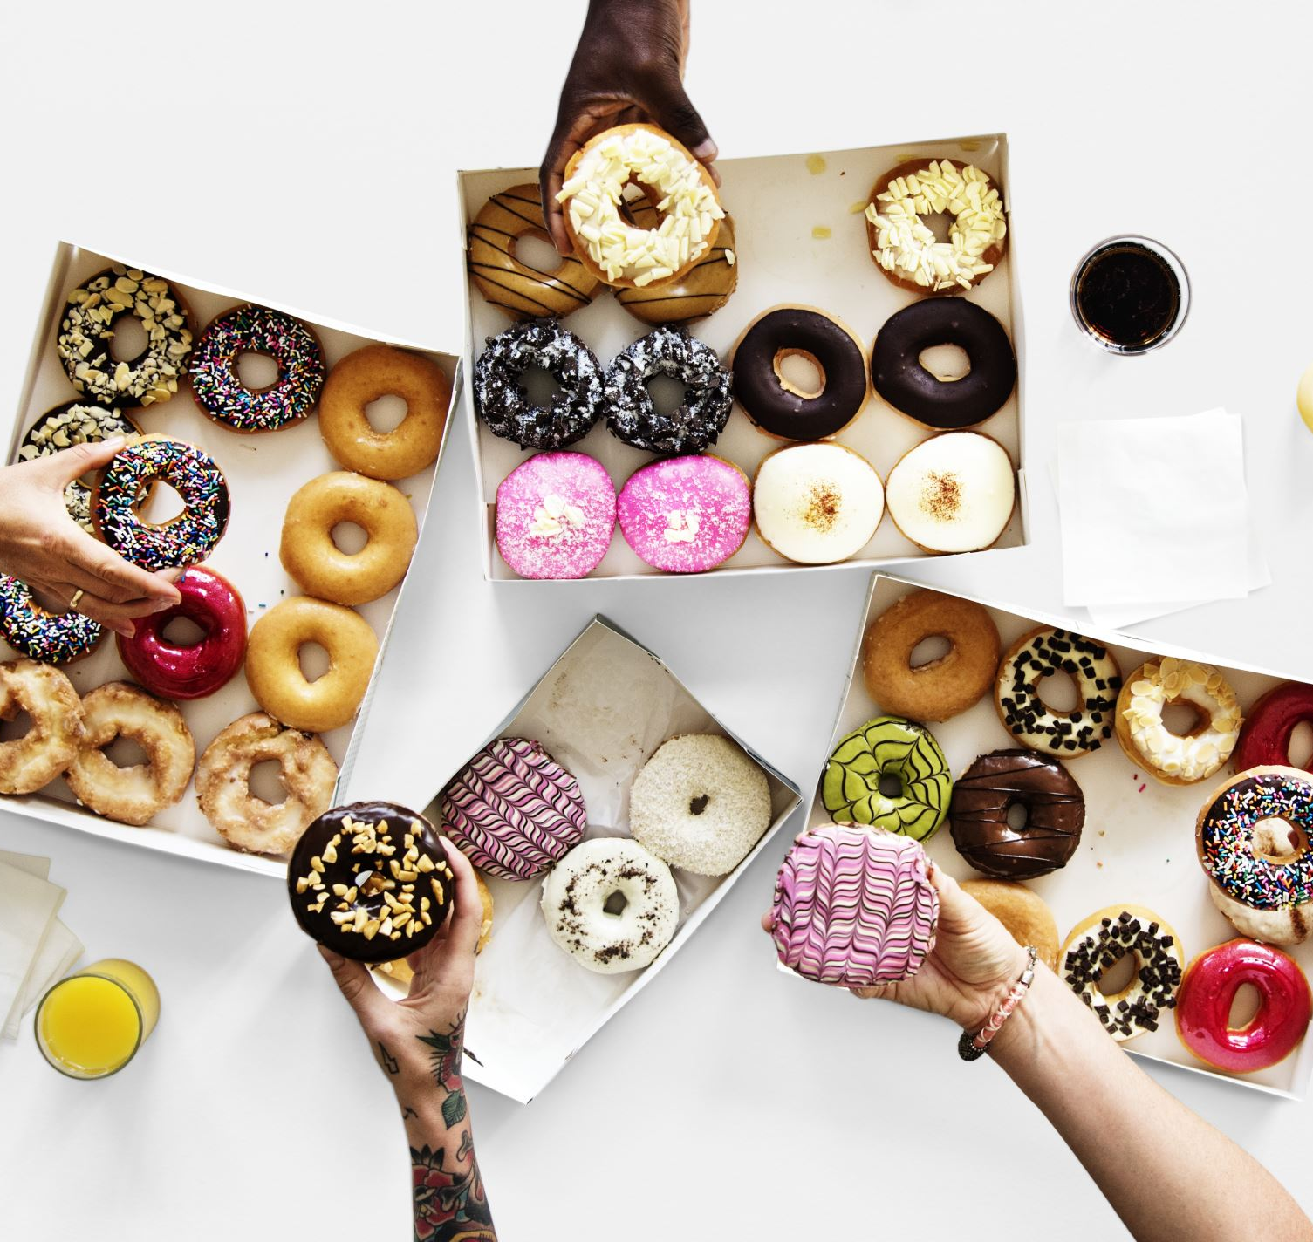
Food Industry Trends
Growing demand for healthy and nutritious food options
Increasing preference for convenience and online food delivery
Rising influence of customer reviews and social media trends
Popularity of personalized and customized food choices
Focus on sustainability and quality ingredients

Slide 6
Tech Stack
Data Collection Tools (Google Forms, Apify)
Data Processing (Python, Pandas, NLP libraries)
Visualization (Power BI )
Storage (Excel / CSV )

Slide 7
Data Collection – Structured Data
Data was collected using structured and unstructured methods.
Structured data was gathered through an online survey using Google Forms.
The survey captured customer demographics, food preferences, and purchasing behavior.
Key attributes included age, gender, city, food type, brand, price, and ratings.
Additional insights were collected on taste, quality, nutrition, motivation, and feedback.

Slide 8
Data Collection – UnStructured Data
Unstructured data was collected from social media platform-Facebook.
Data was extracted using a web scraper (Apify).
Customer comments and reviews were scraped from Facebook.
This data helped understand real-time customer opinions and sentiments.
The unstructured data supported sentiment analysis and trend identification.

Slide 9

Data Preparation & Modeling
Cleaned and preprocessed both structured and unstructured datasets
Removed missing values and standardized data formats
Applied NLP techniques to extract sentiment labels (positive, neutral, negative)
Calculated sentiment scores to measure customer opinions numerically
Transformed text data into meaningful features for analysis
Prepared the final dataset for dashboards and insights generation

Slide 10

Dashboard Overview
- Overview
  Sentiment Analysis
  Product Insights
  Customer Segmentation
  Strategy & Innovation

Slide 11
Product Insights Dashboard
Key performance indicators such as total products and average ratings for taste, packaging, quality, and feedback
Filters for food type, purchase channel, price range, and gender to enable focused analysis
Top brands analysis based on product count and customer preference
Top food items comparison showing most popular food choices
Nutrition claims by brand including high protein, high fiber, and low-fat products
Brand-wise price distribution (cheap, reasonable, expensive)
Relationship analysis between taste, packaging, and feedback ratings
Geographic distribution of customers by city and brand

Slide 12
Customer Segmation Dashboard
Filters for purchase channel, month, price range, and city
Age-group-wise customer distribution by food type (Veg, Non-Veg, Both)
Gender-wise customer segmentation across different food types
Customer distribution based on nutritional claims (high protein, low fat, high fiber, low sugar)
Expectation-based segmentation covering hygiene, price, quality, quantity, and taste
Food preference segmentation including Veg, Non-Veg, Vegan, Sugar-Free, Gluten-Free, and Low-Calorie diets
Calorie-level based customer segmentation (low, medium, high calorie preferences)

Slide 13
Sentiment Analysis Dashboard
Overall sentiment distribution showing positive, neutral, and negative percentages
Word cloud highlighting frequently used words in customer feedback
Average sentiment score by brand comparison
Total customers segmented by sentiment label
Gender-wise sentiment distribution (positive, neutral, negative)
Sentiment distribution based on food preference (Veg, Non-Veg, Vegan, etc.)
Day-wise sentiment score trend to track changes over time

Slide 14
Strategy & Innovation
  Low-sentiment products highlighted for R&D focus
  Sentiment trends tracked over time
  High-performing brands and food items with positive customer sentiment
  Key drivers influencing satisfaction such as price, taste, quality, and nutrition

Slide 15
Conclusion
Customer preferences vary significantly across food types, demographics, and nutritional needs
Sentiment analysis reveals key drivers of customer satisfaction and dissatisfaction
Product and brand performance is strongly influenced by taste, quality, and pricing
Customer segmentation enables more targeted and personalized strategies
Data-driven insights support better decision-making, innovation, and future growth

