Slide 1

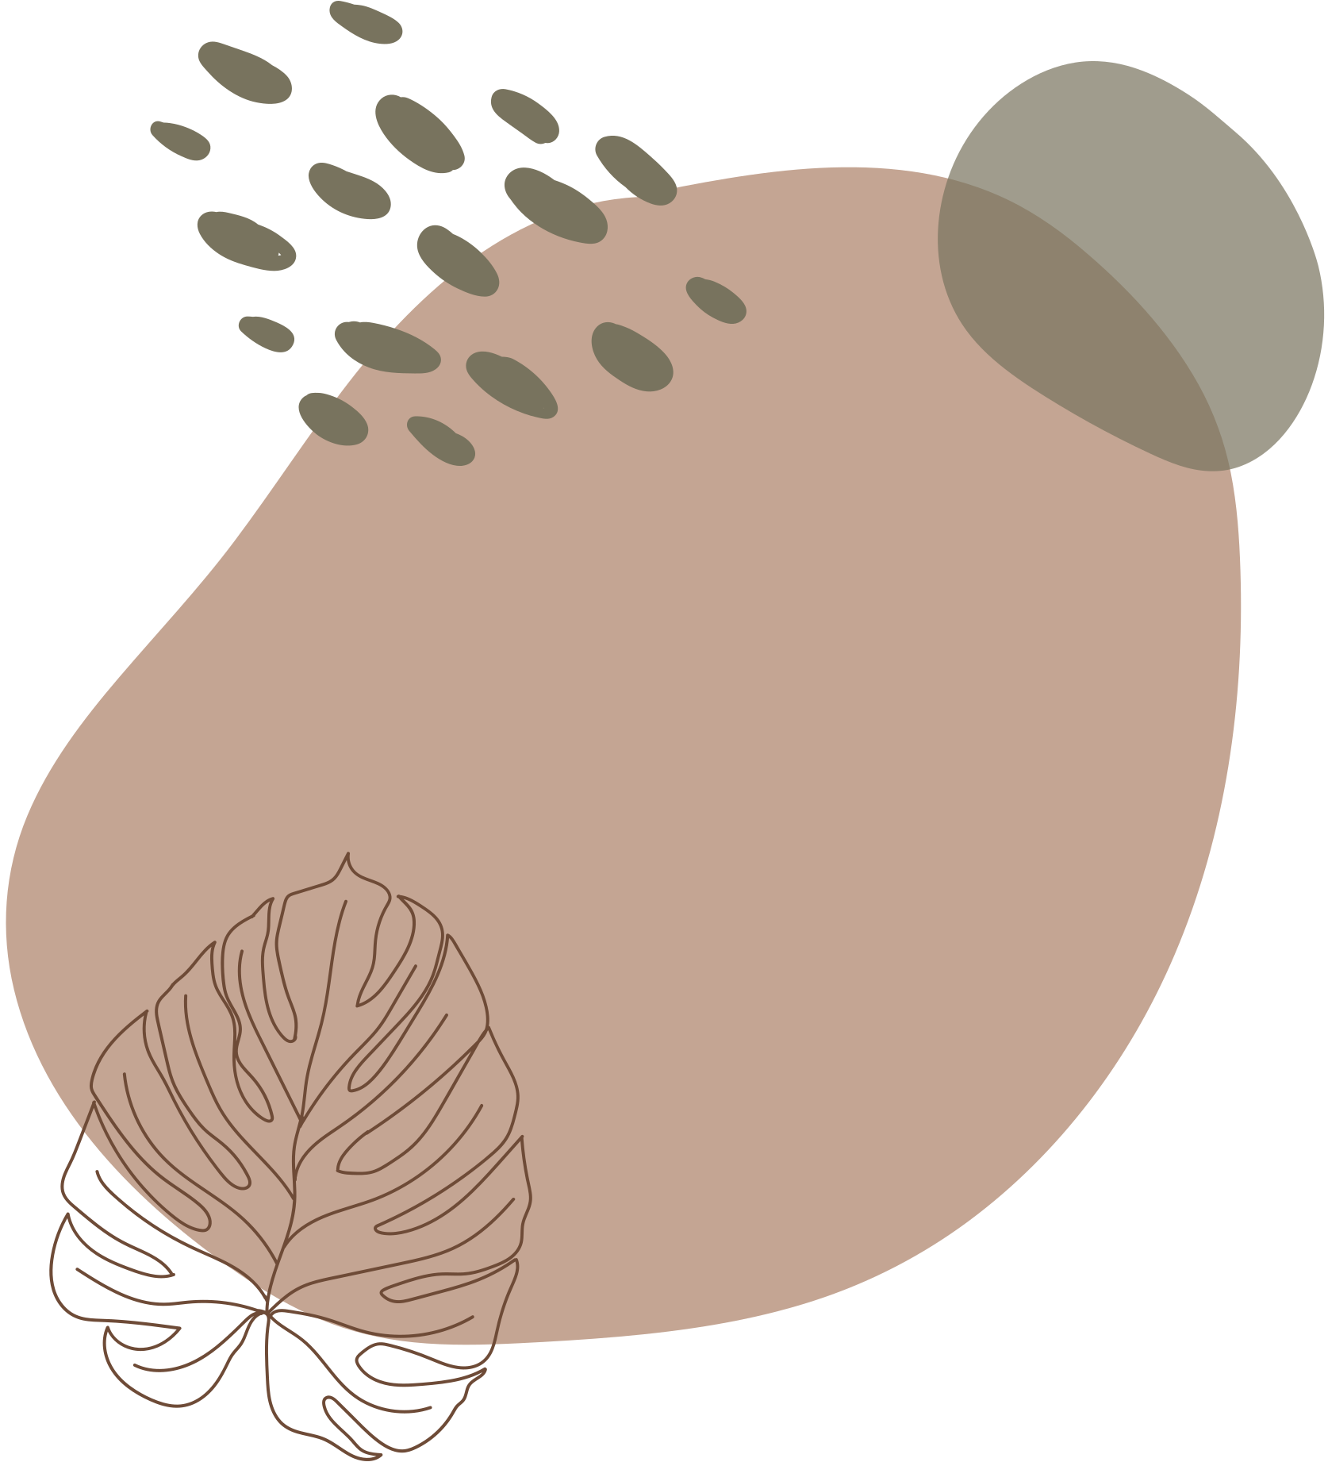









ICS PROJECT
Instructor: Prof. Palash Das
Presented by Group-14
Monit Katariya B25CM1032
Ishita Kulshreshtha B24ME1035
Sanchi Agrawal B25CH1002
Tathya Patel B25CS1050
Harshika Bajaj B25MT1017

Slide 2
PROJECT TOPIC
Read an image into a matrix, divide it into equal-size patches (e.g., 16×16×3), and identify the most important patches based on content scores.

Slide 3
INTRODUCTION
This project implements a complete image processing pipeline in the C programming language, focusing on edge detection and patch-based analysis. It reads a BMP image, processes it through various stages of filtering and transformation, and outputs a visually enhanced version highlighting detected edges and edge-dense regions.

Slide 4
PRINCIPLES USED
The main goal of this project is to understand and implement fundamental image processing operations such as:
Greyscale conversion
Gaussian blurring
Sobel edge detection
Canny edge refinement
Hysteresis thresholding
Patch-based edge density mapping
By using these steps, the program identifies and emphasizes areas in an image where edges (sudden intensity changes) are most concentrated, which can be useful for tasks like object detection, image segmentation, and region-of-interest analysis.

