Slide 1

Shades
Mini
Project
E-commerce Website
Group 27
Harsh Mishra
Harshika Avinash Jadhav

Slide 2
Scope of Project:
We’ve made a website named Shades using
HTML
CSS
JavaScript
PHP

Slide 3
Objective
Provide more opportunities to the local business to grow by increasing their business.
Lenskart dropped their prices by cutting out the middleman, but in the process also cut out the rapport between the small-business and consumers.

Slide 4
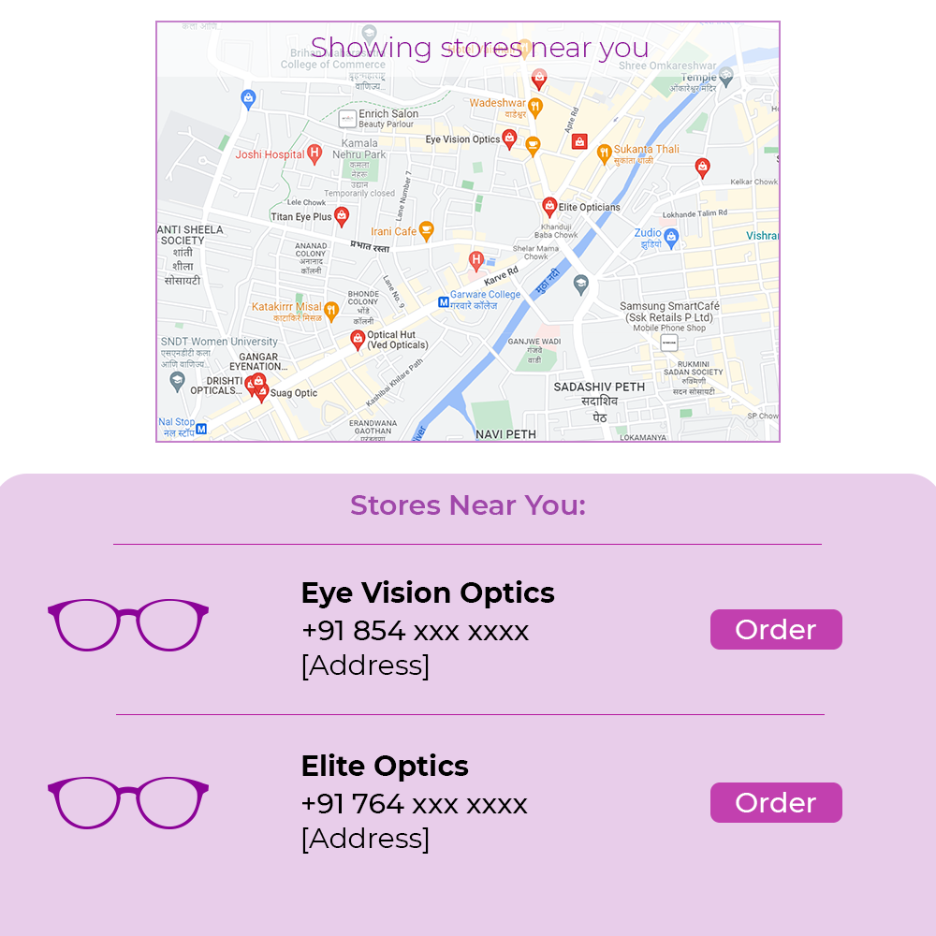

Slide 5
Problem definition
When we buy eyewears online we can’t see them beforehand and get a feel.
Major brands like Lenskart do provide these services but they are limited by locations.

Slide 6
Literature Review
With respect to the prepared website, there is one particular website, known as “Lenskart” that sells different eyewear and does home eye tests but in a very limited quantity.

Slide 7
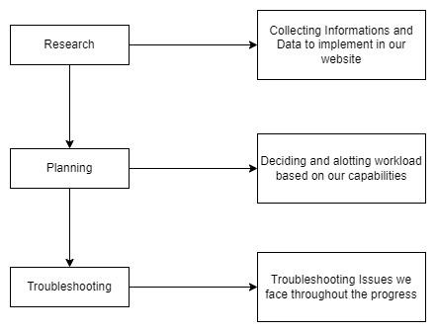
Methodology

Slide 8
THANK YOU

