Slide 1
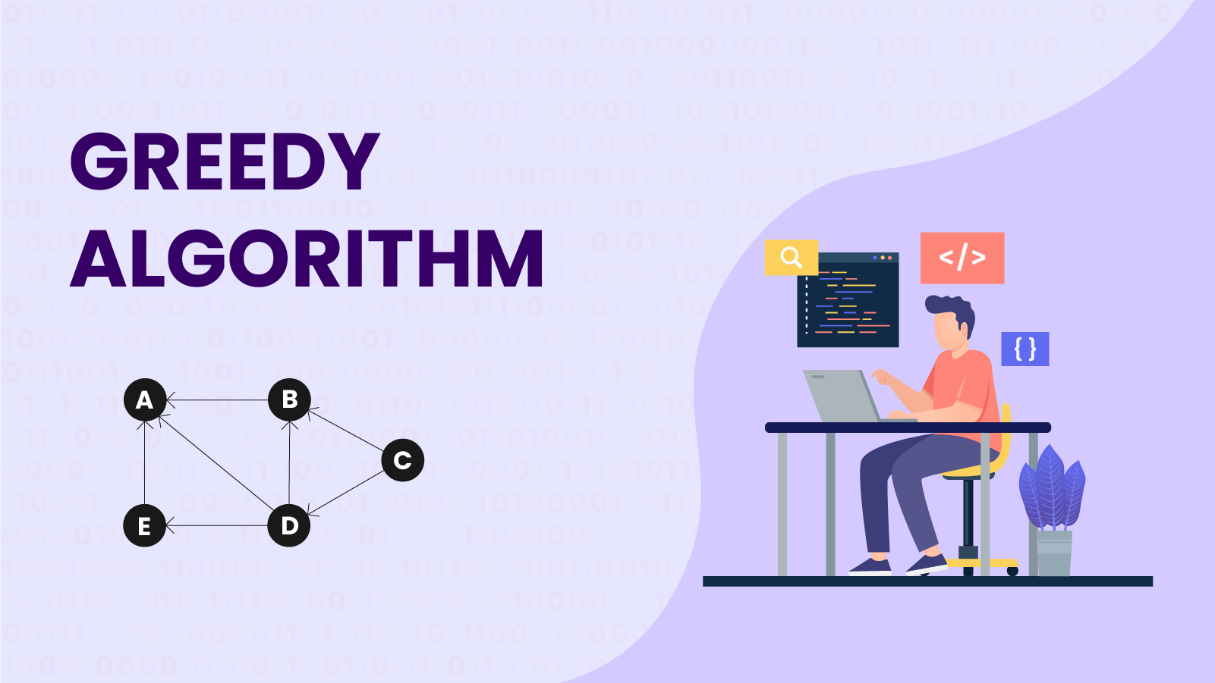
DESIGN AND ANALYSIS OF ALGORITHMS - 202045601
PASSWORD EVALUATER AND ENHANCER USING GREEDY ALGORITHMS
Harshil Patel (12202040501026)
Krushil Dobariya(12202040501036)
Department of Computer Engineering
G H Patel College of Engineering & Technology Vallabh Vidyanagar (Gujarat)
Guided by : Prof. Chaya Zala

Slide 2
Outline
What is Greedy Algorithm
Key Points to understand about Greedy Algorithm
Components of Greedy Algorithm
Types of Greedy Algorithm
Applications of Greedy Algorithm
Password Evaluator and Enhancer using Greedy Algorithms
Greedy Approach in Password Strength Enhancer
Conclusion
2

Slide 3
What is Greedy Algorithm
A greedy algorithm is an approach to problem-solving that follows the "greedy-choice property" at each step.
It makes the locally optimal choice at each stage with the hope of eventually reaching a globally optimal solution.
This means that, at every decision point, the algorithm chooses the best available option without considering the consequences of that choice on future decisions.
The expectation is that the cumulative effect of these local optimums will lead to an overall optimal solution.
3

Slide 4
Key Points to understand about greedy algorithm
Greedy-choice Property:
The heart of a greedy algorithm lies in its greedy-choice property.
At each step, it makes the choice that seems best at that moment, without worrying about what might happen in the future.
This myopic decision-making is what characterizes the approach.
Optimization Problems:
Greedy algorithms are commonly used for optimization problems where the goal is to find the best solution from a set of feasible solutions.
These problems often involve maximizing or minimizing some objective function.
4

Slide 5
Components of Greedy Algorithm
Candidate set:
A solution that is created from the set is known as a candidate set.
Selection function:
This function is used to choose the candidate or subset which can be added in the solution.
Feasibility function:
A function that is used to determine whether the candidate or subset can be used to contribute to the solution or not.
Objective function:
A function is used to assign the value to the solution or the partial solution.
Solution function:
This function is used to intimate whether the complete function has been reached or not.
5

Slide 6
Types of Greedy Algorithm
Activity Selection Problem:
Selects the maximum number of non-overlapping activities from a set of activities, each with a start and end time.
Huffman Coding Problem:
Constructs an optimal prefix code for data compression based on the frequencies of each symbol.
Task Scheduling Problem:
Schedules tasks on resources (e.g., machines) to minimize completion time or maximize efficiency, given constraints.
Knapsack Problem:
Chooses items with given weights and values to maximize the total value without exceeding a weight limit.
Traveling Salesman Problem:
Finds the shortest possible route that visits each city exactly once and returns to the origin city.
6

Slide 7
Applications of Greedy Algorithm
It is used in finding the shortest path.
It is used to find the minimum spanning tree using the prim's algorithm
or the Kruskal's algorithm.
It is used in a job sequencing with a deadline.
This algorithm is also used to solve the fractional knapsack problem.
7

Slide 8
PASSWORD EVALUATER AND ENHANCER USING GREEDY ALGORITHMS
Objective:
Improve password security using a greedy algorithm.
Features:
Evaluate Passwords:
Checks length, character types, and common patterns.
Greedy Improvements:
Add Missing Characters: Includes lowercase, uppercase, digits, and special characters.
Modify Patterns: Adjusts common sequences like "123" and "abc".
Break Sequences: Alters repeated character sequences.
User Interaction:
Provides feedback and suggestions to strengthen passwords.
8

Slide 9
GREEDY APPROACH IN PASSWORD STRENGTH ENHANCER
Character Type Addition:
The algorithm greedily adds missing character types (lowercase, uppercase, digit, special character) to the password to meet the requirements. It adds characters one at a time until the password length approaches the maximum allowed.
Pattern and Sequence Breaking:
The algorithm identifies and modifies common patterns or sequences (like "123", "abc", "qwerty") to improve password strength. It changes characters in these patterns to reduce predictability.
Sequence Modification:
To ensure that no sequences of repeated characters are present, the algorithm makes small changes to break these sequences (e.g., changing 'aaa' to 'aab' or 'aba').
Summary of the Greedy Steps:
Add Missing Character Types: Adds one missing type at a time to ensure all character types are included.
Modify Common Patterns: Adjusts characters in common patterns to enhance complexity.
Break Repeated Sequences: Alters sequences of repeated characters to prevent predictability.
9

Slide 10
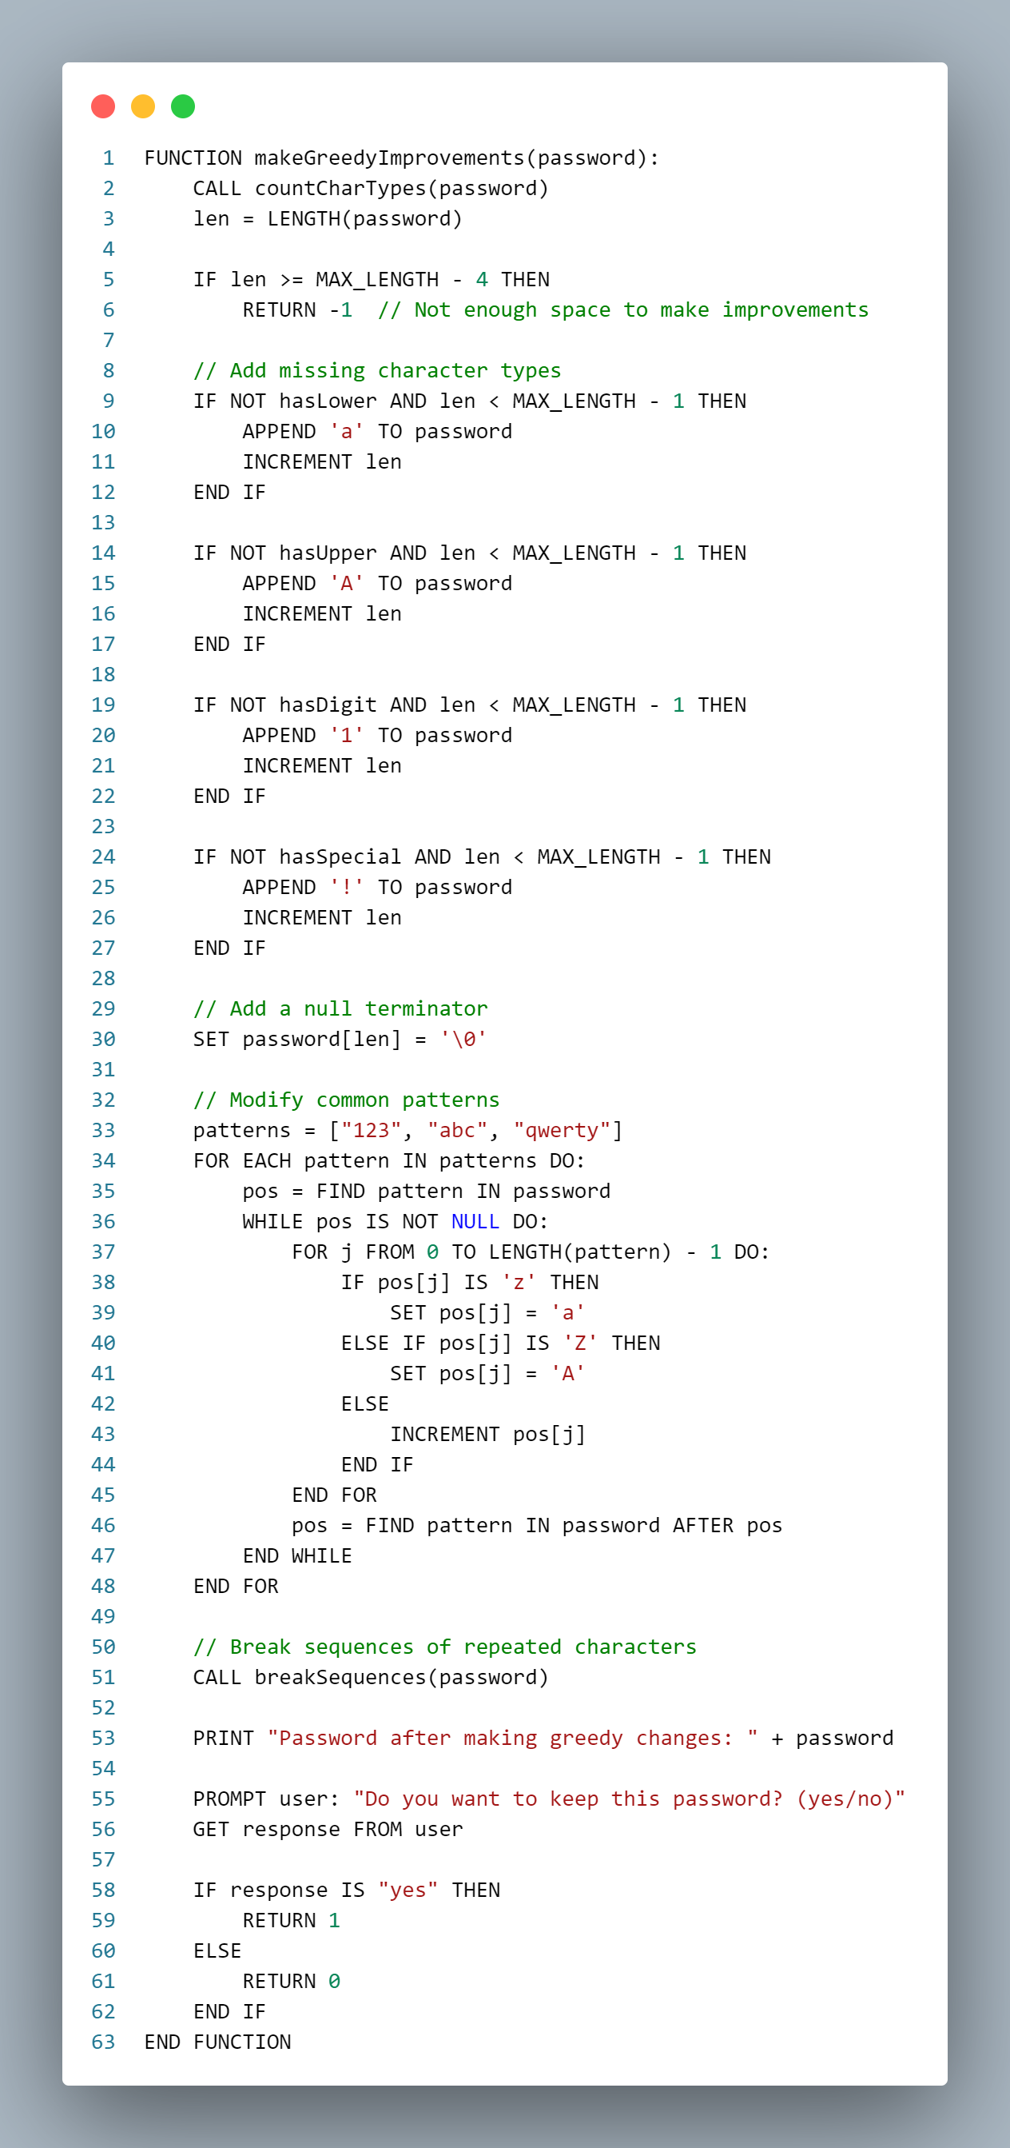
PASSWORD EVALUATER AND ENHANCER USING GREEDY ALGORITHMS
10

Slide 11
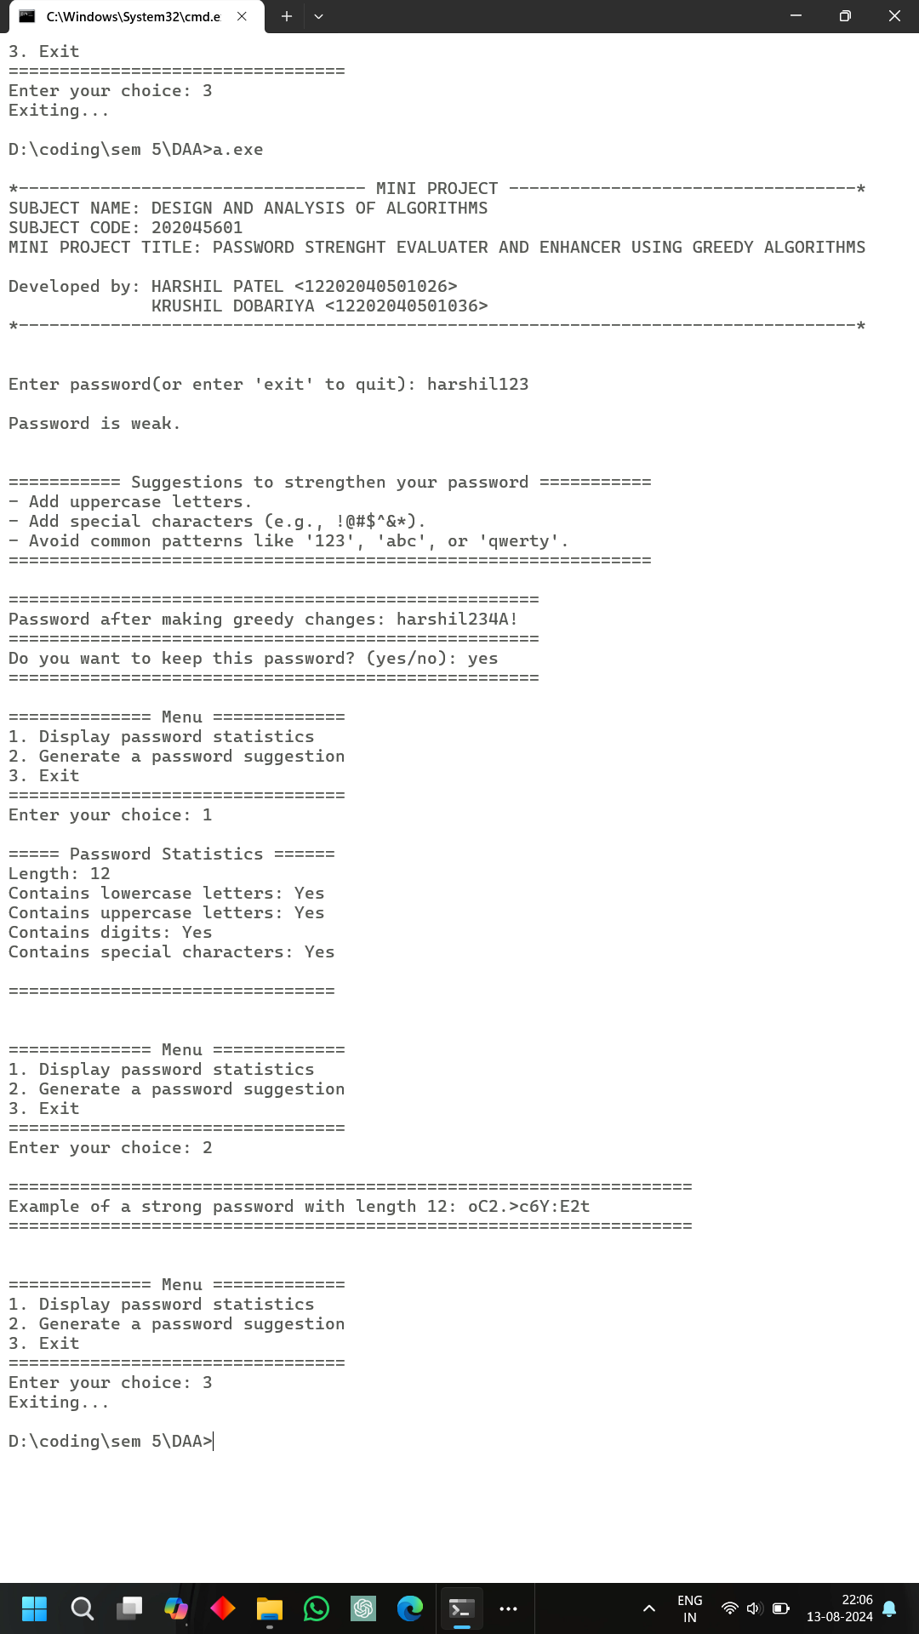
OUTPUT
Case 1 : user enter weak password
11

Slide 12
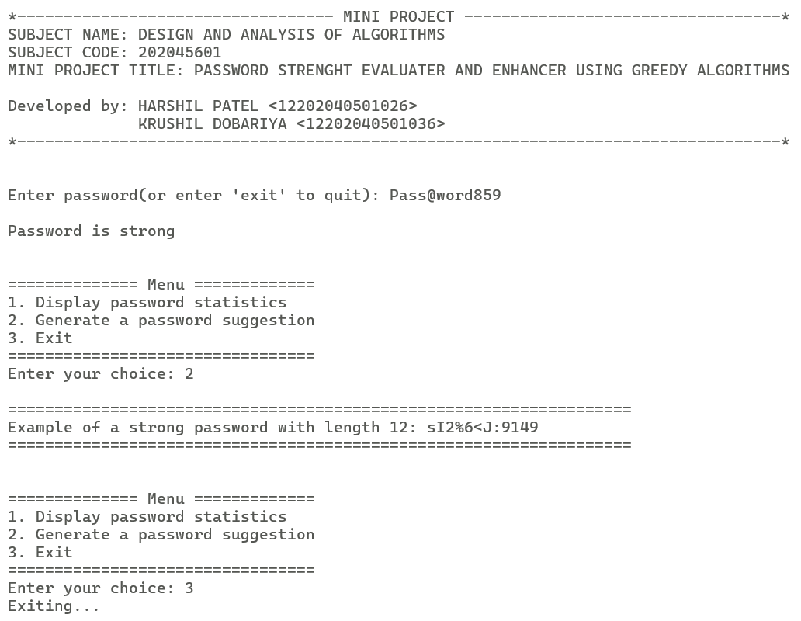
OUTPUT
Case 2 :user enter strong password
12

Slide 13
CONCLUSION
We successfully designed a Password Evaluator and Enhancer using Greedy Algorithms. The system evaluates and strengthens passwords by adding missing character types, modifying common patterns, and breaking repeated sequences. This approach improves password security against brute-force attacks and enhances overall password strength.
The project showcases the effectiveness of greedy algorithms in optimizing solutions for password security. Future work could refine the algorithm for more complex requirements and explore other cybersecurity applications.
13

Slide 14
THANK YOU

