Slide 1

AgriFarm
MARWADI UNIVERSITY
FACULTY OF DIPLOMA STUDIES
COMPUTER ENGINEERING DEPARTMENT
Prepared by:
Nirbhay Bhanderi : 92300938070
Paresh Katariya : 92300938091
Vivek Kantariay : 92300938096
Harshil Ranpariya : 92300938103
Hitraj Solanki : 92300938106
SEMESTER : 6
Project Review - 4
Guided by:
Prof. Foram Chovatiya

Slide 2
Abstract
AgriFarm is a web-based platform that connects farmers and buyers directly, eliminating middlemen and ensuring fairness in agricultural trade.
Farmers can list their products online with details like price, quantity, and images, while buyers can browse, compare, and bid on products in real time.
The system includes a Crop Advisory Module offering recommendations on fertilizers, pest control, irrigation, and farming practices.
A Live Weather Dashboard provides accurate location-based weather updates crucial for sowing, harvesting, and planning.
Built using HTML5, CSS3, JavaScript, PHP, and MySQL, the platform ensures secure login, product management, and administrative oversight.
Real-time bidding, transparent pricing, and advisory tools make AgriFarm a complete, technology-driven agricultural solution.

Slide 3
Aim / Objectives
Aim:
To develop a secure, scalable, and feature-rich digital marketplace that empowers farmers and supports buyers through transparent agricultural trading.
Objectives:
Enable direct online buying and selling of agricultural products.
Provide a real-time bidding system for competitive and transparent pricing.
Offer advisory modules based on weather, soil, and crop data.
Integrate a live weather dashboard for better decision-making.
Ensure secure authentication and role-based user access (Farmer/Buyer/Admin).
Build a responsive, simple, and accessible interface suitable for rural users.
Maintain admin control for user verification, listing moderation, and system monitoring.

Slide 4
Specific Requirements (Software)
Frontend Requirements
• HTML5: Structure of web pages.
• CSS3: Page styling and responsive layout.
• JavaScript: Interactivity and dynamic UI.
• J Query: AJAX calls, real-time updates, simplified scripting.
Backend Requirements
• PHP 7.4+: Server-side logic, API integration, sessions.
• MySQL 5.7+: Secure data storage (users, products, bids, orders)
• phpMyAdmin: Database management, table creation, and SQL monitoring.
APIs & Libraries
• OpenWeatherMap API: Real-time weather data.
• Future: Payment gateway API (Razorpay/PayPal).

Slide 5
Specific Requirements (Hardware)
Smartphones/PCs/Tablets
Stable internet connection (supports low bandwidth)
Browser support: Chrome, Firefox, Edge, Safari

Slide 6
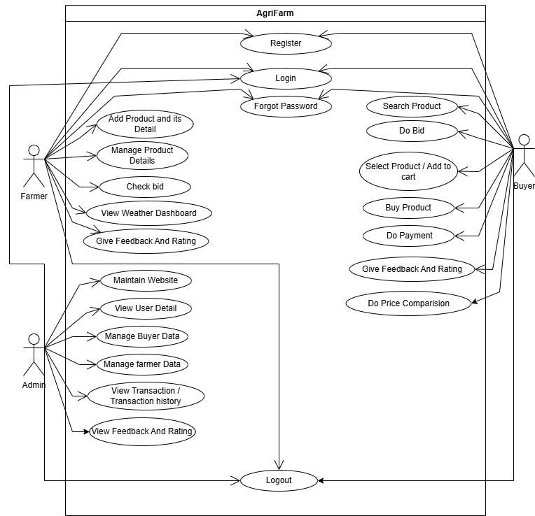
System Design(Diagrams)
Use case Diagram

Slide 7
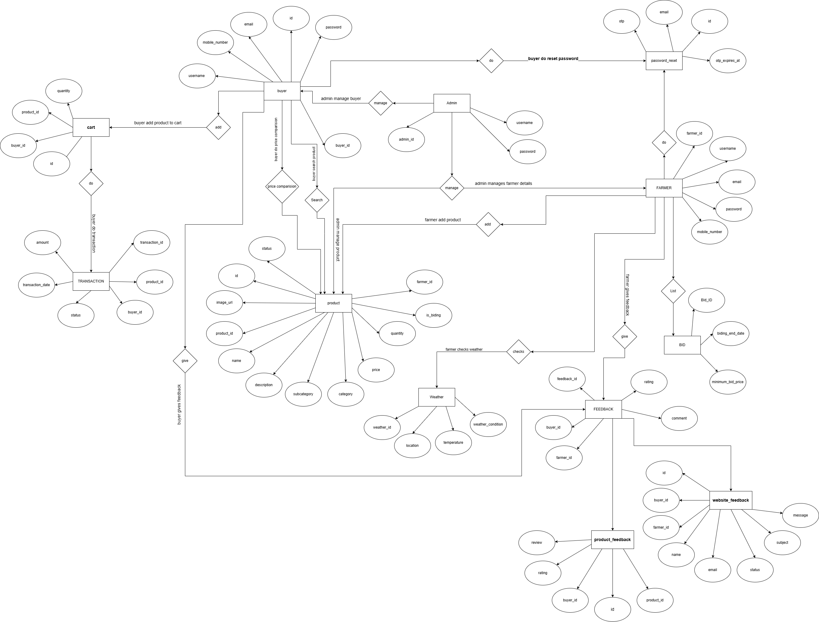
System Design(Diagrams)
2. ER Diagram

Slide 8
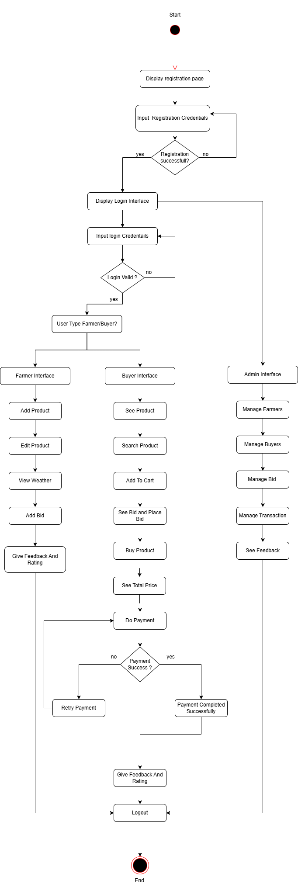
System Design(Diagrams)
3. Activity Diagram

Slide 9
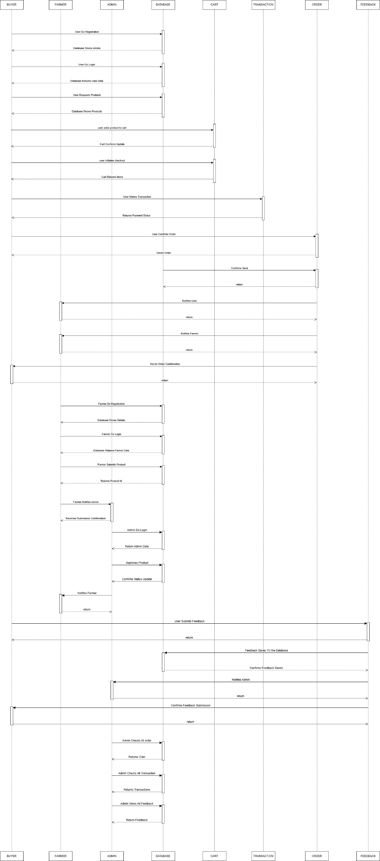
System Design(Diagrams)
4. Sequence Diagram

Slide 10
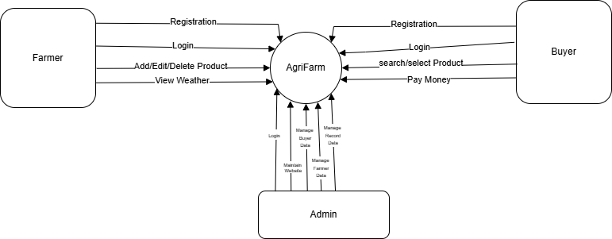
System Design(Diagrams)
5. DFD Level 0

Slide 11
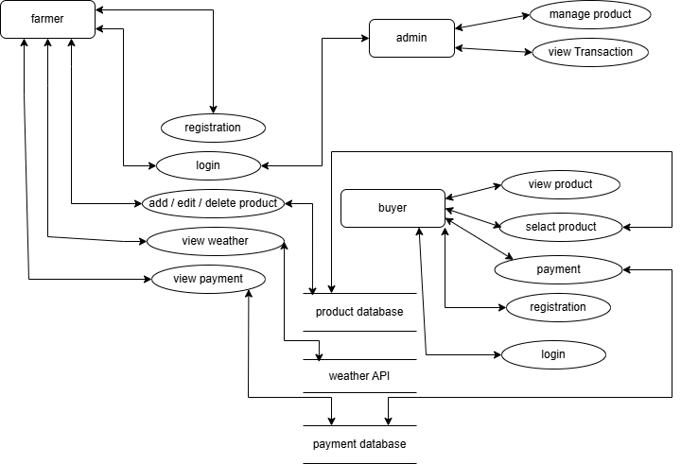
System Design(Diagrams)
6. DFD Level 1

Slide 12
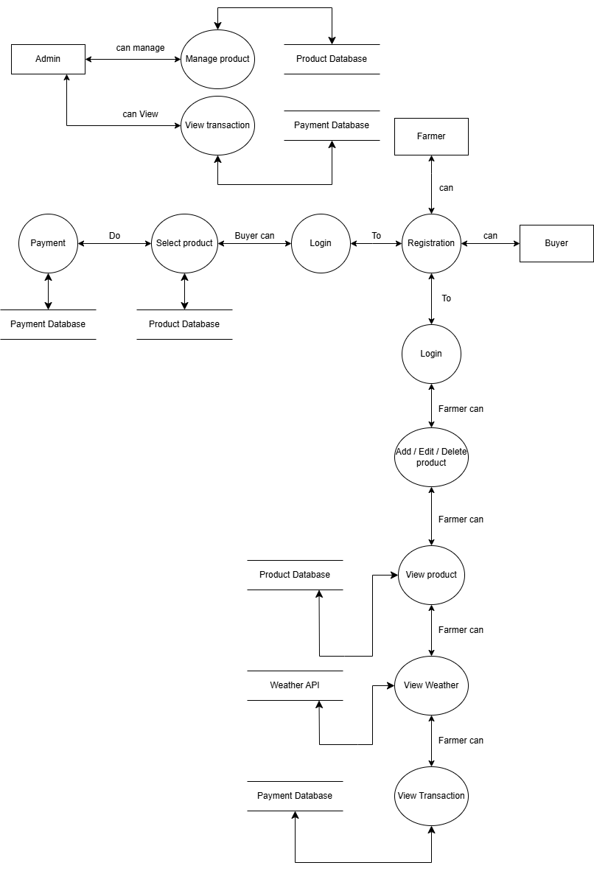
System Design(Diagrams)
7. DFD Level 2

Slide 13
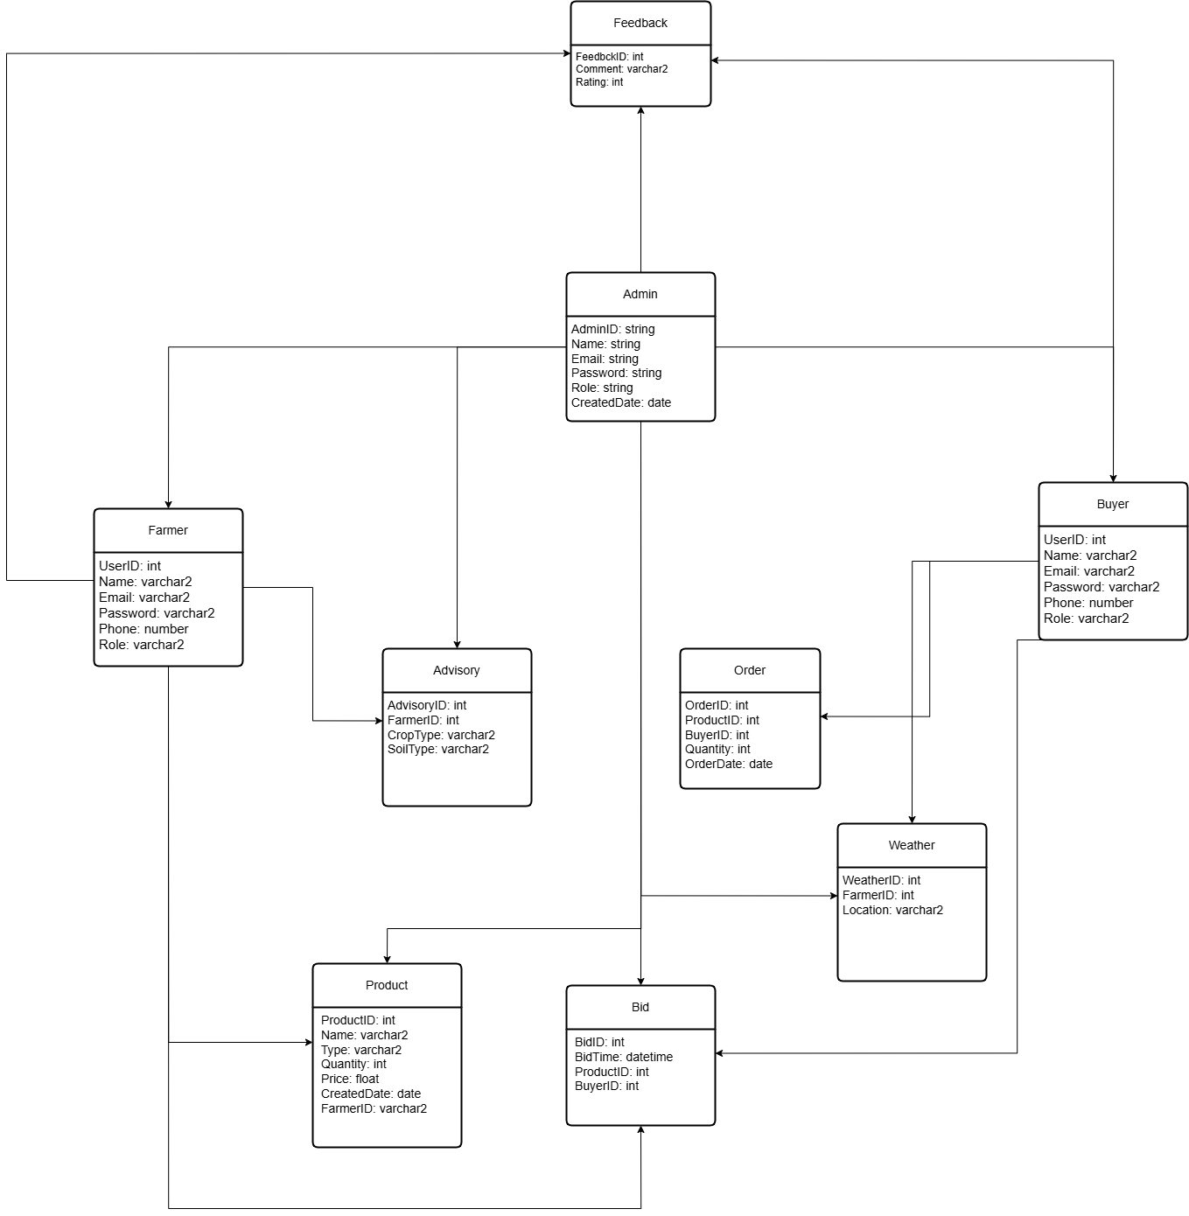
System Design(Diagrams)
8. Class Diagram

Slide 14
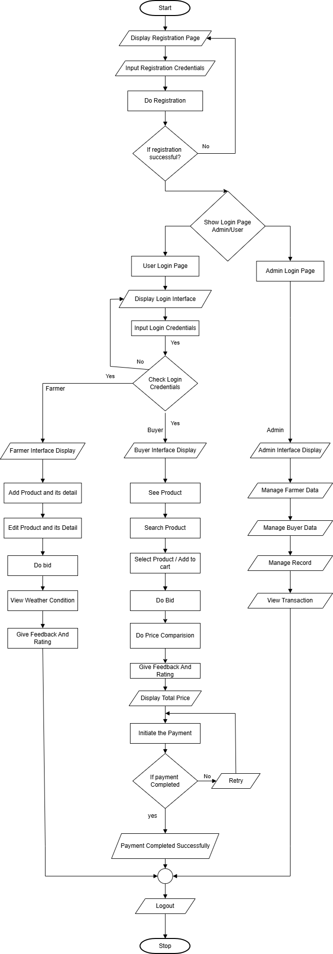
System Design(Diagrams)
9. Flow Chart

Slide 15
References & Sources
ChatGPT – for research and technical explanation
DeepSeek – for guidance and structure
Google – general information & research
W3Schools – HTML, CSS, JS, PHP documentation
OpenWeatherMap API documentation
MySQL & PHP official documentation

Slide 16
Conclusion
AgriFarm successfully addresses the limitations of traditional agricultural trading by providing a transparent, efficient, and technology-driven platform that directly connects farmers and buyers. Through features such as real-time bidding, product listing, live weather updates, and crop advisory services, the system empowers farmers with better market access and informed decision-making while offering buyers competitive pricing and reliable product information. The use of modern web technologies, secure authentication, and structured database design ensures reliability, scalability, and ease of use for all stakeholders. Overall, AgriFarm demonstrates how digital solutions can significantly improve agricultural practices, enhance transparency in the supply chain, and contribute positively to the modernization of rural markets.

Slide 17
THANK YOU

