Slide 1
CMPE 281 – Cloud Project #2 Travel Diary
Mohith Girigowdara Girish, Miyar Karthik Kamath, Harshil Vyas, Ahmed Zaytoun

Slide 2
Presentation Overview
Project Idea / Objective
Problem & Solution
Social Impact
Background
Application Importance
Architecture Diagram
High Availability
Fault Tolerance
Security
DR
Cost Break Down
Work Distrubution
Project Demo
Future Tasks
Features
Updates to Improve Architecture

Slide 3
Project Idea / Objective
Background:
Growing Global Travel
Multimedia-Centric Society
Language Diversity and Barriers
Advancements in AI and ML
Problem:
Organization of Memories
Language Barriers
Emotional Context
Notes:
Ahmed Project Desc:
Travel diary application that goes beyond the traditional pen-and-paper format. This digital platform allows users to store and view images related to their travel experiences. What sets this application apart is its integration of artificial
intelligence (AI) and machine learning (ML) models for image analysis, along with features like text translation and sentiment analysis.
Key Features:
Image Analysis: Users can upload images, and the AI/ML models will analyze the content, identifying objects, landmarks, and themes. This analysis generates tags that are associated with each image, facilitating easy categorization and search.
Text Translation: The application includes a text translation feature where users can enter text, select the target language, and receive translations. This is particularly useful for travelers navigating regions where the local language may be unfamiliar.
Audio Pronunciation: In addition to text translation, the app provides an audio feature that allows users to hear how the translated text is pronounced in the chosen language. This aids in language learning and enhances communication in foreign environments.
Sentiment Analysis: The application employs sentiment analysis to understand the emotional context of the entered text. This adds a layer of depth to the diary entries, capturing the user's feelings and reactions during their travel experiences.
Problems Addressed:
Organization of Memories: Traditional travel diaries may lack organization, making it challenging for users to revisit specific moments. The image analysis feature helps in categorizing and tagging images, providing a structured and searchable archive of memories.
Language Barriers: Traveling to places with different languages can be a barrier to communication. The text translation and audio pronunciation features address this issue, enabling users to bridge language gaps and interact more effectively with locals.
Emotional Context: Conventional diaries may capture events but might miss the emotional nuances. Sentiment analysis adds a layer of emotional understanding to the entries, enriching the storytelling aspect of the travel diary.
Importance:
Enhanced Travel Experience: The application enhances the overall travel experience by combining multimedia elements with advanced technologies. Users can relive and share their adventures in a more interactive and meaningful way.
Cultural Exchange: The text translation feature promotes cultural exchange by enabling users to communicate in local languages. This fosters a deeper connection with the places visited and encourages cross-cultural understanding.
Technological Innovation: The integration of AI/ML technologies distinguishes the application in the market, attracting users who appreciate technological innovation in their travel tools.
Overall Impact and Relevance: The project's impact lies in offering a comprehensive and intelligent solution for documenting travel experiences. It goes beyond the basic functionalities of traditional travel diaries by leveraging AI to organize, translate, and add emotional context to entries. The application's relevance is evident in its ability to address common challenges faced by travelers, making it a valuable tool for those seeking a more enriched and technologically advanced way to capture and remember their journeys. The potential societal impact, through enhanced cultural understanding, adds an additional layer of significance to the project.
Background and Inspiration:
Growing Global Travel:
With the world becoming more interconnected, travel has become a common and enriching aspect of people's lives. Individuals frequently embark on journeys to explore new cultures, landscapes, and experiences.
Multimedia-Centric Society:
In today's digital age, people are accustomed to documenting their lives through multimedia formats. The prevalence of smartphones with high-quality cameras has made capturing images and videos a natural part of any travel experience.
Challenges in Traditional Travel Diaries:
While traditional travel diaries involve recording experiences in written form, they often lack the multimedia richness that characterizes contemporary storytelling. Additionally, organizing and revisiting specific moments within a written diary can be cumbersome.
Language Diversity and Barriers:
Global travel often involves encountering different languages, leading to potential communication challenges. Language barriers can hinder meaningful interactions with locals, limiting the depth of cultural engagement.
Emotional Connection to Memories:
Travel experiences are not just about visiting places; they encompass emotions, reactions, and personal connections. Traditional diaries might capture events but might miss the emotional nuances that make each memory unique.
Advancements in AI and ML:
The rapid advancements in artificial intelligence and machine learning have opened up new possibilities for enriching digital experiences. Applying these technologies to travel documentation can significantly enhance the way people relive and share their adventures.
Inspiration for the Application:
Effortless Organization of Memories:
The inspiration for the image analysis feature comes from the desire to effortlessly organize and categorize travel memories. By automatically tagging images, users can easily search and navigate through their extensive collection of photos, reliving specific moments with ease.
Bridging Language Gaps:
The inspiration for the text translation and audio pronunciation features arises from the recognition of language as a bridge to cultural understanding. The goal is to empower travelers to communicate effectively in diverse linguistic environments, fostering connections and breaking down language barriers.
Capturing Emotional Resonance:
The sentiment analysis feature is inspired by the intention to capture the emotional resonance of travel experiences. Beyond just recording events, the application aims to document the user's feelings, reactions, and overall emotional journey during their adventures.
Technological Innovation in Travel Documentation:
The inspiration for incorporating AI/ML technologies into a travel diary comes from the desire to offer users a technologically innovative way to document their experiences. This not only aligns with the current trend of smart applications but also adds a layer of intelligence to the process of travel storytelling.
Promoting Cultural Exchange:
The overall inspiration for the application stems from a vision of promoting cultural exchange through technology. By facilitating language understanding and encouraging users to engage more deeply with the places they visit, the application aims to contribute to a global community that appreciates and understands diverse cultures.
In summary, the inspiration for this travel diary application comes from a recognition of the evolving nature of travel, the multimedia-centric preferences of modern users, and the transformative potential of AI/ML technologies in enhancing the richness of travel documentation. The goal is to offer a comprehensive, intelligent, and culturally sensitive tool that becomes an indispensable companion for individuals exploring the world.

Slide 4
Project Idea / Objective
Features:
Image Analysis / Image Categorization
Text Translation / Audio Pronunciation
Sentiment Analysis
Optical Character Recognition
Importance:
Enhanced Travel Experience
Cultural Exchange
Technological Innovation
Solution:
Offering a comprehensive and intelligent solution for documenting travel experiences
AI to organize, translate, and add emotional context to entries
Notes:
Project Desc:
Travel diary application that goes beyond the traditional pen-and-paper format. This digital platform allows users to store and view images related to their travel experiences. What sets this application apart is its integration of artificial
intelligence (AI) and machine learning (ML) models for image analysis, along with features like text translation and sentiment analysis.
Key Features:
Image Analysis: Users can upload images, and the AI/ML models will analyze the content, identifying objects, landmarks, and themes. This analysis generates tags that are associated with each image, facilitating easy categorization and search.
Text Translation: The application includes a text translation feature where users can enter text, select the target language, and receive translations. This is particularly useful for travelers navigating regions where the local language may be unfamiliar.
Audio Pronunciation: In addition to text translation, the app provides an audio feature that allows users to hear how the translated text is pronounced in the chosen language. This aids in language learning and enhances communication in foreign environments.
Sentiment Analysis: The application employs sentiment analysis to understand the emotional context of the entered text. This adds a layer of depth to the diary entries, capturing the user's feelings and reactions during their travel experiences.
Problems Addressed:
Organization of Memories: Traditional travel diaries may lack organization, making it challenging for users to revisit specific moments. The image analysis feature helps in categorizing and tagging images, providing a structured and searchable archive of memories.
Language Barriers: Traveling to places with different languages can be a barrier to communication. The text translation and audio pronunciation features address this issue, enabling users to bridge language gaps and interact more effectively with locals.
Emotional Context: Conventional diaries may capture events but might miss the emotional nuances. Sentiment analysis adds a layer of emotional understanding to the entries, enriching the storytelling aspect of the travel diary.
Importance:
Enhanced Travel Experience: The application enhances the overall travel experience by combining multimedia elements with advanced technologies. Users can relive and share their adventures in a more interactive and meaningful way.
Cultural Exchange: The text translation feature promotes cultural exchange by enabling users to communicate in local languages. This fosters a deeper connection with the places visited and encourages cross-cultural understanding.
Technological Innovation: The integration of AI/ML technologies distinguishes the application in the market, attracting users who appreciate technological innovation in their travel tools.
Overall Impact and Relevance: The project's impact lies in offering a comprehensive and intelligent solution for documenting travel experiences. It goes beyond the basic functionalities of traditional travel diaries by leveraging AI to organize, translate, and add emotional context to entries. The application's relevance is evident in its ability to address common challenges faced by travelers, making it a valuable tool for those seeking a more enriched and technologically advanced way to capture and remember their journeys. The potential societal impact, through enhanced cultural understanding, adds an additional layer of significance to the project.
Background and Inspiration:
Growing Global Travel:
With the world becoming more interconnected, travel has become a common and enriching aspect of people's lives. Individuals frequently embark on journeys to explore new cultures, landscapes, and experiences.
Multimedia-Centric Society:
In today's digital age, people are accustomed to documenting their lives through multimedia formats. The prevalence of smartphones with high-quality cameras has made capturing images and videos a natural part of any travel experience.
Challenges in Traditional Travel Diaries:
While traditional travel diaries involve recording experiences in written form, they often lack the multimedia richness that characterizes contemporary storytelling. Additionally, organizing and revisiting specific moments within a written diary can be cumbersome.
Language Diversity and Barriers:
Global travel often involves encountering different languages, leading to potential communication challenges. Language barriers can hinder meaningful interactions with locals, limiting the depth of cultural engagement.
Emotional Connection to Memories:
Travel experiences are not just about visiting places; they encompass emotions, reactions, and personal connections. Traditional diaries might capture events but might miss the emotional nuances that make each memory unique.
Advancements in AI and ML:
The rapid advancements in artificial intelligence and machine learning have opened up new possibilities for enriching digital experiences. Applying these technologies to travel documentation can significantly enhance the way people relive and share their adventures.
Inspiration for the Application:
Effortless Organization of Memories:
The inspiration for the image analysis feature comes from the desire to effortlessly organize and categorize travel memories. By automatically tagging images, users can easily search and navigate through their extensive collection of photos, reliving specific moments with ease.
Bridging Language Gaps:
The inspiration for the text translation and audio pronunciation features arises from the recognition of language as a bridge to cultural understanding. The goal is to empower travelers to communicate effectively in diverse linguistic environments, fostering connections and breaking down language barriers.
Capturing Emotional Resonance:
The sentiment analysis feature is inspired by the intention to capture the emotional resonance of travel experiences. Beyond just recording events, the application aims to document the user's feelings, reactions, and overall emotional journey during their adventures.
Technological Innovation in Travel Documentation:
The inspiration for incorporating AI/ML technologies into a travel diary comes from the desire to offer users a technologically innovative way to document their experiences. This not only aligns with the current trend of smart applications but also adds a layer of intelligence to the process of travel storytelling.
Promoting Cultural Exchange:
The overall inspiration for the application stems from a vision of promoting cultural exchange through technology. By facilitating language understanding and encouraging users to engage more deeply with the places they visit, the application aims to contribute to a global community that appreciates and understands diverse cultures.
In summary, the inspiration for this travel diary application comes from a recognition of the evolving nature of travel, the multimedia-centric preferences of modern users, and the transformative potential of AI/ML technologies in enhancing the richness of travel documentation. The goal is to offer a comprehensive, intelligent, and culturally sensitive tool that becomes an indispensable companion for individuals exploring the world.

Slide 5
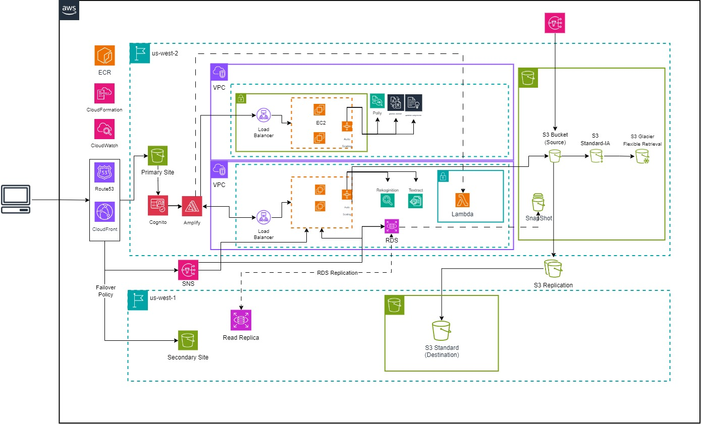
AWS Architecture Diagram
Notes:
Ahmed – Client to Route53, CloudFront, CloudWatch, Health Check, SNS
Harshil – Fail Over Policy, Cognito, Amplify, Lambda, CloudFormation, SNS. S3
Karthik – Load Bal, Auto Scaling, EC2, Rekcogition, Textract, RDS, SNS, S3
Mohith - – Load Bal, Auto Scaling, EC2,P Polly, Translate, Comprehend, CloudFormation, ECR, SNS

Slide 6
Work Distrubution
Ahmed | Mohith | Kartik | Harshil
Route 53 SNS CloudFront CloudWatch AWS Lambda Frontend Backend API | Backend API AWS Translate AWS Polly AWS Comprehend CloudFormation EC2 & Load Balancing Elastic Container Registry SNS (EC2) | Backend API AWS Rekognition AWS Textract S3 EC2 & Load Balancing AWS RDS CloudFront SNS (RDS & EC2) | Frontend S3 AWS Cognito AWS Amplify CloudFormation AWS Rekognition AWS Lambda AWS Translate
Notes:
Mohith

Slide 7
Elements Consider in System Design
High Availability
Fault Tolerance
Security
Disaster Recovery
Multi-AZ Deployment
Load Balancing
Auto Scaling
Elasticity
Data Replication / Backups
Global Content Delivery (CDN)
Multi-AZ Deployment
Load Balancing
Auto Scaling
Amazon RDS Multi-AZ
(ELB) Health Checks
S3 Durability Redundancy
Global Acceleration
Identity and Access Management (IAM)
Virtual Private Cloud (VPC)
Security Groups
AWS CloudWatch
AWS CloudTrail
AWS Organization
AWS Cognito
Data Backups
Multi-Region Deployment
Amazon S3 Cross-Region Replication
AWS CloudFormation
Database Replication
Health Checks
Notes:
Karthik & Ahmed

Slide 8
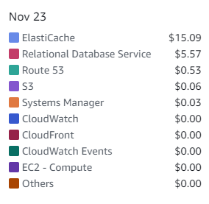
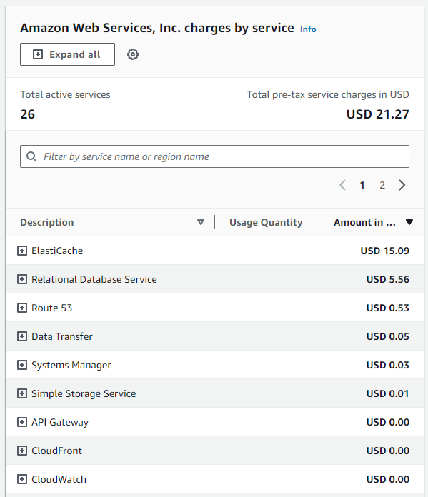
Elements Consider in System Design
Cost Break Down
Notes:
Karthik

Slide 9
Application Demonstration
Github : CMPE281-Cloud-Project-2
Demo Site:
http://travel.karthikkamath.com/
https://bit.ly/cmpe281-cloud2

Slide 10
Future Tasks
Features:
File Sharing
Translate Text From Image
Facial Recognition
Fine Tune Tagging
Improvement in Architecture:
AWS Fargate for Container Orchestration
Amazon Elastic Cache
AWS Cost Explorer
AWS App Runner
Amazon DynamoDB
Notes:
AWS Fargate is a serverless compute engine for containers that lets you run containers without managing the underlying infrastructure. This abstracts away the need to provision and manage servers for containerized applications.

Slide 11
Thank you!!
Notes:
AWS Fargate is a serverless compute engine for containers that lets you run containers without managing the underlying infrastructure. This abstracts away the need to provision and manage servers for containerized applications.

Slide 12
Any Questions?
Notes:
AWS Fargate is a serverless compute engine for containers that lets you run containers without managing the underlying infrastructure. This abstracts away the need to provision and manage servers for containerized applications.

Slide 13
infografías en diapositivas minimalistas para reuniones
Esta plantilla contiene una variedad de recursos infográficos complementarios para la presentación Diapositivas miminalistas para reuniones
Estas infografías están adaptadas al estilo de la presentación antes mencionada, por lo que puedes insertarlas fácilmente y tenerlas completamente integradas a la vez. Solo necesitas hacer lo siguiente:
Selecciona el elemento que deseas copiar
Haz clic derecho y elige "Copiar"
Ve a la diapositiva donde deseas que aparezca el elemento
Haz clic derecho y elige "Pegar"

Slide 14
infografías en diapositivas minimalistas para reuniones
paso 1
paso 3
paso 5
Marte es un lugar muy frío
Neptuno está lejos de la Tierra
Venus tiene una atmósfera tóxica
paso 2
paso 4
Mercurio es un planeta pequeño
La Tierra es el planeta con vida

Slide 15
infografías en diapositivas minimalistas para reuniones
marte
mercurio
Marte es un lugar muy frío
01
02
Mercurio es un planeta pequeño
03
neptuno
Neptuno está lejos de la Tierra

Slide 16
infografías en diapositivas minimalistas para reuniones
marte
Marte es un lugar muy frío
xxxx
neptuno
xxxx
Neptuno está lejos de la Tierra
mercurio
Mercurio es un planeta pequeño
xxxx
tierra
xxxx
La Tierra es el planeta con vida

Slide 17
infografías en diapositivas minimalistas para reuniones
mercurio
Es el planeta más cercano al Sol
marte
neptuno
Marte es un lugar muy frío
Neptuno está lejos de la Tierra
Frío
Rojo
Planeta
Planeta
Grande
Hielo

Slide 18
infografías en diapositivas minimalistas para reuniones
proyecto | lu | ma | mi | ju | vi
Proyecto 01 |  | ✔
Proyecto 02 |  |  |  | ✔
Proyecto 03 |  |  |  |  | ✔
Proyecto 04 |  |  | ✔

Slide 19
infografías en diapositivas minimalistas para reuniones
neptuno
Neptuno está lejos de la Tierra
marte
mercurio
tierra
Marte es un lugar muy frío
Mercurio es un planeta pequeño
La Tierra es el planeta con vida

Slide 20
infografías en diapositivas minimalistas para reuniones
marte
mercurio
neptuno
tierra
Marte es un lugar muy frío
Es el planeta más cercano al sol
Neptuno está lejos de la Tierra
La tierra es un planeta con vida
xxxx
xxxx
xxxx
xxxx
01
02
03
04

Slide 21
infografías en diapositivas minimalistas para reuniones
elemento | tierra | marte
situaciones | La Tierra es el único planeta que alberga vida | A pesar de ser rojo, Marte es un lugar frío
problemas | Es el tercera planeta más cercano al Sol | Está lleno de polvo de óxido de hierro
situaciones
problemas
75%
50%
Mercurio es un planeta pequeño
Júpiter es el mayor planeta de todos

Slide 22
infografías en diapositivas minimalistas para reuniones
mercurio
marte
Es un planeta bastante pequeño
02
Está lleno de polvo de óxido de hierro
01
03
tierra
Es el único planeta que alberga vida

Slide 23
infografías en diapositivas minimalistas para reuniones
87%
mercurio
Mercurio es un planeta bastante pequeño
79%
venus
Venus tiene un nombre muy hermoso
60%
marte
Marte está lleno de polvo de óxido de hierro

Slide 24
infografías en diapositivas minimalistas para reuniones
conclusions
mercurio
saturno
júpiter
Mercurio es un planeta pequeño
Debe su nombre a un dios romano
Júpiter no tiene una superficie sólida
50%
25%
75%

Slide 25
infografías en diapositivas minimalistas para reuniones
Mercurio es el planeta más cercano al Sol y el más pequeño de todos
La Tierra es el único planeta conocido que alberga vida en el Sistema Solar
Venus tiene un nombre precioso, pero también temperaturas altísimas
mercurio
tierra
venus
Mercurio es un planeta bastante pequeño
Es el tercer planeta más cercano al Sol
Es el segundo planeta más cercano al Sol
Es muy pequeño
Es muy caliente, aunque menos que Venus
Está cerca del Sol
La Tierra tiene vida
Todos los humanos viven aquí
Tiene una luna
Es muy caliente
Tiene una atmósfera muy tóxica
Tiene altas temperaturas

Slide 26
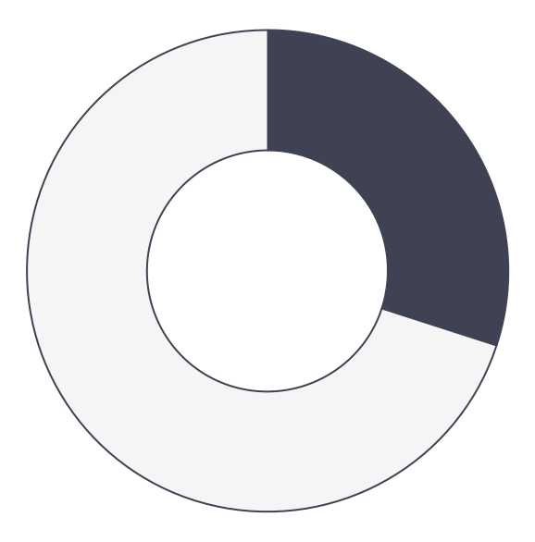
infografías en diapositivas minimalistas para reuniones
70%
30%
júpiter
saturno
Júpiter es el mayor planeta de todos
Debe su nombre a un dios romano
Sigue el enlace del gráfico para modificar sus datos y luego pega el nuevo aquí. Para más información, haz clic aquí

Slide 27
infografías en diapositivas minimalistas para reuniones
Es el planeta más grande de todos
A pesar de ser rojo, Marte es muy frío
júpiter
marte
2XXX
2XXX
2XXX
2XXX
venus
tierra
Venus tiene un nombre precioso
Es el único planeta que tiene vida

Slide 28
infografías en diapositivas minimalistas para reuniones
50%
tierra
Es el único planeta que alberga vida
25%
75%
mercurio
júpiter
Mercurio es un planeta pequeño
Júpiter no tiene una superficie sólida

Slide 29
infografías en diapositivas minimalistas para reuniones
júpiter
venus
marte
Júpiter es el mayor planeta de todos
Venus tiene unas temperaturas altísimas
A pesar de ser rojo, Marte es muy frío
mercurio
tierra
saturno
Mercurio es el planeta más cercano al Sol
La Tierra es el único planeta que tiene vida
Debe su nombre a un dios romano

Slide 30
infografías en diapositivas minimalistas para reuniones
mercurio
tierra
Es el planeta más cercano al Sol
Es el único planeta que alberga vida
venus
júpiter
Venus tiene unas temperaturas altas
Es el planeta más grande de todos

Slide 31
infografías en diapositivas minimalistas para reuniones
 | tarea | semana 1 | semana 2 | semana 3 | semana 4
fase 1 | mercurio |  | ✔
 | Mercurio es el planeta más cercano al Sol y el más pequeño de todos
 | venus |  |  | ✔
 | Venus tiene un nombre precioso, pero también temperaturas altas
 | marte |  |  |  | ✔
 | A pesar de ser rojo, Marte es en realidad un lugar frío

Slide 32
infografías en diapositivas minimalistas para reuniones
01
02
03
04
júpiter
marte
venus
Júpiter es el mayor planeta de todos
tierra
A pesar de ser rojo, Marte es muy frío
Venus tiene temperaturas altas
Es el único planeta que alberga vida

Slide 33
infografías en diapositivas minimalistas para reuniones
venus
júpiter
Venus tiene temperaturas altas
Júpiter es el planeta más grande de todos
neptuno
marte
saturno
Marte es en realidad un lugar muy frío
Está compuesto de hidrógeno y helio

Slide 34
infografías en diapositivas minimalistas para reuniones
hora | lunes | martes | miércoles | jueves | viernes
09:00 | Tarea 1 | Tarea 3 | Tarea 2 | Tarea 3 | Tarea 1
11:00 | Tarea 2 | Tarea 1 | Tarea 3 | Tarea 2 | Tarea 3
13:00 | lunch-time
15:00 | Tarea 3 | Tarea 2 | Tarea 1 | Tarea 3 | Tarea 2
17:00 | Tarea 1 | Tarea 2 | Tarea 3 | Tarea 2 | Tarea 1

Slide 35
infografías en diapositivas minimalistas para reuniones
marte
tierra
neptuno
conclusiones
mercurio
júpiter
venus

Slide 36
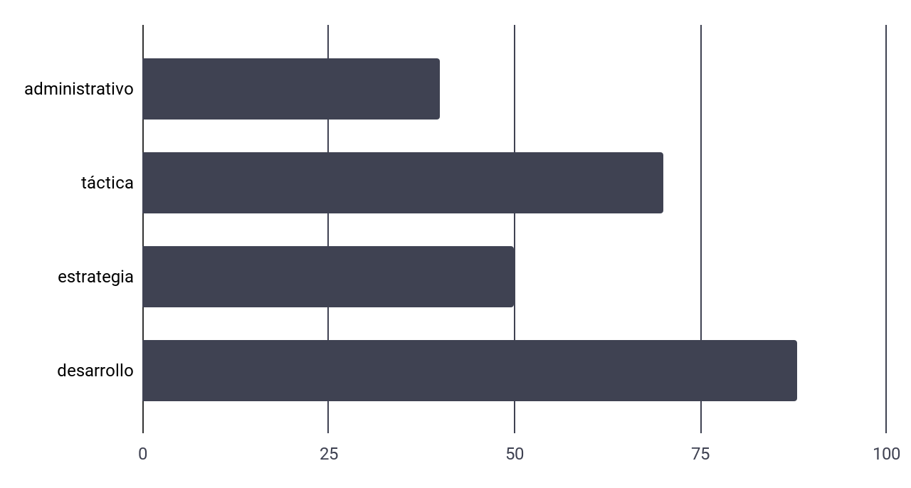
infografías en diapositivas minimalistas para reuniones
contenido | duración
Administrativo | 10 minutos
Táctica | 90 minutos
Estrategia | 4 horas
Desarrollo | 2 días
Sigue el enlace del gráfico para modificar sus datos y luego pega el nuevo aquí. Para más información, haz clic aquí

Slide 37
infografías en diapositivas minimalistas para reuniones
lun | mar | mié | jue | vie | sáb | dom
 |  | 01 | 02 | 03 | 04 | 05
06 | 07 | 08 | 09 | 10 | 11 | 12
13 | 14 | 15 | 16 | 17 | 18 | 19
20 | 21 | 22 | 23 | 24 | 25 | 26
27 | 28 | 29 | 30
viernes 03
Saturno está compuesto por hidrógeno y helio
lunes 13
Júpiter es el planeta más grande del Sistema Solar
jueves 30
Venus tiene unas temperaturas altísimas

Slide 38
infografías en diapositivas minimalistas para reuniones
júpiter
Júpiter es el planeta más grande de todos
venus
saturno
Venus tiene temperaturas altas
Está compuesto de hidrógeno y helio
marte
Marte es en realidad un lugar muy frío

Slide 39
infografías en diapositivas minimalistas para reuniones
saturno
Debe su nombre a un dios romano
mercurio
júpiter
venus
Mercurio es el planeta más cercano al Sol
Júpiter es el planeta más grande de todos
Venus tiene temperaturas altas
tierra
marte
neptuno
Es el único planeta que alberga vida
A pesar de ser rojo, Marte es muy frío
Neptuno está muy lejos de la Tierra

Slide 40
infografías en diapositivas minimalistas para reuniones
 | estrategia 1 | estrategia 2 | estrategia 3
Mercurio es pequeño | ✔ | ✘ | ✔
Venus es muy caliente | ✔ | ✔ | ✘
La Tierra tiene vida | ✔ | ✘ | ✔
Marte es muy frío | ✘ | ✔ | ✔

Slide 41
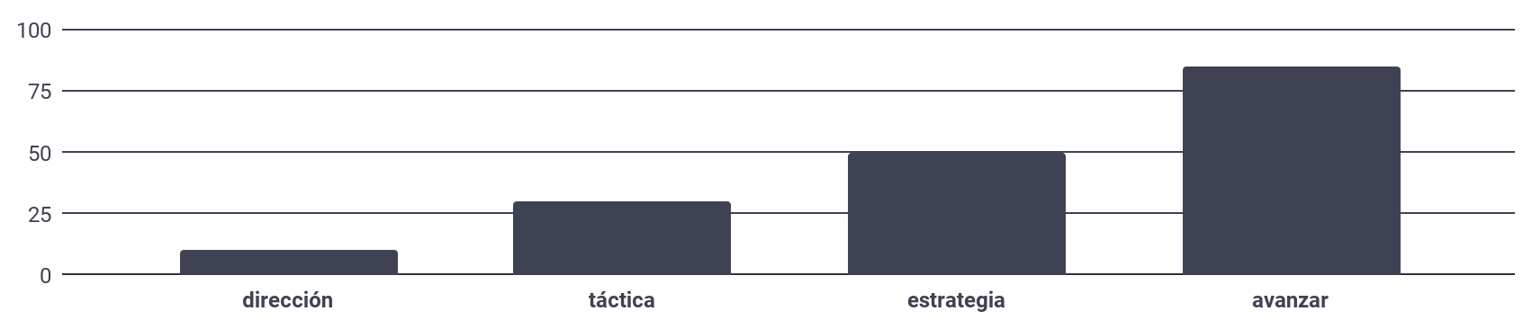
infografías en diapositivas minimalistas para reuniones
Sigue el enlace del gráfico para modificar sus datos y luego pega el nuevo aquí. Para más información, haz clic aquí
dirección
táctica
estrategia
avanzar
Venus tiene temperaturas altas
Júpiter es el planeta más grande de todos
Debe su nombre a un dios romano
Es el único planeta que alberga vida

Slide 42
infografías en diapositivas minimalistas para reuniones
tareas | ene | feb | mar | abr | may | jun | jul | ago | sep | oct | nov | dic
Tarea 1 |  | ✔
Tarea 2 |  |  |  | ✔
Tarea 3 |  |  |  |  |  | ✔
Tarea 4 |  |  |  |  |  |  |  |  | ✔
Tarea 5 |  |  |  |  |  |  |  |  |  |  |  | ✔

Slide 43
infografías en diapositivas minimalistas para reuniones
venus
marte
Venus tiene temperaturas altas
júpiter
tierra
saturno
Júpiter es el mayor planeta de todos
Es el único planeta que alberga vida
mercurio
neptuno
Mercurio es el planeta más cercano al Sol

Slide 44
Instructions for use
If you have a free account, in order to use this template, you must credit Slidesgo in your final presentation. Please refer to the next slide to read the instructions for premium users.
As a Free user, you are allowed to:
- Modify this template.
- Use it for both personal and commercial projects.
You are not allowed to:
- Sublicense, sell or rent any of Slidesgo Content (or a modified version of Slidesgo Content).
- Distribute Slidesgo Content unless it has been expressly authorized by Slidesgo.
- Include Slidesgo Content in an online or offline database or file.
- Offer Slidesgo templates (or modified versions of Slidesgo templates) for download.
- Acquire the copyright of Slidesgo Content.
For more information about editing slides, please read our FAQs or visit our blog:
https://slidesgo.com/faqs and https://slidesgo.com/slidesgo-school

Slide 45
Instructions for use (premium users)
As a Premium user, you can use this template without attributing Slidesgo.
You are allowed to:
Modify this template.
Use it for both personal and commercial purposes.
Share this template in an editable format with people who are not part of your team.
You are not allowed to:
Sublicense, sell or rent this Slidesgo Template (or a modified version of this Slidesgo Template).
Distribute this Slidesgo Template (or a modified version of this Slidesgo Template) or include it in a database or in any other product or service that offers downloadable images, icons or presentations that may be subject to distribution or resale.
Use any of the elements that are part of this Slidesgo Template in an isolated and separated way from this Template.
Register any of the elements that are part of this template as a trademark or logo, or register it as a work in an intellectual property registry or similar.
For more information about editing slides, please read our FAQs or visit our blog:
https://slidesgo.com/faqs and https://slidesgo.com/slidesgo-school

Slide 46
Infographics
You can add and edit some infographics to your presentation to present your data in a visual way.
Choose your favourite infographic and insert it in your presentation using Ctrl C + Ctrl V or Cmd C + Cmd V in Mac.
Select one of the parts and ungroup it by right-clicking and choosing “Ungroup”.
Change the color by clicking on the paint bucket.
Then resize the element by clicking and dragging one of the square-shaped points of its bounding box (the cursor should look like a double-headed arrow). Remember to hold Shift while dragging to keep the proportions.
Group the elements again by selecting them, right-clicking and choosing “Group”.
Repeat the steps above with the other parts and when you’re done editing, copy the end result and paste it into your presentation.
Remember to choose the “Keep source formatting” option so that it keeps the design. For more info, please visit our blog.

