Slide 1
VENDING MACHINE
TEAM NO 9
12/6/18
EE 271

Slide 2
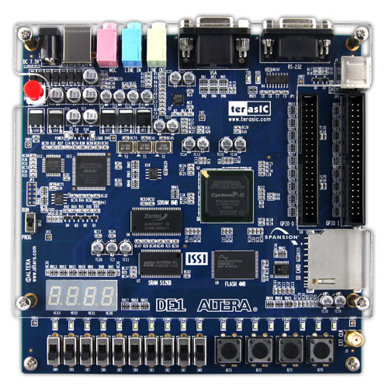
UART
Hardware reset
GPIO x80
Intel Altera Cyclone II DE1
FPGA
7 Segment
Display x4
LED x20
Toggle Switch x10
Push Button x4

Slide 3
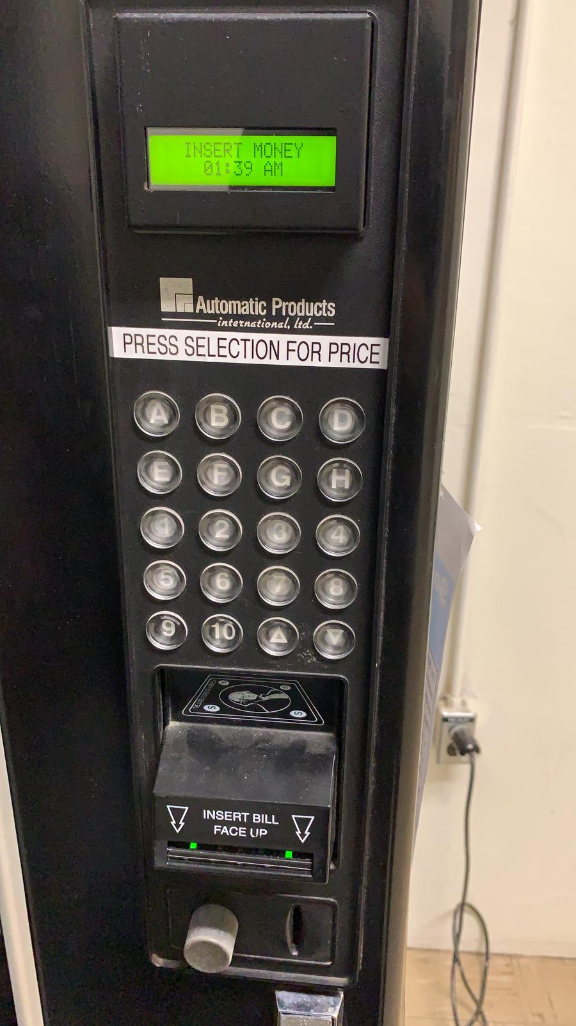
VENDING MACHINE

Slide 4
Block Diagram
Insert money
($1, c50, c25)
Select Product
(A, B, C, D, E, F, G, H)
Confirm
Collect Product and Change
RESET

Slide 5
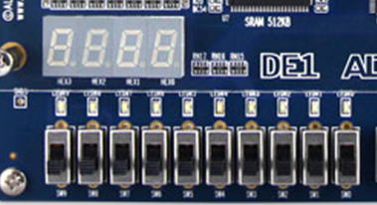

DISPLAY CONVENTION
PRODUCT
DOLLAR
CENTS
4x 7 Segment display
8 product selection toggle switch
2 control input toggle switch
3 money input press switch
$1
c50
c25
A
B
C
D
E
F
G
H
YES
RESET

Slide 6
DEMONSTRATION
Product | Price ($)
A | 1.00
B | 2.55
C | 3.00
D | 3.60
E | 3.48
F | 4.50
G | 4.10
H | 5.76

Slide 7
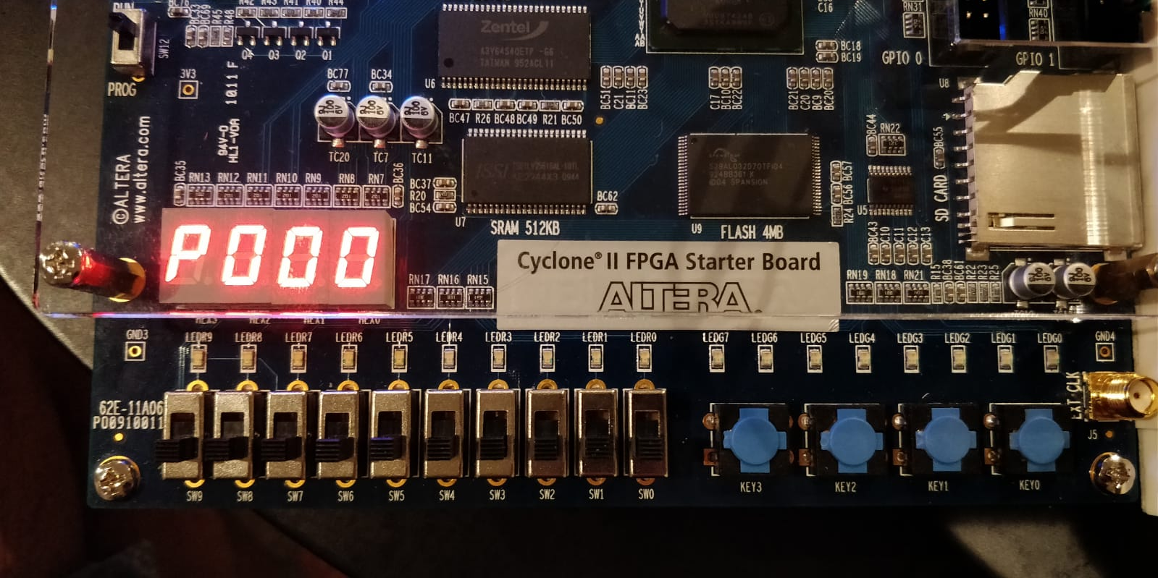
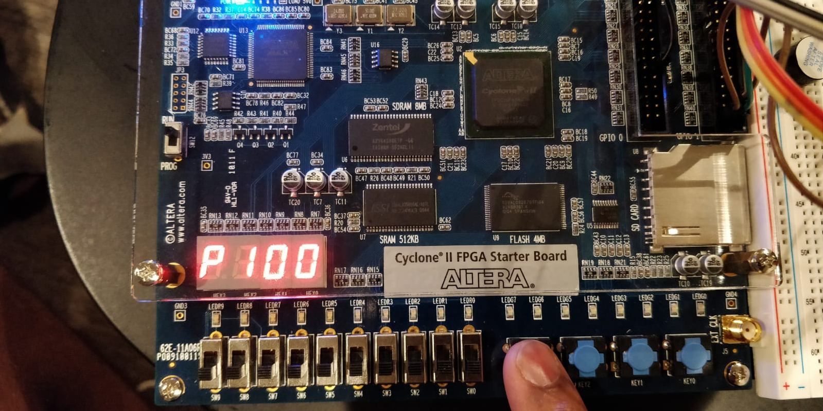

Slide 8
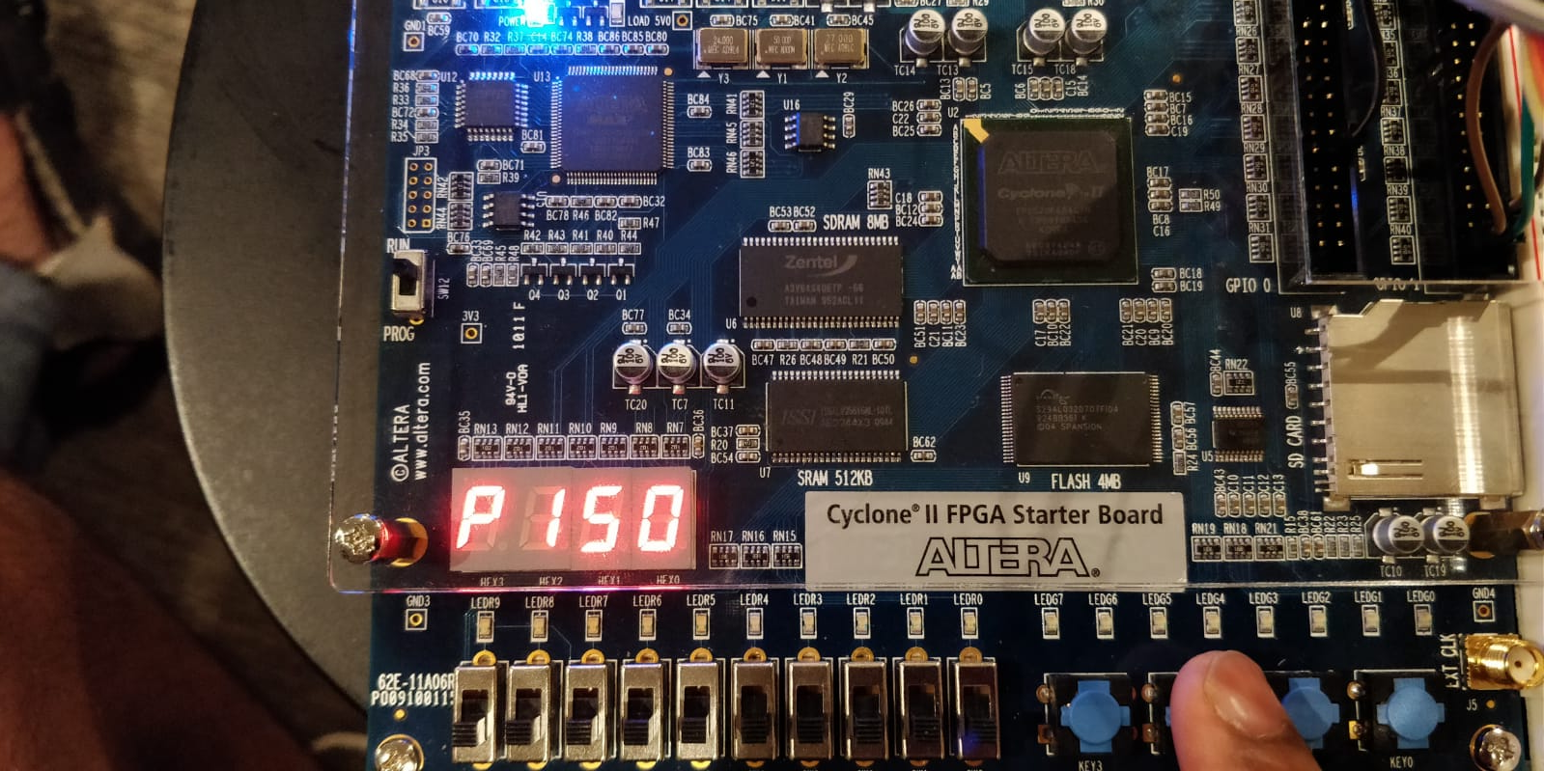
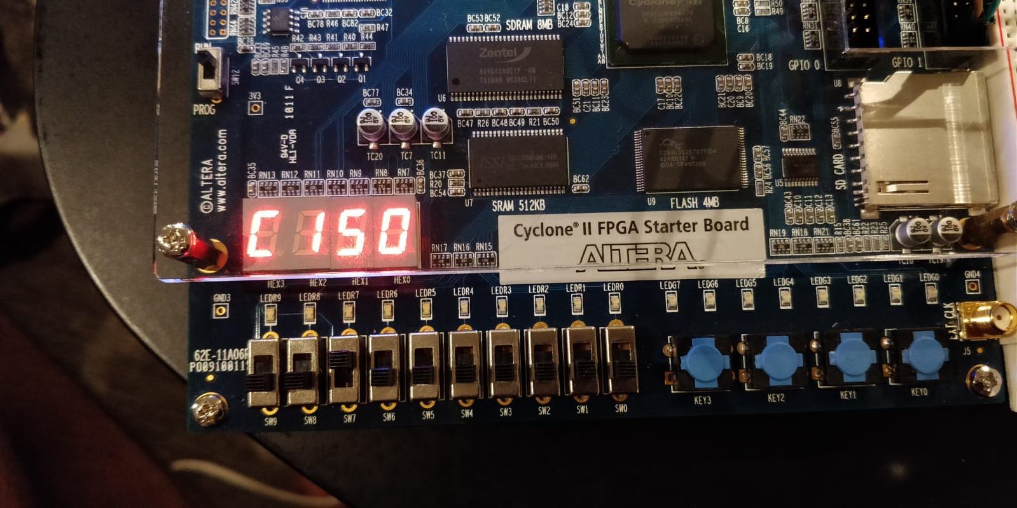

Slide 9
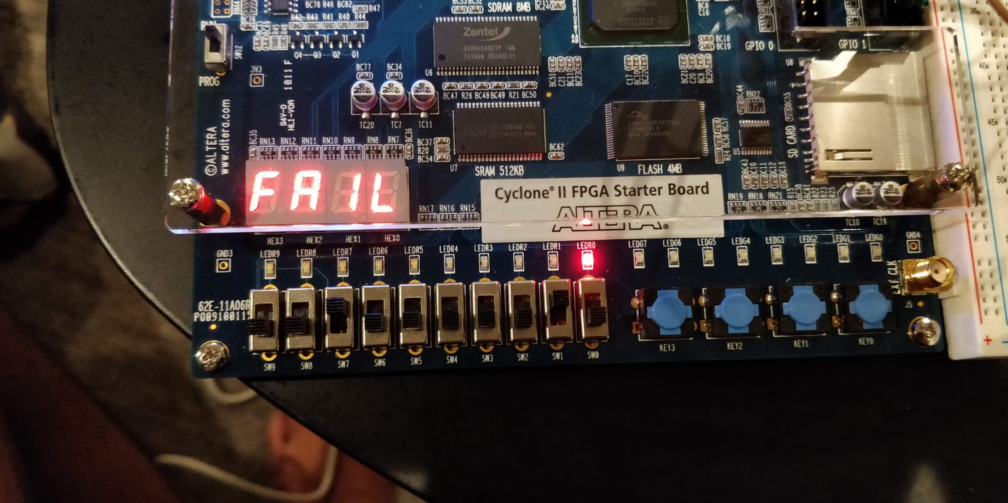

Slide 10
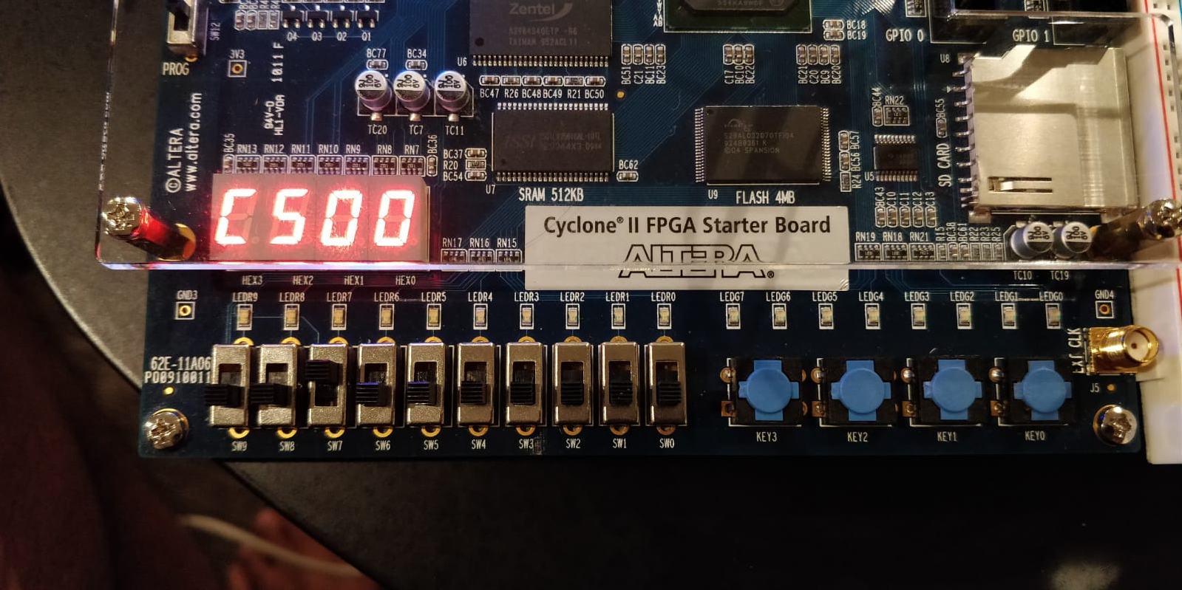
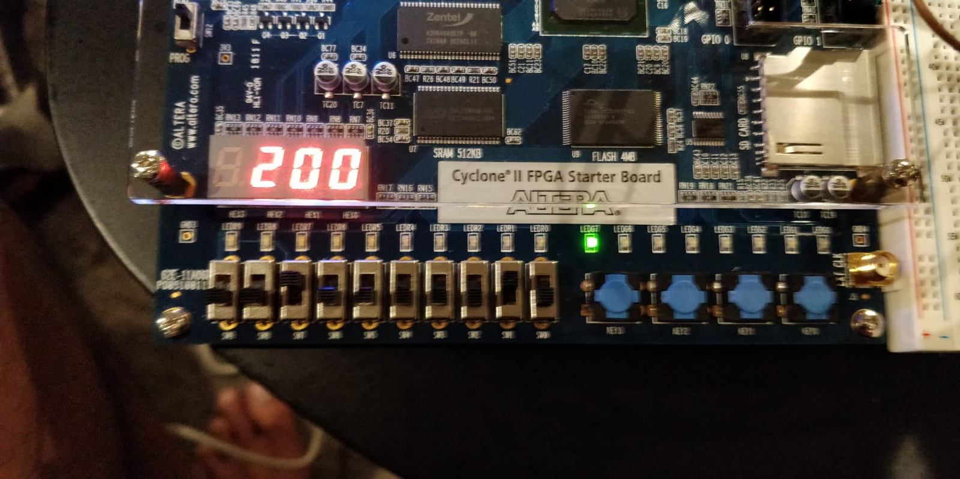

Slide 11
THANK YOU

