Slide 1

Drug Discovery Using VAEs
De Novo Molecular Generation in a Continuous Latent Space
Team Details
23BT04098 - Harshil Patel
23BT04123 - Varun Patel
24BT04D213 - Dharmik Gajjar
Notes:
Introduce the project: we teach a neural network the grammar of chemistry so it can design new, drug-like molecules from scratch. Introduce the three team members.

Slide 2
Drug Discovery Using VAEs
Outline
1. Problem Statement
2. Objectives
3. Tools and Techniques
4. Methodology, Diagrams and Algorithms
5. Results and Discussion
6. Project Demonstration – link
7. Conclusion and Future Scope
Project at a glance
249,455
ZINC training molecules
64-D
latent space (GRU VAE)
81,267
novel, valid molecules
0.72
average QED (drug-likeness)
Notes:
Walk through the outline. The right panel shows the four headline numbers of the project.

Slide 3
Drug Discovery Using VAEs
Problem Statement
$2.6 B
average cost to bring one new drug to market
10–15 yrs
from discovery to approval, mostly lab trial-and-error
> 90 %
of candidates fail in clinical trials
Search space vs. screening capacity
Problem statement
10⁶⁰ – 10⁶⁸ drug-like molecules
Physical screening can only sample a tiny fraction of chemical space. We need a generative model that learns the grammar of chemistry from data and proposes novel, valid, drug-like molecules directly.
Our approach: learn a 64-D latent space with a VAE, then sample new molecules from it.
≤ 10⁷ compounds testable by screening
Not to scale: the gap is 50+ orders of magnitude
Notes:
Traditional discovery costs about $2.6B and 10-15 years, and over 90% of candidates fail in trials. Chemical space is estimated at 10^60-10^68 molecules while screening reaches at most 10^6-10^7. We need AI that invents promising molecules directly.

Slide 4
Drug Discovery Using VAEs
Objectives
1
Learn the grammar of chemistry: train on 249,455 drug-like ZINC molecules written as SMILES strings.
2
Build a GRU-based VAE: compress each molecule into a continuous 64-dimensional latent space.
3
Generate new molecules: sample z ~ N(0, I) and decode, with no explicit chemistry rules given.
4
Validate with RDKit: measure validity, uniqueness, novelty, QED and LogP of the output.
5
Deliver usable outputs: export 81,000+ candidates as CSV and an 84-page PDF structure catalog.
Notes:
Five objectives: learn chemical grammar, build the VAE, generate, validate, deliver.

Slide 5
Drug Discovery Using VAEs
Tools and Techniques
PyTorch
RDKit
NumPy / Pandas
GRU encoder–decoder VAE, Adam optimiser, GPU training and checkpoints
SMILES parsing, validity checks, QED, Crippen LogP and 2D drawings
Dataset loading, tokenised tensors (224,509 × 122) and CSV exports
scikit-learn
Matplotlib / Seaborn
Jupyter Notebooks
90/10 train–test split, PCA and t-SNE latent-space maps
Loss curves, property distributions and the 84-page PDF catalog
Six notebooks: EDA, preprocessing, training, generation, visualization, 100k evaluation
Techniques: Variational Autoencoder · GRU sequence model · Reparameterization trick · β-weighted ELBO · Temperature sampling
Notes:
Everything is Python: PyTorch for the model, RDKit for chemistry, scikit-learn for splits and projections.

Slide 6
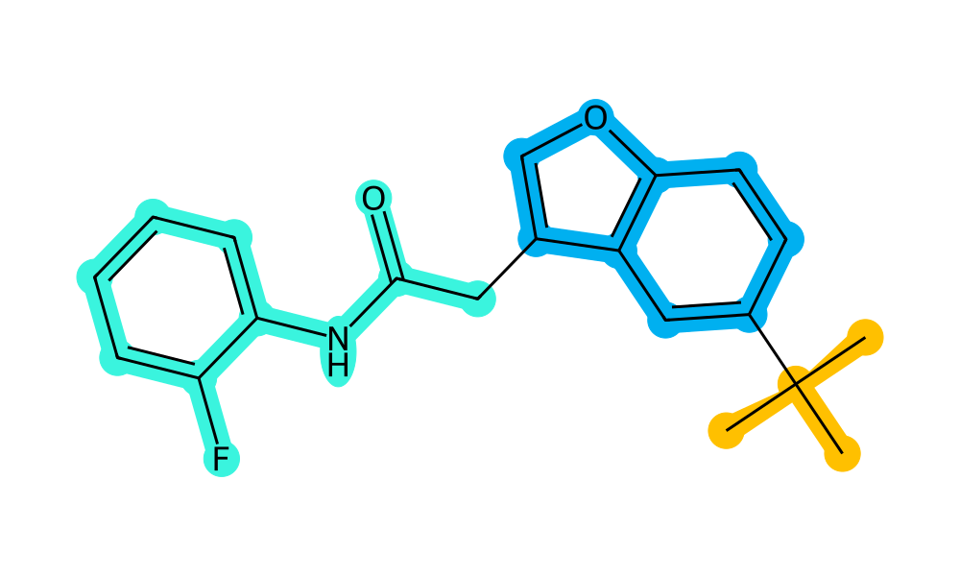
Drug Discovery Using VAEs
Dataset and SMILES Representation
249,455
ZINC molecules
4
columns: smiles, logP, qed, SAS
110
max SMILES length (chars)
45.31
mean SMILES length (chars)
Atoms C N O F Cl Br
Aromatic lowercase c n o s
Bonds = double, # triple
Branches ( … )
Rings digits: c1ccccc1 = benzene
CC(C)(C)c1ccc2occ(CC(=O)Nc3ccccc3F)c2c1
tert-butyl
benzofuran core
amide + fluorobenzene
Example: row 0 of ZINC 250k
Notes:
ZINC 250k has 249,455 commercially available drug-like molecules. SMILES turns a chemical graph into a line of text, so sequence models can be used. The example is row 0 of the dataset.

Slide 7
Drug Discovery Using VAEs
Methodology: Preprocessing and Tokenization
1
2
3
4
Raw ZINC CSV
Clean and filter
Character tokens
Pad and split
249,455 molecules with smiles, logP, qed and SAS columns
Drop nulls and duplicates; keep SMILES up to 120 characters (all kept)
35 unique characters plus <PAD>, <SOS>, <EOS> give a 38-token vocabulary
Length 122 (120 + SOS + EOS); 90/10 split: 224,509 train, 24,946 test
Tokenization example: "CC(=O)N" (acetamide)
<SOS>
C
C
(
=
O
)
N
<EOS>
<PAD>
<PAD>
…
1
21
21
5
18
26
6
25
2
0
0
Why character-level? Atoms, ring digits and bond symbols stay single units, with no large subword (BPE) vocabulary. Numbers below each token are its vocabulary ID.
Notes:
Preprocessing: clean, build a 38-token character vocabulary, pad to 122, split 90/10. Character-level SMILES keeps every atom, ring index and bond symbol as one token.

Slide 8
Drug Discovery Using VAEs
Methodology: VAE Mathematics
Evidence Lower Bound (ELBO)
Total loss
ℒ = E[ log p(x|z) ] − D_{KL} ( q(z|x) ‖ p(z) )
ℒ_{total} = ℒ_{recon} + β · D_{KL}
Reconstruction term plus KL regulariser, maximised during training.
Cross-entropy reconstruction, β = 0.05
Closed-form KL for Gaussians
Why β = 0.05?
D_{KL} = −½ Σ ( 1 + log σ² − μ² − σ² )
Too high: posterior collapse, the latent code is ignored
Too low: disjointed latent space, poor interpolation
0.05 learns SMILES grammar first, then smooths the manifold
No Monte Carlo estimate needed; a single line in PyTorch.
Reparameterization trick
z = μ + σ ⊙ ε , ε ~ N(0, I)
Randomness moves outside the network so gradients reach μ and σ.
Plain AE: dead zones. VAE: continuous, sampleable space.
Notes:
The VAE maximises the ELBO: reconstruction minus KL to a standard normal. The KL has a closed form. The reparameterization trick lets gradients flow through sampling. We weight the KL by beta = 0.05 to avoid posterior collapse.

Slide 9
Drug Discovery Using VAEs
Methodology: Model Architecture
ENCODER
Input tokens
(B, 122) integer IDs
Embedding
vocab 38 → dim 128
GRU encoder
hidden size 256
fc_mu · fc_var
256 → 64 each
Latent z (64-D)
z = μ + σ ⊙ ε , ε ~ N(0, I)
DECODER
fc_z_to_hidden
64 → 256, sets h₀
Embedding + GRU
decoder, hidden 256
fc_out
256 → 38 logits
Output SMILES
token by token
Notes:
Encoder: embedding, a GRU with 256 hidden units, then two linear layers produce mu and log-variance. We sample z with the reparameterization trick. The decoder maps z to its initial hidden state and reconstructs the SMILES token by token with teacher forcing.

Slide 10
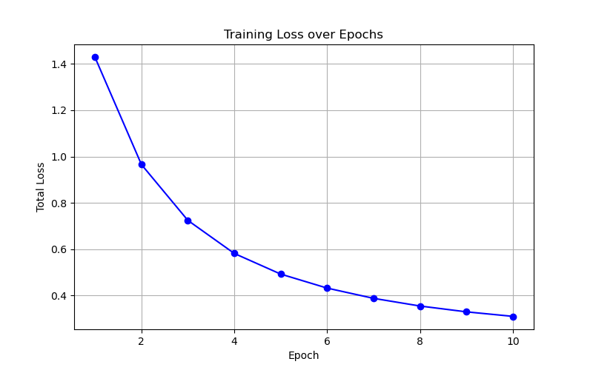
Drug Discovery Using VAEs
Methodology: Training
Setting | Value
Optimizer | Adam, lr = 0.001
Batch size | 128 (1,754 per epoch)
Loss | Cross-entropy + 0.05 · KL
Grad. clipping | max-norm 5
Checkpoints | every epoch, auto-resume
Final weights | vae_final.pt (2.63 MB)
Teacher forcing: the decoder reads the shifted sequence and predicts every next token.
Total loss falls from about 1.43 (epoch 1) to 0.31 (epoch 10), converging smoothly.
Notes:
Training uses Adam at 0.001, batch size 128, gradient clipping at 5 and a fixed beta of 0.05. The loss curve drops from about 1.43 to 0.31 over the plotted 10 epochs.

Slide 11
Drug Discovery Using VAEs
Methodology: Generation Pipeline
1
2
3
4
Sample prior
Decode
Validate
Filter, export
100,000 random vectors z ~ N(0, I), each 64-D
GRU starts at <SOS>, samples tokens at T = 1.0 until <EOS>
RDKit rejects bad syntax, valences and ring closures
Keep unique, check novelty vs ZINC, export CSV and PDF
Result funnel from 100,000 samples
100,000
sampled
81,308
valid (81.31 %)
81,267
unique (99.95 %)
81,267
novel (100 %)
Temperature sampling, not greedy argmax: greedy decoding collapses to repeated tokens and ring strings.
Notes:
At inference we sample 100,000 latent vectors, decode with temperature 1.0, validate with RDKit, then check uniqueness and novelty against the training set. 81,308 are valid, 81,267 unique and all novel.

Slide 12
Drug Discovery Using VAEs
Results and Discussion: Benchmarks
81.31 %
validity
99.95 %
uniqueness
100 %
novelty
0.72
average QED
Metric | Target | Our result | Status
Chemical validity | > 70 % | 81.31 % (81,308 / 100,000) | Met
Uniqueness | > 95 % | 99.95 % (81,267 / 81,308) | Met
Novelty | > 90 % | 100.00 % (81,267 / 81,267) | Met
Average QED | > 0.65 | 0.72 | Met
LogP distribution | −0.4 to 5.0 | 1.8 to 4.2 | Within range
Notes:
Validity 81.31%, uniqueness 99.95%, novelty 100%, average QED 0.72. All targets are met. Exact-string reconstruction is near zero for character-level VAEs because SMILES is not unique, so generative metrics are the right benchmark.

Slide 13
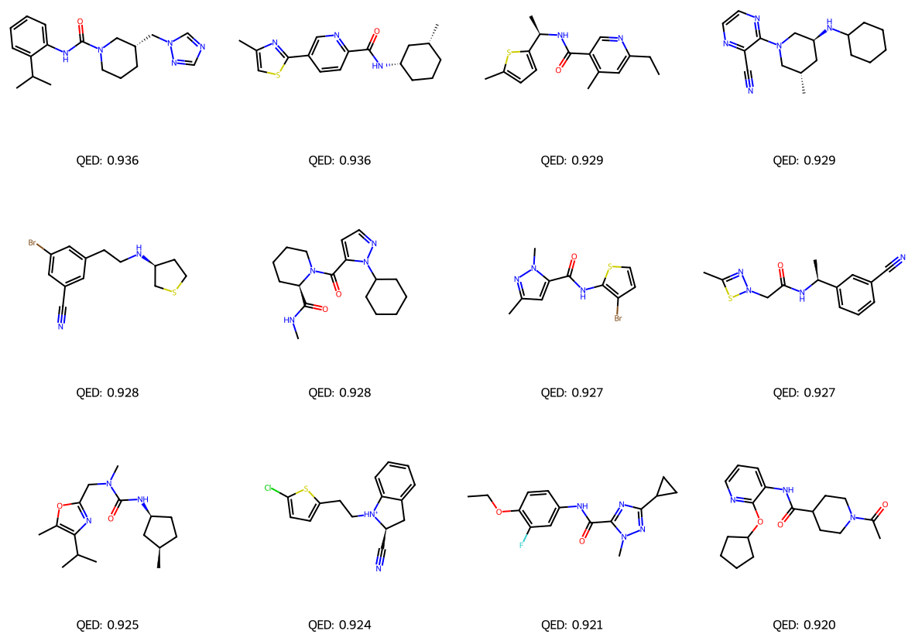
Drug Discovery Using VAEs
Results and Discussion: Generated Molecules
What the model designed
Top 12 of 500 sampled points, ranked by QED (0.920 to 0.936)
Drug-like motifs: amides, ureas, piperidines, thiophene, pyrazole, triazole, oxazole
Every structure parses in RDKit, so valence and ring rules hold
Valid is not the same as makeable: a few outputs show strained rings
Next check: SAS scoring and chemist review before any synthesis.
Notes:
These are the highest-QED molecules among 500 samples. They show realistic drug-like scaffolds. Be upfront that validity does not guarantee synthesizability; a couple of structures contain unusual rings.

Slide 14
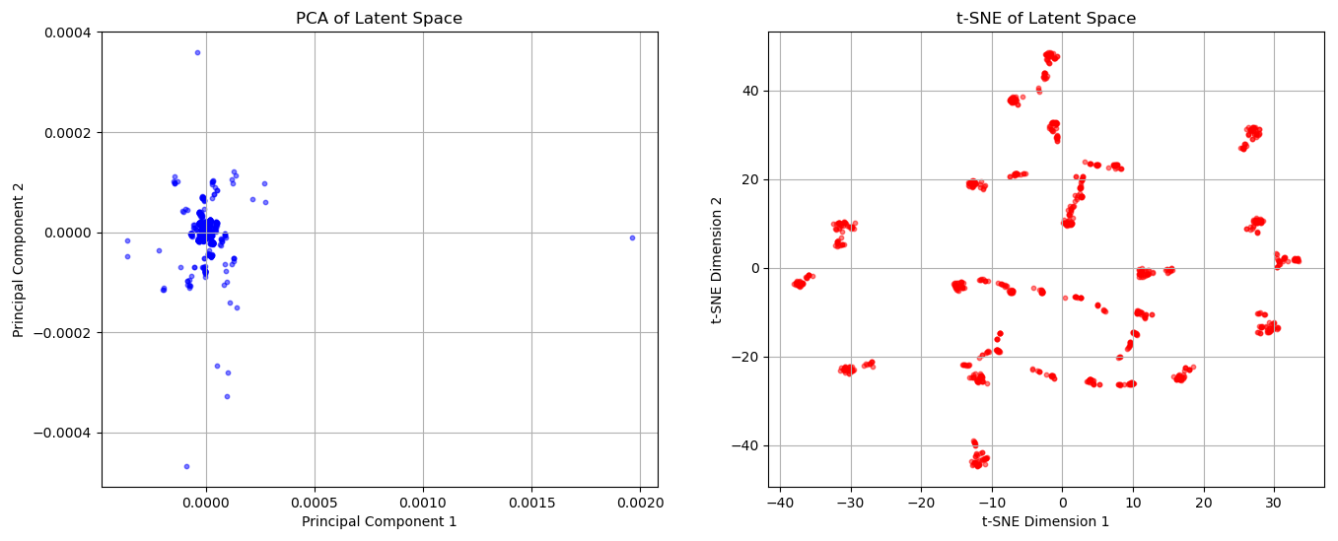
Drug Discovery Using VAEs
Results and Discussion: Latent Space
t-SNE: compact local groups; similar molecules sit together.
PCA: encoded means sit near the origin (axes about 10⁻⁴) with a few outliers.
Notes:
1,000 encoded training molecules projected with PCA (left) and t-SNE (right). t-SNE shows compact local groups. PCA shows the latent means very close to the origin on a tiny scale, which is consistent with strong KL regularisation; describe it as it is rather than as a smooth manifold.

Slide 15
Drug Discovery Using VAEs
Project Demonstration
Project deliverables
GitHub repository
.csv
all_generated_drugs.csv: 81K valid SMILES
github.com/Harshil7031/Drug-Discovery-VAE
.csv
all_generated_drugs_full.csv: adds logP, QED, SAS
Live demo: web dashboard
.pdf
1000_new_drugs_multipage.pdf: 84-page structure catalog
Generate batches of 6, 12 or 24 molecules
Filter by QED and SAS in real time
Inspect 2D structure, formula and properties
.ipynb
Six notebooks, from EDA to the 100k-sample evaluation
.pt
vae_final.pt: trained weights (2.63 MB)
Notes:
Show the GitHub link and the deliverables. Switch to the local web dashboard for a short live demo: generate a batch, apply the QED filter, open the molecule inspector.

Slide 16
Drug Discovery Using VAEs
Conclusion and Future Scope
249,455
training molecules
64-D
latent space
81,267
novel molecules
0.72
average QED
Conclusion
Future scope
A GRU-based VAE learned SMILES grammar with no explicit chemistry rules (81.31 % valid)
99.95 % unique and 100 % novel: no mode collapse, no memorisation
Average QED 0.72 and LogP 1.8 to 4.2 match drug-like ZINC molecules
Full pipeline delivered: notebooks, CSV, 84-page PDF catalog
Conditional VAE to target properties or protein binding
Graph or SELFIES decoders to push validity toward 100 %
Latent-space optimisation of QED and SAS
Toxicity screening and wet-lab verification (human in the loop)
Notes:
Summarise: the VAE learns chemistry without rules and produces valid, unique, novel, drug-like molecules. Future work: conditional generation, better decoders, property optimisation, and wet-lab verification.

Slide 17
Drug Discovery Using VAEs
23BT04098 - Harshil Patel
23BT04123 - Varun Patel
24BT04D213 - Dharmik Gajjar
github.com/Harshil7031/Drug-Discovery-VAE
Thank You..
Notes:
Thank the audience and invite questions.

