Slide 1
First Evaluation
MIN-300 (Spring 2020)
Lab Based Project
Intelligent Fault Diagnosis
Members :-
Mridul - 17117048
Harshil - 17117033
Saurabh - 17117077
Subhram - 17117080
Advisor
Prof. S. P. Harsha
Group Number: D10

Slide 2
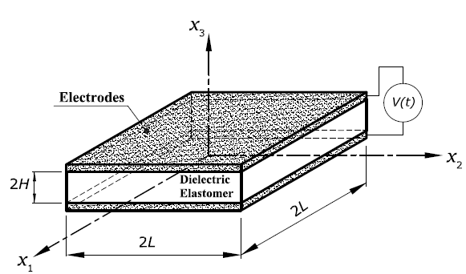
Motivation and Problem Definition
Use this space to highlight background and motivation of your problem.
Use bulleted points as far as possible.
Be precise and to the point.
Make use of charts/flow diagrams/blocks/ etc. to aid your claims.
Mathematical equations need to be written only using math-type (install if you don’t have). See below equation as an example, double click to edit.
Allowable font: Times new roman (strictly).
Allowable Font Size: 13-16.
Use this space for figures/charts/small table/historical data/ that you deem suitable for justifying your arguments/claims stated in the motivation.
A reference needs to be given for all figure/graphs, which are not created by you.
Do not forget to indicate the axes titles for graphs. A graph is incomplete without axis titles.
Problem Definition
State the precise problem definition (Shouldn’t be identical to the title on the first slide)
Your sentence should start with ‘To’, e.g., o investigate, To explore, To simulate, etc.
Use the same font size and color here [Do not change].

Slide 3
Methodology and Deliverables
Use this space to explain the approach that you are going to adopt.
Explain the theoretical and experimental components, if any.
Manage the space judiciously. Make use of equations, figures, flow charts, to convey how you are going to approach the problem.
If you use equations, try to identify/specify different terms (see example).
Stress equilibrium
Mechanical BC
Deliverables
List the deliverables in a bulleted format.
Be precise.
Be realistic, do not list too ambitious deliverables.
Feel free to add any figure here (adjacent to this list) if you feel that is appropriate to explain any of the deliverables.

Slide 4
Progress made
This slide has a free-format. However, you need to respect the font size, font type, and other instructions stated on the previous slides.
Use this slide to exposit any progress that you have made so far in the project. You may also wish to enlist the difficulties/challenges that you are facing.
Below are some critical points concerning the presentation
You get just three slides (four including title slide) for this presentation. No matter how passionate you are about your project/ how much work you have done, we would like to see just three slides, that’s all. Manage your space!
You will get 7 minutes to present your work followed by 3 minutes of Q&A. Marks will be deducted for lengthy/sloppy presentations. Manage your time!
You are requested to bring the presentation in a thumb drive.
All students must be present for all presentations in the respective group. If you are not present at the time of group call, it is a case of no-show which will attract zero marks.
Failing to form a group/find a supervisor/no-show during presentation will result in dentation in the course and you will have to wait until next year to pass a course.

