Slide 1
CLI Test Presentation
This is a test of the slides command
Second line

Slide 2
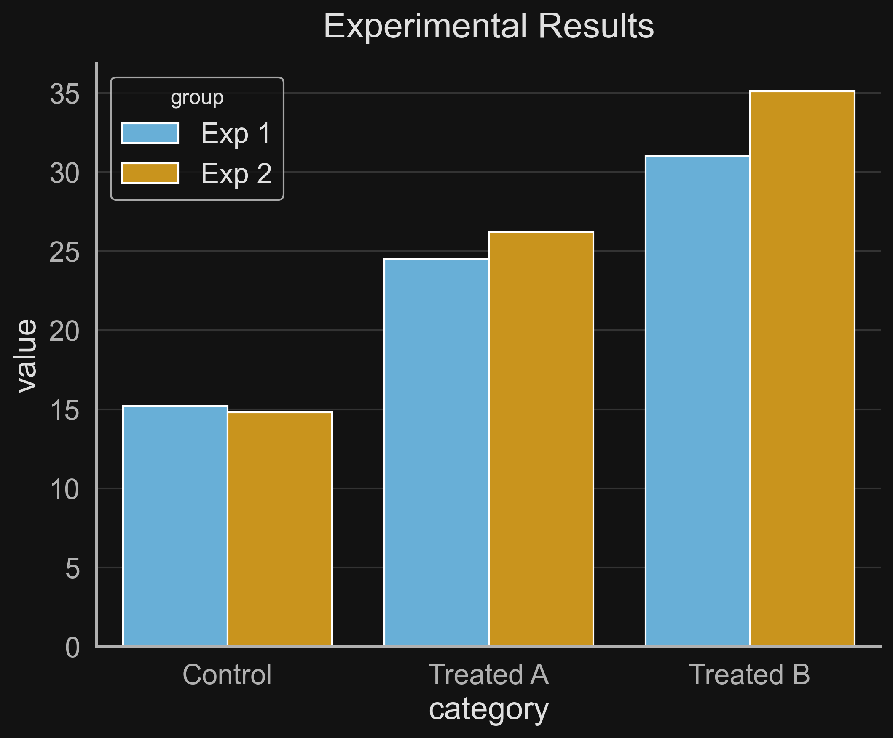
Experimental Results

Slide 3
System Architecture

