Slide 1

TRACE-PD
Department of Computer Science and Engineering (Data Science)
Temporal Reasoning and Confidence Explanation for Parkinson's Disease
Guide: Dr. Kriti Srivastava
Aishwarya Deshmukh 60009230154
Rutu Mehta 60009240017
Harshil Bhanushali 60009230069

Slide 2
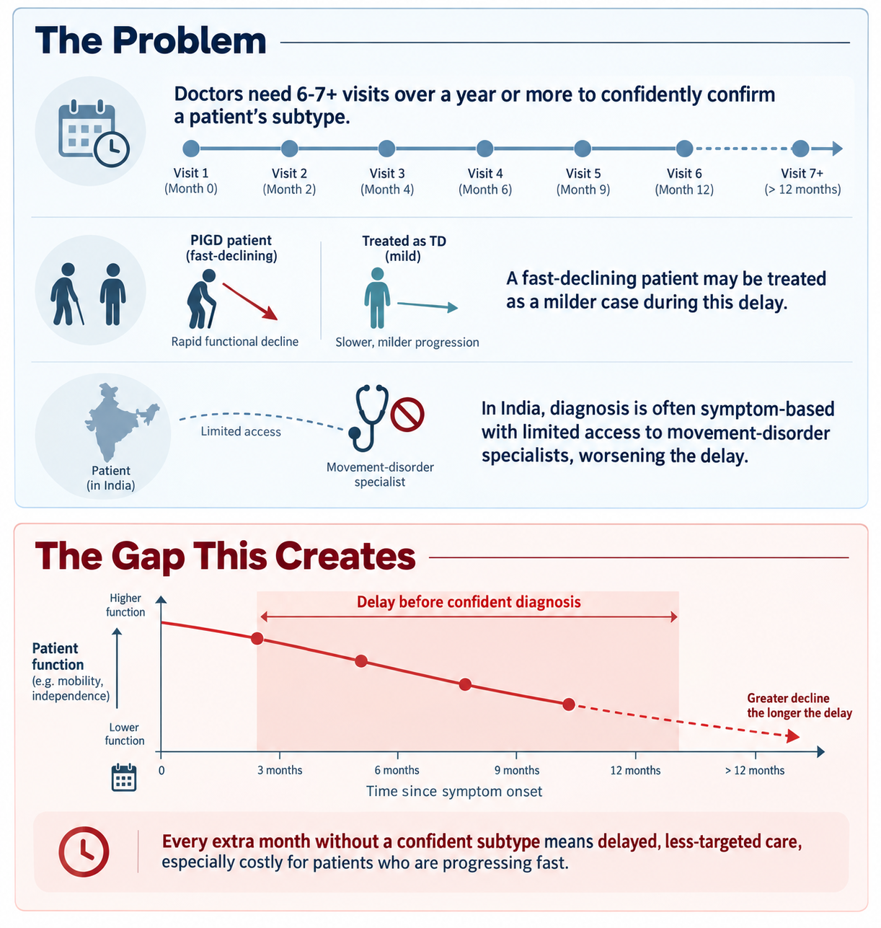
What is Parkinsons Disease?
A progressive neurodegenerative disorder that affects movement, caused by the loss of dopamine-producing brain cells. Symptoms worsen over time and vary a lot between patients, most fall into two main types: tremor-dominant (shaking) or postural instability and gait difficulty, PIGD (balance and walking problems).
Why does the subtype matter?
PIGD patients decline faster and fall more often than TD patients
PIGD patients respond worse to standard treatment (levodopa, DBS)
Knowing the subtype earlier changes how closely a patient should be monitored and treated

Slide 3
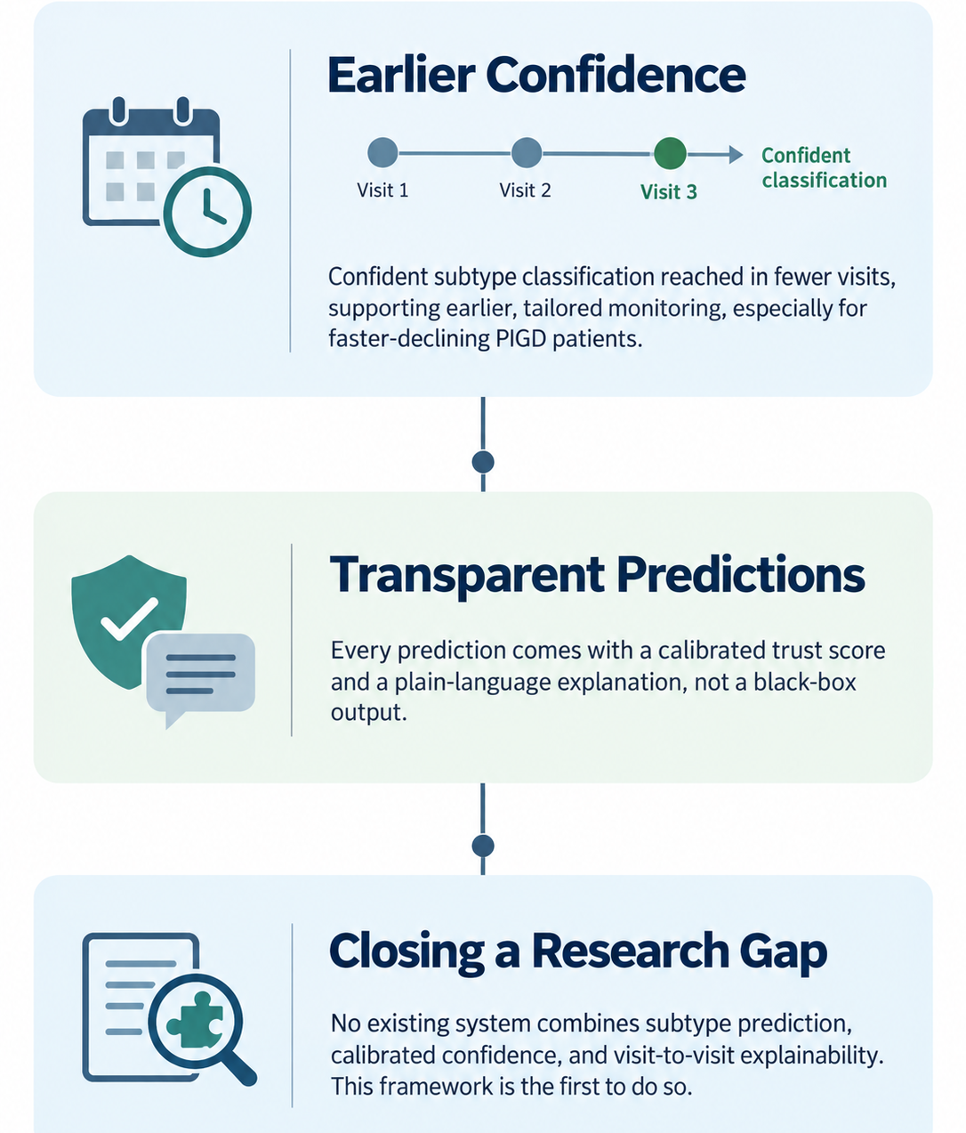
The Problem Definition:
Issues:
Doctors need 6-7+ visits over a year or more to confidently confirm a patient's motor subtype (TD vs. PIGD)
A third to half of patients get reclassified within 1-2 years, so even that confirmed label isn't stable
Fast-declining PIGD patients may be treated as milder TD cases during this delay
In India, diagnosis is often symptom-based, with limited access to movement-disorder specialists, worsening the delay
Solution:
ML classifier (XGBoost) trained on routine clinical visit data to predict TD/PIGD/indeterminate subtype earlier
Conformal prediction layer to attach a calibrated, statistically guaranteed confidence score to each prediction
Longitudinal tracking across visits to flag when a patient's classification is unstable or likely to shift
Custom explainability layer that shows which specific clinical changes drove a shift in confidence between visits, not just which features mattered at one snapshot in time
Impact:

Slide 4
Introduction to our Solution
What is TRACE-PD?
An ML-powered clinical decision-support framework built to predict a Parkinson's patient's motor subtype and tell doctors how much to trust that prediction, using established clinical criteria, calibrated uncertainty quantification, and longitudinal visit tracking.
Why Use It?
Earlier Confidence — Predicts TD/PIGD/indeterminate subtype using fewer visits than traditional clinical judgment alone.
Calibrated Trust — Every prediction comes with a statistically guaranteed confidence score, not a raw guess.
Stability Tracking — Flags patients whose classification is likely to shift before it actually does.
Transparent Reasoning — Explains which specific clinical changes are driving each prediction, in plain language.
Key Benefits
Established Ground Truth — Built on the published Jankovic/Stebbins formula, no new clinical validation needed.
Visit-by-Visit Confidence — Tracks how sure the model is over time, not just at one snapshot.
Delta Explainability — Shows what changed between visits and why confidence shifted.
Clinician-Ready Output — Plain-language report per patient: subtype, confidence, trend, and reasoning.
Fills a Real Gap — No existing system combines subtype prediction, calibrated confidence, and explainability in one framework.

Slide 5
Literature Review (1 / 2)
Paper Title | Techniques | Advantages | Issues
CASCADE: Conformal Prediction for Two-Stage Clinical Decision Support in PD (2026) | Two-stage conformal prediction Screening classifier + dosage regression Medication dosing (LEDD) forecasting | Propagates calibrated uncertainty across stages Statistically guaranteed coverage First conformal application to a PD outcome | Applied to medication dosing, not subtype classification Single-visit framing, no longitudinal tracking
7T Quantitative MRI and ML for Motor Subtype Stratification (2026) | Ultra-high-field 7T MRI features Multiple classifiers (KNN, SVM, RF, XGBoost) HC vs. PIGD vs. TD classification | Very high-resolution imaging features Tests multiple algorithms for robustness | Only moderate accuracy (~0.62) Exploratory; no uncertainty calibration No longitudinal tracking
Understanding Clinical Reasoning Variability in Medical LLMs (Jan 2026) | Mechanistic interpretability analysis Prompt-format sensitivity testing across medical LLMs | Reveals hidden reliability gaps in LLM clinical reasoning Informs safer LLM deployment design | Accuracy can shift >50% based on prompt format alone Models can sound confident with insufficient input
Enhancing LLM Clinical Support with ML Risk and SHAP Explainability (ICU) (2026) | XGBoost mortality-risk prediction SHAP feature attribution GPT-4o for bedside explanation generation | Combines validated ML signal with readable LLM explanation Demonstrates ML-to-SHAP-to-LLM pipeline | Applied to ICU mortality, not PD No uncertainty/confidence component built in

Slide 6
Literature Review (2 / 2)
Paper Title | Techniques | Advantages | Issues
Conformal Prediction for Disease-Course Prediction in Multiple Sclerosis (2025) | Conformal prediction for individualized diagnostic uncertainty Disease-course classification | Calibrated, patient-specific confidence Prediction-set size reflects model certainty | Applied to MS, not PD No stability or transition-risk framing across visits
Automatic Differentiation of PD Motor Subtypes via Deep Learning and Radiomics (2025) | MRI radiomic features from 8 brain nuclei Five ML classifiers PPMI cohort (135 patients: 92 TD, 43 PIGD) | Directly targets TD/PIGD classification Tests multiple classifiers for comparison | Same-visit imaging only, not earlier prediction No calibrated confidence reported Imaging not routinely available every visit
Conformal Bands for Biomarker Trajectories in Alzheimer's/MCI (Nov 2025) | Group-conditional conformal prediction bands Irregularly-timed longitudinal biomarker visits | Flags high-risk patients earlier than standard scores Handles irregular visit timing | Applied to Alzheimer's, not PD Predicts a continuous biomarker, not a discrete subtype label

Slide 7
Gaps in Existing Systems → How We Solve Them
Imaging-Dependent Classification
Most ML approaches to TD/PIGD classification rely on MRI or DaTscan imaging, which isn't routinely collected at every clinical visit
No Calibrated Confidence
Existing subtype classifiers report only accuracy or AUC, giving no per-patient measure of how much to trust a given prediction
Self-Derived, Unvalidated Subtypes
Data-driven clustering approaches invent new progression categories that require independent clinical validation before they can be trusted as ground truth
Static, Single-Visit Framing
Every existing subtype study evaluates one snapshot in time, despite published evidence that a third to half of patients get reclassified within 1-2 years
No Explainability for Uncertainty
Standard explainability tools (SHAP, LIME) explain a single prediction, not why a model's confidence changed, or is likely to change, over time
Uses routine clinical exam data (motor, cognitive, autonomic scores) already collected every visit, no imaging dependency.
Applies conformal prediction to attach a statistically calibrated confidence score to every prediction, not just a raw label.
Anchors ground truth to the established Jankovic/Stebbins TD/PIGD formula, published and peer-reviewed, requiring no new clinical validation.
Tracks predictions across a patient's full visit history, computing a confidence curve and stability index to flag when a label is likely to shift.
Introduces a custom delta-attribution explainability layer, extending existing conformal-aware attribution methods to show which specific clinical changes drove a shift in confidence between visits, not just which features mattered once.

Slide 8
Data Description
Source & Cohort
PPMI data via LONI IDA — extract dated 16 Aug 2026; no new patient data collected
Cohort: PPMI PD cohort (COHORT == 1) → 439 patients
242 sporadic PD, 197 genetic-cohort PD (LRRK2 / GBA / SNCA enriched by recruitment design)
19 Source Tables Merged
12 visit-level tables — outer join on PATNO + EVENT_ID
5 static per-patient tables — left join on PATNO
2 medication logs — joined by date interval, not visit code
Reproducibility
Single deterministic preprocessing script, no random seeds — same extract reproduces byte-for-byte
Final Dataset
ppmi_tdpigd_long.csv — long format, 75 columns, one row per patient-visit
Dictionary-driven roles — every column’s role (feature / label / excluded) is assigned programmatically, not chosen by hand
Label Definition
Tremor score = mean of 11 items;
PIGD score = mean of 5 items
Ratio = Tremor / PIGD → ≥1.15 = TD, ≤0.90 = PIGD, else Indeterminate
Verification
0 mismatches across all 5,638 labeled rows when every label was independently recomputed

Slide 9
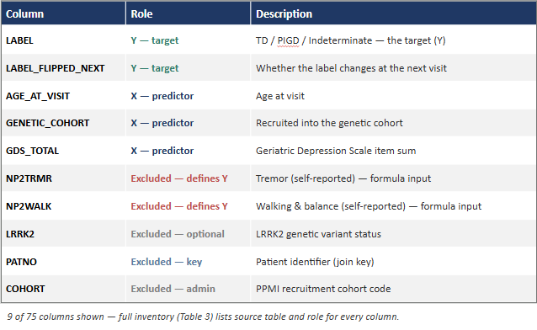
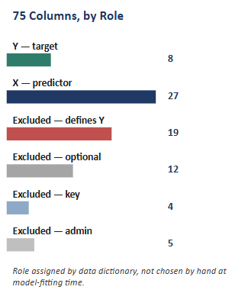
Data Description

Slide 10
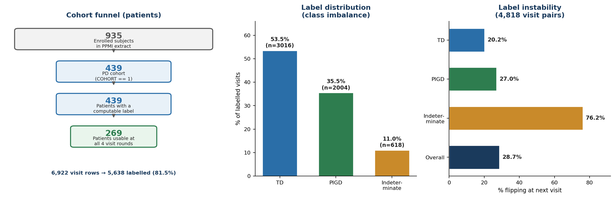
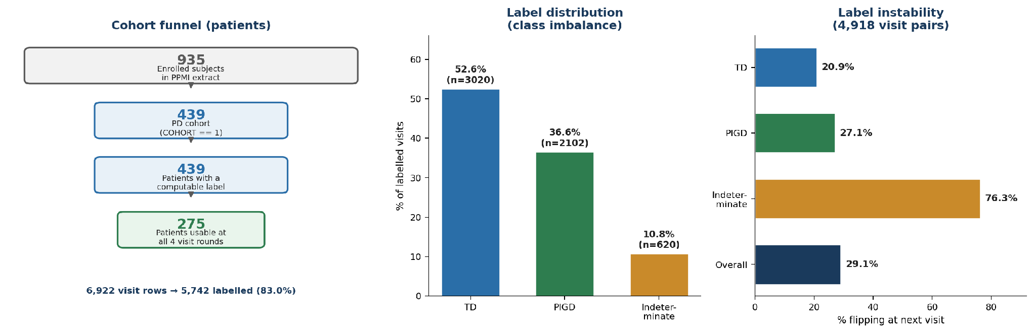
Data Analysis
Funnel: 439 patients → visits joined → 5,638 labeled visit-rows (18.5% unlabeled, concentrated at later visits)
Class balance (visit-level): TD 53.5% / PIGD 35.5% / Indeterminate 11.0%
Instability: 344 of 439 patients (78.4%) change label at least once across visits — corroborates the 33–50% reclassification range reported in the literature; Indeterminate is the least stable class

Slide 11
Deriving the Label: Jankovic / Stebbins Formula
Where the Formula Comes From
Jankovic et al. (1990) — original ratio-based split, derived from the DATATOP cohort
Stebbins et al. (2013) — re-derived and validated for the modern MDS-UPDRS scale used in PPMI and most current PD registries
Tremor Score
Mean of 11 items — 1 Part II (patient-reported) + 10 Part III (examiner-scored resting, postural & kinetic tremor)
PIGD Score
Mean of 5 items — 2 Part II (gait, freezing) + 3 Part III (gait, freezing of gait, postural stability)
Classification Rule:
Ratio = Tremor score / PIGD score
ratio ≥ 1.15 → TD
ratio ≤ 0.90 → PIGD
0.90 < ratio < 1.15 → Indeterminate
Edge Cases
PIGD score = 0 → TD if tremor > 0, else Indeterminate (845 rows, 15.0% of labeled rows)
Completeness rule — label only assigned when all 16 items are present (18.5% of visit-rows remain unlabeled)
Verification
0 mismatches — every label independently recomputed from its two component scores across all 5,638 labeled rows

Slide 12
System Architecture & User Workflow
Data Ingestion & Join – 19 PPMI source tables are pulled from LONI IDA and joined on PATNO + EVENT_ID, with medication logs merged by date-interval join (not key join) to attach the correct LEDD to each visit.
Preprocessing & Feature Governance – Cohort is restricted to COHORT == 1 (439 patients), producing a curated dataset of 6,922 visits × 75 columns, with structural missingness and visit-level duplicates resolved.
Label Engine (Stebbins Ratio) – Ground truth Y is computed deterministically from 11 tremor items and 5 PIGD items using the published ratio: TD if ≥ 1.15, PIGD if ≤ 0.90, Indeterminate in between.
Leakage Guard (Policy Gate) – A machine-enforced feature registry splits every column into permitted X / label-defining Y / banned, and asserts at runtime that none of the 16 Y-defining items reach the model.
Model Training & Calibration – An XGBoost classifier is trained with StratifiedGroupKFold grouped by PATNO (≈16 visits per patient), preventing the same patient from appearing in both train and test folds.
Conformal Confidence – Raw probabilities are converted into calibrated prediction sets via MAPIE (APS method) at a target 90% coverage, so the system can say "TD or Indeterminate" instead of forcing a single guess.
Longitudinal Tracking & Transition Risk – Per-visit predictions are written to a patient history store, producing a subtype trajectory, label stability score, and flip risk when a patient is drifting from TD toward PIGD.
Explanation Orchestrator – An LLM grounded strictly in model outputs and the feature registry turns the prediction set, drivers, and stability signal into clinician-readable justification — no free-form clinical claims.
Final Report Generation – Produces a clinician-facing report with the predicted subtype, confidence set, contributing features, trajectory chart, and an explicit audit trail of which columns were and were not used.

Slide 13
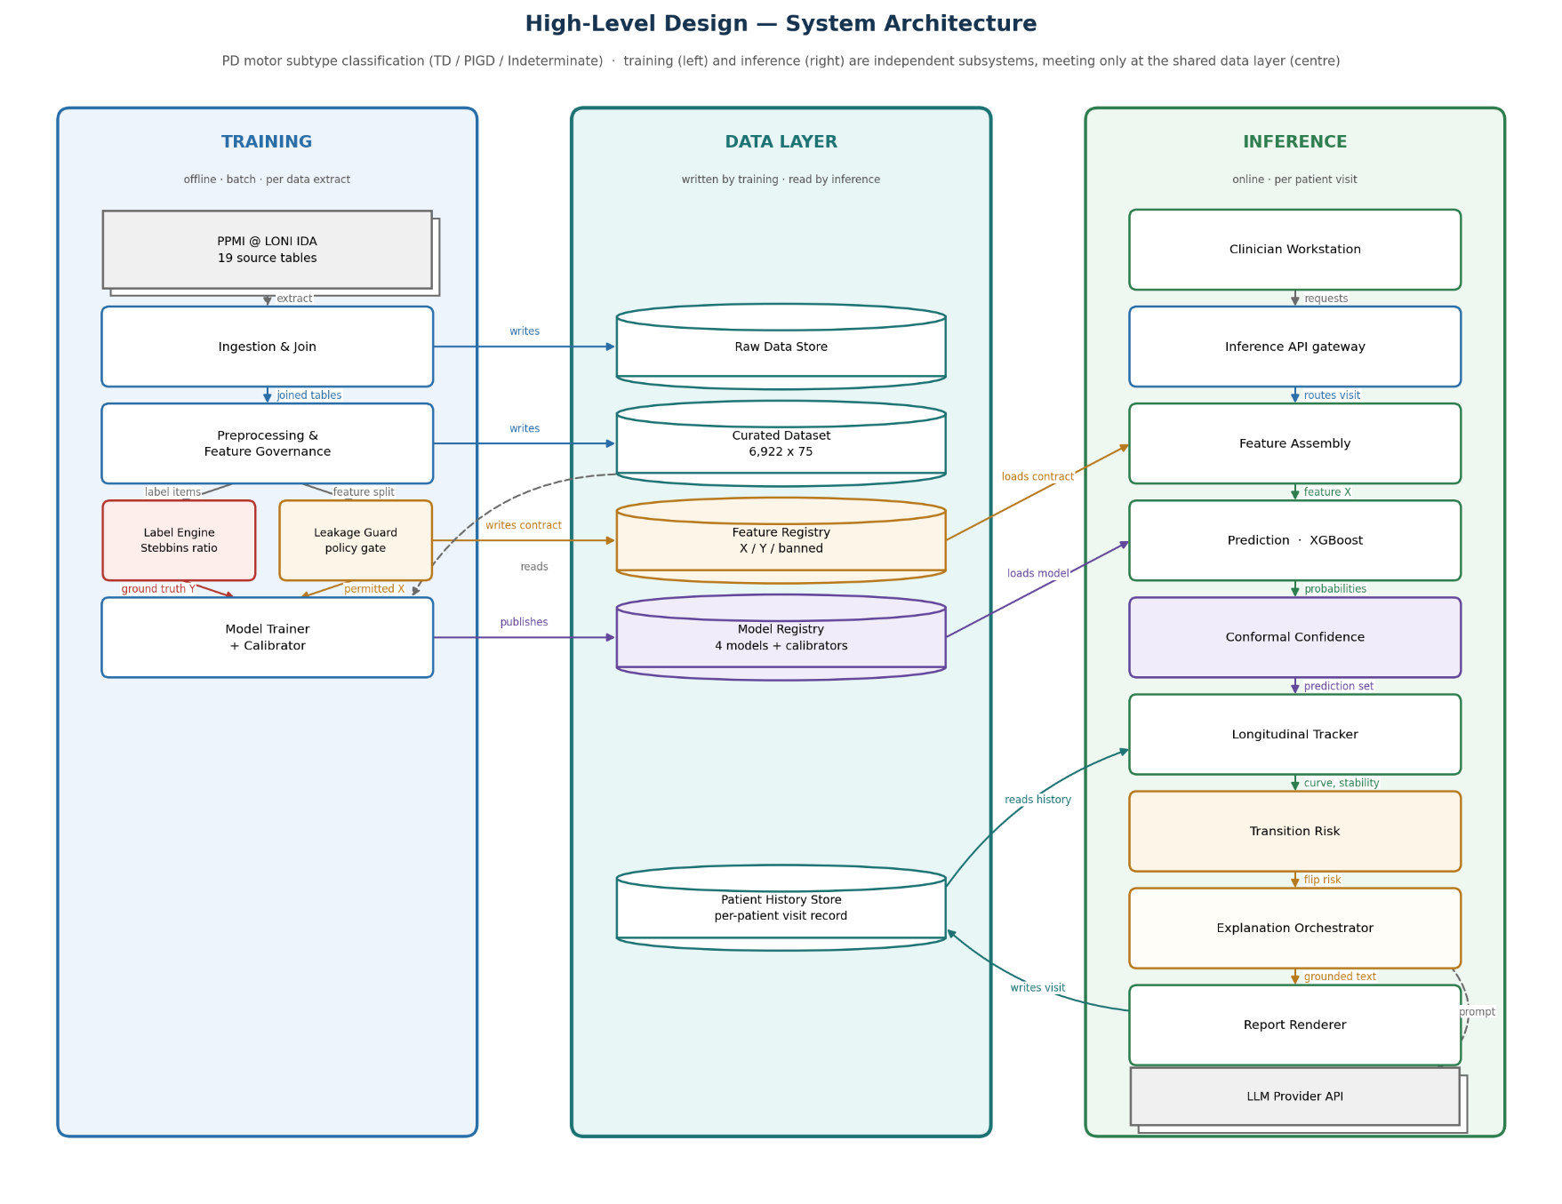
Proposed Solution

Slide 14
References

Slide 15
Thank You
TRACE-PD — Temporal Reasoning and Confidence Explanation for Parkinson's Disease
Aishwarya Deshmukh · Rutu Mehta · Harshil Bhanushali
Guide: Dr. Kriti Srivastava

