Slide 1


Internship/Project (3180701) Review 1- (01/03/2025)
Trackwizz-Ckyc
GTU Team ID: (ID)
Name ( Enrollment no)
Guided By
Internal Guide: External Guide Name: Sagar Savaliya
Internship Company Name: TSS Consultancy PVT LTD
Internship role : Associate Software Engineer-Intern
Department of information technology

Slide 2
Introduction
Overview of training objectives
Key focus areas: TSS Introduction, Client Training, Development, and Angular Concepts

Slide 3
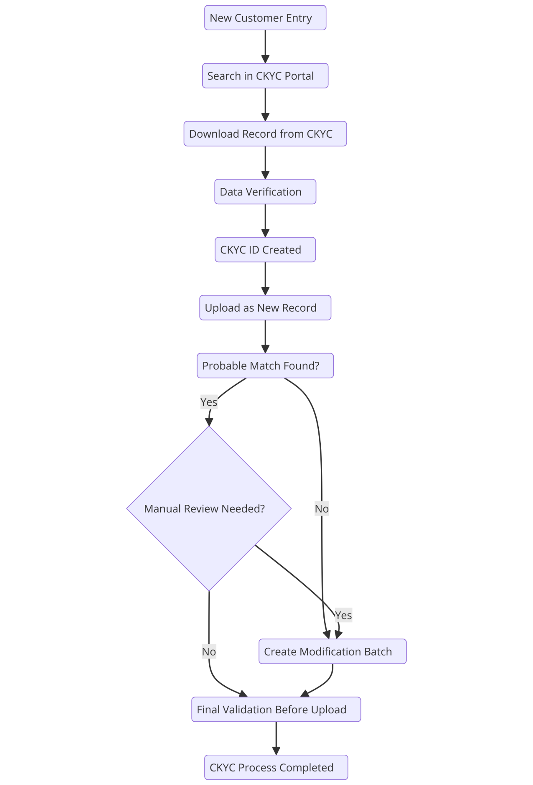
Project Workflow
Summary of CKYC Process Workflow:
New Customer Entry → Search in CKYC Portal → Download Record from CKYC
Data Verification → CKYC ID Created → Upload as New Record
Check for Probable Match
If No Match Found, proceed to the next step.
If Match Found, determine if Manual Review is Needed.
If Manual Review is Not Needed, proceed to Final Validation Before Upload.
If Manual Review is Needed, determine if Modification is Required.
If Yes, create a Modification Batch and proceed to Final Validation Before Upload.
If No, go directly to Final Validation Before Upload.
CKYC Process Completed.

Slide 4
Training Progress Report
Week-wise Breakdown of Tasks
Nirav Borad
Date: [01 MAR 2025]

Slide 5
Week 1
Introduction to TSS and HR Activities
Client and Product Overview Training
IT Induction and Security Awareness Training
CKYC Overview for Trackwizz
Debugging the CKYC Project

Slide 6
Week 2
Continued Debugging
Frontend Training
Advanced JavaScript Training (Event Bubbling, JSON Handling)
CRUD Operations & DOM Manipulation
Dice Board Game Development

Slide 7
Week 3
Enhancing Dice Board Game
Introduction to Angular (Component-based Architecture, TypeScript)
Angular Services and Routing
API Integration in Angular
Advanced Angular Concepts

Slide 8
Week 4
UI Enhancements with Angular Material
Advanced Routing & Pagination
Snapshot & Navigation Handling
Route Guards & Async Data Handling
Login Implementation & Conditional Rendering

Slide 9
Week 5
Understanding Angular Reactive Forms
Registration Form Implementation with Reactive Forms
Module Migration: UI Data Loading
CRUD Operations & API Integration
Performance Optimization & Testing

Slide 10
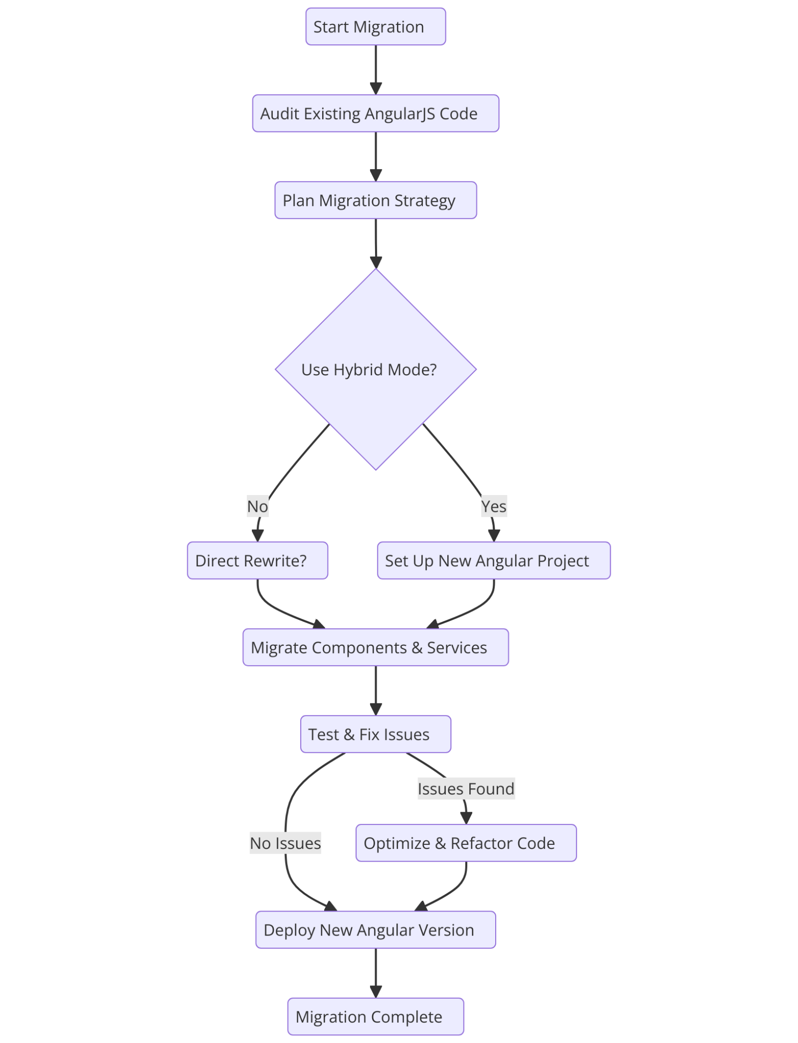
Migration Workflow
Summary of AngularJS to Angular Migration Workflow:
Start Migration → Audit Existing AngularJS Code → Plan Migration Strategy
Decide whether to Use Hybrid Mode
If Yes, Set Up New Angular Project
If No, decide on Direct Rewrite
Migrate Components & Services
Test & Fix Issues
If Issues Found, Optimize & Refactor Code
If No Issues, proceed directly to deployment
Deploy New Angular Version
Migration Complete.

Slide 11
Week 6
Service Integration & Async Handling
Using HTTP Methods (GET, POST, PUT, DELETE)
Lazy Loading & Code Splitting
Advanced Form Handling & Dynamic Validations
Final Testing & Deployment Preparation

Slide 12
Conclusion
Key Learnings & Skills Gained
Gained expertise in frontend (Angular, JavaScript, API integration), backend debugging, security best practices, and project collaboration. Strengthened problem-solving, communication, and performance optimization skills.

Slide 13


