Slide 1
Collison Avoidance Robot
CS7680 Final Project
By:- Harshil Bhojwani

Slide 2
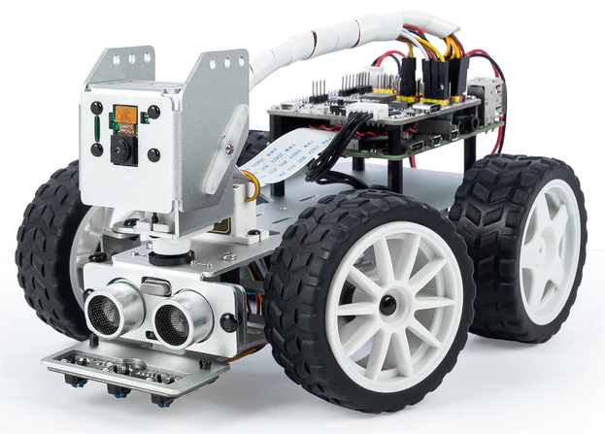
Chassis

Slide 3
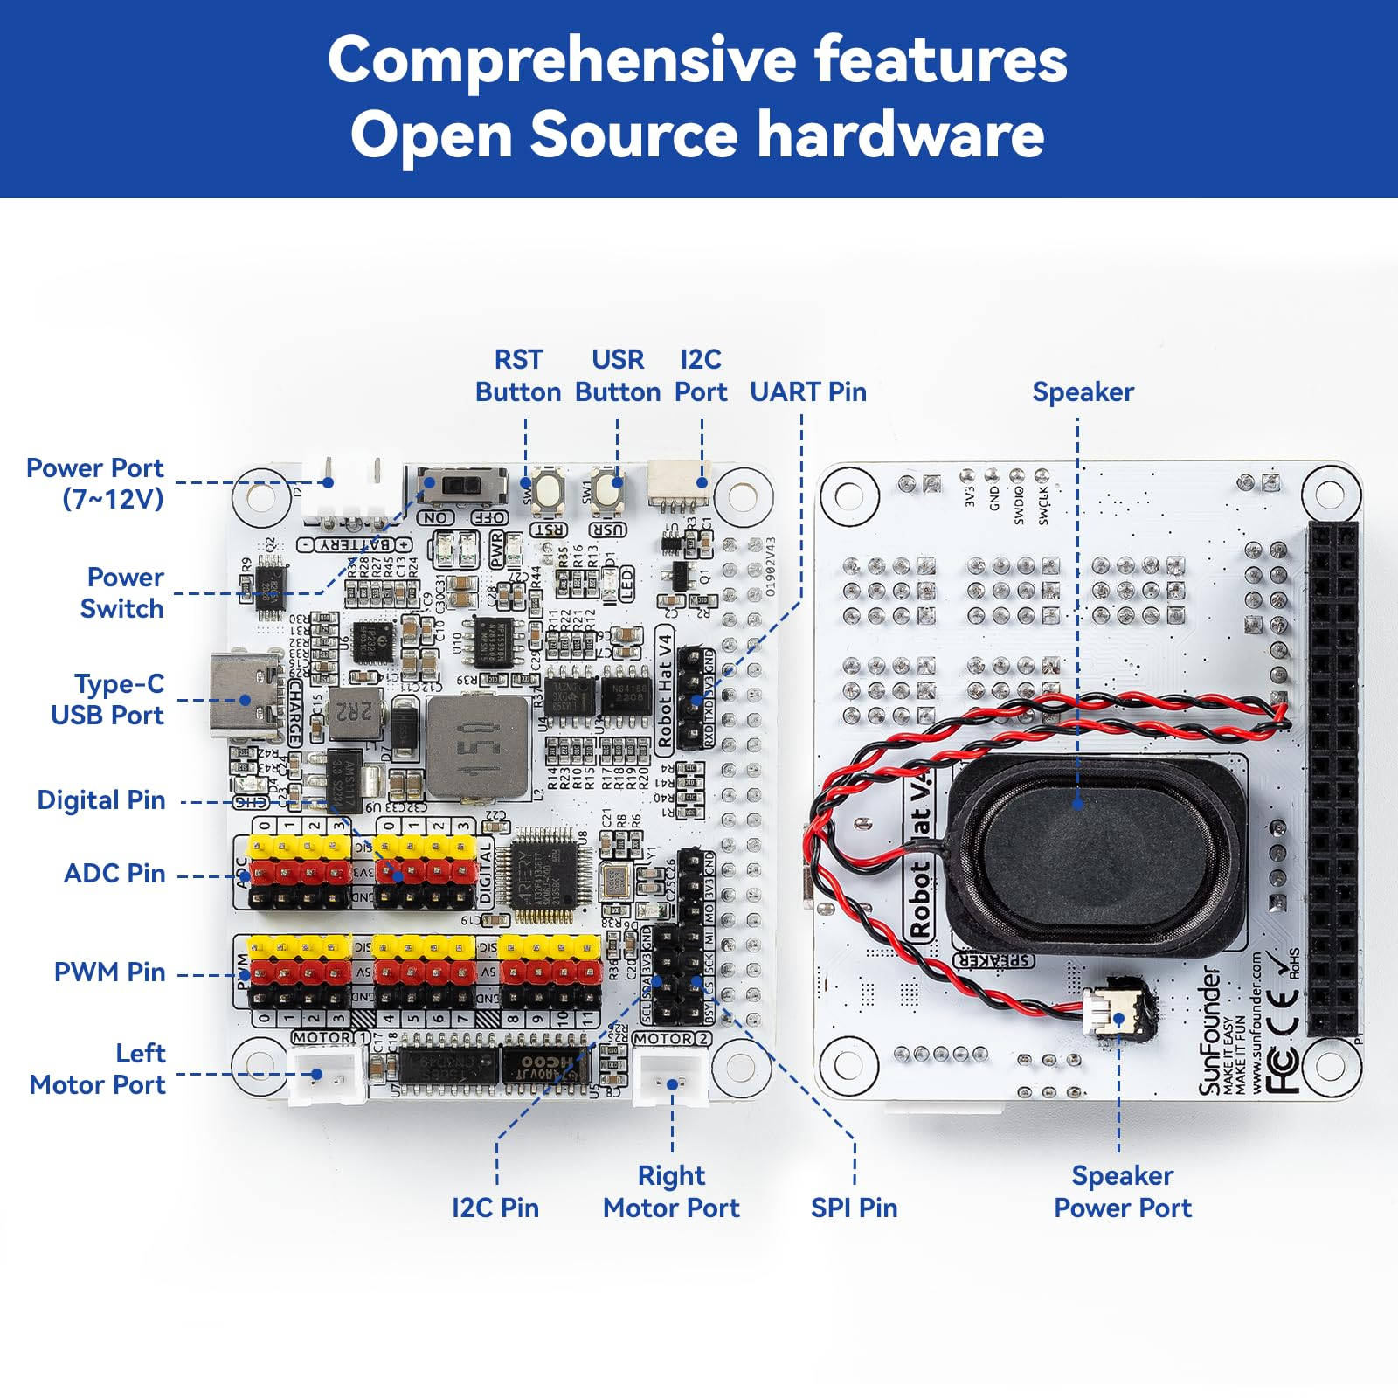
Robot Hat

Slide 4
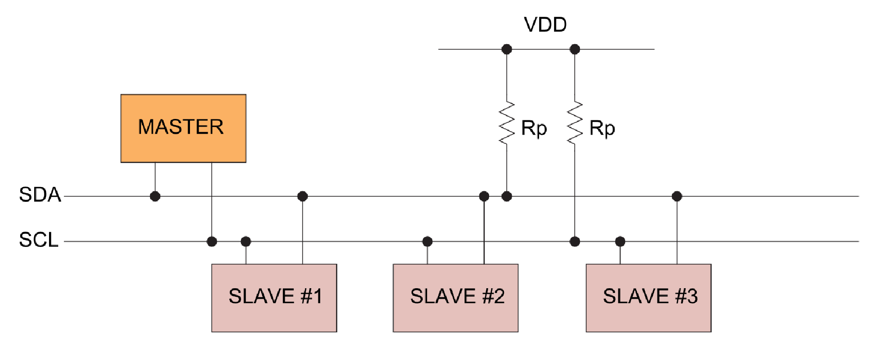
I2C
Notes:
I2C stands for Inter-Integrated Circuit. It is a businterface connection protocol incorporated into devices forserial communication. It is widely used for attaching lower-speed peripheral integrated circuits (ICs) to processors andmicrocontrollers in short-distance, intra-board communication.where one device acts as a master controlling communicationwith other devices acting as slaves; it utilizes two lines, one fordata (SDA) and one for clock (SCL) to transfer informationbetween devices. Each slave device has a unique address toidentify it on the bus.

Slide 5
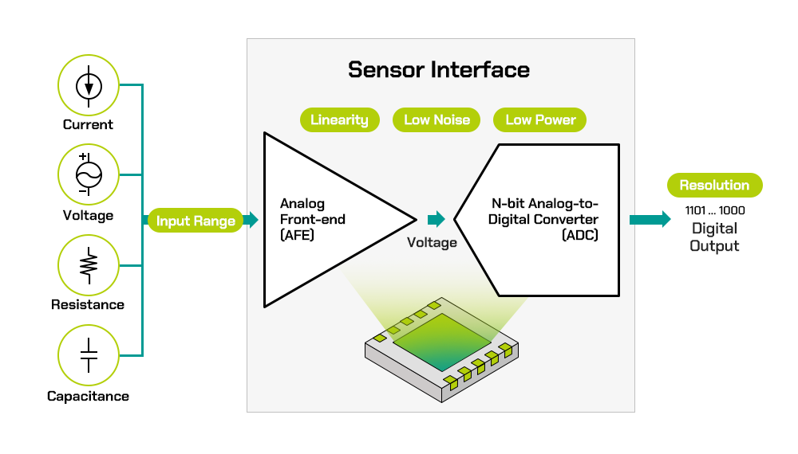
ADC
Notes:
Considering the raspberri pi by default only readsDigital signals and ADC helps as it converts converts ananalog signal (continuous in time and amplitude) into a digitalsignal (discrete in time and amplitude). ADCs are widelyused in applications like sensors, audio processing, and dataacquisition systems where real-world analog signals must beprocessed digitally.

Slide 6
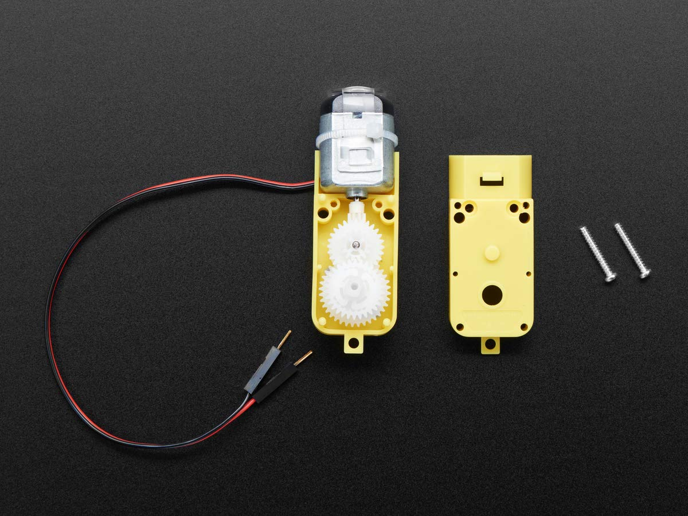
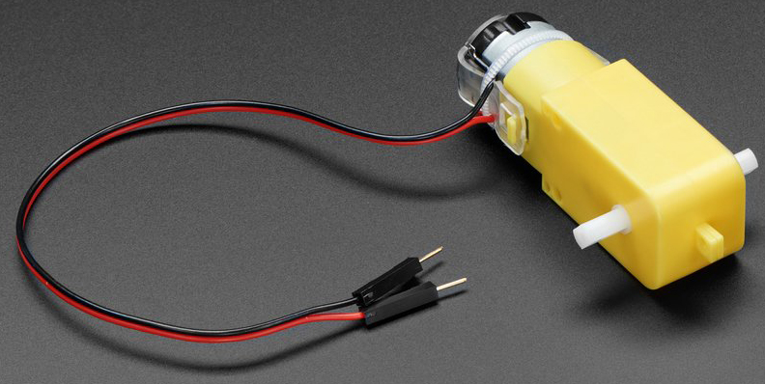
TT Motor
Notes:
A TT motor is a type of DC motor that hasa gearbox attached to it. The gearbox reduces the speed ofthe motor and increases its torque. A TT motor is commonlyused in applications such as driving wheels, propellers, fans,among others. A TT motor has two wires: a positive wireand a negative wire. The positive wire is usually red and thenegative wire is usually black.

Slide 7
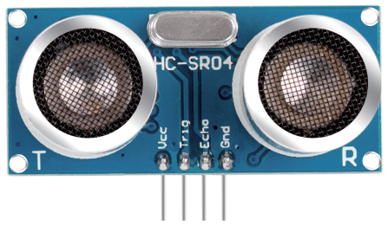
Proximity Sensor
Notes:
Proximity sensor consist of an ultrasonic reciever andtransmitter within it, he he transmitter continuously sends signals in the form ofultrasonic waves at a frequency of 40KHz and the receiverchecks if they receive any waves in return. The period forwhich recived remains High for is what calculates the distanceof the object from the sensor.Total Distance = High Time x soundspeedtransmitter and reciever are connected to 1 GPIO pineach where the reciever is an input device and the transmitteris an output device.

Slide 8
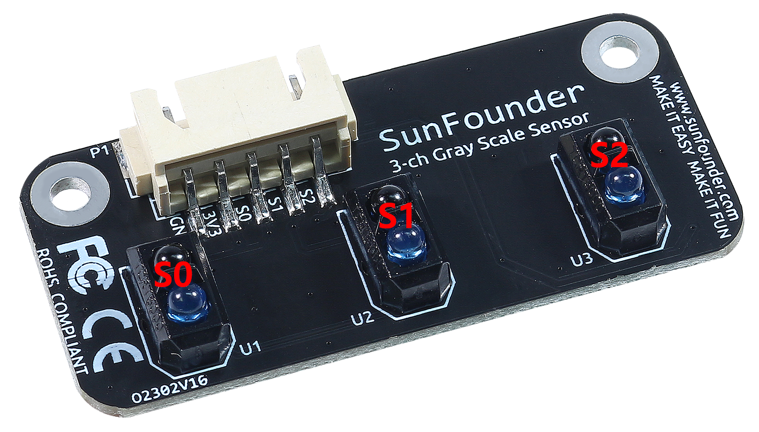
Grey Scale Module
Notes:
GreyScale sensor grayscale sensor module consisting of3 TCRT5000 transmitting sensors, which can be used forline following and edge detection. The TCRT5000 transmittersensor consists of an infrared light-emitting diode and aphototransistor covered with a lead material to block visiblelight. When working, the IR LED of TCRT5000 continuouslyemits infrared light (invisible light) with a wavelength of950nm. When the emitted infrared light is not reflected backby the obstacle or the reflection intensity is insufficient, thephototransistor does not work

Slide 9
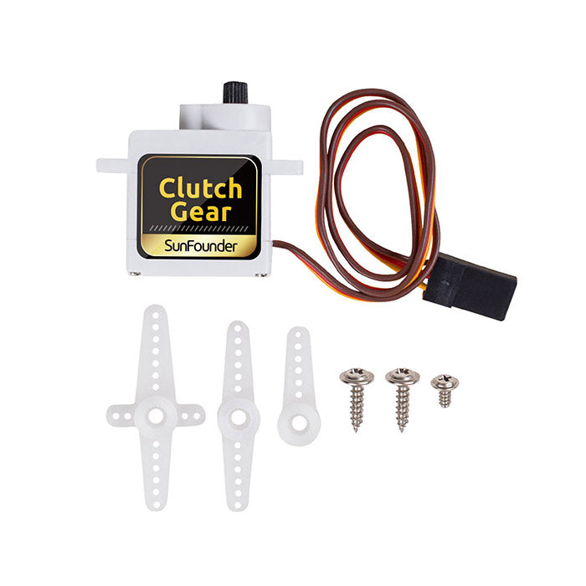
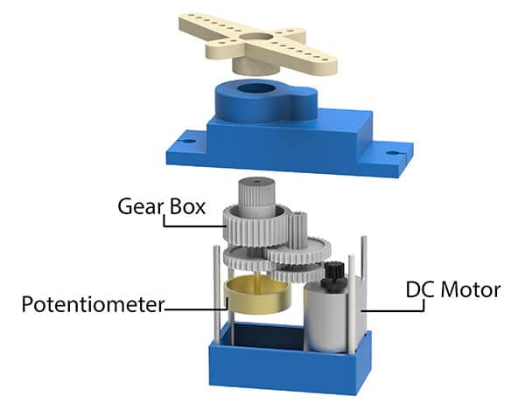
Servo
Notes:
Servo motors are devices that can rotate to aspecific angle or position. They can be used to move roboticarms, steering wheels, camera gimbals, etc. Servo motors havethree wires: power, ground and signal. A servo is generallycomposed of the following parts: case, shaft, gear system,potentiometer, DC motor, and embedded board.

