Slide 1

Windows process protector
Fall 2024 Senior Design Project

Slide 2
Meet The Team
Academic Advisor Nitin Nitin
Email: nitinfu@ucmail.uc.edu
Developers Bartosz Kawalkowski
Email: kawalkba@mail.uc.edu
Harshil Patel
Email: patel3hs@mail.uc.edu

Slide 3
Project Abstract
The Windows Process Protector is an advanced security solution that provides comprehensive protection for 64-bit Windows applications through kernel-level process monitoring and real-time web-based surveillance. This system implements multiple protection mechanisms including memory access prevention, code integrity verification, DLL injection blocking, and remote thread creation prevention. The project combines low-level system programming with modern web technologies to create a scalable security platform. Key innovations include real-time threat detection, encrypted data transmission between the process protector and web interface, and minimal performance impact on protected processes. This solution addresses critical needs in both gaming anti-cheat and enterprise security applications.

Slide 4

User Stories
As a game developer, I want to detect and block any unauthorized access attempts to my running processes so that I can protect the integrity of the game that I am developing.
As a cybersecurity analyst, I want to view the activity of processes running so that I can detect and analyze any security threats and improve our system.
As a software tester, I want to use different cheating techniques to test the system's response to see how effective it is in detecting and preventing this type of behavior.
As a power user, I want to customize protection settings for different types of processes so that I can balance security needs with performance requirements for various applications.
As a support technician, I want to troubleshoot issues related to protected processes using diagnostic tools provided by the system so that I can quickly resolve problems and minimize downtime.

Slide 5
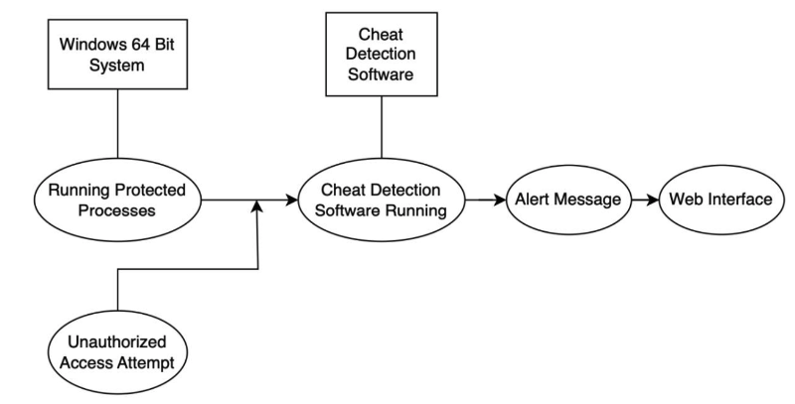
Design Diagrams – D0
There are two systems in the top boxes: Windows 64 bit and the Cheat Detection Software (CDS).
We see the processes running on Windows and any unauthorized access attempts being made. These are both the inputs used in the CDS.
CDS then outputs a message that alerts the user about unauthorized access attempt and displays it on the web interface.
The boxes show running systems, the ovals show what the software is doing.
The lines connect the System to its running process, the arrows show the flow of CDS.

Slide 6
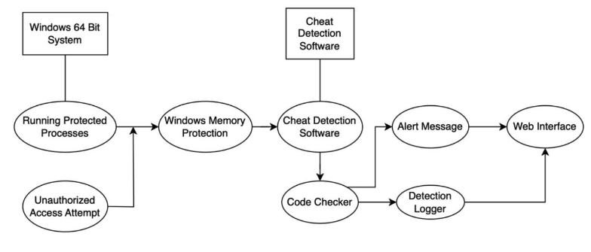
Design Diagrams – D1
After further expansion, we have a windows memory protection stage that is an expansion of the input being made in CDS. This module detects any suspicious activity that is being detected in the memory and inputs it into CDS.
We also show a Code Checker component in CDS to check the integrity of the code. This is to detect any unauthorized alterations being made in the code.
Any unauthorized alterations get forwarded to the detection logger.
The outputs we see going to the user web interface is the alert message and a logged message.

Slide 7
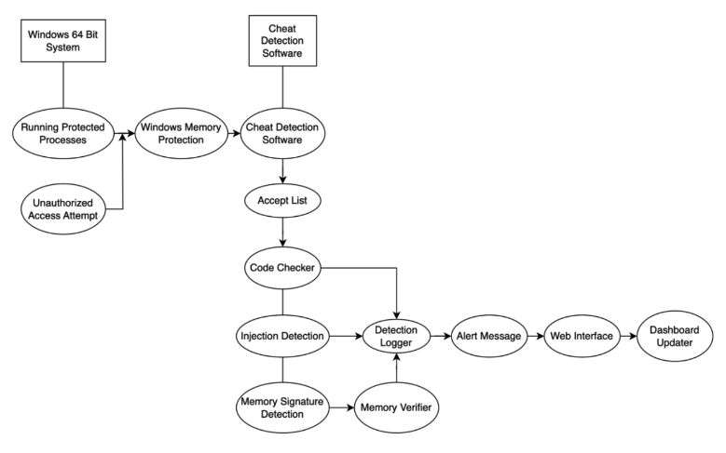
Design Diagrams – D2
Within CDS, we first go through the Trust List. This checks to see if any detected processes were previously detected or if they are already trusted and marked as safe.
Further expanding on CDS:
Injection Detection: Detects any cheating happening through memory injection.
Memory Signature Detection: Collects the memory signature for further analysis.
Memory Verifier: Identifies if the suspicious activity happening in memory has been detected before.
After these components have been executed, they output the unauthorized access being made in any running processes and forwards them to the Detection Logger.
Then the alert message is created and outputted to the Web Interface.
A Dashboard Updater component updated the list of detected process on the Web Interface, as well as adding the alert message.

Slide 8
Project Constraints
Economic Constraint: Our limited budget will restrict use from creating advanced features, this means that for our project currently, we will be using mostly open-source tools.
Legal Constraints: We must look into and follow all privacy laws when using user data. We must make sure that this data is properly protected
Ethical Constraints: We are making sure that user data is protected because we need to guarantee the user that their data will not be misused.
Social Constraints: Our system needs to be readily accessible to all users because our original goal is to detect cheating and make gaming, and using other applications, fair for everyone.

Slide 9
Current Project Update
Let me update you on our current project status. We've successfully completed our initial research phase, which involved extensive analysis of existing anti-cheat solutions and process protection mechanisms. Our system architecture design has been finalized, establishing a solid foundation for both the kernel-level components and web interface integration.
We've made significant progress in mapping out our core protection mechanisms, with particular attention to memory protection strategies and code integrity verification approaches. The preliminary design of our web interface components is taking shape, focusing on creating an intuitive dashboard for real-time monitoring.
Our team has begun exploring Windows kernel driver development requirements and establishing our development environment. We've also started working on proof-of-concept implementations for several key components, allowing us to validate our architectural decisions early in the development process.
Currently, we're focusing on:
Refining our technical specifications
Developing initial prototypes of core components
Establishing the framework for our web monitoring interface

Slide 10

Expected Accomplishments
By the end of this term, we expect to have a working prototype demonstrating core protection features including memory protection and code integrity checking. The web interface will be capable of displaying basic monitoring data, and we'll have completed initial integration between the process protector and web components. This will serve as the foundation for further development in the spring semester, focusing on the most critical security features while maintaining system stability and performance.

Slide 11
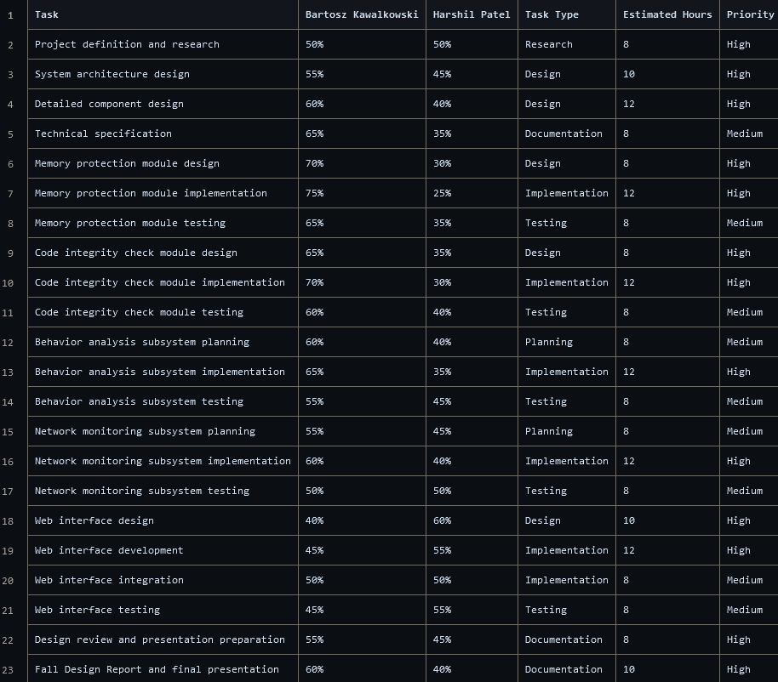
Division Of Work
Our project work distribution leverages each team member's core strengths.
Bartosz takes the lead on the technical implementation of core protection mechanisms and kernel-level components, while Harshil focuses primarily on the web interface development and user-mode protection features.
Harshil will also be responsible for implementing various Ring 3 protection mechanisms to complement the kernel-level security features. Both team members maintain active involvement across all project areas, with shared responsibility for testing and documentation.

Slide 12
Demo
At the expo, we plan to demonstrate a proof-of-concept implementation of our Windows Process Protector system. While not all planned features will be fully implemented, we aim to showcase the core functionality including:
Basic process protection mechanisms demonstrating memory access prevention
A simplified version of our web monitoring interface showing real-time process status
Basic threat detection capabilities
Integration between the process protector and web components
Our goal is to demonstrate the fundamental concepts and architecture of our system, proving the viability of our approach while acknowledging that some advanced features will require additional development beyond the scope of this semester's work. This prototype will serve as a foundation for future development and feature implementation.

