Slide 1

Windows process protector (WPP)
Spring 2025 Senior Design Project

Slide 2
Meet The Team: Windows Process Protector w/ Interactive Web-based Monitoring
Academic Advisor: Nitin Nitin
Email: nitinfu@ucmail.uc.edu
Students / Developers: Bartosz Kawalkowski (CS)
Email: kawalkba@mail.uc.edu
Harshil Patel (CS)
Email: patel3hs@mail.uc.edu

Slide 3
Project Goals & Background
Background: Windows applications and critical system processes are vulnerable to unauthorized tampering and manipulation, which can lead to system instability, security breaches, and data loss. Traditional process management tools lack robust protection mechanisms against modern attack vectors.
Our project mission: is developing a robust system that protects Windows applications from unauthorized access and tampering, with a focus on real-time monitoring and threat prevention. We want to enable users to easily identify and protect critical system and user applications.
Our core objectives: include implementing comprehensive process monitoring and protection mechanisms with a user-friendly web interface for threat visualization, developing memory protection and code integrity verification systems, and establishing real-time alert systems for suspicious activities.

Slide 4

Intellectual Merits
Novel hybrid approach combining web technologies with low-level Windows system programming.
Modern web-based UI architecture that bridges system-level operations with user-friendly controls.
Real-time monitoring system with minimal system overhead and bidirectional communication between system processes and web dashboard.
Implementation of privilege elevation controls for critical operations.
Custom-designed DLL injection system that maintains process integrity w/ sophisticated memory protection.

Slide 5
Broader Impacts of our project
Enhanced Cybersecurity for All – WPP simplifies advanced process protection capabilities, making enterprise-level security accessible to everyday users. Can help prevent malware and ransomware attacks by protecting critical system & user processes.
Educational Value - serves as an educational tool for understanding Windows process management, creating opportunities for students & developers to learn about system-level programming, modern web technologies, and security implementations. Future Impact – provides a solid foundation for developing more sophisticated security tools, contributing to the open-source security community & promoting better cybersecurity practices in software development.

Slide 6
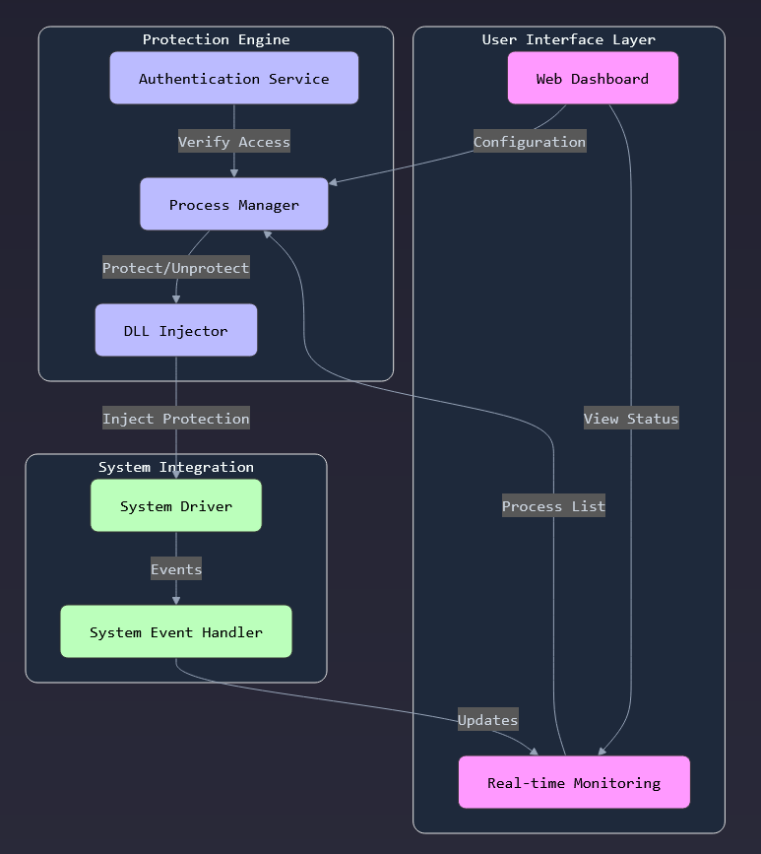
Design Specifications / Diagrams
The WPP system consists of three primary layers: User Interface, Protection Engine, and System Integration. The diagram illustrates the three-layer architecture of WPP, with:
Pink components representing the user-facing layer
Blue components showing the core protection engine
Green components indicating system-level integration
Each arrow represents a specific interaction or data flow between components, with labeled relationships showing the purpose of each connection.

Slide 7
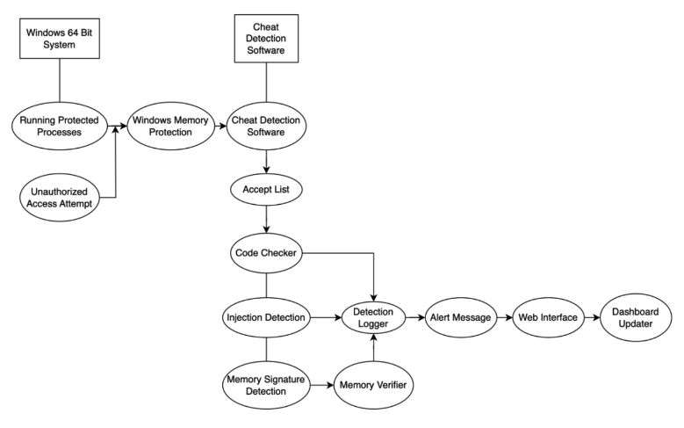
Design Specifications/Diagrams
Within CDS, we first go through the Trust List. This checks to see if any detected processes were previously detected or if they are already trusted and marked as safe.
Further expanding on CDS:
Injection Detection: Detects any cheating happening through memory injection.
Memory Signature Detection: Collects the memory signature for further analysis.
Memory Verifier: Identifies if the suspicious activity happening in memory has been detected before.
After these components have been executed, they output the unauthorized access being made in any running processes and forwards them to the Detection Logger.
Then the alert message is created and outputted to the Web Interface.
A Dashboard Updater component updated the list of detected process on the Web Interface, as well as adding the alert message.

Slide 8
Technologies Utilized in our Project
Core Development Technologies: Our project is primarily developed in C++, leveraging modern C++17 features for robust system-level programming. This choice enables direct interaction with Windows APIs while maintaining high performance and security. Windows API integration forms the backbone of our process management system:
Native Windows API for low-level process control
NT API for advanced system operations
Windows Security Framework for privilege management
DLL injection mechanisms for process protection
Web Technologies and Interface – our user interface is built using modern web technologies:
HTML5 and CSS3 for responsive layout
Material Design for a clean, professional appearance
Dynamic dashboard for real-time process monitoring
Interactive controls for process management
Key Libraries and Frameworks
cpp-httplib: Provides secure HTTPS server implementation and RESTful API endpoints
nlohmann/json: Handles data serialization and API communication
OpenSSL: Ensures secure communication between components
CMake: Manages build system and dependency resolution

Slide 9
Project Milestones / Timeline (Spring 2025)
February 19 - March 1: Core Enhancement ✓ Completed: Process monitoring, Information gathering, Basic UI → Current: Performance optimization, Enhanced monitoring, System display refinement
March 2 - March 10: Protection System ✓ Completed: DLL injection framework, Base protection system → Current: Advanced protection features, Security validation, Edge case handling
March 11 - March 17: UI/UX ✓ Completed: Material Design base, Core dashboard → Current: Advanced UI features, Process visualization, Real-time updates
March 18 - March 24: Security ✓ Completed: HTTPS, Core security → Current: Security hardening, Performance optimization, System testing
March 25 - April 7: Expo Preparation • Documentation & Demo preparation (March 25-31) • Final system polishing & Rehearsals (April 1-7)
Key Dates: • CEAS Expo: April 8 • Project Finalization: April 9 – through to the end of semester

Slide 10
Results – What we have achieved so far...
We have successfully implemented a robust process monitoring system with real-time tracking capabilities, complemented by a modern web-based dashboard that provides comprehensive system information. The core functionality of process protection through DLL injection has been established, allowing for basic process security and monitoring. Our user interface, built with Material Design principles, offers intuitive process management and system monitoring capabilities. The implementation of secure communication protocols and basic authentication mechanisms demonstrates our commitment to security-first design principles.
Looking ahead, our final development phase focuses on enhancing and refining these core features. Key finishing tasks include optimizing the DLL injection system for improved stability, implementing advanced security features for process protection, and enhancing the real-time update system for smoother performance. We are also working on comprehensive documentation and testing procedures to ensure system reliability. The final deliverables will include a functional process protection system, technical documentation, user guides, and demonstration materials for the CEAS Expo. Our current progress positions us well to deliver a system that effectively addresses the challenges of process protection in Windows environments.

Slide 11
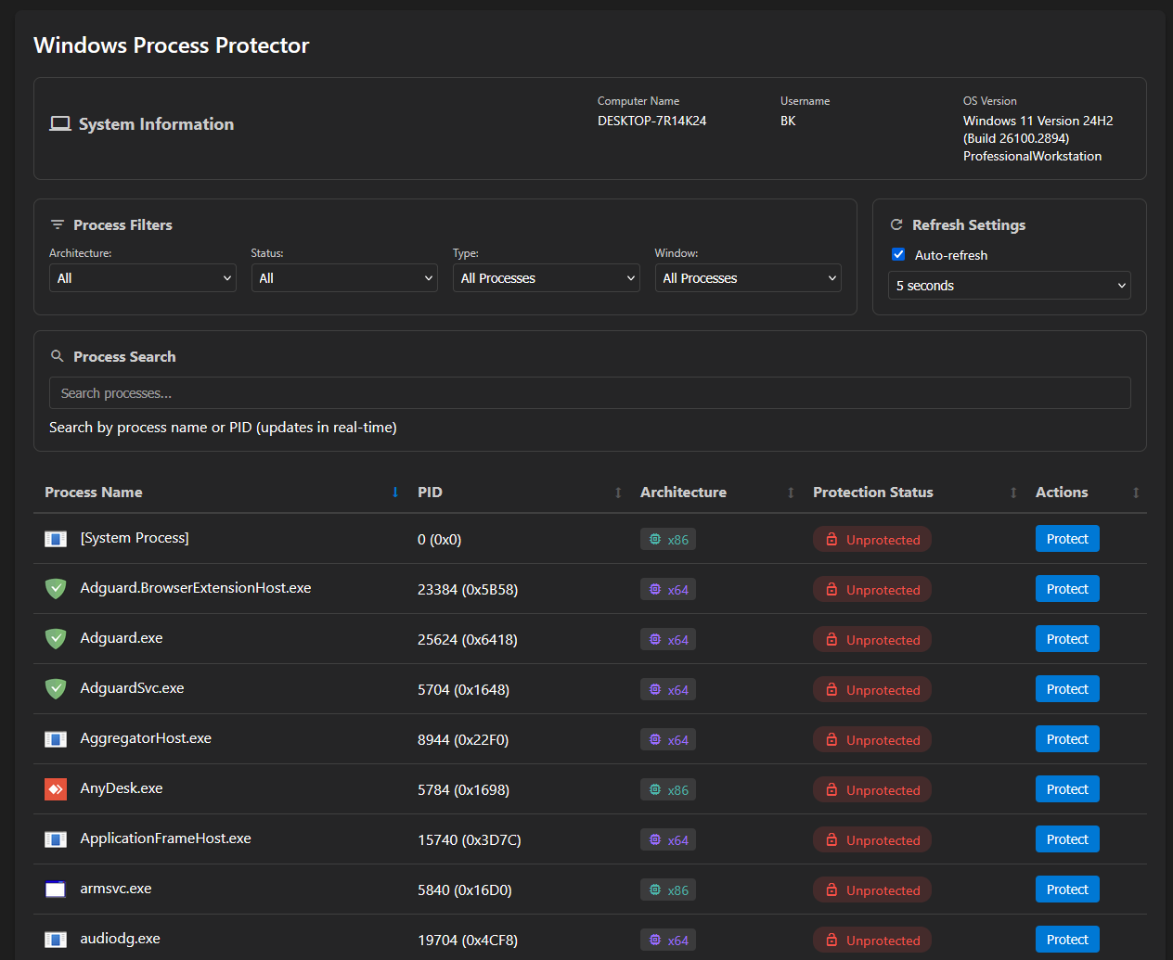
Results – What we have achieved so far…
The Windows Process Protector project has achieved significant milestones in its development cycle. Our most significant accomplishment is the development of a seamless web-based interface that communicates effectively with low-level Windows processes. We've successfully implemented real-time process monitoring, system information display, and the foundational DLL injection mechanism that forms the core of our protection system.

Slide 12
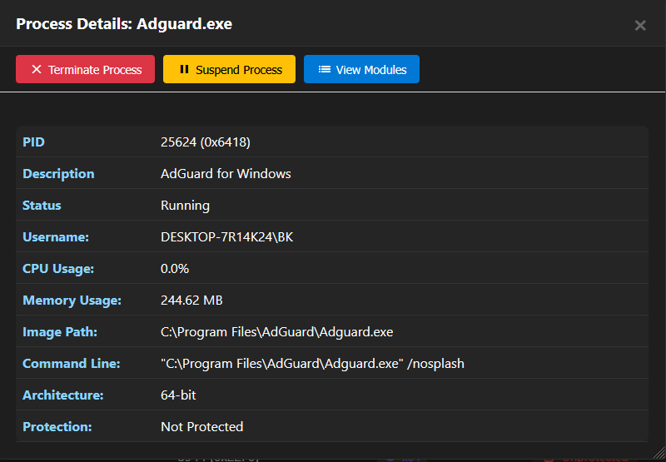

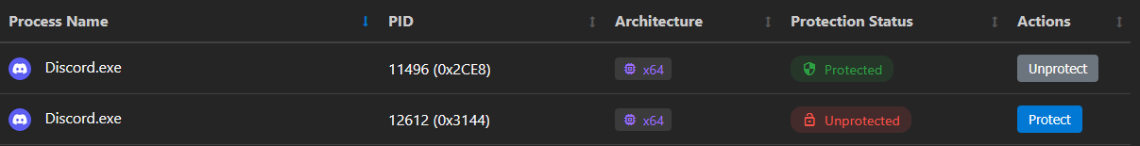
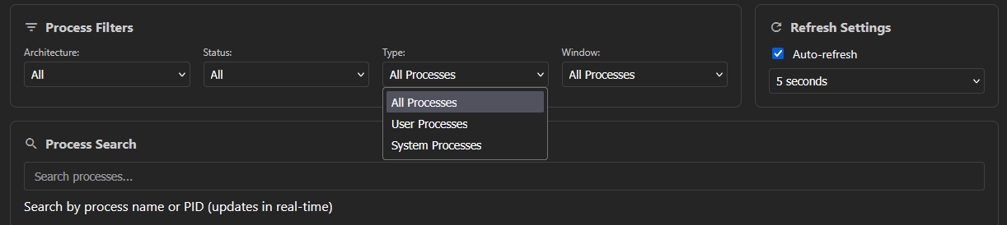
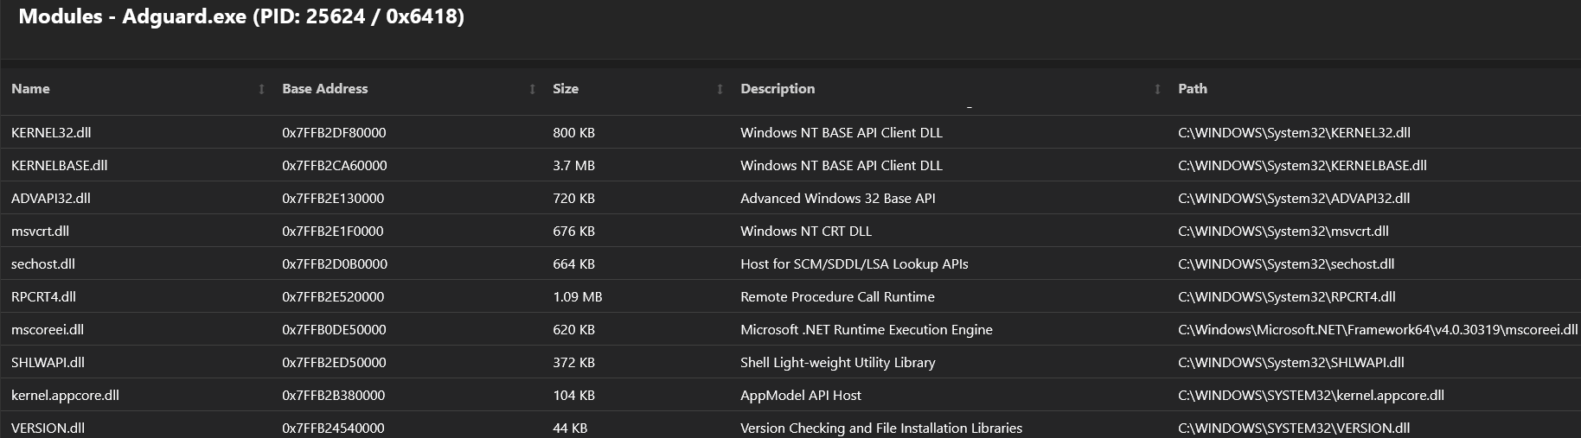
Results – What we have achieved so far…

Slide 13
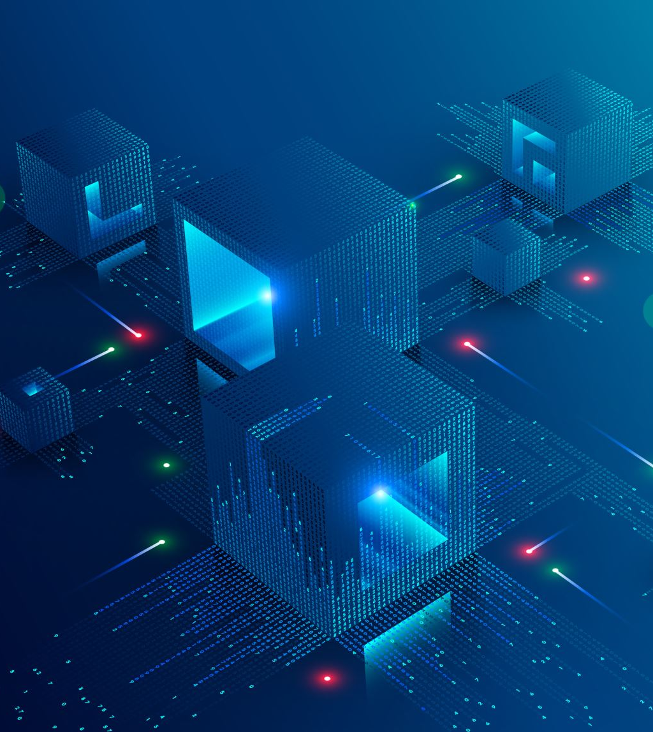
Biggest Challenges / Roadblocks
Integration of Web Technologies with System-Level Operations: One of our most significant challenges was bridging the gap between high-level web interface operations and low-level Windows system functions. We successfully developed a secure communication layer between the web UI and system processes, implementing a custom protocol that maintains both performance and security.

Slide 14
Expo Demo
At the expo, we plan to demonstrate a proof-of-concept implementation of our Windows Process Protector system. While not all planned features will be fully implemented, we aim to showcase the core functionality including:
Basic process protection mechanisms demonstrating memory access prevention
A responsive and intuitive web monitoring interface showing real-time process status
Basic threat detection & mitigation capabilities
Seamless integration between the process protector and web components
Our goal is to demonstrate the fundamental concepts and architecture of our system, proving the viability of our approach while acknowledging that some advanced features will require additional development beyond the scope of this semester's work. This prototype will serve as a foundation for future development and feature implementation.

