Slide 1

VQA: Visual Question Answering
Team :
Avni Mehta
Harshil Patel
Raji Muppala
Santosh Jada
Ref: VQA: Visual Question Answering {santol, aish, jiasenlu, dbatra, parikh}@vt.edu 2 {memitc, larryz} @microsoft.com
Notes:
1

Slide 2
Outline
Introduction
Dataset
Feature Specification
Image Classification
VQA using Localization
VQA using Mask R-CNN
VQA using Yolo - Darknet
Challenges

Slide 3
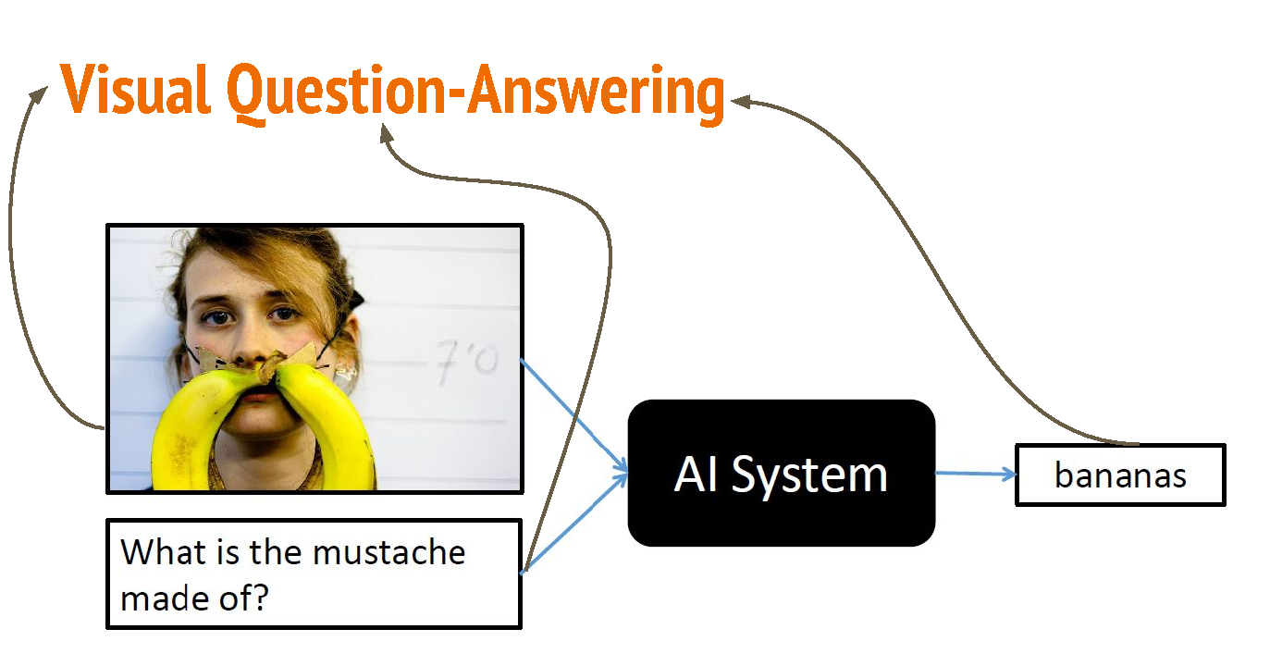
Introduction
Predict the answer of a given question related to an image
Multi-disciplinary task: combines Computer Vision, NLP and KRR
Type of Questions | Our model
What is…
Is there…
How many…
Where is…
Does the…

Slide 4
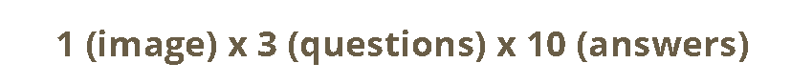
Dataset
MS COCO Dataset
~205K Images, ~615K Questions and ~3700K Answers
Selected Domain
Home Interiors
Categories
Living Room, Bedroom, Bathroom and Kitchen

Slide 5
Feature Specifications
Image classification using Shallow Learning (Decision Tree, Naïve Bayes and Random Forest)
Image classification using Deep Learning ( Softmax, CNN, Inception)
Image classification using Clarifai and TensorFlow Lite
VQA using Mask R-CNN for “Is there” and “How many” types of questions
Bounding box using Darknet for “Where is” type of question
Web application

Slide 6
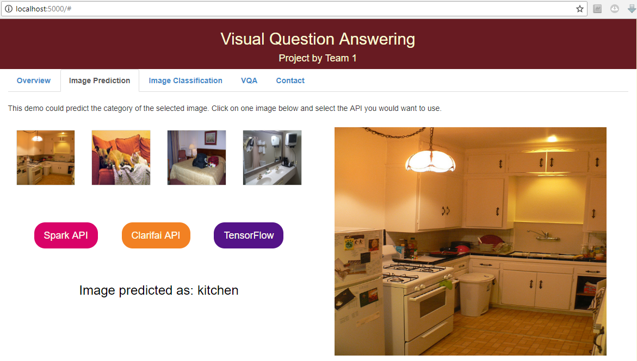
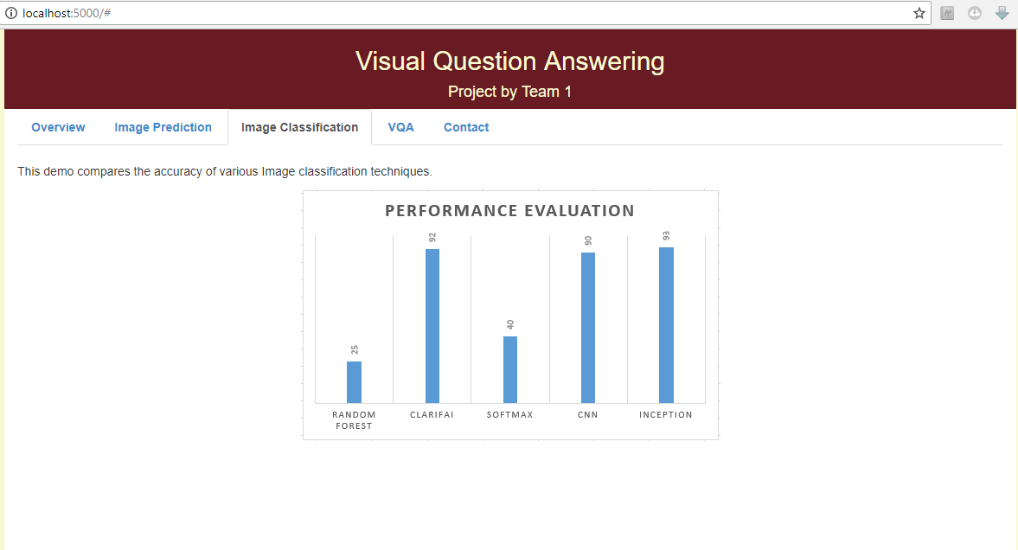
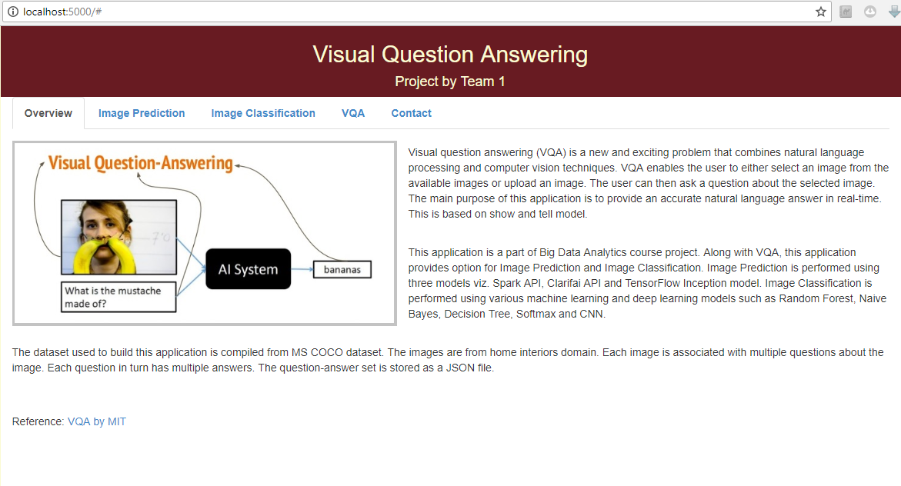
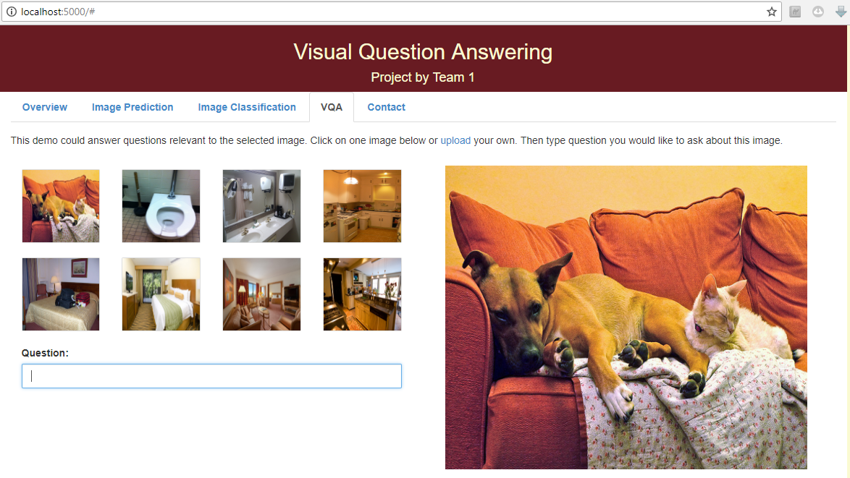
Web Application

Slide 7
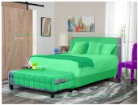
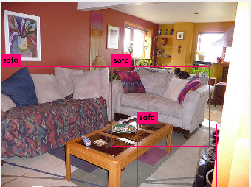
VQA using Localization
Segmentation
Bounding Box
Where is the bed ?
How many sofas ?

Slide 8
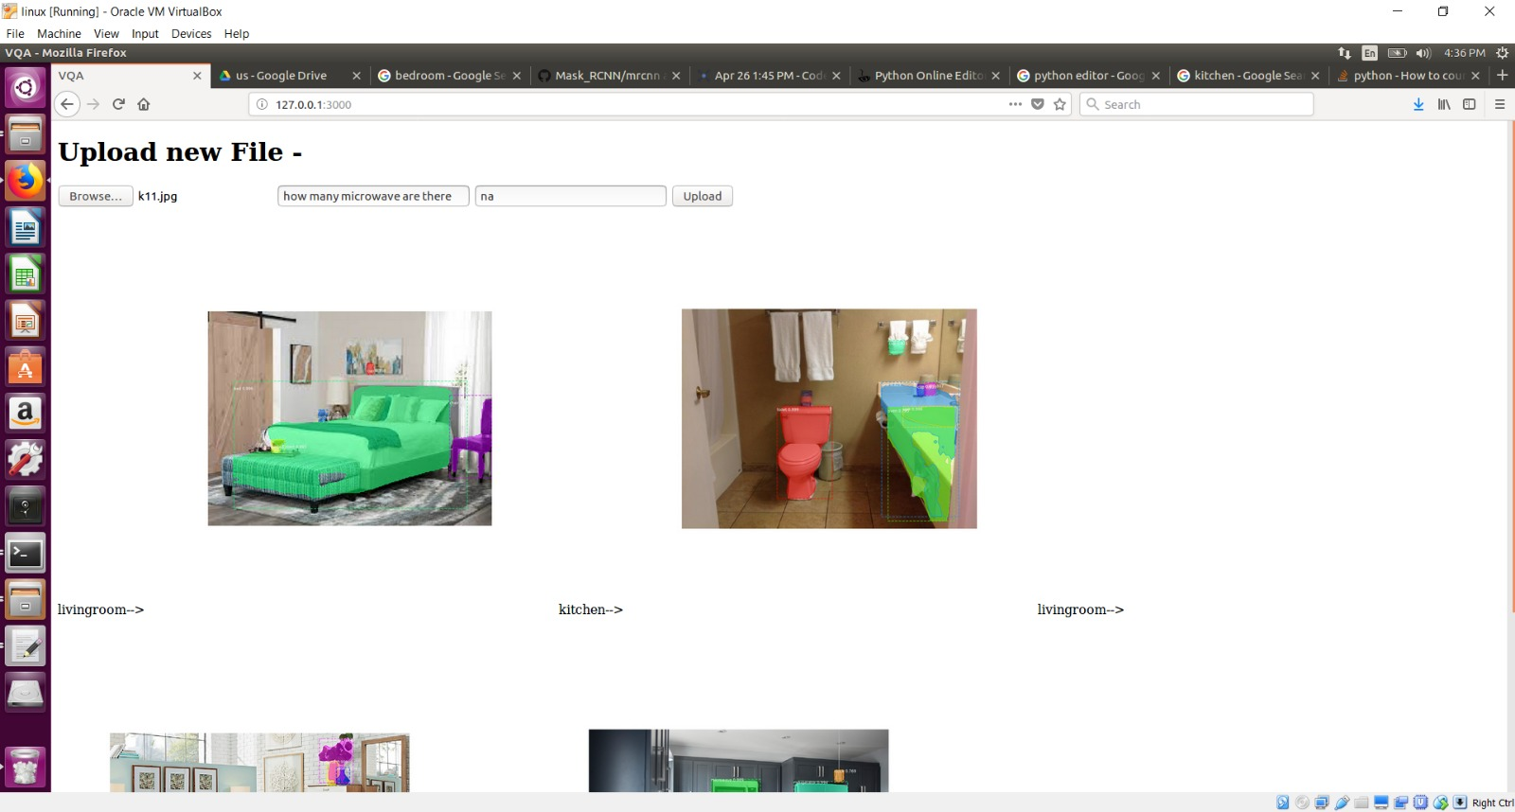
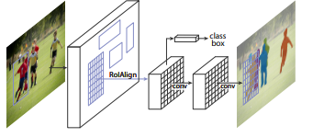
VQA using Mask R-CNN

Slide 9
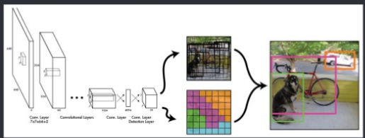
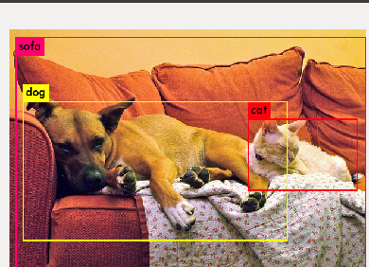
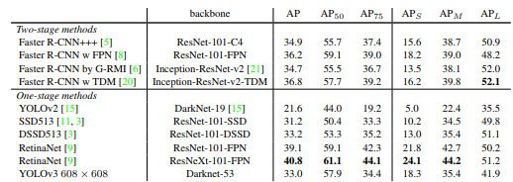
VQA using Yolo - Darknet

Slide 10
Conclusion
Experiments on various methods for Image Classification for our dataset.
VQA is achieved for the following types of questions:
“Where is…?” via. bounding box using Darknet model
“How many…?” using Mask R-CNN model
“Is there…?” using Mask R-CNN model
Challenges:
Implementing a pure android application for our VQA model, Spark REST API and TensorFlow REST API
Building various VQA models on CPU only machines
Training the existing VQA model developed by MIT

Slide 11
Acknowledgement
The work has been completed under the guidance of Dr. Yugi Lee, Mayanka Chandra Shekar, and TAs (Megha Nagabhushan, Sidrah Junaid) of CS5542 Big Data Analytics and Apps, University of Missouri - Kansas City), Spring 2018

Slide 12
References
https://arxiv.org/pdf/1702.01923.pdf
https://www.slideshare.net/xavigiro/openended-visual-questionanswering
https://pjreddie.com/media/files/papers/YOLOv3.pdf
https://mc.ai/yolo3-a-huge-improvement/
https://pjreddie.com/darknet/yolo/
https://research.fb.com/wp-content/uploads/2017/08/maskrcnn.pdf

