Slide 1
PID FUZZY-LOGIC (RIGHT_EDGE AND OBSTACLE AVOIDANCE) COMBINATION (OA+RE)
NAME: HARSHINI BANGALORE AMARNATH
REG. NO. : 2311849
MODULE: CE801- Intelligent Systems and Robotics

Slide 2
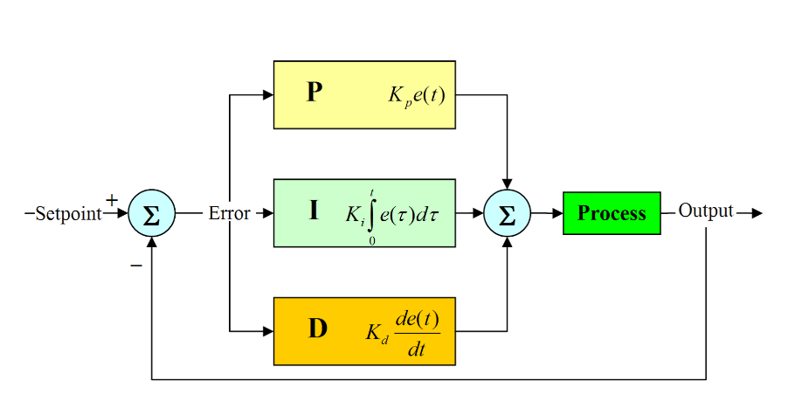
PID (PROPORTIONAL INTEGRAL AND DERIVATIVE)
Ei=0
Eprevious=0
E = desired_distance – current_distance
Ei = Ei + E
Ed = E – Eprevious
Eprevious = E
PID = kp*E + ki*Ei + kd*Ed
Tuning the PID parameters:
1. Tuned kp first, then ki
2. Depending on the speed, Kd was tuned
3. Desired distance was 0.5
4. Current distance is sensor readings i.e, regions['right']
kp = 1.2 , ki = 0.0002, kd = 0.4

Slide 3
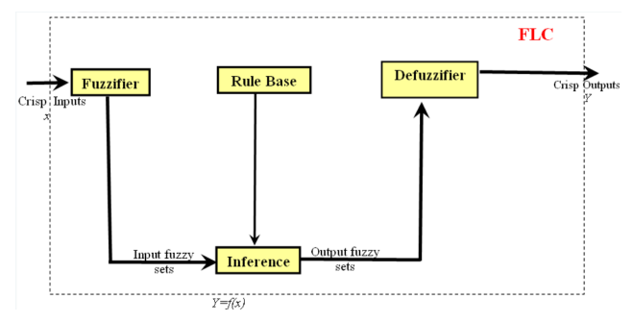
FUZZY LOGIC

Slide 4
RIGHT EDGE FOLLOWING
Defining membership values --> FRS, BRS for inputs and Linear, Angular speed for output
Fuzzification
These were calculated using rising edge and falling edge formulas
rising edge = (sensor_reading - first_index_value) / (second_index_value - first_index_value)
falling edge = (second_index_value - sensor_reading) / (second_index_value - first_index_value)
3. Defining 9 rules for right edge
4. Calculating firing strengths (r1,r2.......rn) :
AND = min
OR = product
5. De-fuzzification --> Calculating linear and angular speed :
Linear speed .X =
((r1*rule_linearspeed) + (r2*rule_linearspeed) +.........(rn*rule_linearspeed)) / (sum(r1,r2.....rn))
Angularr speed .Y =
((r1*rule_angularspeed) + (r2*rule_angularspeed) +.........(rn*rule_angularspeed)) / (sum(r1,r2.....rn))

Slide 5
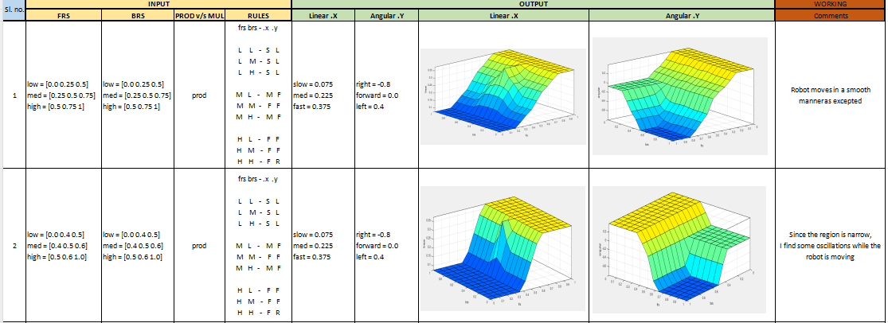
Tuning values using MATLAB

Slide 6
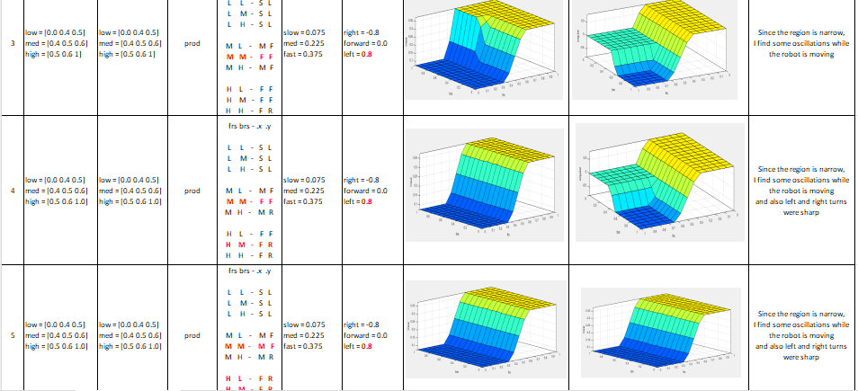
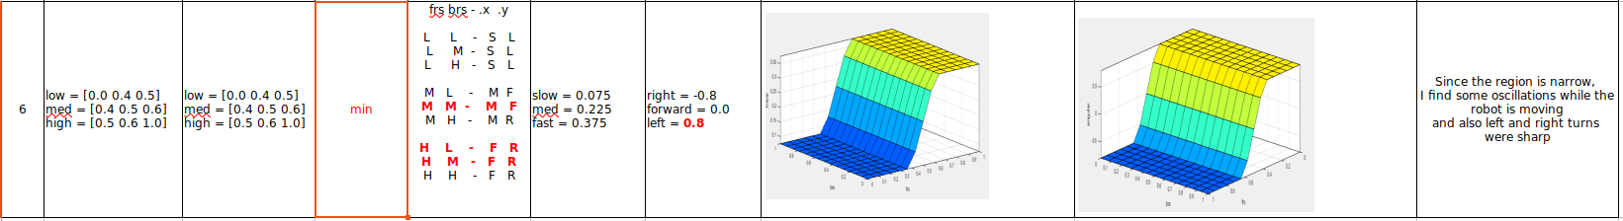

Slide 7
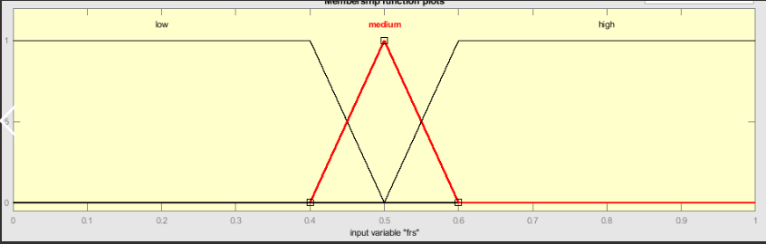
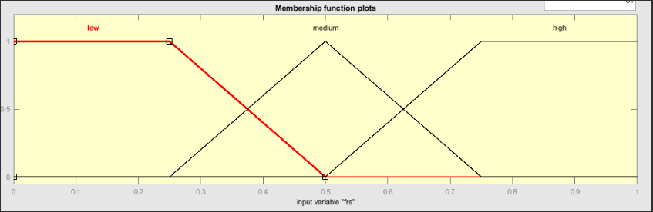
Drawbacks of smooth Surface and how values were changed :
Since the Values were narrow i.e,
frs/brs_low = [0.0 0.4 0.5]
frs/brs_med = [0.4 0.5 0.6]
frs/brs_high = [0.5 0.6 1.0]
Robot had more oscillations.
In order to reduce oscillations, values were tuned to following values
frs/brs_low = [0.0 0.25 0.5]
frs/brs_med = [0.25 0.5 0.75]
frs/brs_high = [0.5 0.75 1.0]

Slide 8
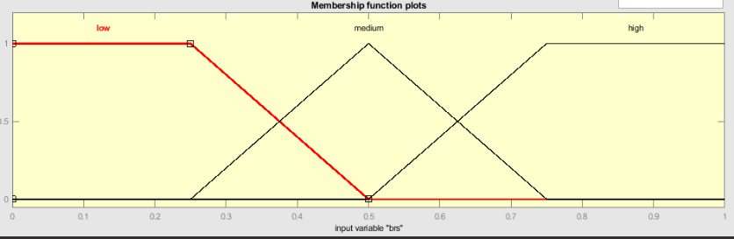
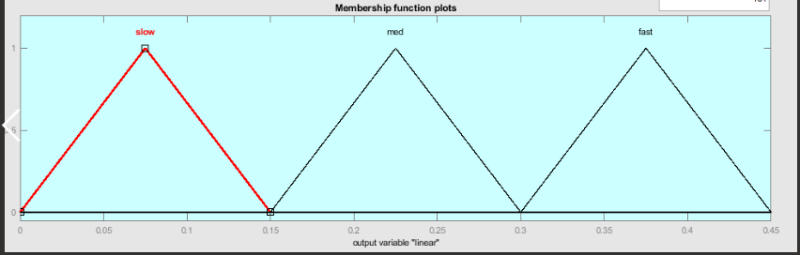
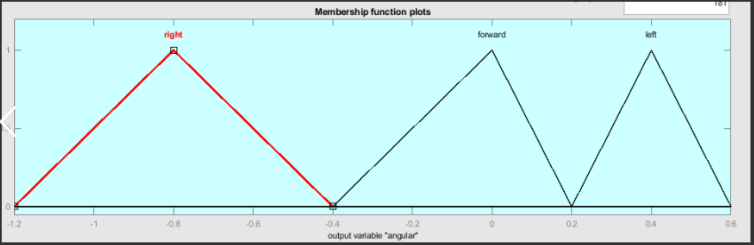
Defining crisp values (inputs and outputs)
FRS - INPUT
BRS - INPUT
OUTPUT
LINEAR_SPEED
OUTPUT
ANGULAR_SPEED

Slide 9
RULES
Sl. no | FRS | BRS | Linear speed | Angular speed
1 | Low | Low | Slow | Left
2 | Low | Medium | Slow | Left
3 | Low | High | Slow | Left
4 | Medium | Low | Medium | Forward
5 | Medium | Medium | Medium | Forward
6 | Medium | High | Medium | Forward
7 | High | Low | Fast | Right
8 | High | Medium | Fast | Right
9 | High | High | Fast | Right

Slide 10
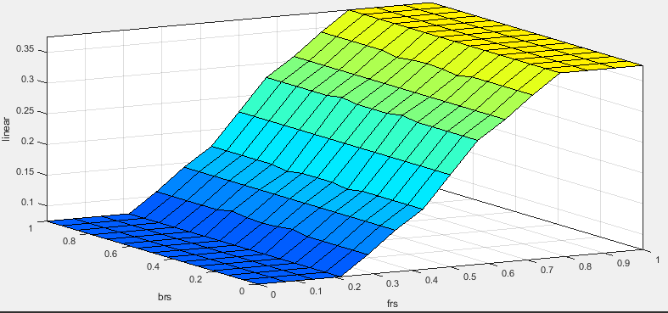
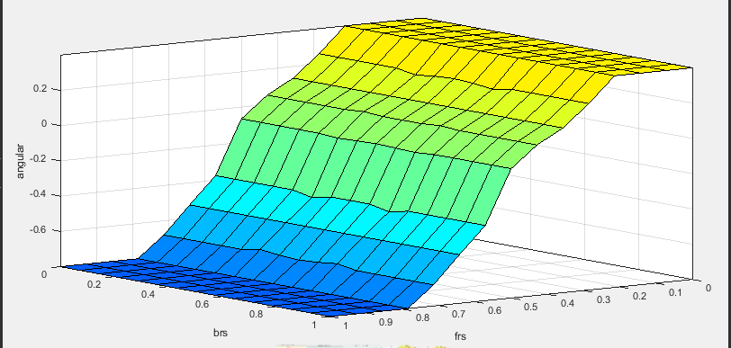
OUTPUT - SURFACE MAPPING
LINEAR
ANGULAR

Slide 11
OBSTACLE AVOIDANCE
Defining membership values --> FRS, BRS for inputs and Linear, Angular speed for output
Fuzzification
These were calculated using rising edge and falling edge formulas
rising edge = (sensor_reading - first_index_value) / (second_index_value - first_index_value)
falling edge = (second_index_value - sensor_reading) / (second_index_value - first_index_value)
3. Defining 27 rules obstacle avoidance
4. Calculating firing strengths (r1,r2.......rn) :
AND = min
OR = product
5. Calculating linear and angular speed :
Linear speed .X =
((r1*rule_linearspeed) + (r2*rule_linearspeed) +.........(rn*rule_linearspeed)) / (sum(r1,r2.....rn))
Angularr speed .Y =
((r1*rule_angularspeed) + (r2*rule_angularspeed) +.........(rn*rule_angularspeed)) / (sum(r1,r2.....rn))

Slide 12
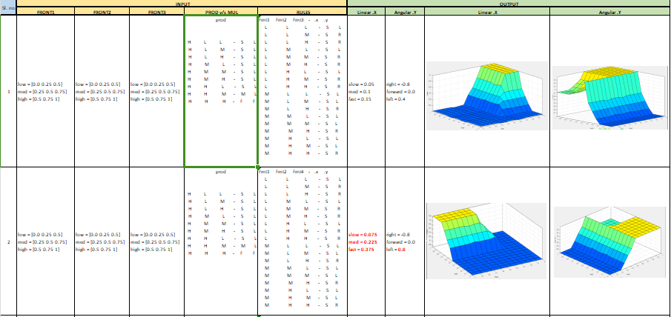
OA --> Tuning values using matlab

Slide 13
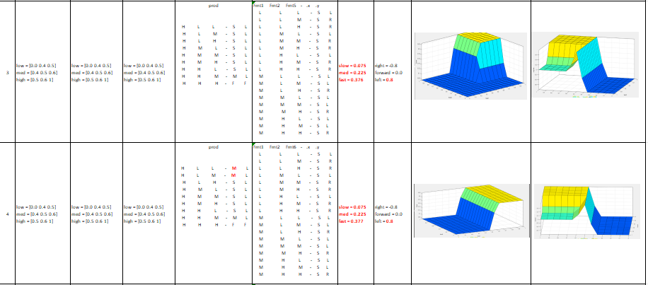
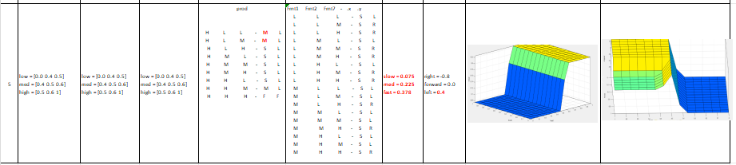

Slide 14
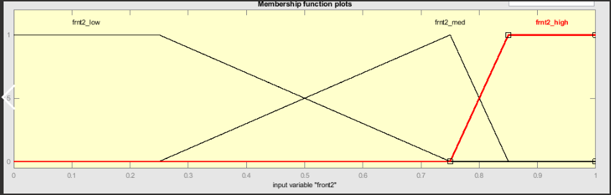
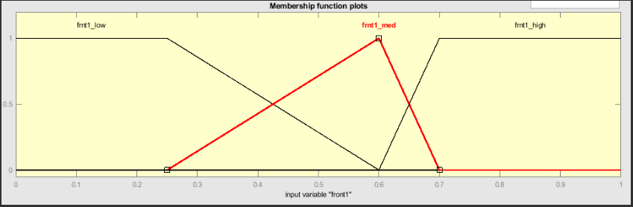
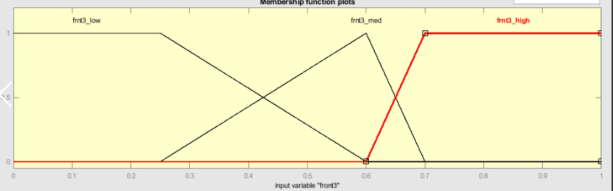
Defining crisp values (INPUTS)
Frnt2 - INPUT
Frnt1 - INPUT
Frnt3 - INPUT

Slide 15
RULES
Sl. no. | Front1 | Front2 | Front2 | Linear Speed | Angular Speed
1 | Low | Low | Low | Slow | Left
2 | Low | Low | Medium | Slow | Right
3 | Low | Low | High | Slow | Right
4 | Low | Medium | Low | Slow | Left
5 | Low | Medium | Medium | Slow | Right
6 | Low | Medium | High | Slow | Right
7 | Low | High | Low | Slow | Left
8 | Low | High | Medium | Slow | Right
9 | Low | High | High | Slow | Right

Slide 16
RULES
10 | Medium | Low | Low | Slow | Left
11 | Medium | Low | Medium | Slow | Left
12 | Medium | Low | High | Slow | Right
13 | Medium | Medium | Low | Slow | Left
14 | Medium | Medium | Medium | Slow | Left
15 | Medium | Medium | High | Slow | Right
16 | Medium | High | Low | Slow | Left
17 | Medium | High | Medium | Slow | Left
18 | Medium | High | High | Slow | Right

Slide 17
RULES
19 | High | Low | Low | Slow | Left
20 | High | Low | Medium | Slow | Left
21 | High | Low | High | Slow | Left
22 | High | Medium | Low | Slow | Left
23 | High | Medium | Medium | Slow | Left
24 | High | Medium | High | Slow | Left
25 | High | High | Low | Slow | Left
26 | High | High | Medium | Medium | Left
27 | High | High | High | Fast | Forward

Slide 18
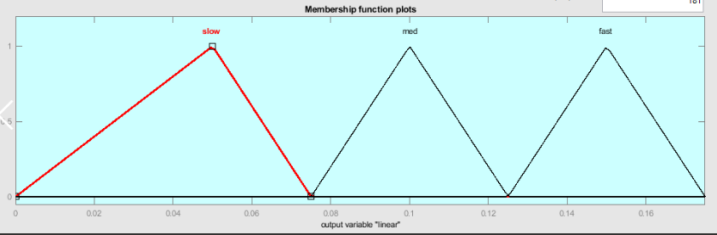
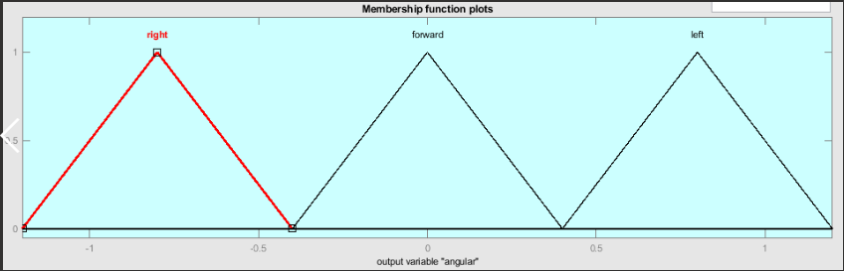
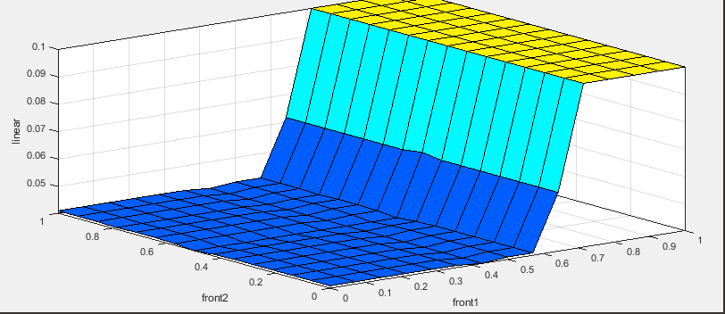
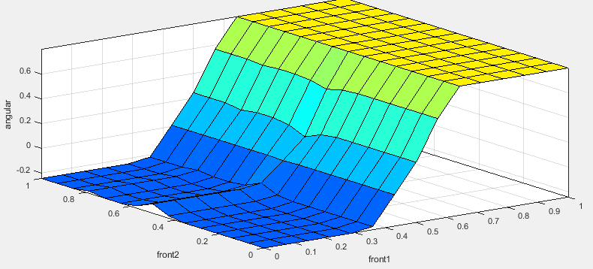
Defining crisp values (OUTPUTS)
LINEAR_SPEED
ANGULAR_SPEED
OUTPUT - Surface mapping

Slide 19
Drawbacks and how values were changed :
Since 27 rules were created, 3 sensors were used
front1 sensor --> regions_['fleft']
front2 sensor --> regions_['front1'] + regions_['front2'] / 2
front3 sensor --> regions_['fright']
Usage of these sensors created a issue during sensing the distance. This was because
'front2': find_nearest (msg.ranges[355:360]),
'fright': find_nearest (msg.ranges[310:320]),
'front1': find_nearest (msg.ranges[0:5]),
'fleft': find_nearest (msg.ranges[40:50]),
Due to this gap, there is no values recorded in these gaps and robot sensors are not sensing the distance here.
To overcome come this, gaps were reduced to 5 -10 degrees.
'front2': find_nearest (msg.ranges[355:360]),
'fright': find_nearest (msg.ranges[310:350]),
'front1': find_nearest (msg.ranges[0:5]),
'fleft': find_nearest (msg.ranges[15:50]),
from 320 to 355, there is 35 degree gap
from 40 to 5, there is 35 degree gap
from 350 to 355, there is 5 degree gap
from 15 to 5, there is 10 degree gap

Slide 20
Front 2 sensor is covering range from [0:5] and [355:360], so the front2 sensor should sense the robot early as compared to other sensors, defining regions for membership values were modified accordingly.
#Define regions for front1 inputs
frnt1_low = [0.0, 0.25, 0.6]
frnt1_medium = [0.25, 0.6, 0.7]
frnt1_high = [0.6, 0.7, 1]
#Define regions for front2 inputs
frnt2_low = [0.0, 0.25, 0.75]
frnt2_medium = [0.25, 0.75, 0.85]
frnt2_high = [0.75, 0.85, 1]
#Define regions for front3 outputs
frnt3_low = [0.0, 0.25, 0.6]
frnt3_medium = [0.25, 0.6, 0.7]
frnt3_high = [0.6, 0.7, 1]

Slide 21
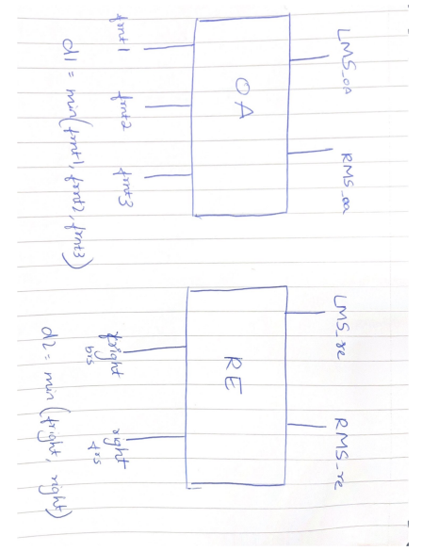
COMBINATION (OA + RE)

Slide 22
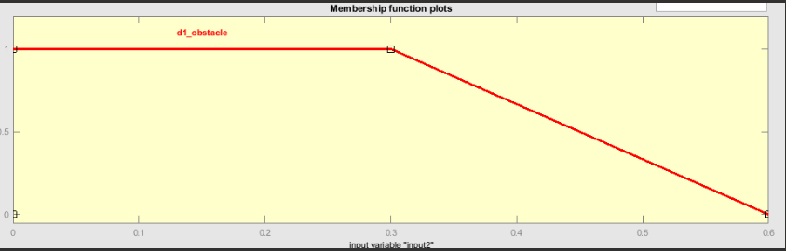
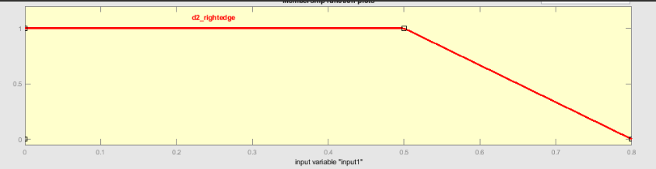
Plotting d1 and d2 membership values

Slide 23
1. Calculating Left and Right Motor speed (LMS and RMS)
LMS_oa = Linear_speed of OA
LMS_re = Linear_speed of RE
RMS_oa = Angular_speed of OA
RMS_re = Angular_speed of RE
2. Calculating Membership values M_d1 and M_d2 based on falling edge
falling edge = (second_index_value - sensor_reading) / (second_index_value - first_index_value)
3. Calculating linear and angular speed :
LMS_combination =
((M_d1*LMS_oa) + (M_d2*LMS_re)) / (M_d1 + M_d2)
RMS_combination=
((M_d1*RMS_oa) + (M_d2*RMS_re)) / (M_d1 + M_d2)

Slide 24
Drawbacks:
• If precise membership functions are still specified in order to satisfy a certain set of environmental and operating conditions, minor changes has to be done in these conditions in order for the ROBOT to work properly.
• This can cause degradation in the FLC performance which can result in poor control and inefficiency.

Slide 25
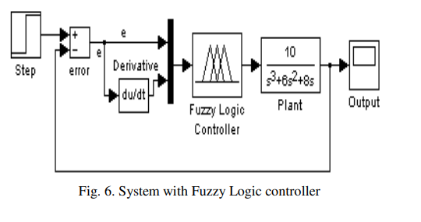
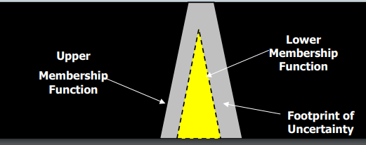
Going Beyond......
1. PID using FUZZY
The system response can be divided in two phases.
1. Phase A - System output is below the set point.
2. Phase B - System output is
above the set point. Depending upon whether the output is
increasing or decreasing, 4 rules were derived for the fuzzy
logic controller. These four rules are sufficient to
cover all possible situations
https://iaeng.org/publication/WCECS2007/WCECS2007_pp855-858.pdf
2. Usage Of AI, machine learning and Complex python programming
3. TYPE-2 FUZZY Sets
Since I had ECE backgroud, AI and machine learning can be used in this project.
But also, its not only important to know AI and Machine learning, even with the basic knowledge on python I implemented the project.

