Slide 1
Clustering

Slide 2
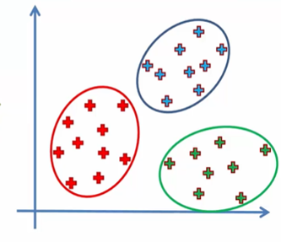
Clustering is similar to classification, but the basis is different.
In Clustering we don’t know what we are looking for, and we are trying to identify some segments or clusters in our data.
When we use clustering algorithms on your dataset, unexpected things can suddenly pop up like structures, clusters and groupings we would have never thought of otherwise.

Slide 3
Objective of Clustering
Task ----→ Group similar points in one cluster
Points in one cluster are close together
Points in different clusters are far away

Slide 4
Applications of clustering
https://en.wikipedia.org/wiki/Cluster_analysis#Applications
Ecommerce -> To ‘gp’ similar customers
Where manual labelling is time consuming, perform clustering as pre processing step and then do manual labelling

Slide 5
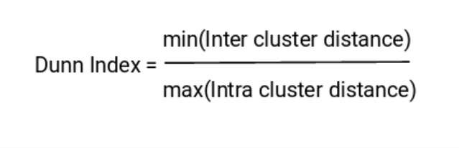
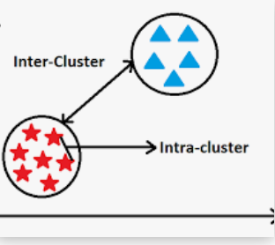
Metrics for clustering
Clusters are far apart
Clusters are compact
Intracluster dist should be small
Inter cluster dist should be large

Slide 6
TYPES OF CLUSTERING
K –Means clustering
Hierarchical clustering
DBSCAN (Density based clustering)

Slide 7
K – means Clustering

Slide 8
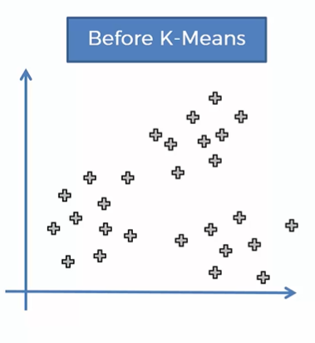
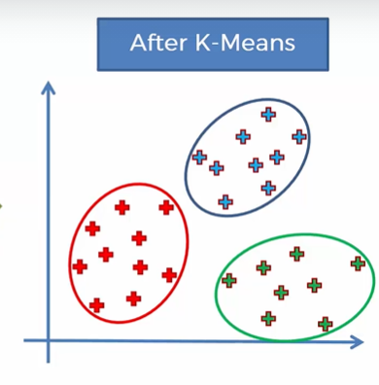
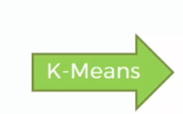
Can we divide the data into groups??

Slide 9
K-Means is Centroid Based clustering
K- no of clusters (hyper-parameter)
HyperParameters are those which can’t be deduced from the given data.
Eg K= 3 ie. 3 Means Clustering
No of clusters = 3
For each cluster, No of centroids = 3 (C1 , C2 , C3)
For each cluster , No of corresponding set of points = 3(S1, S2, S3)
S1 U S2 U S3 = D i.e Each point should belong to any cluster
S1 n S2 = Ø , S1 n S3 = Ø , S2 n S3 = Ø i.e No point belongs to more than one cluster

Slide 10
K-Means Algorithm
Choose the number K of clusters.
Select random K points, the CENTROIDS (not necessarily from the dataset)
Assign each data point to the closest centroid → It form K clusters
Compute and place new centroid of each cluster
Reassign each datapoint to the new closest centroid. If any reassignment happens , go to step4 otherwise finish.

Slide 11
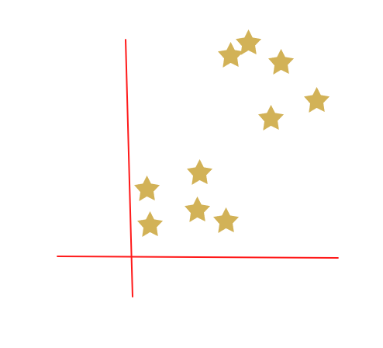
Step 1: Choose the number K of clusters
K = 2

Slide 12
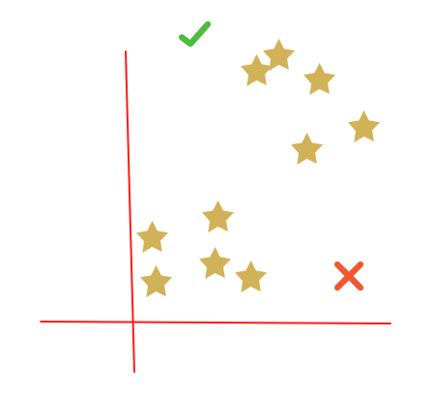
STEP 2: Select random K points, the CENTROIDS

Slide 13

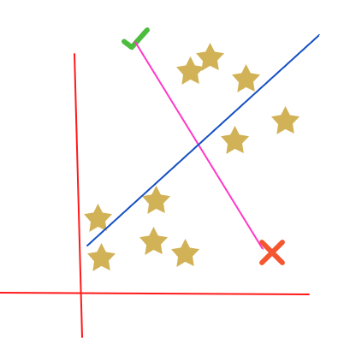
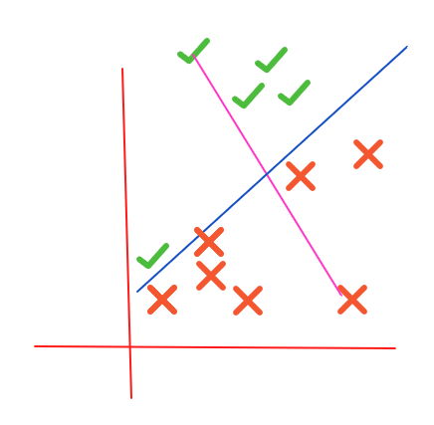
Step 3 - Assign each data point to the closest ceNtroid

Slide 14
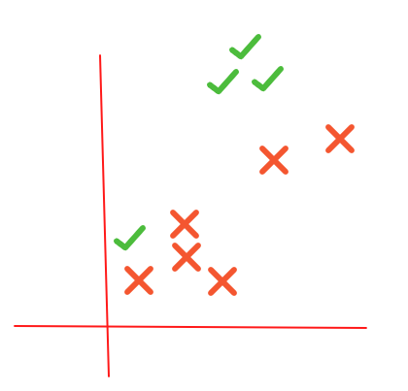
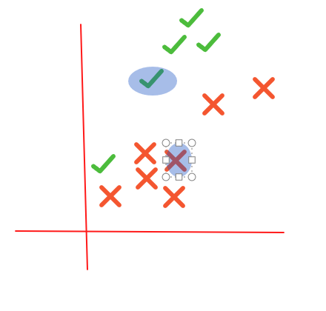
Step -4 Compute and place new centroid of each cluster

Slide 15
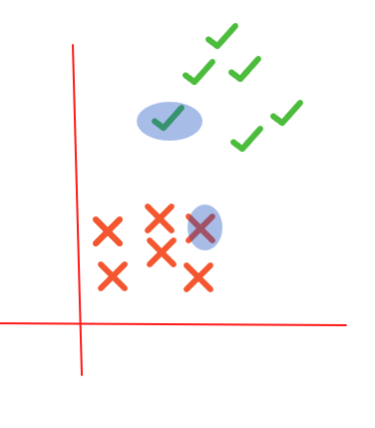
Step -5 Reassign each datapoint to the new closest centroid

Slide 16
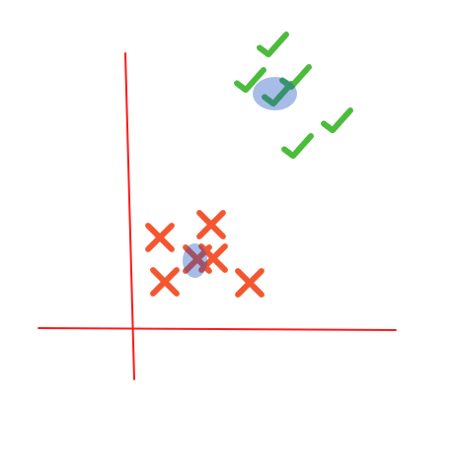
Repeat Step -4 Compute and place new centroid of each cluster

Slide 17
Repeat Step 5-Reassign each datapoint to the new closest centroid. Since no reassignment happens ,finish.

Slide 18
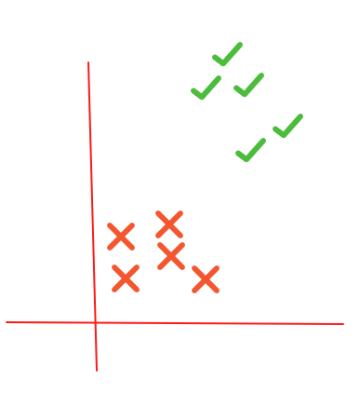
Final Clusters

Slide 19
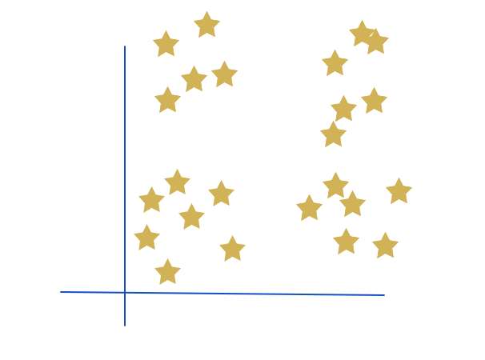
Determining THE right K
Once we get the centroids, we can easily describe the datapoint. But first how many clusters should be there?
Q- Find no of clusters?

Slide 20
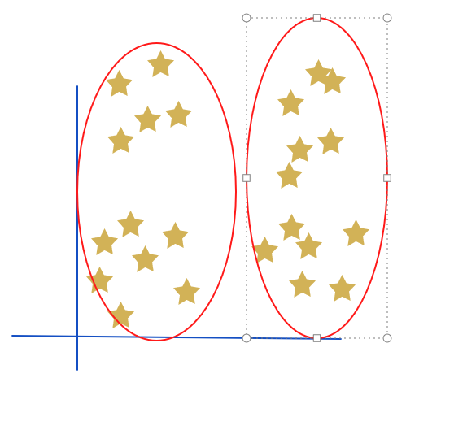
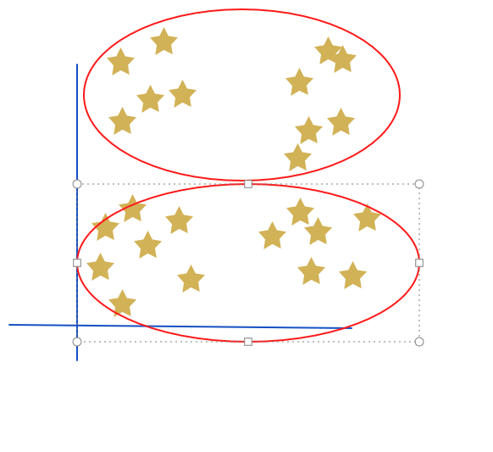
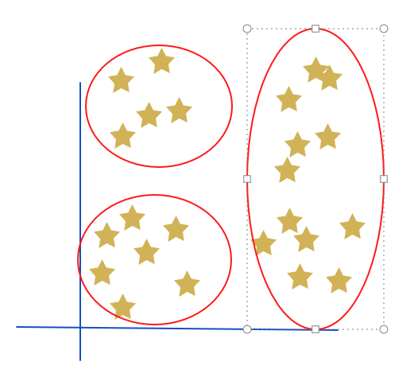
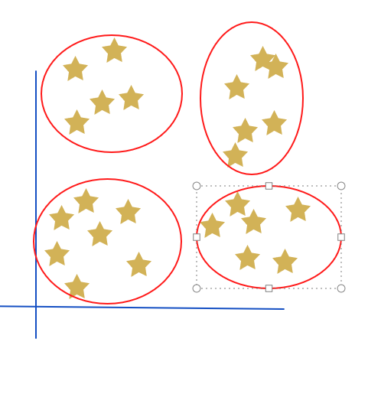
Points in one cluster are close together
Points in different clusters are far away

Slide 21
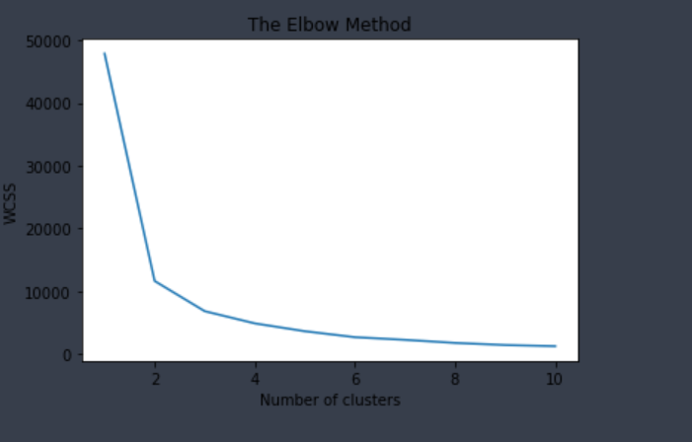
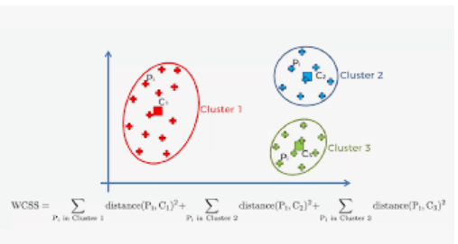
Determining THE right K
K is Hyper Parameter i.e. It’s value can’t be estimated from the data
1. DOMAIN KNOWLEDGE e.g. –Movie Reviews.. Only three categories are possible +ve, neutral, -ve
2. Elbow Method :

Slide 22
Limitations of K-means
K-Means have problem when clusters are of different
sizes.
Density
Non-globular shapes
K-Means have problem when data contains outliners

Slide 23
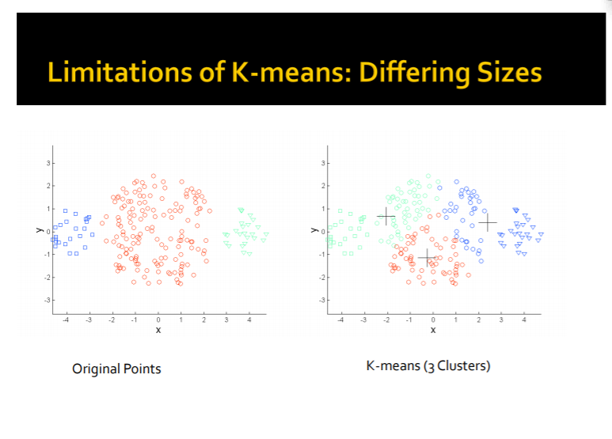
https://cs.wmich.edu/alfuqaha/summer14/cs6530/lectures/ClusteringAnalysis.pdf

Slide 24
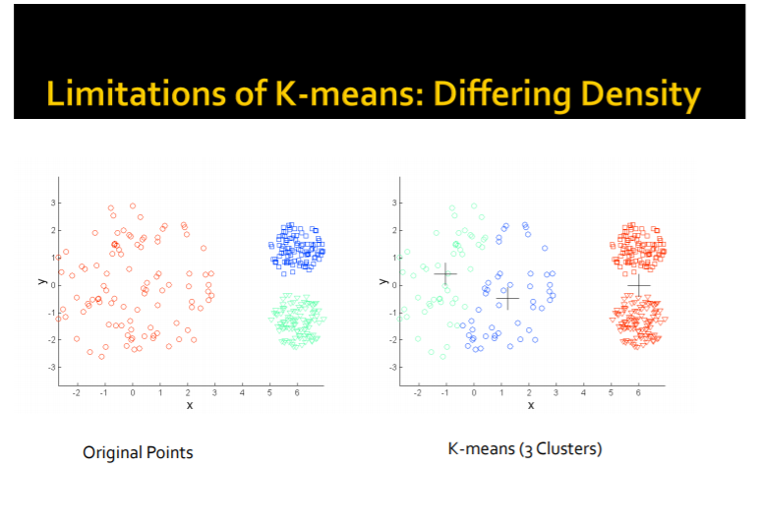

Slide 25
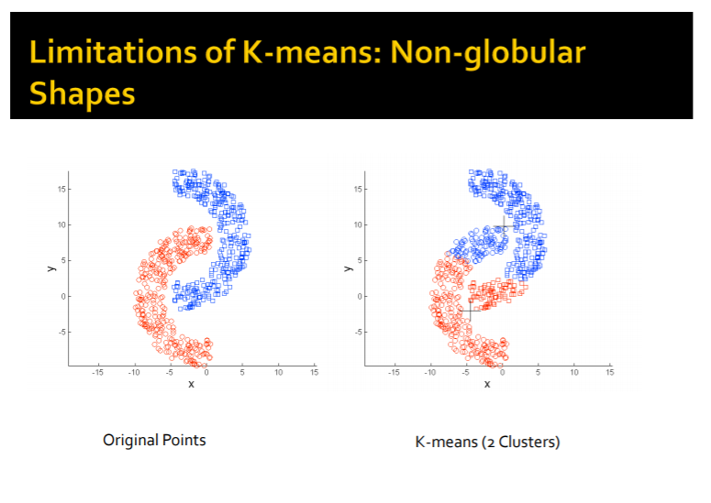

Slide 26
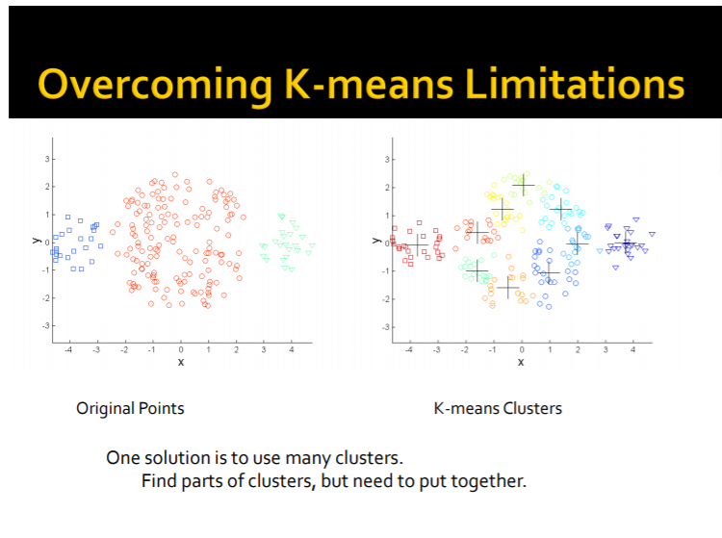

Slide 27
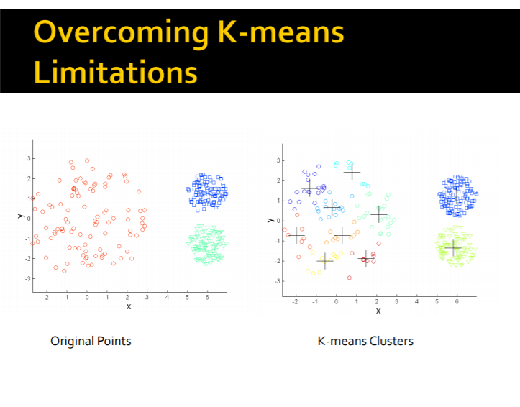

Slide 28
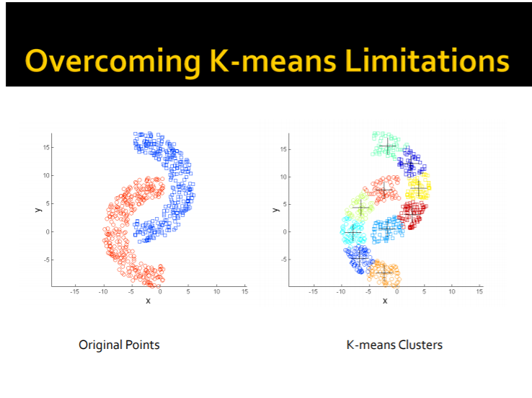

Slide 29

Thanks!!

