Slide 1
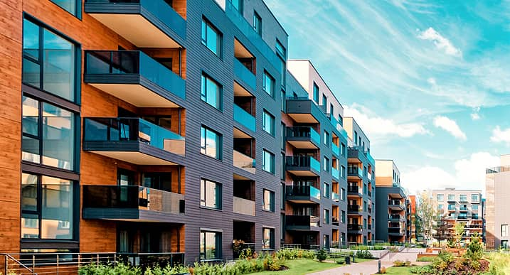

Community Management System: "CommUnity"
A User-Friendly Web Application for enhancing community engagement
Batch 4
1. Induja R.M
2. Nikhil Ahir
3. Harshini Kadali
4. Ramprasad Sunkara
5. Rohit Ninawe

Slide 2
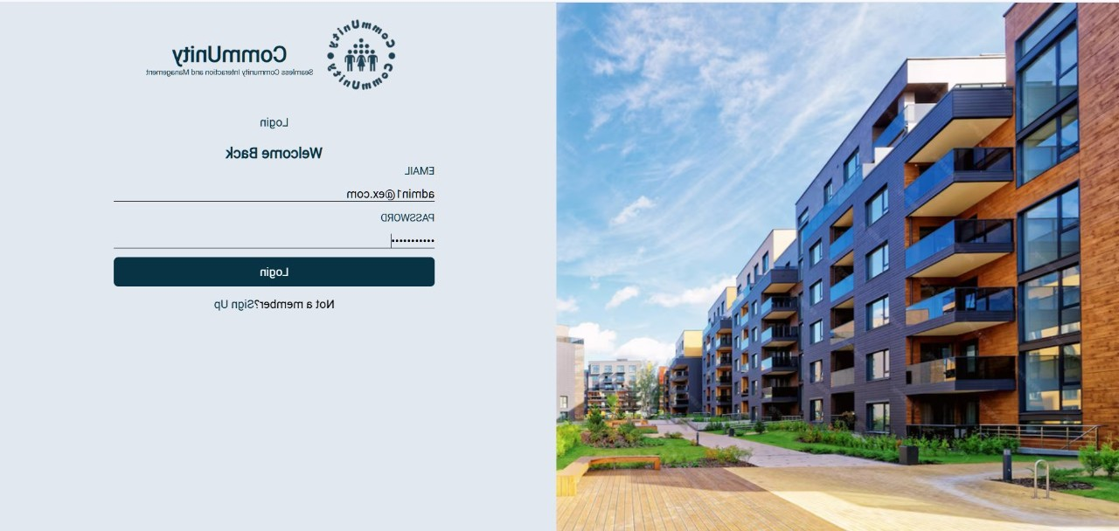
Work contributed
Induja R.M –Backend(Java Spring Boot )
Nikhil Ahir –Frontend(ReactJS)
Harshini Kadali – Frontend(ReactJS)
Ramprasad Sunkara - Admin dashboard, Backend(Java Spring Boot )
Rohit Ninawe -API integration, srs documentation

Slide 3
Abstract
Overview:
"CommUnity" is a scalable, multi-tenant Community Management System designed to simplify housing society operations. Built with Java Spring Boot and ReactJS, it enhances communication, streamlines management, and ensures transparency for both administrators and residents.
The platform offers features such as user authentication, society and resident management, event and notice management, complaint tracking, and online payment for maintenance bills. These functionalities aim to foster transparent communication, efficient management, and enhanced community engagement.
Key Features:
User and Society Management: Manage user roles, society data, and resident profiles.
Notices, Events, and Complaints: Share notices, organize events, and handle complaints efficiently.
Online Payments: Simplify maintenance bill generation, payment, and tracking.
Scalability: Designed to handle multiple societies and a growing user base effectively.

Slide 4
MILESTONES
Milestone 1(Weeks 1-2): User Authentication and Registration
Features: Registration, login, and JWT-based authentication.
Evaluation: Successful login and registration for both admins and residents.
Milestone 2 (Weeks 3-4): Resident and Society Management
Features: Event creation, feedback collection, and notice updates.
Evaluation: Residents access event details and provide feedback.
Milestone 3 (Weeks 5-8): Event and Notice Management
Features: CRUD operations for societies and residents.
Evaluation: Proper association of residents with societies.
Milestone4(Weeks9-10): Maintenance Payment System
Features: Razorpay integration, bill generation, and payment tracking.
Evaluation: Residents can pay bills; admins track payment statuses.

Slide 5
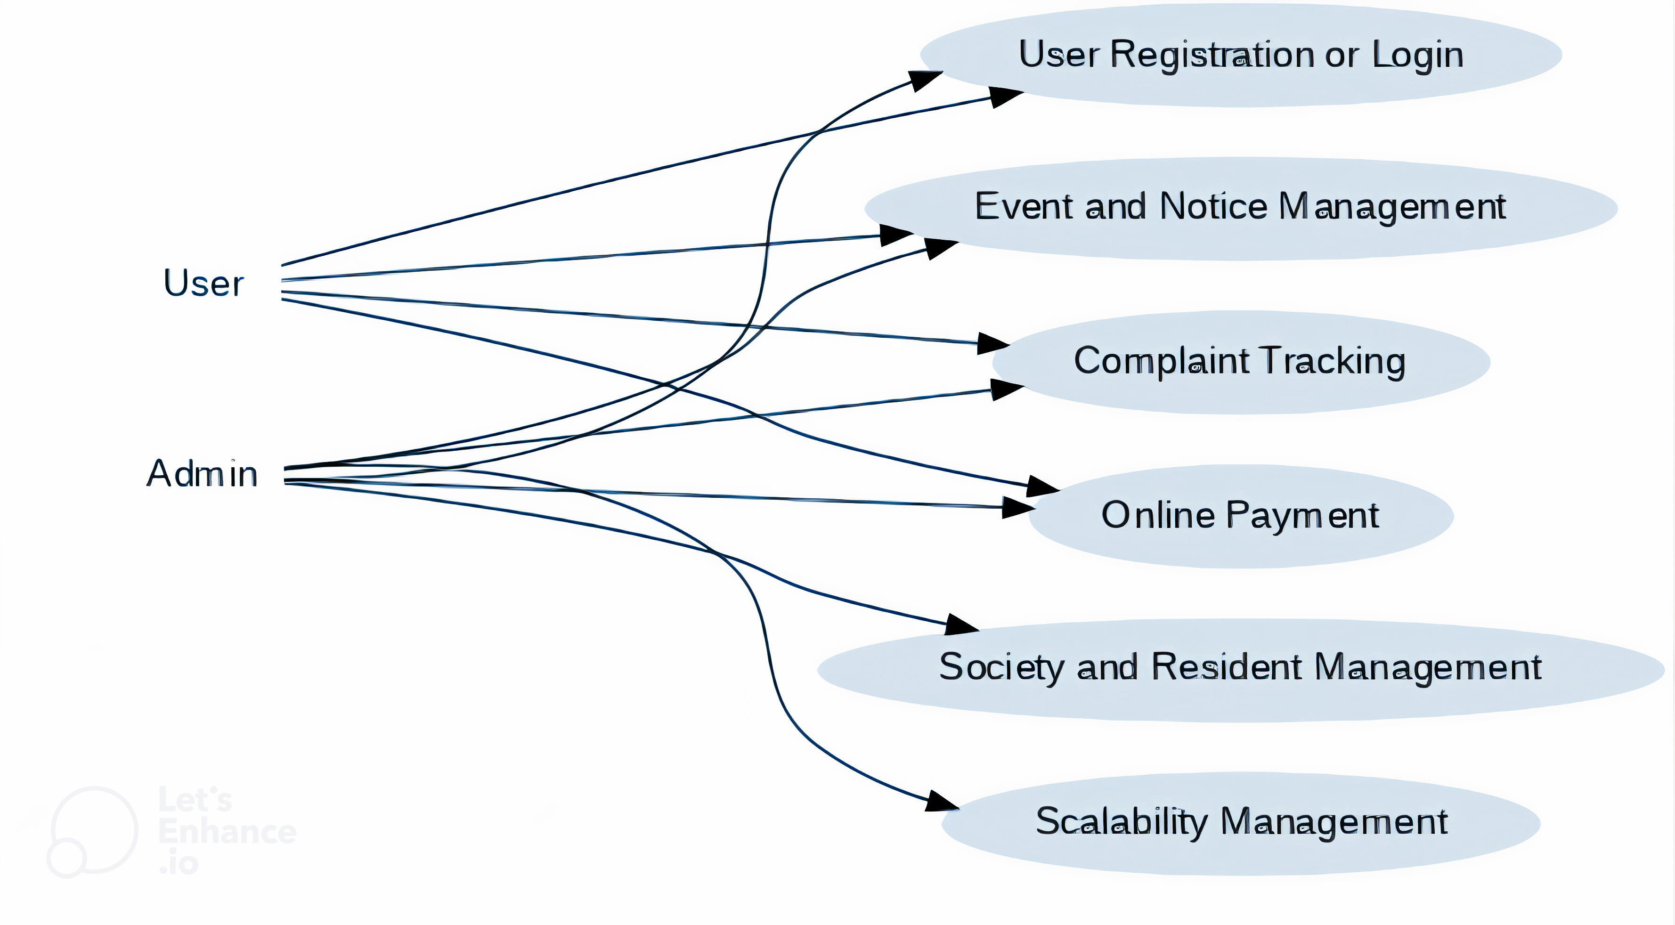
Use Case Diagram

Slide 6
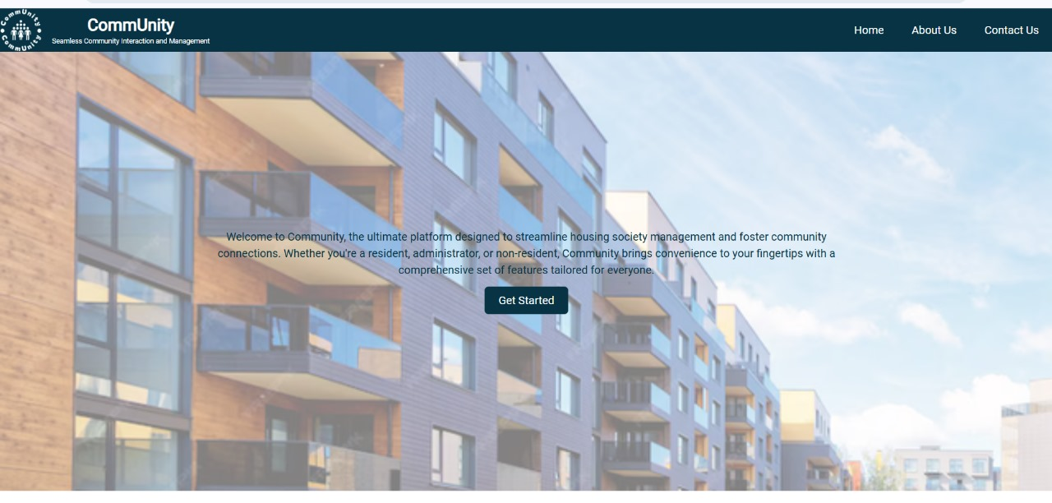
Output Screenshot

Slide 7
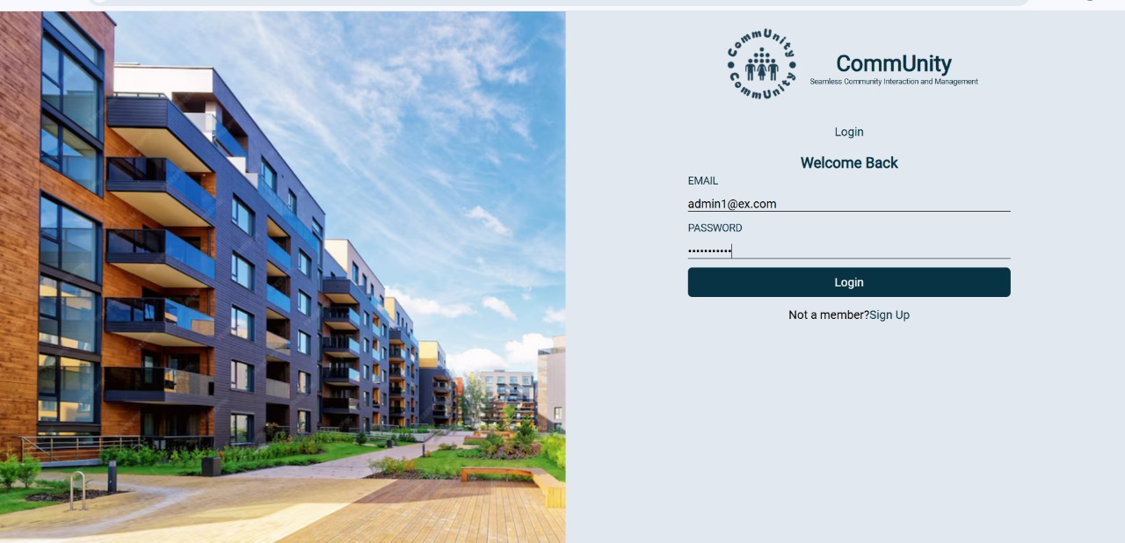
HOME

Slide 8
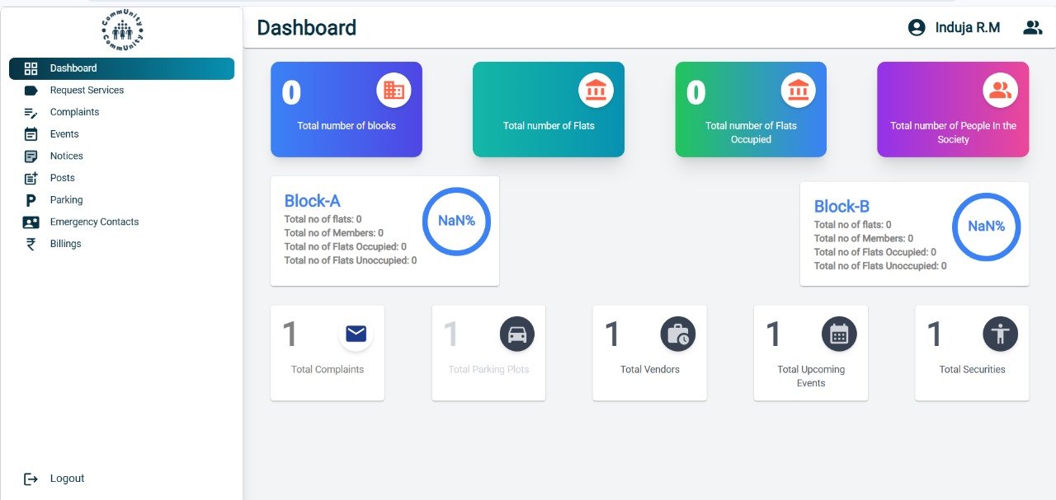
DASHBOARD

Slide 9
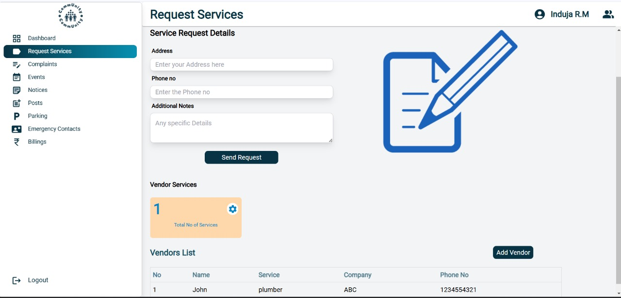
Request services

Slide 10
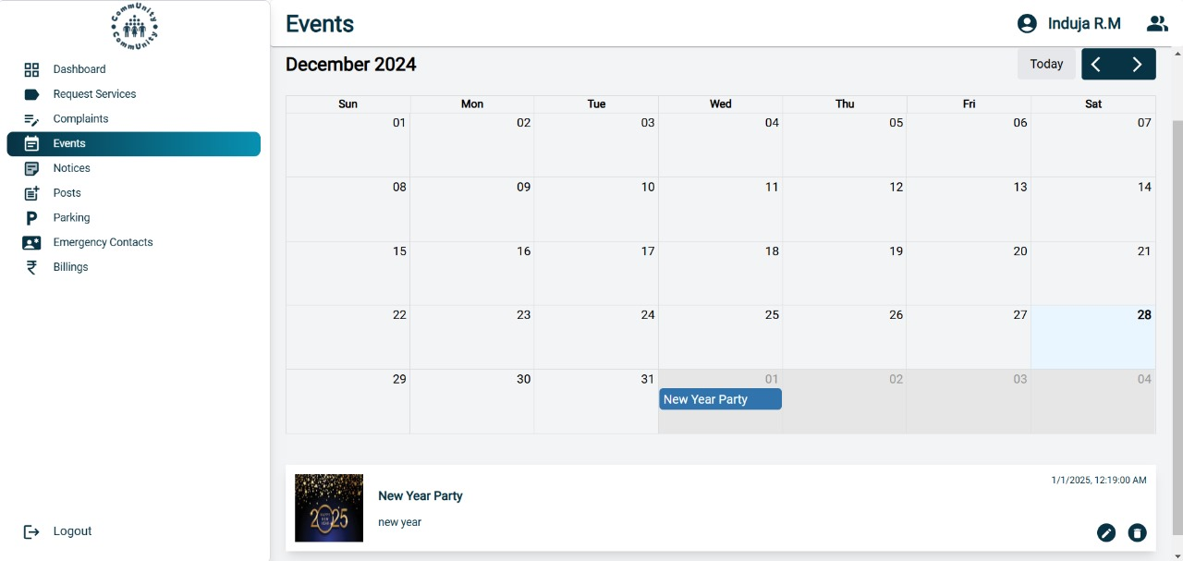
events

Slide 11
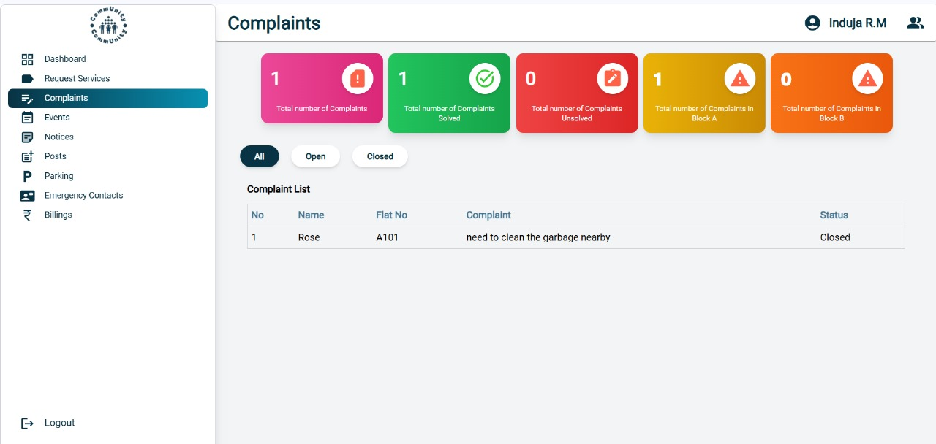
Complaints

Slide 12
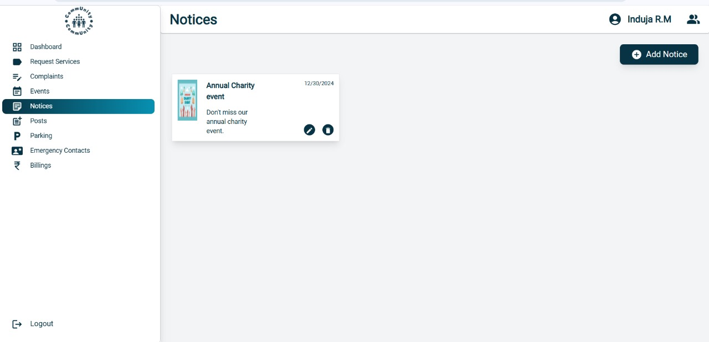
Noticeboard

Slide 13
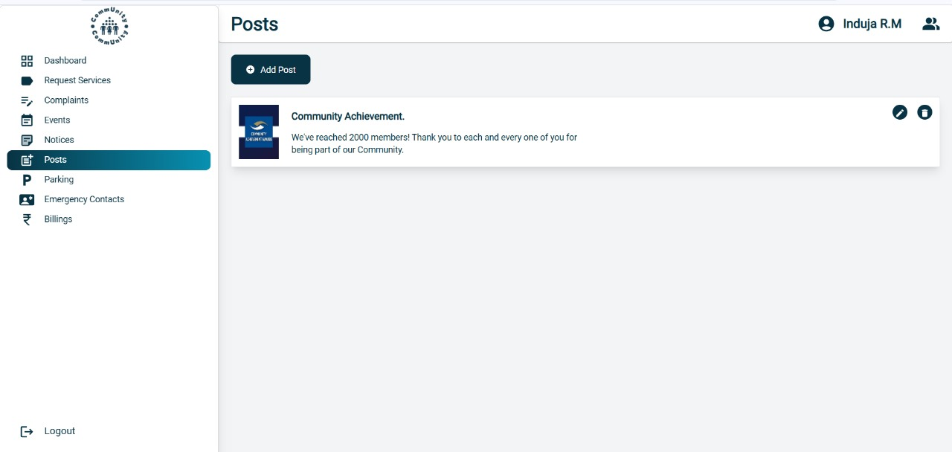
posts

Slide 14
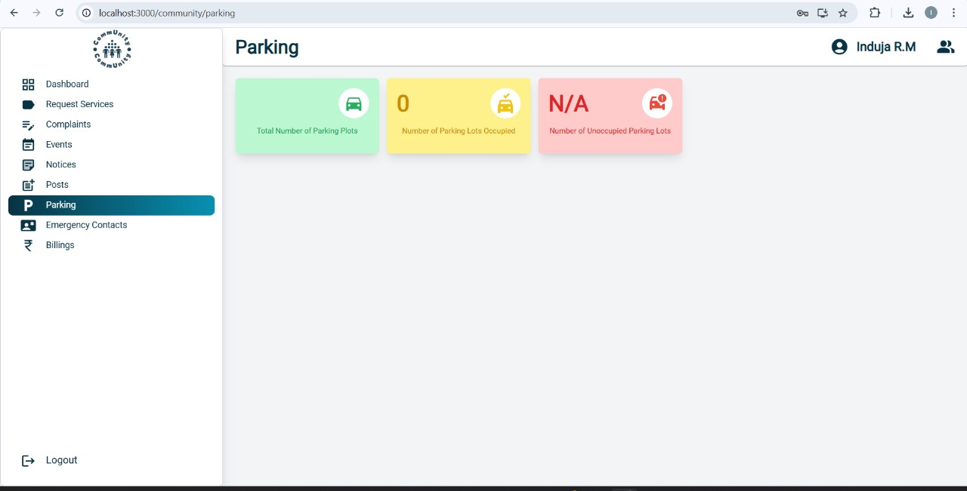
parking

Slide 15
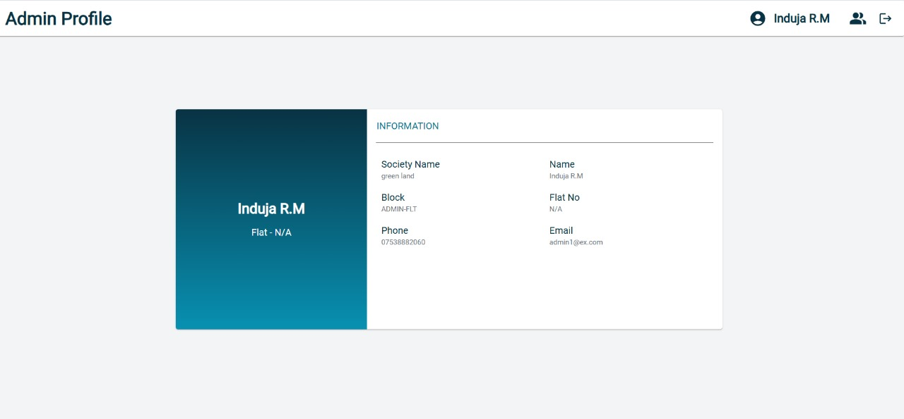
Admin profile

Slide 16
Feature Enhancement
Dynamic Role Customization
Allow admins to create custom roles with specific permissions tailored to their society's needs.
Mobile Application Integration
Develop a mobile app for Android and iOS for on-the-go access to platform features.
Visitor Management System
Include features to log, track, and manage visitors with OTP-based approvals.
Real-Time Notifications
Enable push notifications and SMS alerts for critical updates, event reminders, and payment due dates.

Slide 17
CONCLUSION
"CommUnity" is a transformative platform that redefines housing society management by simplifying operations, enhancing communication, and fostering transparency. With its modular, multi-tenant architecture, the system is scalable to meet the evolving needs of modern communities. By integrating advanced features like online payments, complaint tracking, and event management, "CommUnity" aims to create a cohesive and well-managed living environment. As we implement future enhancements, the platform is poised to become an indispensable tool for efficient and harmonious community living.

