Slide 1
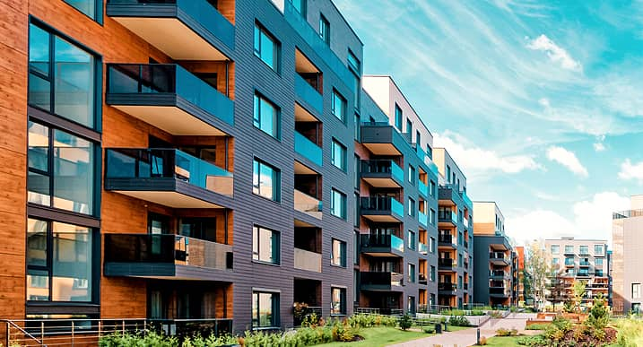

Community Management System: "CommUnity"
A User-Friendly Web Application for enhancing community engagement
Batch 3
1. Induja R.M
2. Nikhil Ahir
3. Harshini Kadali
4. Ramprasad Sunkara
5. Rohit Ninawe
6. Preethiga R

Slide 2
Abstract
Overview:
"CommUnity" is a scalable, multi-tenant Community Management System designed to simplify housing society operations. Built with Java Spring Boot and ReactJS, it enhances communication, streamlines management, and ensures transparency for both administrators and residents.
The platform offers features such as user authentication, society and resident management, event and notice management, complaint tracking, and online payment for maintenance bills. These functionalities aim to foster transparent communication, efficient management, and enhanced community engagement.
Key Features:
User and Society Management: Manage user roles, society data, and resident profiles.
Notices, Events, and Complaints: Share notices, organize events, and handle complaints efficiently.
Online Payments: Simplify maintenance bill generation, payment, and tracking.
Scalability: Designed to handle multiple societies and a growing user base effectively.

Slide 3
MILESTONES
Milestone 1(Weeks 1-2): User Authentication and Registration
Features: Registration, login, and JWT-based authentication.
Evaluation: Successful login and registration for both admins and residents.
Milestone 2 (Weeks 3-4): Resident and Society Management
Features: Event creation, feedback collection, and notice updates.
Evaluation: Residents access event details and provide feedback.
Milestone 3 (Weeks 5-8): Event and Notice Management
Features: CRUD operations for societies and residents.
Evaluation: Proper association of residents with societies.
Milestone4(Weeks9-10): Maintenance Payment System
Features: Razorpay integration, bill generation, and payment tracking.
Evaluation: Residents can pay bills; admins track payment statuses.

Slide 4
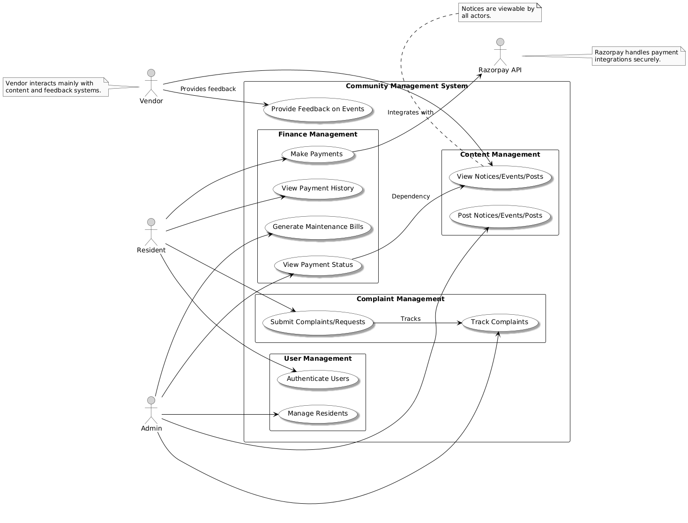
Use case diagram

Slide 5
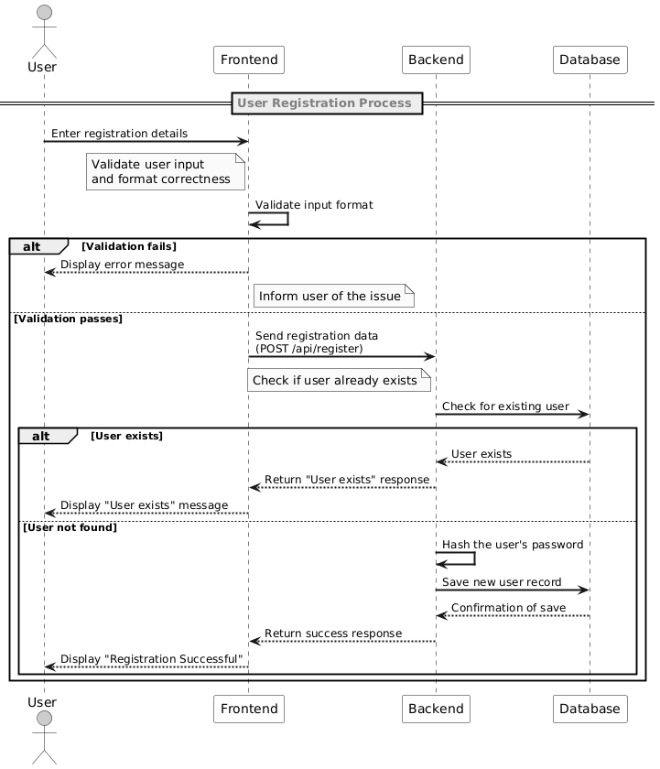
Sequence diagram

Slide 6
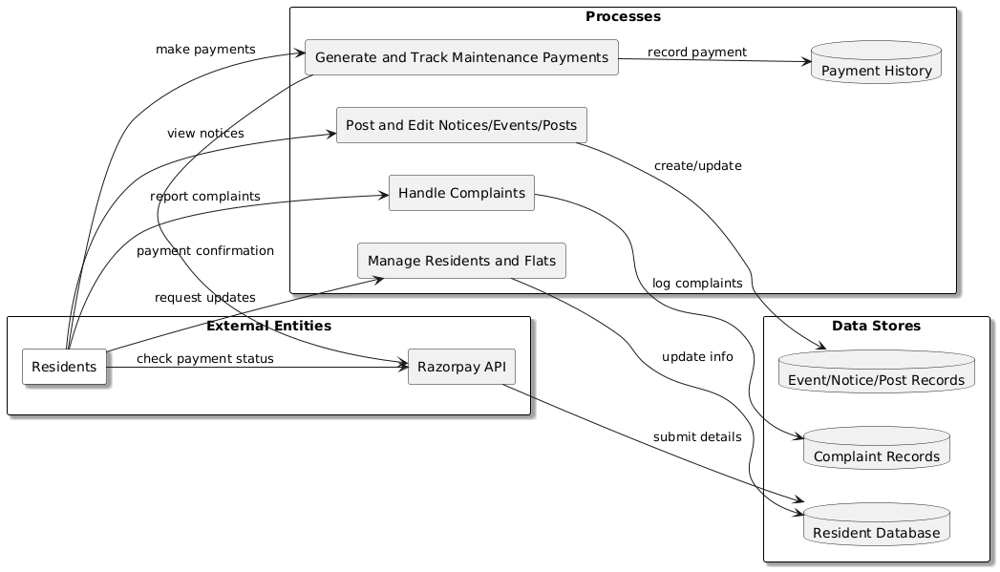
Dfd for admin

Slide 7
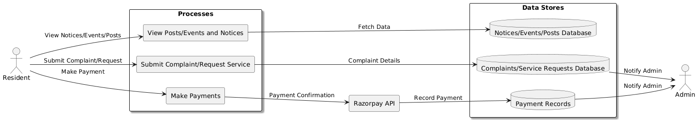
Dfd for resident

Slide 8
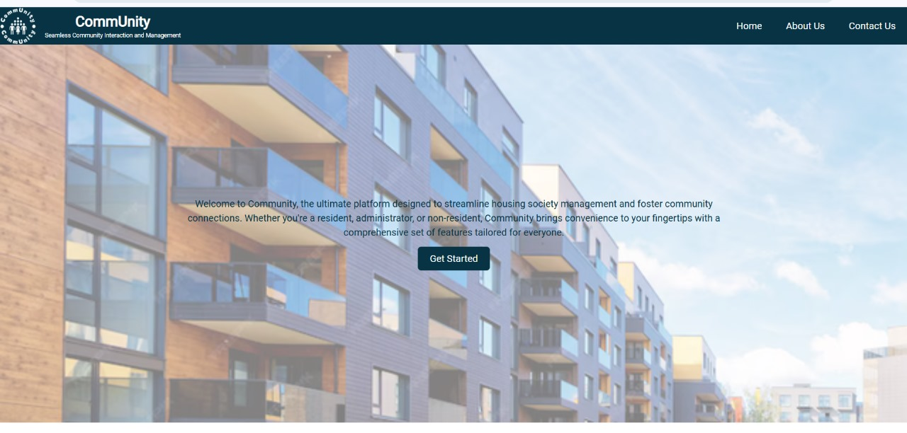
Output Screenshot

Slide 9
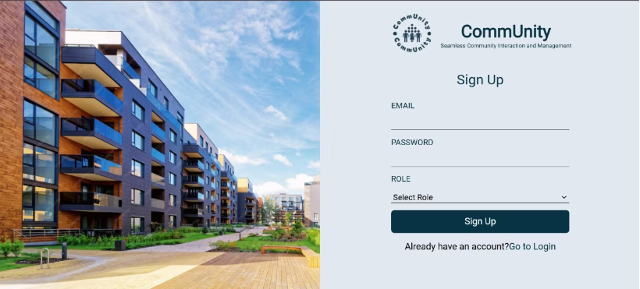
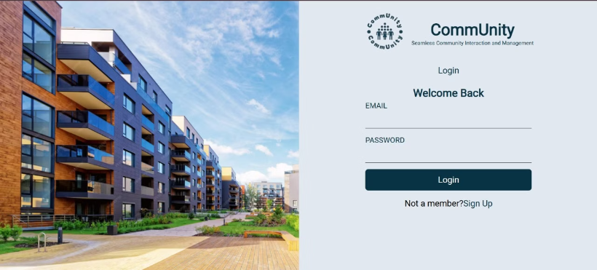
HOME
Sign Up Page
Login Page

Slide 10
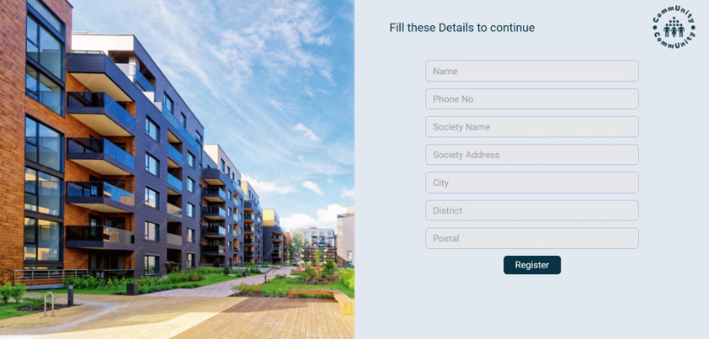
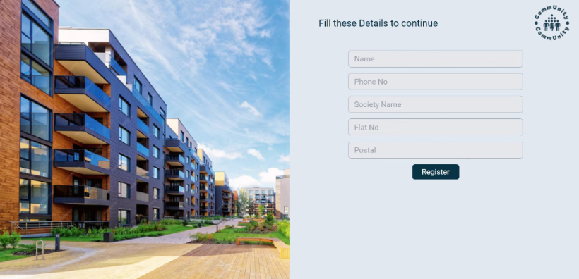
Form Details
Admin register form
Resident register form

Slide 11
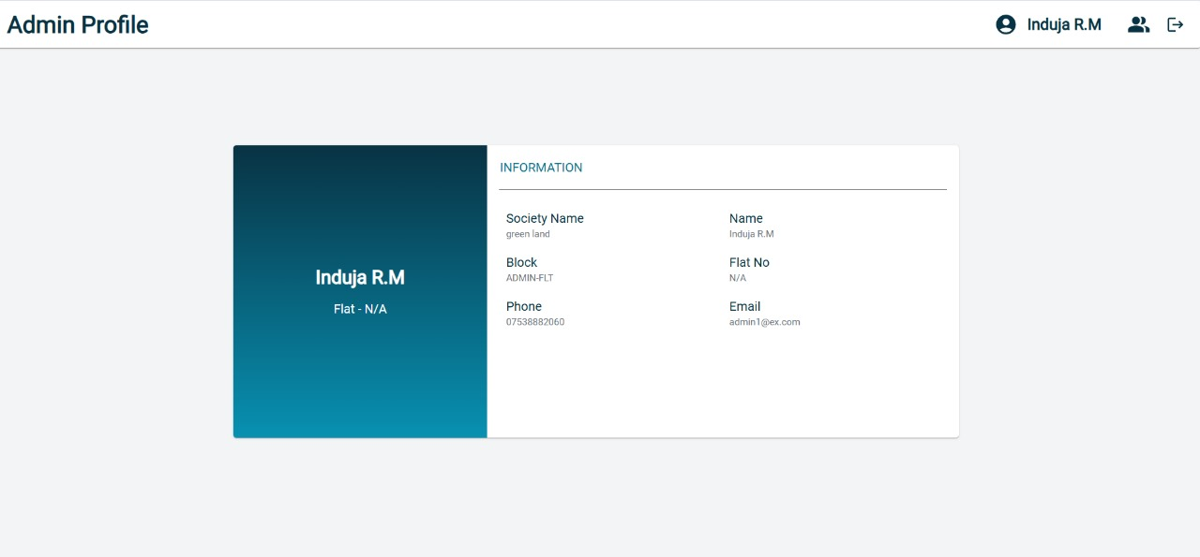
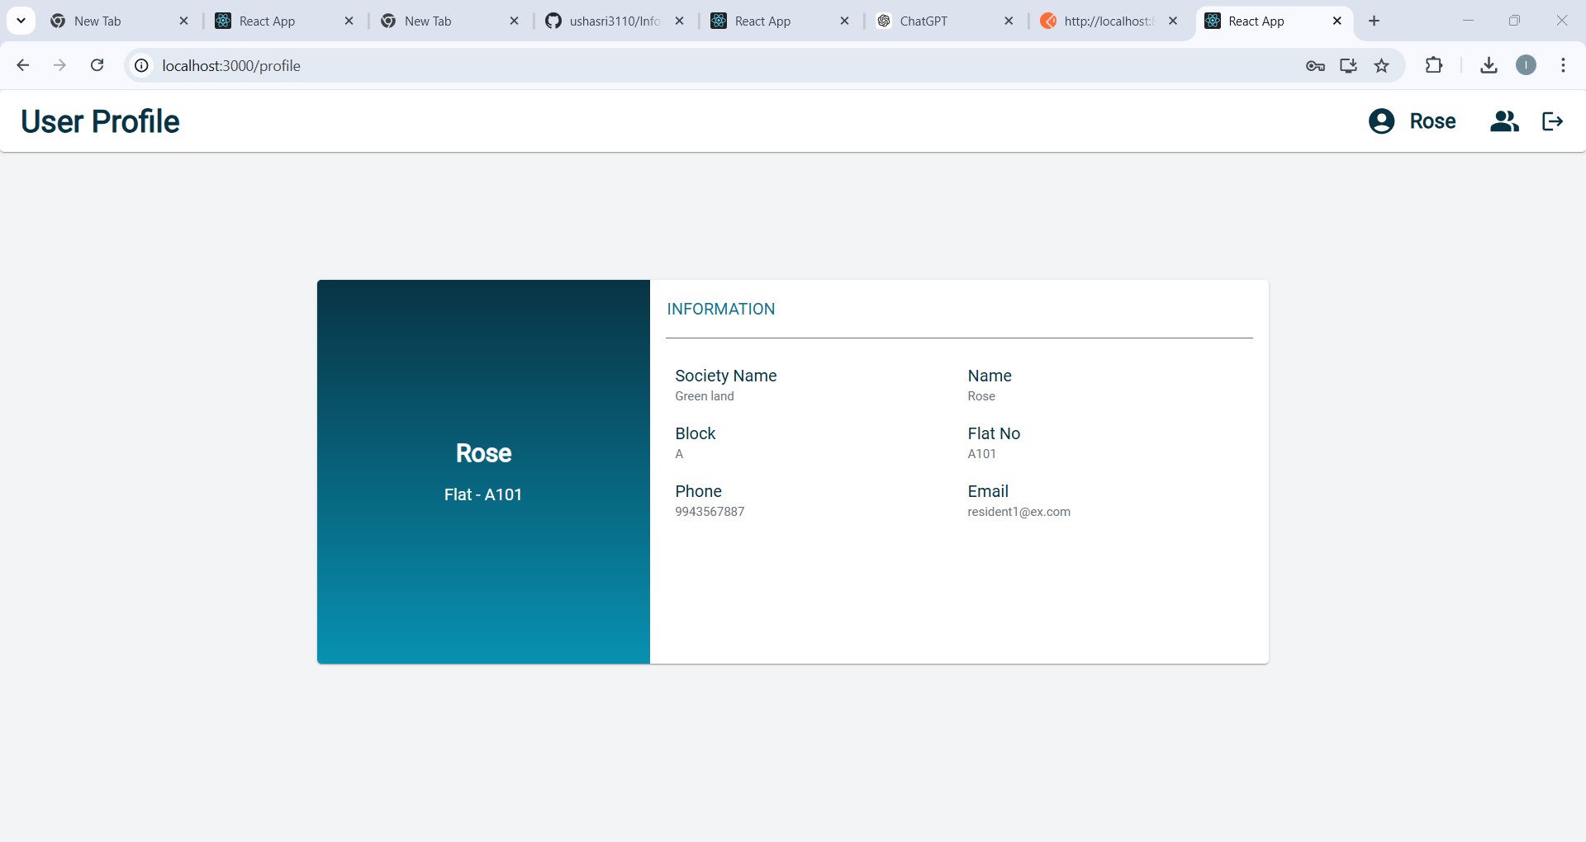
profile
admin Profile
Resident Profile

Slide 12
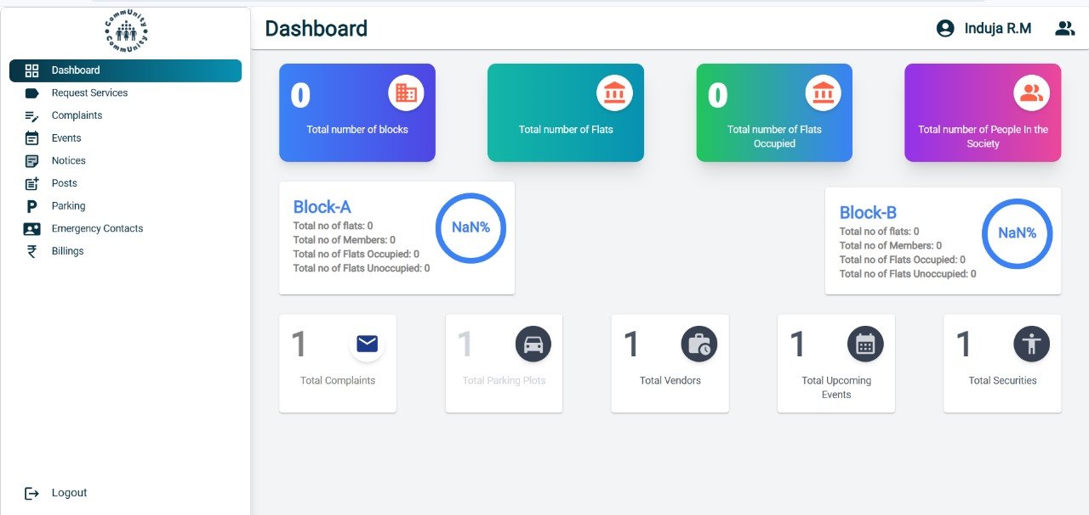
DASHBOARD

Slide 13
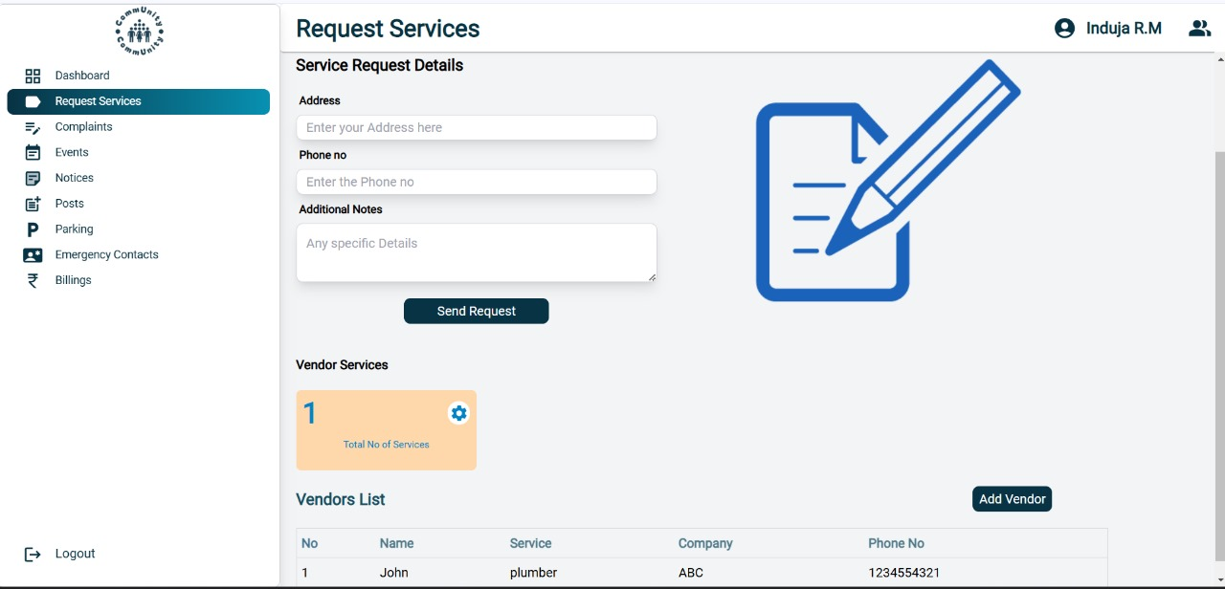
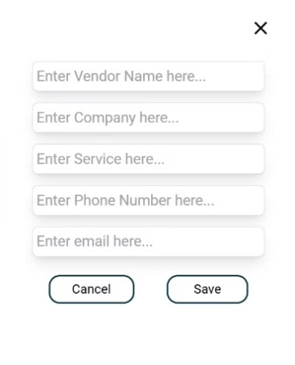
Request services

Slide 14
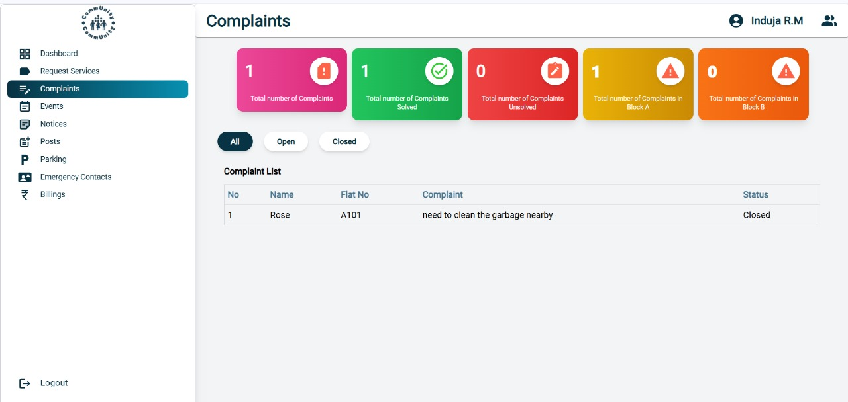
Complaints

Slide 15
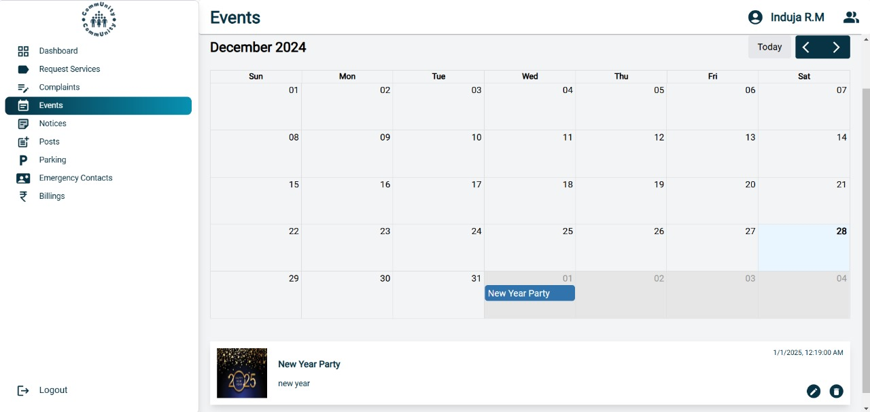
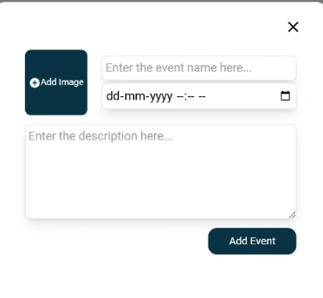
events

Slide 16
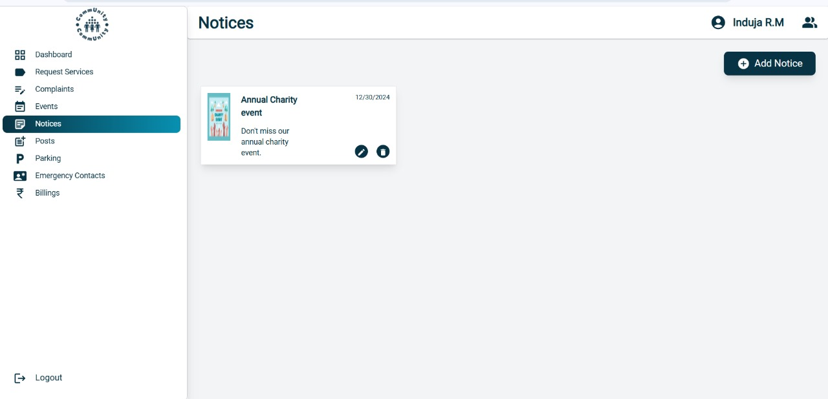

Notices

Slide 17
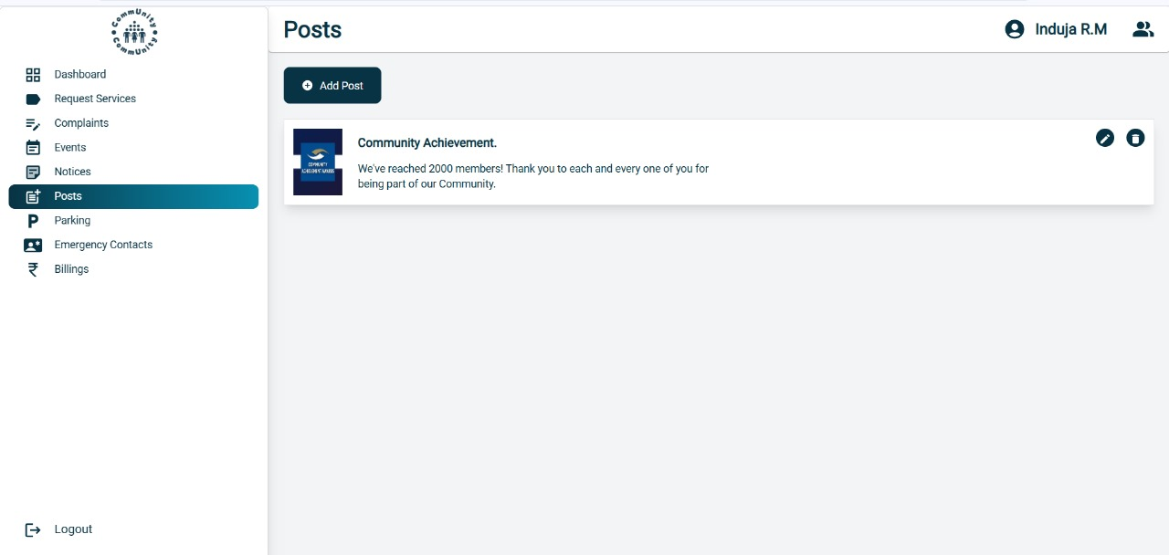
posts

Slide 18
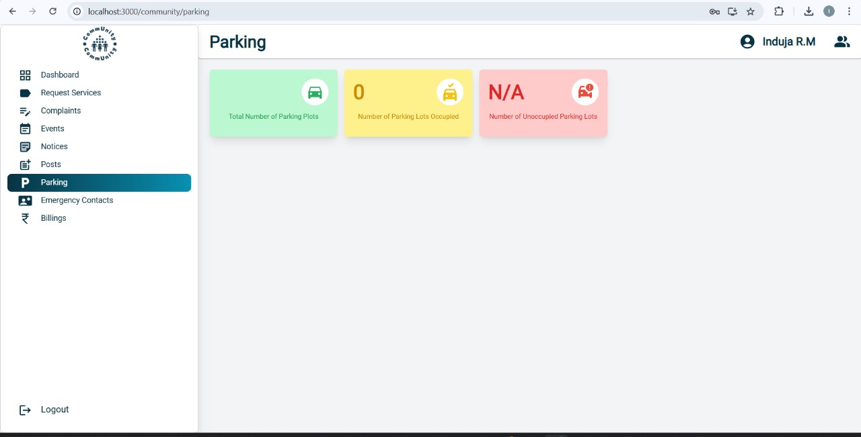
parking

Slide 19
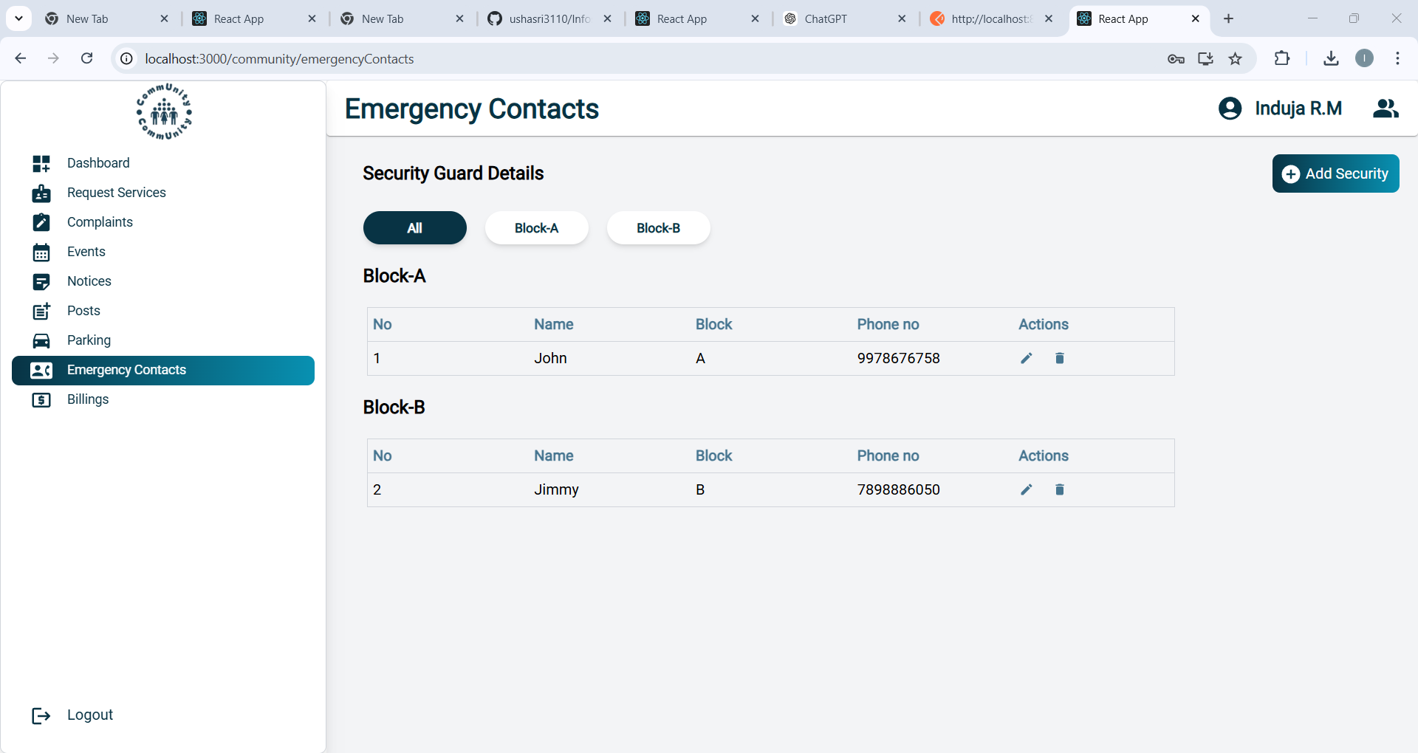
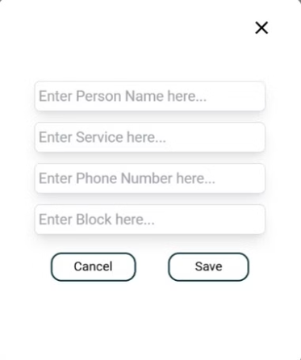
Emergency contacts

Slide 20
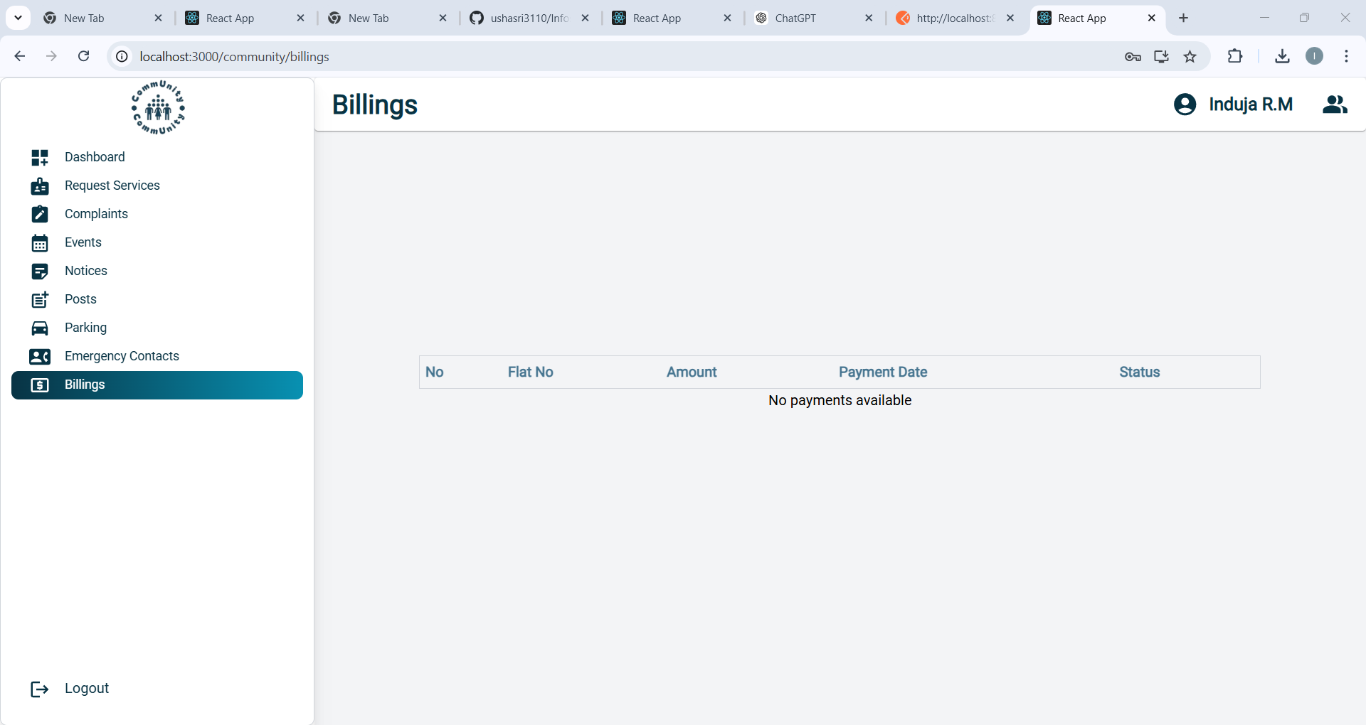
billing

Slide 21

Feature Enhancement
Dynamic Role Customization
Allow admins to create custom roles with specific permissions tailored to their society's needs.
Mobile Application Integration
Develop a mobile app for Android and iOS for on-the-go access to platform features.
Visitor Management System
Include features to log, track, and manage visitors with OTP-based approvals.
Real-Time Notifications
Enable push notifications and SMS alerts for critical updates, event reminders, and payment due dates.

Slide 22

CONCLUSION
"CommUnity" is a transformative platform that redefines housing society management by simplifying operations, enhancing communication, and fostering transparency. With its modular, multi-tenant architecture, the system is scalable to meet the evolving needs of modern communities. By integrating advanced features like online payments, complaint tracking, and event management, "CommUnity" aims to create a cohesive and well-managed living environment. As we implement future enhancements, the platform is poised to become an indispensable tool for efficient and harmonious community living.

