Slide 1
INTERNNOVA
PYTHON INTERNSHIP
WEEK 6
Student Management System
Final Python Project
A menu-driven application demonstrating Python fundamentals, file handling,
exception handling and Object-Oriented Programming.
Technology: Python 3 | Version Control: Git & GitHub

Slide 2
1. Project Introduction
Overview
What is the project?
Why was it developed?
A console-based Student Management System that allows users to add, view, search, update and delete student records.
To apply the Python concepts learned during the six-week internship in one practical application.
Storage
Learning Focus
Student data can be saved into a text file using Python file handling.
The project combines fundamentals, standard libraries, error handling and OOP in a single workflow.
InternNova Python Internship • Week 6 • Student Management System 2

Slide 3
2. Problem Statement & Objectives
Purpose
Problem Statement
Objectives
Manual student record management can make it difficult to maintain, search and update information consistently. A simple computerized system can make these operations faster and more organized.
• Build a practical Python application
• Manage student records through a menu
• Apply OOP concepts
• Use file handling and exception handling
• Validate user input
• Use Git and GitHub for version control
InternNova Python Internship • Week 6 • Student Management System 3

Slide 4
3. Key Features
Functionality
Add Student
View Students
Enter name, age, course and marks.
Display all stored records and grades.
Search Student
Update Marks
Find a record using Student ID.
Change marks with 0–100 validation.
Delete Student
Save to File
Remove a selected student record.
Store records in students.txt.
Date & Time
Polymorphism
Display current date and time.
Show different role behavior for Student and Teacher.
InternNova Python Internship • Week 6 • Student Management System 4

Slide 5
4. Python Concepts Used
Implementation
Variables and data types
Input / output
Type casting
Used in the application
Used in the application
Used in the application
if / elif / else
while loop
Functions
Used in the application
Used in the application
Used in the application
Dictionary data structure
File handling
Exception handling
Used in the application
Used in the application
Used in the application
datetime library
abc module
String formatting
Used in the application
Used in the application
Used in the application
InternNova Python Internship • Week 6 • Student Management System 5

Slide 6
5. Object-Oriented Programming
Core OOP
Class & Object
Constructor
Person, Student, Teacher and StudentManagementSystem.
__init__() initializes object attributes.
Inheritance
Abstraction
Student and Teacher inherit from Person.
Person uses ABC and an abstract display_role().
Encapsulation
Polymorphism
Private __marks is accessed through getter/setter methods.
Student and Teacher implement display_role() differently.
InternNova Python Internship • Week 6 • Student Management System 6

Slide 7
6. Project Workflow
How it works
1
Start program
2
Display menu
3
Choose operation
4
Validate input
5
Create / manage Student objects
6
View / search / update / delete records
7
Save data to students.txt
8
Continue until Exit
InternNova Python Internship • Week 6 • Student Management System 7

Slide 8
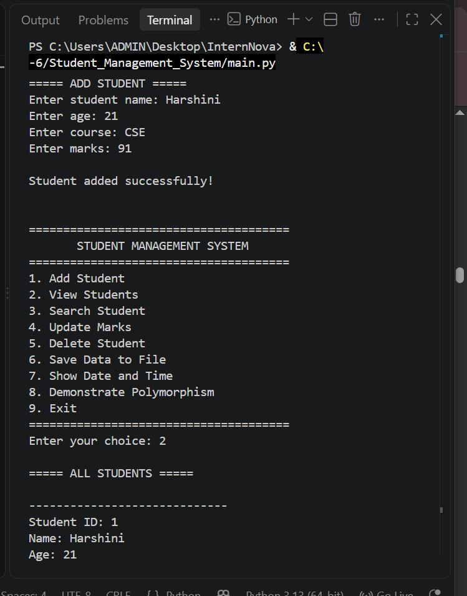
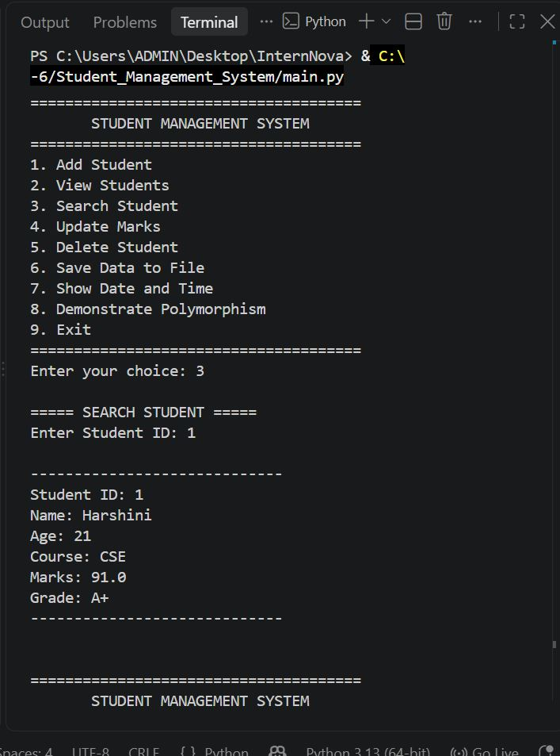
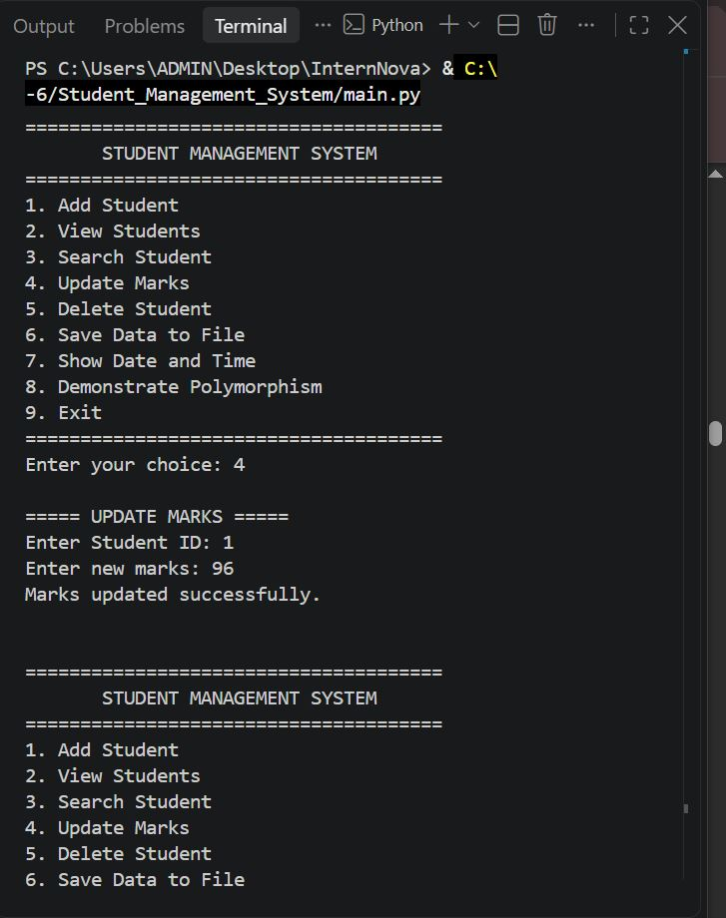
7. Project Output
Execution screenshots
Add Student
Search Student
Update Marks
InternNova Python Internship • Week 6 • Student Management System 8

Slide 9
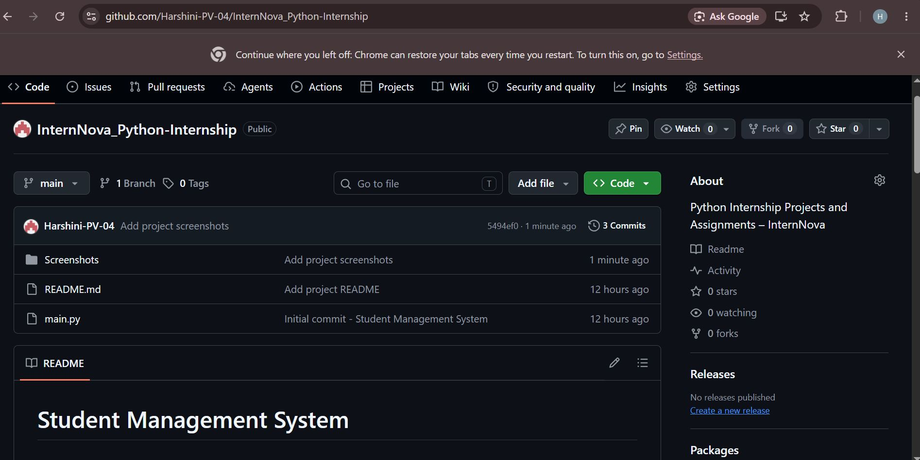
8. Git & GitHub
Version control
Git Workflow
Repository Contents
1. Initialize repository with git init
2. Check files with git status
3. Stage files with git add .
4. Commit project changes
5. Set main branch
6. Connect GitHub remote
7. Push to origin/main
• main.py
• README.md
• Screenshots/
The project was successfully pushed to GitHub, with the repository organized for submission and future maintenance.
InternNova Python Internship • Week 6 • Student Management System 9

Slide 10
9. Challenges, Future Improvements & Conclusion
Summary
Challenges
Future Improvements
Conclusion
• Working in the correct project folder
• Configuring Git email privacy
• Organizing repository files
• Validating user input
• Implementing multiple OOP concepts together
• Capturing clear terminal output
• Add a GUI
• Use SQLite/database storage
• Add login and authentication
• Add sorting and advanced search
• Generate performance reports
• Export data to CSV/PDF
The project successfully demonstrates Python fundamentals, file handling, exception handling, standard libraries and OOP. Git and GitHub were used to manage and publish the final project.
InternNova Python Internship • Week 6 • Student Management System 10

