Slide 1
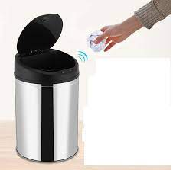
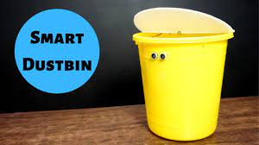
ENVIRONMENT
SMART DUSTBIN WITH ARDUINO
Presented by,
HARSHINI SA
II YR,ECE
ST.JOSEPH’S INSTITUTE OF TECHNOLOGY.
CHENNAI

Slide 2
AGENDA
CONTEXT
OBJECTIVE
COMPONENTS
WORKING
IMPLEMENTATION
ADVANTAGES
DISADVANTAGES
CHALLENGES
GLOBAL TRENDS
DESIGN
CONCLUSION

Slide 3
CONTEXT
Dustbins(or garbage bins, trash cans) are small plastic(or metal) containers that are used to store trash (or waste) on a temporary basis. They are often used in homes, offices, streets, parks, etc. to collect the waste.
In some places,litering is a serious offence and hence public waste containers are the only way to dispose small waste.
Usually, it is common practice to use separate bins for collecting wet or dry, recyclable or non-recyclable waste.
In this project, I have designed a simple system called smart dustbin using arduino, ultrasonic sensor and servo motor, where the lid of the dustbin will automatically open itself upon detection of human hand.

Slide 4
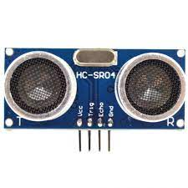
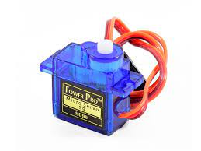
OBJECTIVE
In this project , I will show you how to make a smart dustbin using arduino, where the lid of the dustbin will automatically open when you approach with trash. The other important components used to make this smart dustbin are an HC-04 ultrasonic sensor and an SG90 TowerPro servo motor.
The main concept behind the smart dustbin using arduino project is object detection. A similar methodology is implemented here, where the ultrasonic sensor is placed on the top of dustbin’s lid and when the sensor detects any objects like a human hand, it will trigger arduino to open the lid.

Slide 5
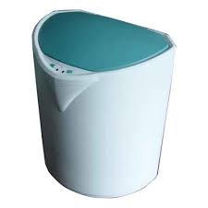
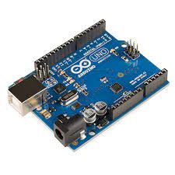
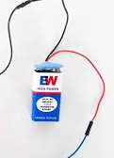
COMPONENTS USED
Arduino UNO
HC-SR04 Ultrasonic sensor module
Towerpro SG90 servo motor
Connecting wires
5V Power supply
A small dustbin with hinged lid
Miscellaneous(glue,plastic tube,etc.)

Slide 6
WORKING
First, I will start with the mechanism to open lid. In order to open the lid, I have fixed a small plastic tube (like an empty refill of a ball-point pen) to the servo horn (a single ended horn) using instant glue. For this mechanism inorder to be able to open the lid of the dustbin, it must be placed near the hinge where the lid is connected to the main can. The servo motor is fixed on the can. Also ,make sure that the lifting arm is parallel to ground under closed lid condition. Once the servo is in position, you can move into ultrasonic sensor. Make two holes corresponding to the ultrasonic sensor on the lid of the dustbin.
Now from the inside, place the ultrasonic sensor through the holes and fix its position with the help of glue. The final step in the build process is to make the necccessary connections using long connecting wires and securing these wires so that they don’t hang around. All the wires from both the components i.e. ultrasonic sensor and servo motor are connected to respective pins of arduino. This finishes up the build process of the smart dustbin.

Slide 7
IMPLEMENTATION
After setting up the smart dustbin and making all the necessary connections,upload the code to arduino and provide 5v power supply to the circuit. Once the system is powered ON, arduino keeps monitoring for any object near the ultrasonic sensor.
If the ultrasonic sensor detects any object like a hand for example, arduino calculates its distance and if it is less than a certain predefined value,arduino will activate the servo motor and with the support of the extended arm,it will list the lid open.
After a certain time,the lid is automatically closed.

Slide 8
ADVANTAGES
Users consider these systems effective as they offer multiple benefits in terms of time saving, minimizes infrastructure, and operating costs by up to 30%.
In addition , rising dependency of users on smart systems that have the ability of reducing manpower requirements to handle the garbage collection process,is found to be an additional benefit
Cost effective, easy to use.
Improved environment(i.e. no overflowing bins and less pleasant odours)
They are useful in more remote locations, such as parks ,campsites and beachside areas, where data on bin fill-levels would allow collection services to only travel out when needed.

Slide 9
DISADVANTAGES
Sensor nodes used in the dustbins have limited memory size.
It reduces man power requirements which results into increase in unemployments for unskilled persons.
System requires more number of waste bins for separate waste collection as per population in the city. This results into high intial cost due to expensive smart dustbins compare to other methods.
Also , rough action and usage of the user may cause damages to the sensors.
The process is not always cost effective.
The practices are not done uniformly.

Slide 10
CHALLENGES
According to the laws of physics ,you will require more energy to push the lid from the hinge than at the extreme end. But in order to open the lid and not have any obstacle,this is the only place to fix the servo motor with its arm.
We have to use a sharp objects with a lot of force to make these holes.

Slide 11
GLOBAL TRENDS
Major players across the global are introducing smart trash bins with unique materials and advanced technology that help users in easing logistics, reducing costs, and improving the environment.
This is likely to drive the demand for smart trash bins in the coming years.
Increasing awareness about the usage of technologically advanced trash bins among users is influencing them to opt for smart trash bins.
Emerging countries across the global are promoting their major cities with smart technology in order to meet smart city project intiatives, which is likely to gain demand for smart trash bins.

Slide 12
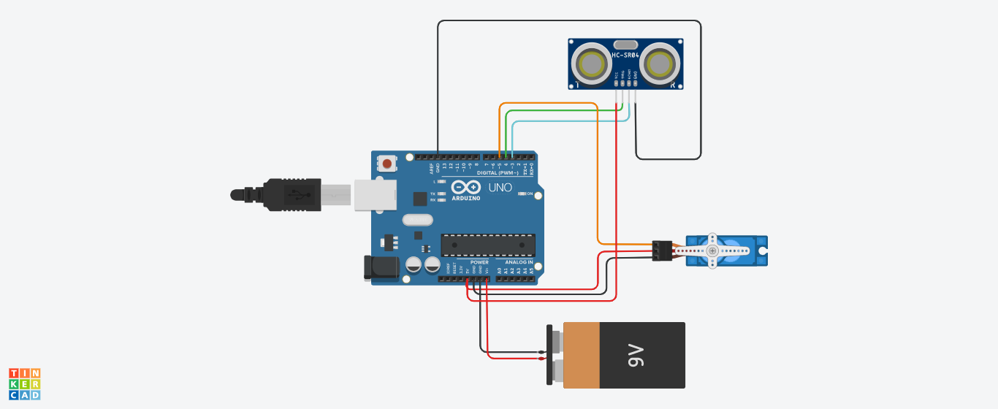
SOFWARE DESIGN USING TINKERCAD

Slide 13
CONCLUSION
A simple but useful project called smart dustbin using arduino is designed and developed here.Using this project , the lid of the dustbin stays closed, so that waste is not exposed (to avoid flies and mosquitoes) and when you want dispose any waste, it will automatically open the lid.
This project came in comfortable which a worthy elucidation for maintaining green environment . The proposed system is an attempt to improve current waste collection system in India for the “CLEAN INDIA MISSION”.

Slide 14
THANKYOU

