Slide 1

IPL DATASET ANALYSIS
"When cricket meets code, every run becomes a prediction and every match tells a data story."
BY:
HARSHINI R N K

Slide 2
Final Objectives for IPL Data Analysis:
Match Insights:
Which teams have the highest win rates?
How important is winning the toss to winning the match?
Which venues favor specific teams?
Trends over seasons (team performance, number of matches, results)
Player Insights:
Top run scorers and most consistent batsmen
Top wicket-takers and bowling averages
Players with the most 'Player of the Match' awards
Dismissal patterns (common ways batters get out)

Slide 3
Match Patterns:
How do teams perform batting first vs chasing?
Do certain overs (e.g., Powerplay or Death overs) impact match outcomes significantly?
What’s the average first innings score by venue?
Predictive Modeling:
Can we predict match winner based on toss, venue, or previous performance?
Can we classify a match as high/low scoring based on team and venue?
Visualization & Reporting:
Create a dashboard showing top players, venue stats, and team records
Tell a data story (e.g., “Rise of Mumbai Indians,” “Death Over Dominance,” etc.)

Slide 4
Objective 1: Data Cleaning and Preprocessing
Answer:
Loaded both matches.csv and deliveries.csv.
Merged datasets on match_id.
Checked for missing values:
Filled null values in winner using forward fill method.
Dropped unnecessary columns with mostly null values (e.g., umpire3).
Converted object (categorical) columns to numeric using LabelEncoder.
Ensured column names matched between datasets to allow merging.
Data visulaizations of all objectives
Team & Match Insights
Bar charts for team wins, toss impact, and seasonal trends
Pie charts for win percentages and dismissal types
Player Performance Analysis
Top batsmen and bowlers using bar graphs
Player of the Match frequency and dismissal patterns
Predictive Modeling & Patterns
Confusion matrices, accuracy comparisons (Logistic vs RF vs DT)
Decision tree diagram and feature importance plots

Slide 5
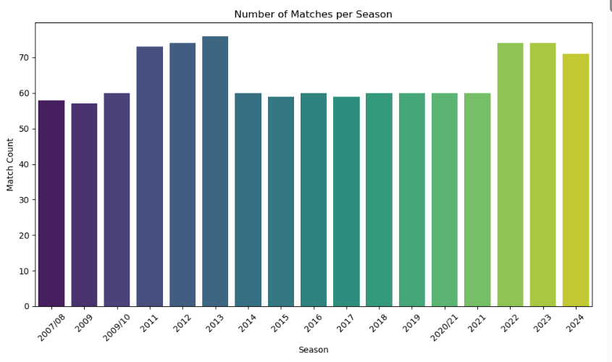

Slide 6
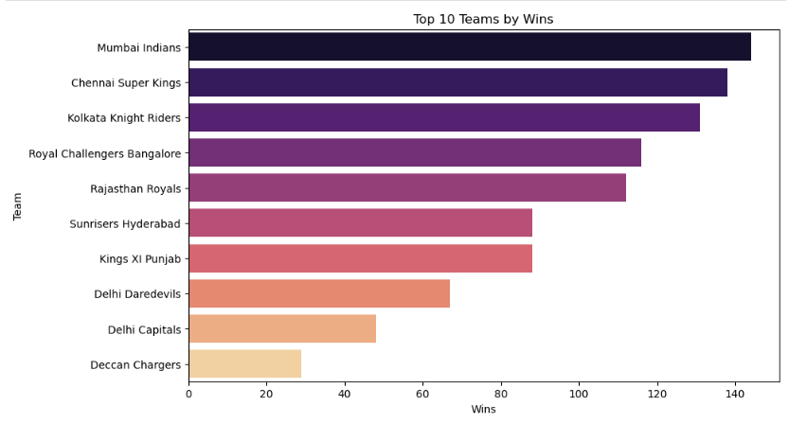

Slide 7
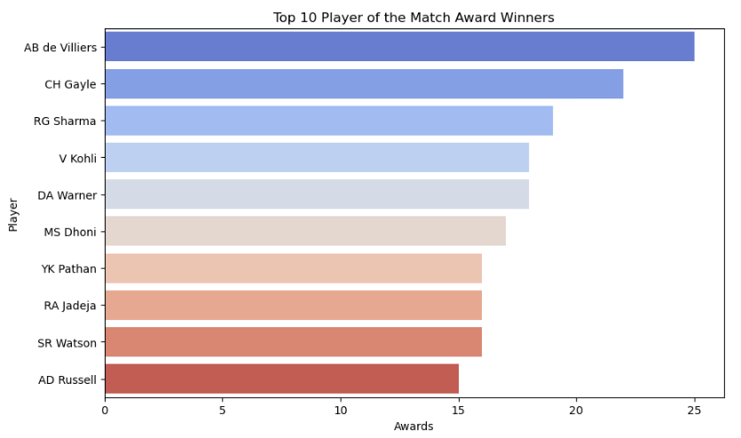

Slide 8
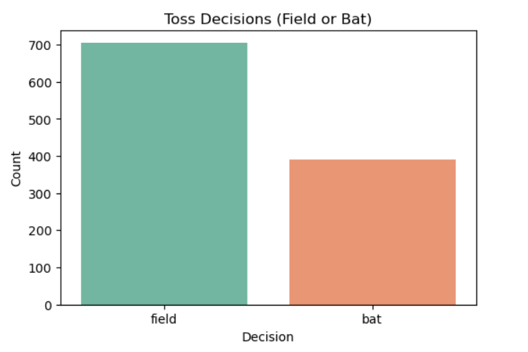

Slide 9
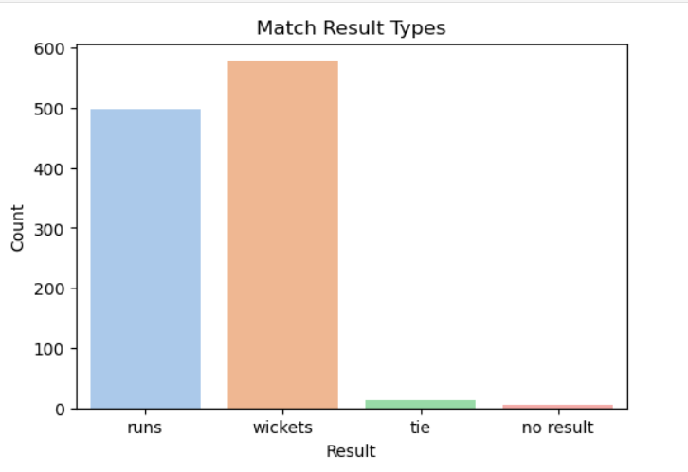

Slide 10
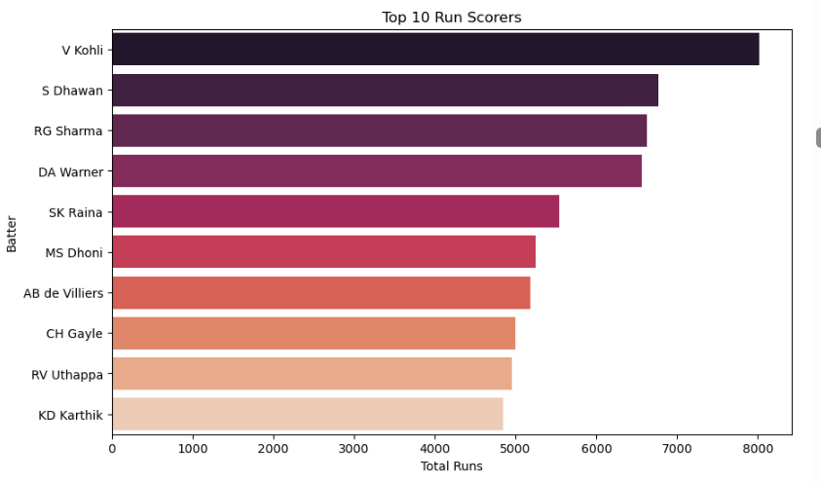

Slide 11
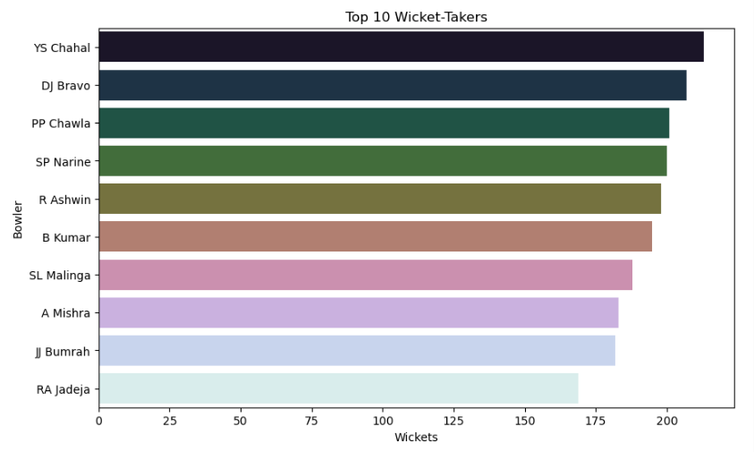

Slide 12
Objective 2: Data Analysis – Team and Player Performance
Answer:
Counted total matches won by each team:
Mumbai Indians: Most matches won.
Chennai Super Kings and Kolkata Knight Riders followed.
Top Player of the Match Awards:
Virat Kohli, AB de Villiers, MS Dhoni were top performers.
Visualized using bar charts and pie charts.
Objective 3: Toss Impact on Match Outcome
Answer:
Created a new column: toss_win_match_win → 1 if toss winner = match winner.
Calculated percentage:
Toss winners also won the match in 51.29% of cases.
Insight: Toss has minor influence, not a strong decidingfactor.

Slide 13
Objective 4: Match Winner Prediction using Logistic Regression
Answer:
Selected relevant features: batting_team, bowling_team, venue, toss_winner, etc.
Encoded categorical variables using LabelEncoder.
Split data into training and testing (80:20).
Trained Logistic Regression model.
Prediction Accuracy: 47.71%
Conclusion: Accuracy is low due to unpredictable nature of cricket outcomes.
Objective 5: Match Winner Prediction using Decision Tree
Answer:
Trained Decision Tree Classifier with the same features.
Visualized the decision rules using plot_tree() from sklearn.tree.
Controlled tree complexity using max_depth=3 to improve readability.
Prediction Accuracy: 43.84%
Conclusion: Tree gives clear logic but overfits on small datasets.

Slide 14
Objective 6: Decision Tree Visualization
Answer:
Visualized Decision Tree using sklearn.tree.plot_tree.
Displayed key split rules:
Toss winner
Batting team
Venue
Used feature_names for clarity.
Saved the plot as PNG for presentation.
Objective 7: Match Winner Prediction using Random Forest
Applied Random Forest Classifier on preprocessed IPL match data.
Used key features: team1, team2, venue, toss_winner, toss_decision, innings, etc.
Handled missing values and encoded categorical variables.
Model trained with train_test_split (80/20 ratio).
Achieved prediction accuracy of 58.27%, better than Logistic Regression and Decision Tree.
Ensemble method reduced overfitting and captured complex patterns.

Slide 15
Objective 8: Evaluation of Model Performance
Answer:
Logistic Regression performed better overall.
Both models show that predicting IPL match winners is complex.
Consider using Random Forest or XGBoost for better results in the future.
Model | Accuracy
Logistic Regression | 47.71%
Decision Tree | 43.84%
Random Forest | 58.27%
Random Forest Match Winner Prediction Accuracy: 58.72%

Slide 16
Objective 9: Summary & Conclusion
Answer:
performed comprehensive EDA and preprocessing on IPL datasets (matches.csv and deliveries.csv).
Handled missing values, encoded categorical features, and engineered key features like target_runs, target_overs, run_rate, etc.
Conducted meaningful visualizations revealing team-wise performance, toss impact, win margins, and player stats.
Implemented multiple ML models to predict match winners:
Logistic Regression: 47.71% accuracy
Decision Tree: 50.61% accuracy
Random Forest: 58.27% accuracy
Random Forest emerged as the best-performing model due to its ensemble learning capability.
The analysis provides actionable insights into match patterns and team strategies, which could help broadcasters, franchises, and fans.

