Slide 1


SMART INDIA HACKATHON 2026
Weather GPT
Problem Statement ID – 26068
Problem Statement Title –Weather GPT: Conversational AI for
Weather Forecasting, Alerts, Climate Information
Theme – Agriculture, Food Tech & Rural Development
PS Category – Hardware
Team Name (Registered on portal) – CodeXcape

Slide 2
PROPOSED SOLUTION
WEATHERGPT
ASK
( voice/text in 10+ regional language) ↓ UNDERSTAND
(LLM intent and Geo-Location Parsing) ↓ RETRIEVE
(Real –Time IMD, Satellite and NWP Feeds) ↓ EXPLAIN
(Generative Advisory in plain language) ↓ ACT
(instant early warnings and actionable alerts)
KEY FEATURES
PROBLEM
WHY WE STAND OUT
• Conversational access instead of dashboard-heavy interfaces.
• Location + context aware responses for agriculture, disaster management, aviation and cities.
• Multilingual + voice interaction for wider accessibility.
• Live weather + NWP + warnings + historical climate analysis in one flow.
Conversational AI querying- asking complex
queries
Automated bulletin parsing- AI ingests daily
IMD bulletins
Real-time alerting system- push emergency warnings via sms and whatsapp for sudden floods
Multi-Modal Analytics-
Supports spatial graph displays
Low-latency Edge Access-
Optimized micro-LLM
• Weather data is fragmented across portals, bulletins, satellite products and forecast systems.
• Users struggle to convert technical forecasts into simple, actionable decisions.
• During cyclones, floods and other extremes, delayed understanding can increase risk.

Slide 3
TECHNICAL APPROACH
TECHNOLOGIES TO BE USED :
Frontend : React.js/Flutter
Backend : Python, FastAPI
AI/ML : Python, NLP, Machine Learning
Weather Data : IMD APIs, GFS/WRF model data, Satellite & Radar data
Database : PostgreSQL/MongoDB
Maps : GIS, Mapbox API
Voice : Speech-to-Text, Text-to-Speech
Languages : English + Indian Regional Languages
Cloud : AWS/Google Cloud Platform
METHODLOGY AND PROCESS FOR IMPLEMENTATION
User Query/Voice Input:
User asks a question
2. Language & Intent :
NLP model and under
3. Location Identification:
Detects user location(GPS/IP/manual input
4. Retrieve Real-Time Weather + Forecast Data:
Fetch data from IMD, APIs, Radar etc.
8.Text/ Voice+ Weather Map: Provide response in text/voice with interactive map
7. Personalized Advisory/ Alert: Generate location based advisory/alert.
6. Risk & Extreme Weather Detection: Detect heavy rain, cyclone, heatwave, etc.
5. AI/ML Analysis: Analyze data, predict weather condition & trends.

Slide 4
WORKING PROTOTYPE
User Query:
"Will it rain heavily in my area tomorrow ?"
WeatherGPT identifies location & retreives data
Detects heavy rainfall risk
AI analyses forecast & rainfall data
Response (Text/ Voice):
Heavy rainfall is likely tomorrow between 3PM – 7PM.
Avoid unnecessary travel and stay alert for local advisories

Slide 5



FEASIBILITY AND VIABILITY
• Built from existing APIs, NWP data, LLMs, GIS and open software frameworks.
• Modular backend allows individual data sources to be added or replaced.
• Pilot can start with selected locations and priority use cases.
• Cloud/container deployment supports scaling as usage grows.
• Forecast uncertainty / disagreement between models.
• External API or network downtime.
• LLM hallucination or incorrect interpretation.
• Language and voice recognition errors.
• Alert fatigue during frequent events.
• Show forecast time, source and uncertainty where relevant.
• Use caching, fallbacks and retry mechanisms.
• Ground AI answers in retrieved meteorological data.
• Confidence checks + multilingual testing.
• Prioritize severe, location-relevant warnings.

Slide 6
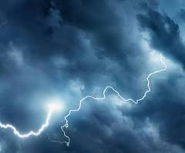

IMPACT AND BENEFITS
IMPACTS:
BENEFITS:
Improved weather awareness
Early Weather Alerts
Makes weather information easier to understand than traditional weather apps.
Warns users about extreme weather such as heavy rain, storms, floods, and heatwaves.
Conversational Interaction
Early Alerts & Disaster Preparedness
Users can simply ask questions in natural language instead of reading complicated weather data
Provides timely alerts for heavy rainfall, storms, heatwaves, floods, etc.

Slide 7

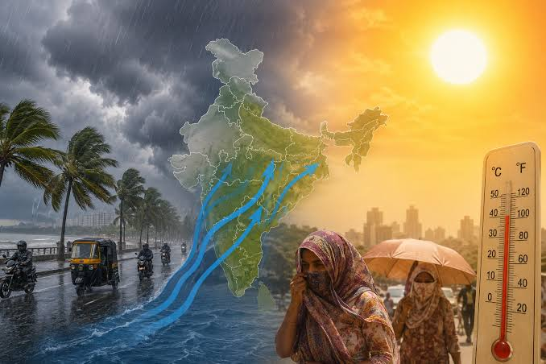
Agricultural and Economic Resilience
Delivers hyper local, regional
language advisories to over 100M+ farmers to prevent crop loss and boost yield
Climate Awareness
Location-Based Forecasts
Goes beyond short-term forecasts by explaining climate patterns, extreme weather trends, and environmental changes.
Provides weather information
relevant to the user's location.
Improves Safety
Personalized Information
Gives users advance information to prepare for potentially dangerous weather conditions
Intead of giving everyone the same information , WeatherGPT
Can answer questions based on the user's location , situation and
Specific needs.
Quick Access to Information
Users can get answers instantly instead of searching through multiple sources

Slide 8
RESEARCH AND REFERENCES
TAM – Total Addressable Market (Indian Digital Weather & Climate Tech Market)
Scope: All smartphone/internet users in India needing real-time weather & agricultural advisories (~900 Million users).
Calculation: Under 100% adoption assumption = ~$1.2 Billion
SAM – Serviceable Available Market (Indian Agricultural & Emergency Response Segment)
Scope: Smallholder farmers, rural agriculture communities, and regional disaster management teams (~150 Million users).
Calculation: Under targeted adoption assumption = ~$350 Million
REFERENCE:
"Accurate medium-range global weather forecasting with 3D neural networks (Pangu-Weather)," Nature, vol. 619, pp. 533–538, 2023. doi:10.1038/s41586-023-06185-3.
Bhashini AI Team, "Empowering Rural Accessibility via Multilingual Voice Translation Frameworks," National Language Translation Mission (NLTM), Ministry of Electronics and IT, 2024.
Pathak et al., "DeepLearning and LargeLanguage Models forAutomated WeatherForecasting andDisaster Response,"Journal of Atmosphericand Solar-TerrestrialPhysics, vol. 214, pp.105-118, 2024.
India Meteorological Department (IMD), "Integration Guidelines for Open Weather APIs and Numerical Weather Prediction (NWP) Data Services," Ministry of Earth Sciences (MoES) Technical Report, 2023.
SOM – Serviceable Obtainable Market (1-Year Initial Target)
Scope: Active agricultural users across 2–3 major agrarian states using regional voice/WhatsApp interfaces (~5 Million active users).
Calculation: Target 5% conversion rate in Year 1 = ~$15 Million

