Slide 1
Audio Transcription App using OpenAI Whisper
Team Name:
Alcoholics

Slide 2
Problem Statement
The app is an audio transcription tool that utilizes Whisper, a powerful AI model for speech recognition. It allows users to upload audio files (MP3 or WAV format) and transcribes the speech into text.
Challenges:
Manual transcription is slow and error-prone.
Existing tools lack accuracy and multilingual support.
High transcription costs for industries like media, education, and legal services.

Slide 3
Our Solution
How it Works:
Uses OpenAI Whisper, a cutting-edge speech recognition model.
Supports multiple languages with high accuracy.
Accepts MP3 and WAV formats for ease of use.
Converts speech into text efficiently and quickly.
Provides a user-friendly interface for seamless interaction.

Slide 4
How It Works
Process:
Upload Audio
Whisper AI processes the file
Speech-to-text conversion
User can edit or review the transcribed text
Download or share the transcription

Slide 5
Features & Advantages
High Accuracy with AI-powered transcription.
Supports Multiple Languages and dialects.
Handles Noisy Backgrounds effectively.
Fast Processing & Real-Time Transcription.
User-Friendly Interface for smooth interaction.
Export Options: Download in various formats (TXT, DOCX, PDF).
Secure & Private: Ensures data privacy with encrypted storage.

Slide 6
Technology Stack
Technologies Used
Backend: Python, Flask/Fast API
AI Model: OpenAI Whisper
Frontend: React.js, HTML, CSS
Cloud Storage: AWS/GCP
Database: PostgreSQL/Firebase
Deployment: Docker, Kubernetes

Slide 7
Use Cases
Industries Benefiting from the App:
Journalists – Quick interview transcription.
Students & Educators – Convert lectures into notes.
Content Creators – Automatic subtitles for videos.
Legal & Healthcare Professionals – Convert dictations into documents.
Customer Service & Call Centers – Analyze customer interactions.

Slide 8
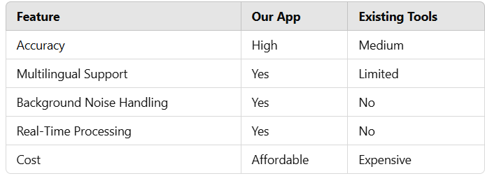
Competitive Analysis

Slide 9
Future Enhancements
Upcoming Features:
Live Transcription for Video Calls.
Integration with Zoom, Google Meet, and Microsoft Teams.
Custom Voice Models for Different Accents.
Punctuation & Formatting Improvements.
Mobile App Version for On-the-Go Transcription.

Slide 10
Business & Monetization Plan
Revenue Model:
Freemium Model: Basic free version with limited features.
Subscription Plans: Monthly premium plans for advanced features.
API Licensing: Offer APIs for integration into third-party apps.
Enterprise Solutions: Custom solutions for businesses.
Target Market: Media, education, healthcare, and corporate sectors

Slide 11
Conclusion
Our AI-driven transcription app enhances efficiency and accessibility.
The solution is scalable, accurate, and supports multiple languages.
Future advancements will strengthen its impact across industries.
It offers businesses and individuals a reliable transcription tool.

Slide 12
THANK YOU

