Slide 1
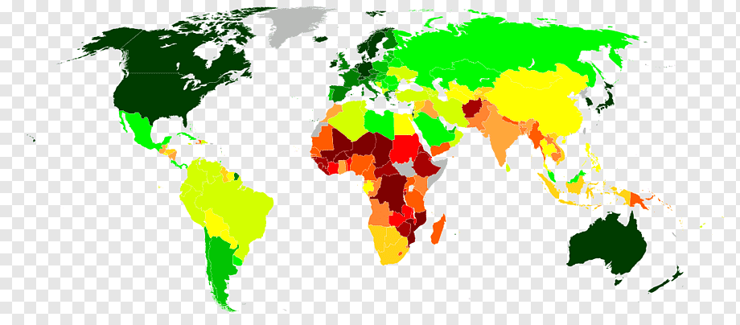
World Development Measurements Clustering
GUIDED BY – PRANAM SRAVANI

Slide 2
TEAM MEMBERS
Pratik Sutar
Usharani H K
MD RAFAY AHMED
Kale Saurabh Arjun
Rohit Rathod
G HARSHINI
Yaragarla Susmitha

Slide 3
Project Contents-
Understanding Data
Data set Description.
Description of All Features
Exploratory Data Analysis (EDA)
Data Cleaning and preparation.
Plotting Distribution and Box plots.
Model Building, Model Selection & Validation
Building Different Kinds of Clustering Models.
Selecting the Best Model.
Deployment
Deploying the Model using Streamlit.

Slide 4
Business Problem and objectives
Creating clusters on the global development measurement dataset.
The objective of the analysis is to form clusters based on the given global development measurement data.

Slide 5
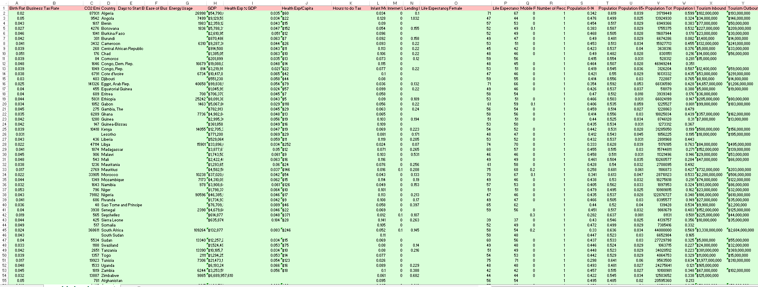
UNDERSTANDING THE DATA
Data set details
No. of Rows: 2704
No. of Features: 25
No. of Categorical Features: 1
No. of Continuous Features: 24

Slide 6
The given dataset is the world development measures dataset.
It contains the data of different measurement indexes of every country that spans over 13 years.
The dataset contains 2704 records and 25 features.
Out of 25 features 24 are Numerical features and the remaining one is a Categorical Feature i.e. Name of the country.
Even though the remaining features are numerical some values contain special characters like ‘$’,’%’ and ’,’, so the machine thinks of it as an object or a string.

Slide 7
The description of each feature:
Birth Rate: The Birth rate in the country
Business Tax Rate: The Business Tax rate in the Country
CO2 Emissions: Annual CO2 emissions of the country
Country: Name of the Country
Days to Start Business: Average number of days taken by an industry/company to start a business in that country
Ease of Business: Ranking of the country in terms of Ease of Doing Business
Energy Usage: Total energy usage of the country
GDP: Total GDP of the Country
Health Exp % GDP: Decimal value of Percentage of GDP spent on the Health Sector in the Country
Health Exp/Capita: The money spent on each individual of the country by health sector (in $)
Hours to do Tax: Number of Hours to do Tax
Infant Mortality Rate: The infant mortality rate of the country
Internet Usage: The internet usage of the country
Lending Interest: The lending interest of the Country
Life Expectancy Female: The average Life expectancy of Females in the Country
Life Expectancy Male: The average Life expectancy of Males in the Country
Mobile Phone Usage: The Mobile usage in the country
Number of Records: The Number of records from which the data is collected.
Population 0-14: Decimal value of Percentage of the population aged between 0 and 14 in the Country

Slide 8
Population 15-64: Decimal value of Percentage of the population aged between 15 and 64 in the Country
Population 65+: Decimal value of Percentage of the population aged above 64 in the Country
Population Total: Total population of the Country
Population Urban: Decimal value of Percentage of population living in urban areas of the Country
Tourism Inbound: The amount of revenue generated by foreign Inbound tourists in the country.
Tourism Outbound: The amount of revenue generated by the outbound tourists from the country.

Slide 9
Exploratory Daya Analysis (EDA)
Describing data
Removing symbols and convert objects into flot datatypes
Dealing with Missing values
Dropping Unnecessary columns
Duplicate values
Correlation
Outliers
Visualizations

Slide 10
Dealing with NULL Values:
We observed that there are so many NULL values in every feature of the dataset.
Before dealing with NULL values, We dropped some unnecessary columns and renamed some columns for our use.
To deal with these NULL values wewe replaced it with Mean and Median.
We observed that there are 208 unique Country names and each name is repeated 13 times.
This indicates that this dataset contains data in a span of 13 years.
This newly grouped dataset contains 208 entries with 23 features along with the Country name.

Slide 11
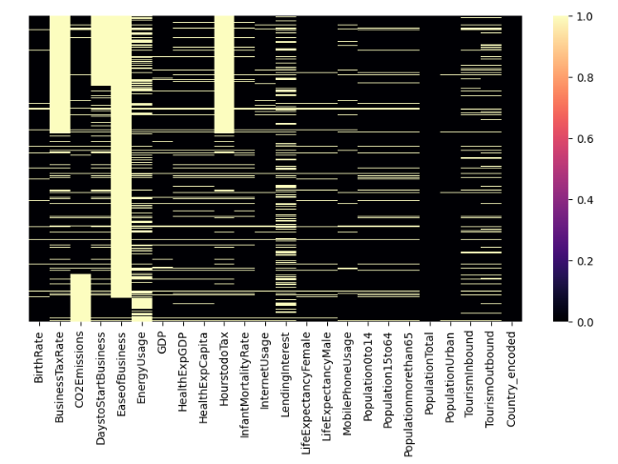
Representation of NULL values of each attributes

Slide 12
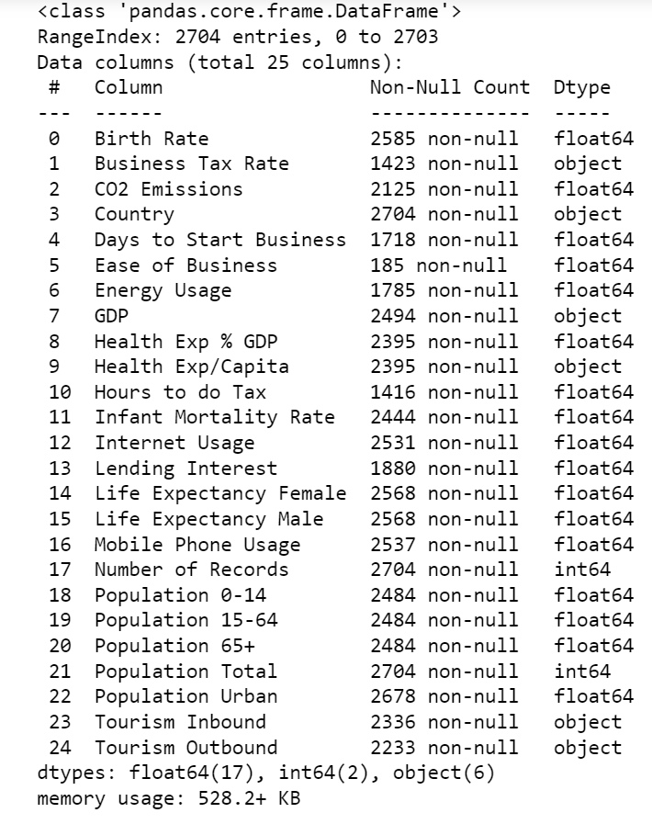
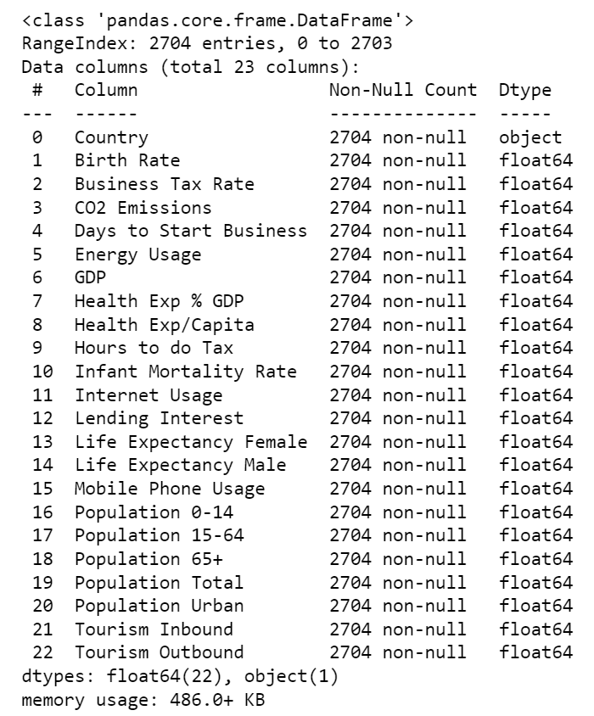
Dealing with Datatypes, NULL values and Unnecessary columns
BEFORE:
AFTER:

Slide 13
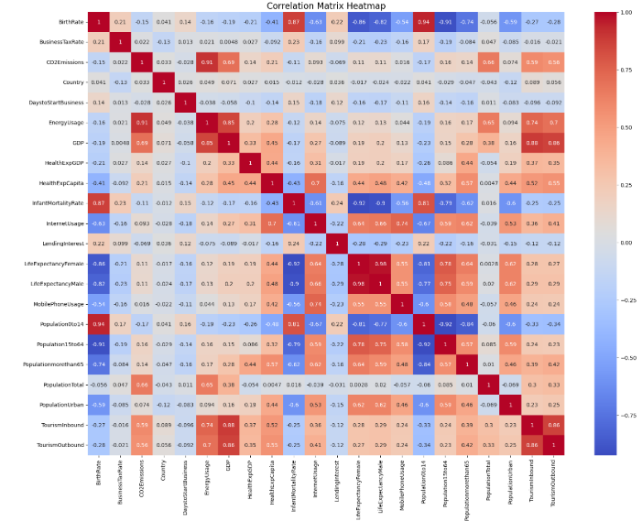
Heat Map of Correlation between Features :

Slide 14
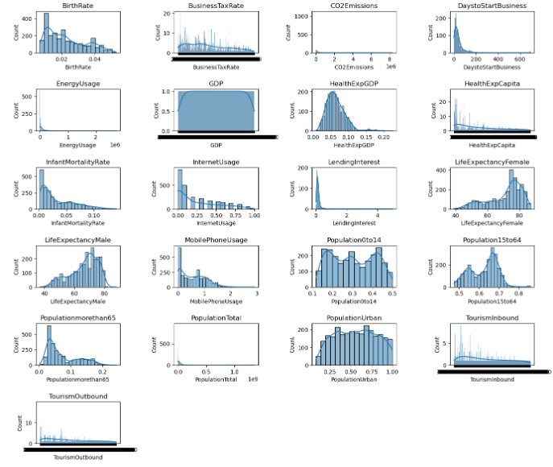
Representation of Histogram of Columns :

Slide 15
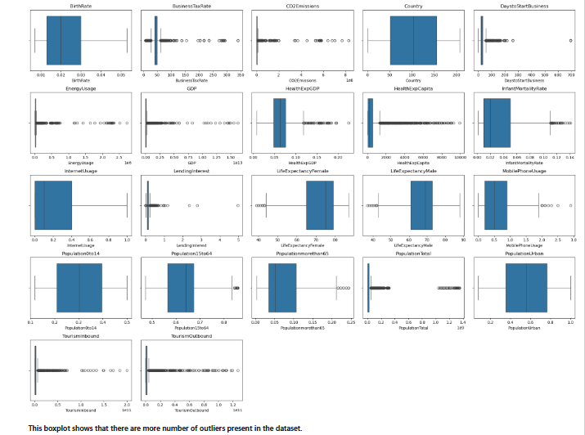
Box Plots of all Features :

Slide 16
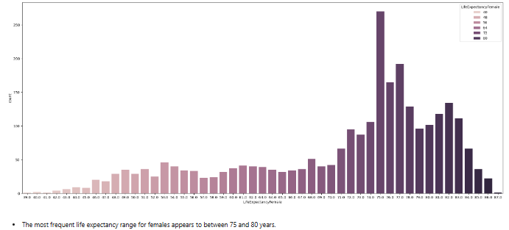
Count plot that shows the most frequent life expectancy range for females appears to between 75 and 80 years :

Slide 17
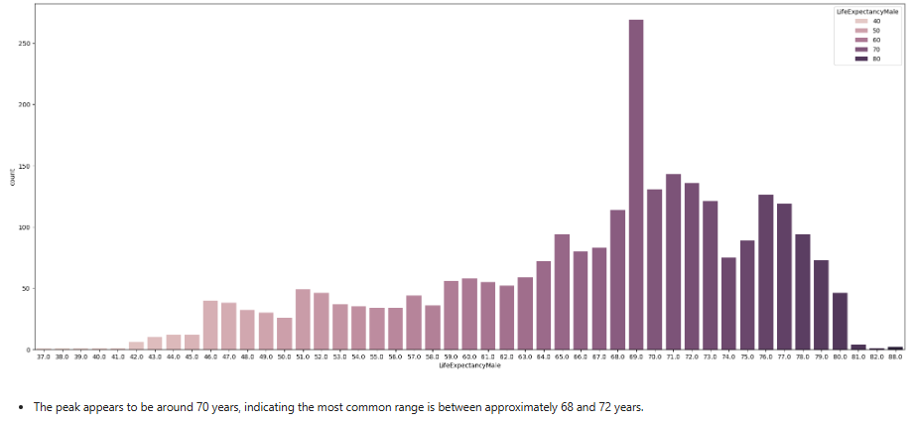
Count plot that shows the peak appears to be around 70 years, indicating the most common range is between approximately 68 and 72 years :

Slide 18
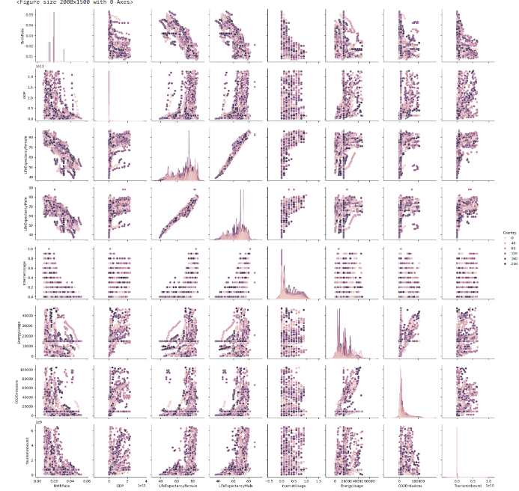
Pair Plot of the columns :

Slide 19
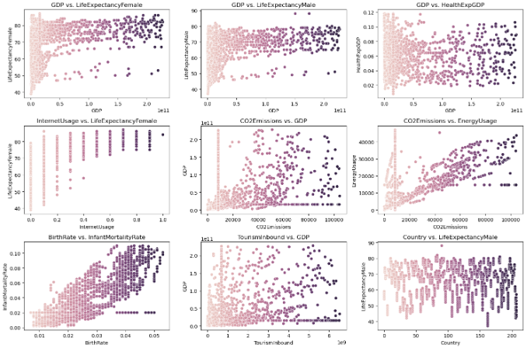
Scatter Plot of the columns :

Slide 20
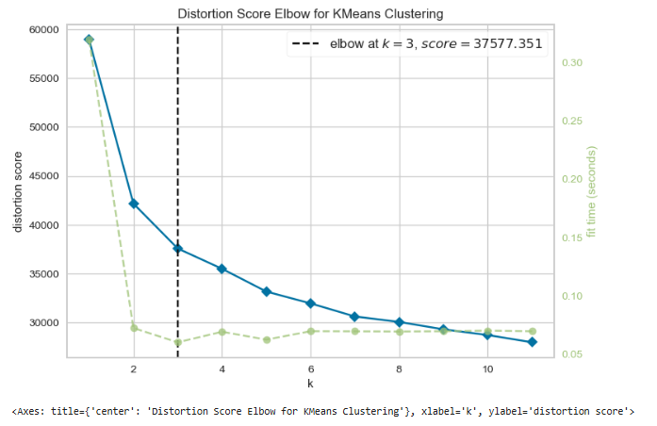
Elbow Plot of the K-Means clustering :

Slide 21
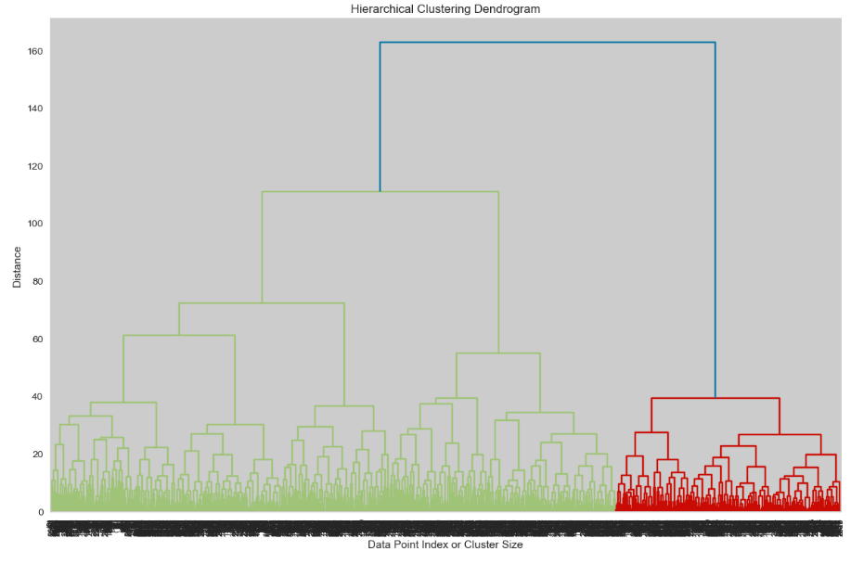
Dendogram of Hierarchical clustering :

Slide 22
INSIGHTS
The Major Insights gained by observing all the Graphs are:
None of the features has a Perfect Normal Distribution.
Every feature has many outliers.
The Countries having higher Tourism Inbound & Outbound are having higher GDP
The elbow curve suggests that the optimal number of clusters is 3.
The countries with higher business tax rates tend to have higher energy usage.
A positive correlation between GDP and energy usage is expected, as more developed economies generally consume more energy.
The most frequent life expectancy range for females appears to between 75 and 80 years .
The peak appears to be around 70 years, indicating the most common range is between approximately 68 and 72 years

Slide 23
Model Building :
CLUSTERING : Clustering is a process of grouping a set of objects or data points into subsets or clusters based on their similarity in some predefined way. The goal of clustering is to create groups of objects that are more similar to each other than to objects in other clusters while maximizing the dissimilarity between different clusters.
Clustering Techniques Used in this Project :
K-Means Clustering
Agglomerative Clustering
DBSCAN Clustering

Slide 24
K-Means Clustering : KMeans clustering is a popular unsupervised machine learning algorithm used to partition a dataset into a set of distinct, non-overlapping clusters.
Task done in K-Means clustering:
In K-Means clustering we have done PCA (Principle Component Analysis).
PCA : Principal Component Analysis (PCA) is a statistical technique used in data analysis and machine learning to simplify complex datasets.

Slide 25
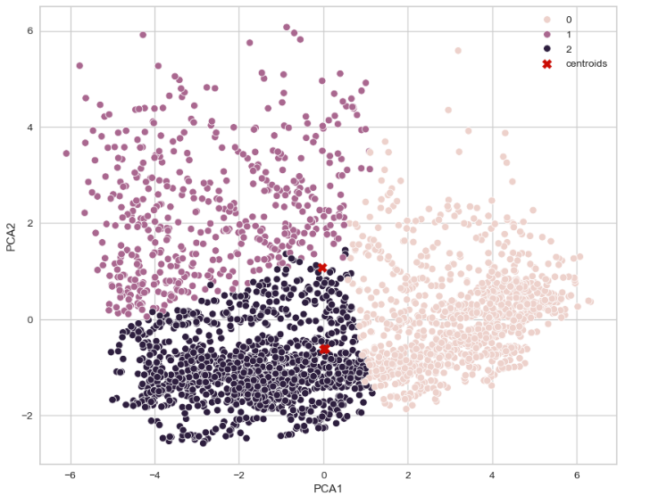
Scatter plot of data points and clusters formed in K-Means :

Slide 26
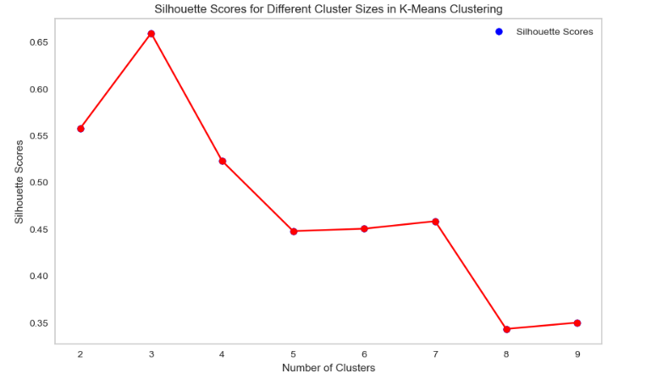
Elbow plot of Silhouette Scores for different sizes formed in K-Means :

Slide 27
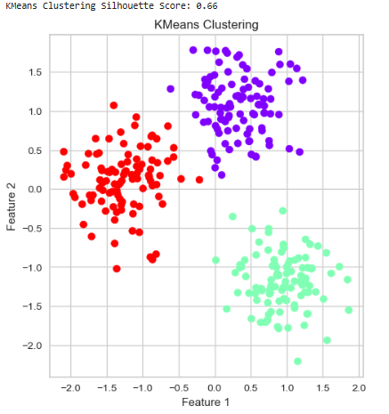
Calculating the Silhoutte Score of K-Means Clustering:

Slide 28
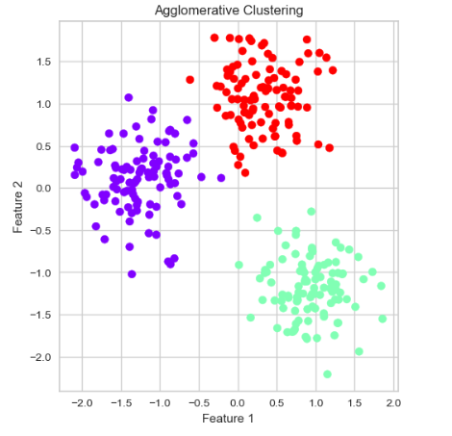
Agglomerative Clustering :
Agglomerative Clustering is a type of hierarchical clustering that builds a hierarchy of clusters in a bottom-up manner. It's one of the most common types of hierarchical clustering.
Calculating the Silhoutte Score of Agglomerative Clustering:

Slide 29
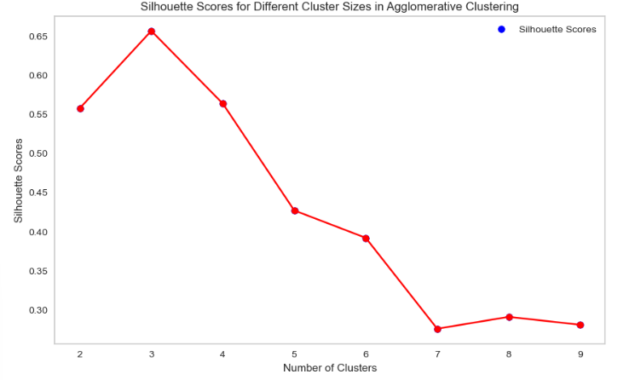
Elbow plot of Silhouette Scores for different sizes formed in Agglomerative :

Slide 30
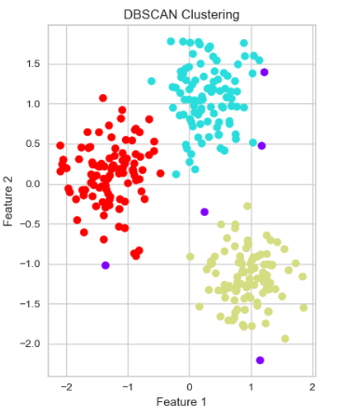
DBSCAN Clustering :
DBSCAN (Density-Based Spatial Clustering of Applications with Noise) is a popular clustering algorithm used in
machine learning and data mining. Unlike KMeans, which partitions data into a predefined number of clusters,
DBSCAN is capable of discovering clusters of arbitrary shape and size
Calculating the Silhoutte Score of DBSCAN Clustering:

Slide 31
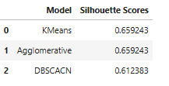
Silhouette Score Of all Models
After Performing all three Clustering techniques on the final dataset, the Optimal Number of Clusters, Silhouette scores and other important values stand like this :

Slide 32
DEPLOYMENT
Step 1: Model Training, The initial phase involved training the World development measurement model utilizing data within a Jupyter Notebook environment. We have decided to go forward with the Kmeans model with K=3 as our final model.
Step 2: Model Preservation, Following the training process, the model was preserved as a file through a method known as Pickle. This approach facilitates the storage of the model for future applications, thereby eliminating the necessity for retraining with each use.
Step 3: Deployment Using Streamlit , Subsequent to saving the model, a straightforward Streamlit application was developed.Within this application, the Pickle file was loaded, enabling the app to accept user inputs and deliver predictions in real-time.
Step 4: User Engagement, Upon the submission of data by users, the application employs the pre-trained model to assess and predict that in which cluster the value lies.

Slide 33
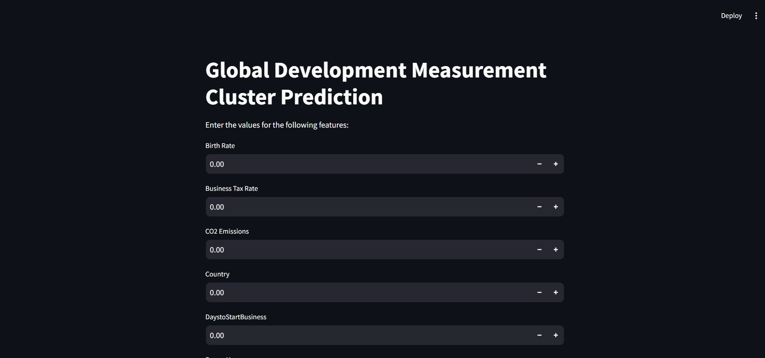
INTERFACE OF APP :

Slide 34
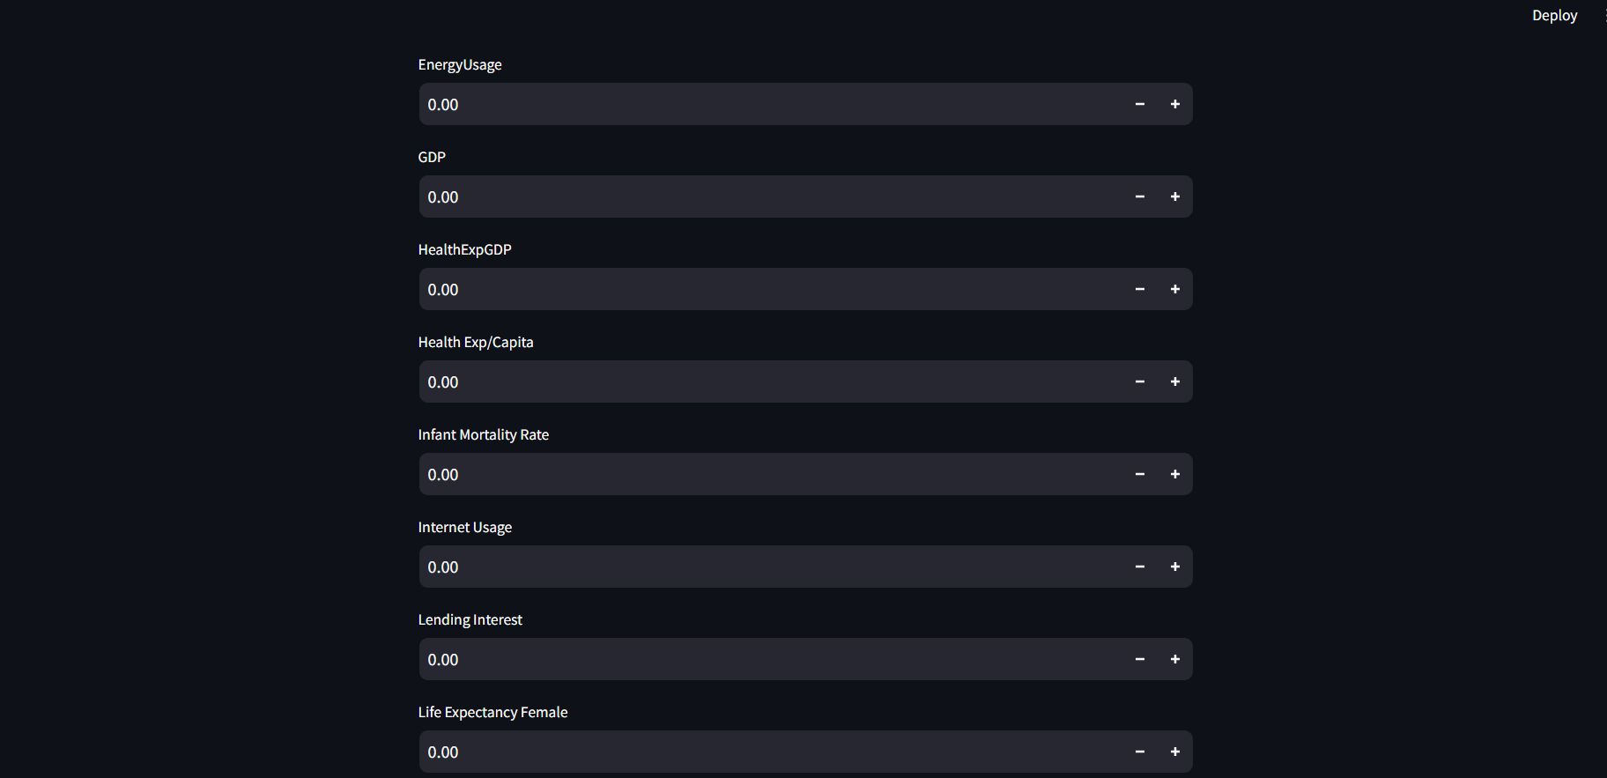

Slide 35
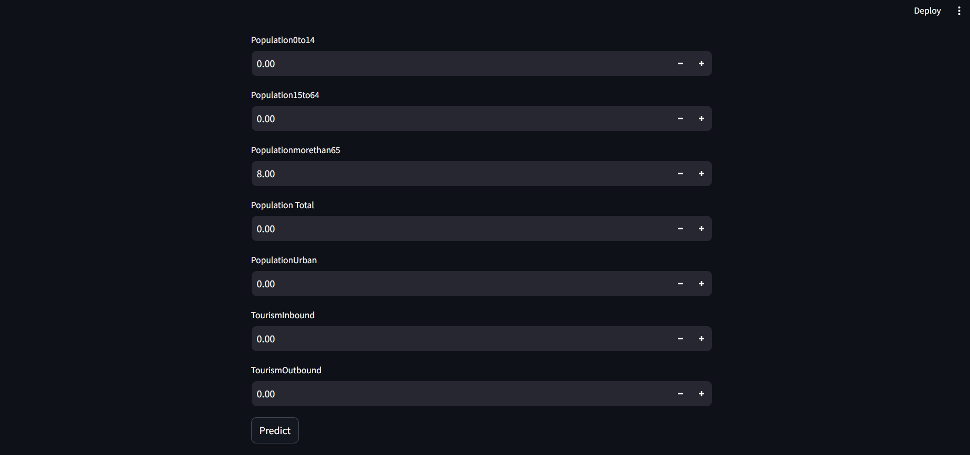

Slide 36
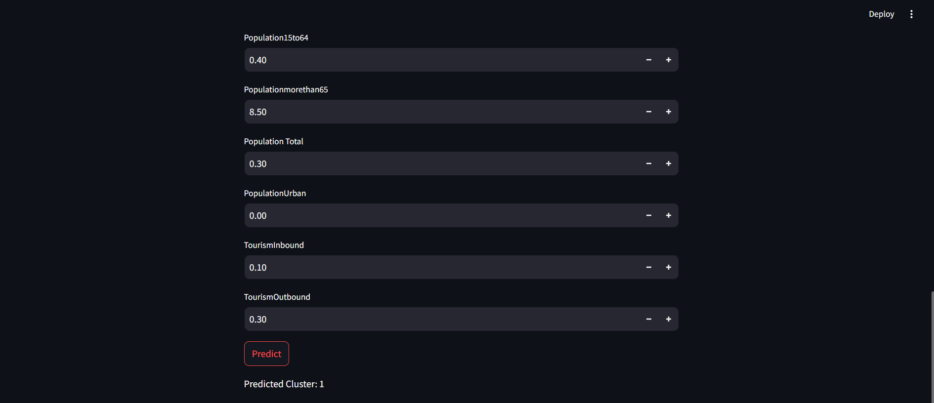
OUTPUT:
Cluster 1 is characterized by countries with moderate to high GDP, low birth rates, and advanced levels of internet usage. These countries typically have well-established healthcare systems, as indicated by higher health expenditure per capita and lower infant mortality rates. Additionally, Cluster 1 countries have higher urban populations and significant mobile phone usage.

Slide 37
Challenges we faced
Data preprocessing were challenging to use.
We have removed symbols and converted objects into float and integers datatype.
We have checked for null values and replaced them.
We have treated outliers .
We have used different models to check weather which model have high silhouette score .
Then we deployed the model using streamlit function.

Slide 38
THANK YOU

