Slide 1
AI-assisted User Code → MAAP DPS / OGC Application Package
NISAR_OGC_JOB demonstration: notebooks, MCP metadata, LLM review, dependency graphing, V2 notebook synthesis, and OGC validation
1

Slide 2
Problem: notebooks are not automatically deployable
Science workflows often start as exploratory notebooks with hidden cell state.
MAAP DPS jobs must be non-interactive, parameterized, reproducible, and output to output/.
OGC Application Packages require CWL, containers, metadata, inputs/outputs, and validation.
Manual conversion is repetitive and support-intensive: wrappers, envs, dependencies, credentials, access strategy, validation.
2

Slide 3
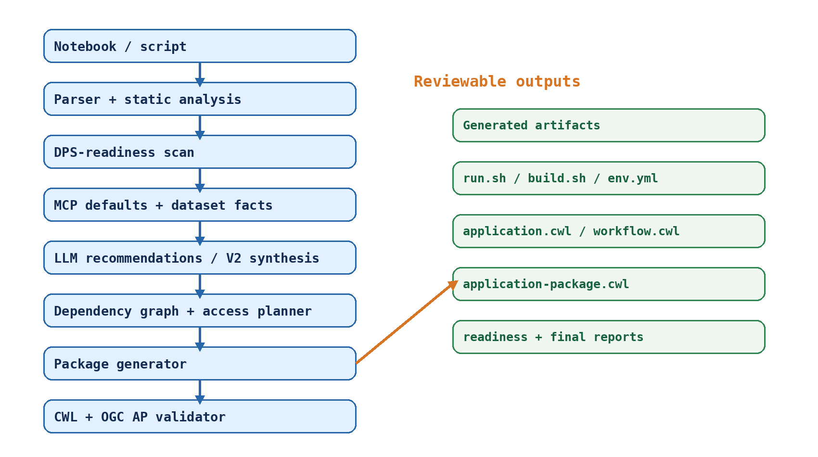
Implemented end-to-end architecture
3

Slide 4
Repository map: what was implemented
generator/: parser, scanner, dependency graph, access planner, validator, reports, notebook V2.
mcp_server/tools/: CMR, asset inspection, access options, subset-cost, default resolver.
templates/: Dockerfile, run.sh, env.yml, algorithm.yml, application.cwl, workflow.cwl.
notebooks/: MAAP-docs-style sample and GEDI Cal/Val MAAP STAC demo notebook.
tests/: 35 unit/integration tests for generator, MCP tools, access planning, and OGCification pipeline.
Repository: https://github.com/HarshiniGirish/NISAR_OGC_JOB
4

Slide 5
Demo inputs: MAAP docs + MAAP STAC dataset
NISAR Access tutorial: direct S3 credentials + Earthaccess HTTPS fallback.
GEDI Cal/Val demo: uses GEDI_CalVal_Lidar_Data from the MAAP STAC stack.
The demo notebook intentionally contains notebook-only visualization and DPS-ready metadata processing sections.
The pipeline shows original notebook → readiness scan → suggested V2 → generated package → validation → run outputs.
MAAP NISAR docs: https://docs.maap-project.org/en/develop/science/NISAR/NISAR_access.html
GEDI Cal/Val STAC: https://stac-browser.maap-project.org/collections/GEDI_CalVal_Lidar_Data
5

Slide 6
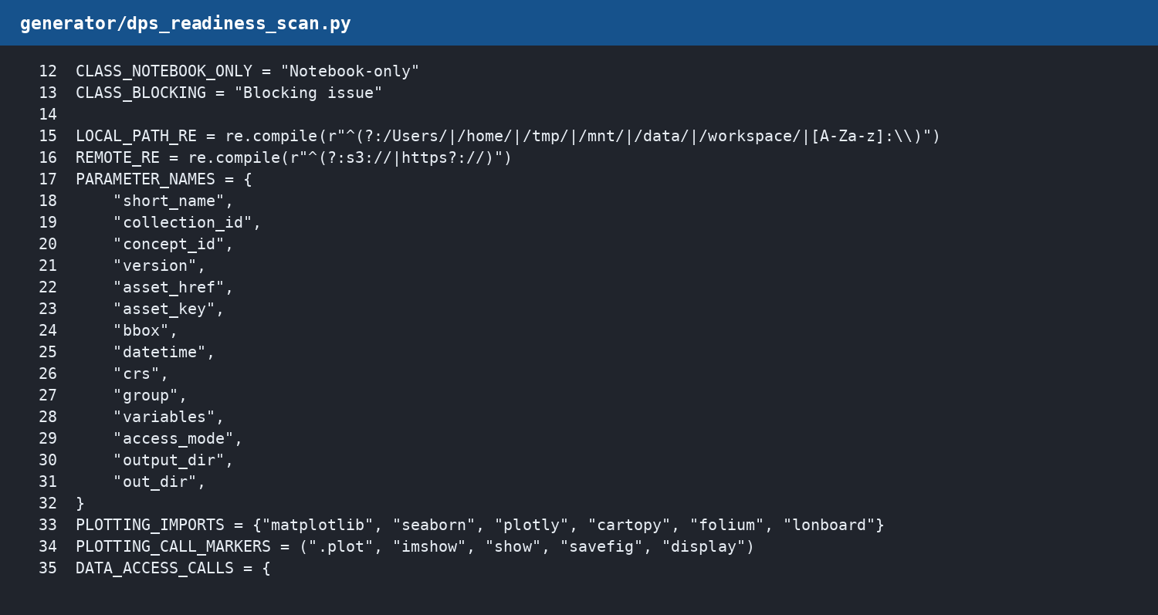
DPS-readiness scanner
Classifies notebook cells/functions/blocks as DPS-ready, candidate-after-refactor, notebook-only, or blocking.
Detects imports, data access, outputs, hardcoded values, plotting, interactive code, local paths, and dependencies.
Produces dps_readiness_report.json and dps_readiness_report.md.
Code: https://github.com/HarshiniGirish/NISAR_OGC_JOB/blob/cursor/ai-ogcification-system-ad8b/generator/dps_readiness_scan.py
6

Slide 7
Example NISAR readiness results
DPS-ready cells: S3 credentials, Earthaccess discovery, S3 open path, HTTPS open path.
Notebook-only cells: markdown, display, matplotlib/folium visualization, inspection cells.
Info warnings: implicit notebook state; these are not failures but highlight ordering/refactor risks.
Outcome: V2 notebook makes runtime values explicit and packages the DPS-relevant path.
7

Slide 8
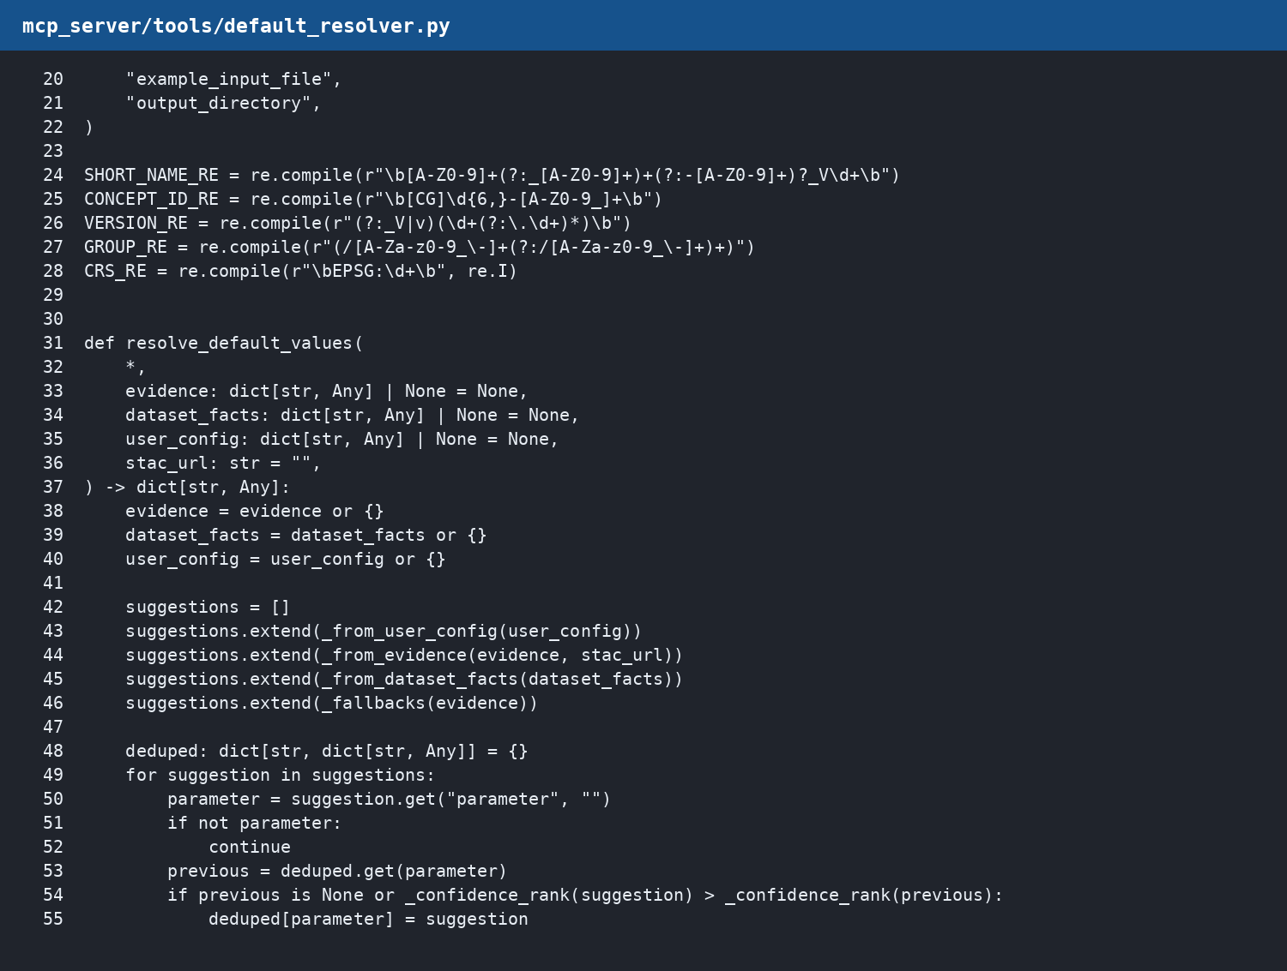
MCP metadata/default resolver
Creates provenance-tagged default suggestions for collection_id, short_name, asset_href, bbox, variables, access_mode, output_directory.
Does not hardcode MAAP docs values as real defaults.
Sources: user manifest, source evidence, MAAP/STAC/CMR facts, safe fallback logic.
Code: https://github.com/HarshiniGirish/NISAR_OGC_JOB/blob/cursor/ai-ogcification-system-ad8b/mcp_server/tools/default_resolver.py
8

Slide 9
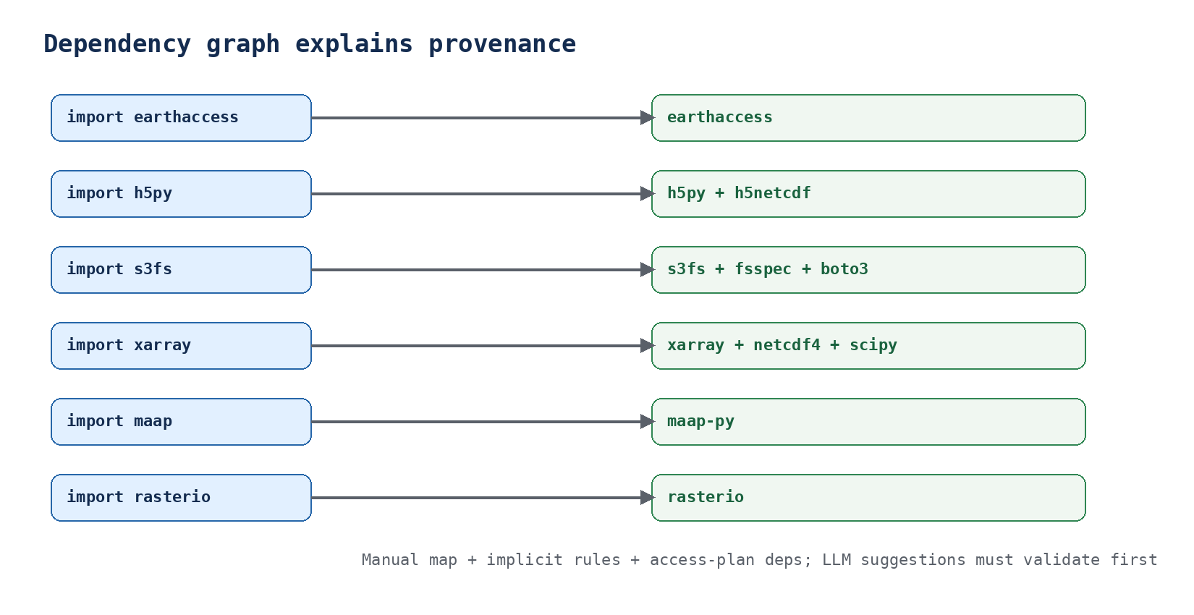
Dependency graph: explain why every dependency exists
Code: https://github.com/HarshiniGirish/NISAR_OGC_JOB/blob/cursor/ai-ogcification-system-ad8b/generator/dependency_graph.py
9

Slide 10
Access strategy planner
Rule-based planner always works; OpenAI planner is optional.
Allowed strategies include direct_s3_xarray, direct_s3_h5py, rasterio_windowed_read, zarr_open_zarr, harmony_subset, cmr_search_then_s3, stac_raster_api, HTTPS fallback.
AI cannot invent unsupported strategies; every plan is validated.
Writes access_plan.json and access_runtime.py with implementation hints.
Code: https://github.com/HarshiniGirish/NISAR_OGC_JOB/blob/cursor/ai-ogcification-system-ad8b/generator/access_planner.py
10

Slide 11
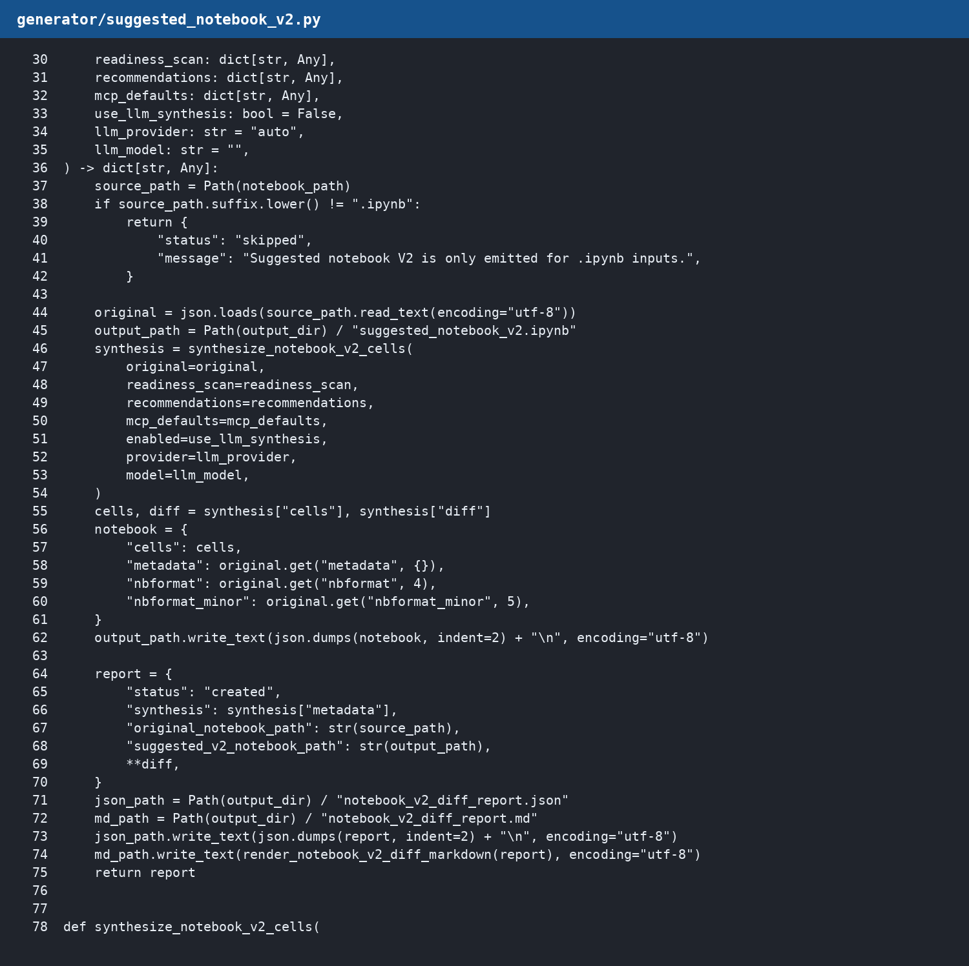
LLM guardrails + suggested notebook V2
LLM is optional: core generation remains deterministic.
OpenAI can synthesize a runtime-safe V2 notebook from hidden-state/readiness analysis.
Returned notebook JSON is schema-checked and code cells must compile.
Original notebook is never overwritten; fallback V2 is emitted if LLM fails.
Code: https://github.com/HarshiniGirish/NISAR_OGC_JOB/blob/cursor/ai-ogcification-system-ad8b/generator/suggested_notebook_v2.py
11

Slide 12
Generated OGC / MAAP package
MAAP DPS artifacts: algorithm.yml, algorithm_config.yaml, run.sh, build.sh, env.yml, Dockerfile, register_dps.py.
OGC artifacts: application.cwl, workflow.cwl, packed application-package.cwl, STAC input/output manifests, publish_ogc.py.
Analysis artifacts: analysis.json, dps_readiness_report.md, dependency_graph.json, dataset_facts.json, access_plan.json, final_readiness_report.json.
12

Slide 13
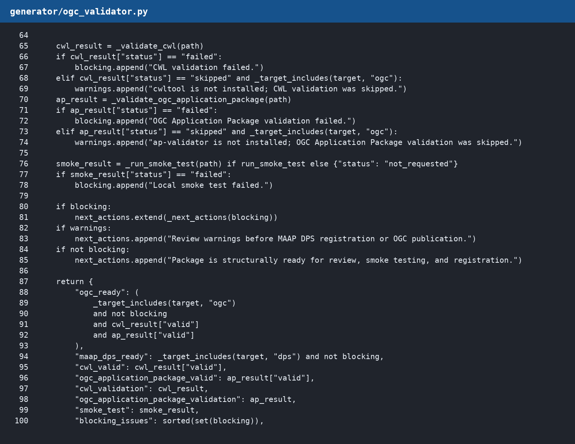
Validation: cwltool + ap-validator
cwltool validates application.cwl and workflow.cwl syntax.
cwltool --pack creates application-package.cwl.
ap-validator checks OGC EO Application Package best-practice compliance.
ogc_validation_report.md reports OGC ready, MAAP DPS ready, CWL valid, OGC AP valid, warnings, and next actions.
Code: https://github.com/HarshiniGirish/NISAR_OGC_JOB/blob/cursor/ai-ogcification-system-ad8b/generator/ogc_validator.py
13

Slide 14
GEDI MAAP STAC demo: complete path
Dataset: GEDI_CalVal_Lidar_Data from MAAP STAC.
Notebook recommends an algorithm from a small catalog: metadata inventory, asset manifest, full LAS metrics, rasterization.
DPS-ready path summarizes STAC item metadata and writes output/gedi_calval_summary.json + output/asset_manifest.csv.
V2 notebook can be packaged and run as its own generated OGC/MAAP package.
Notebook: https://github.com/HarshiniGirish/NISAR_OGC_JOB/blob/cursor/ai-ogcification-system-ad8b/notebooks/gedi_calval_maap_stack_ogcification_demo.ipynb
14

Slide 15
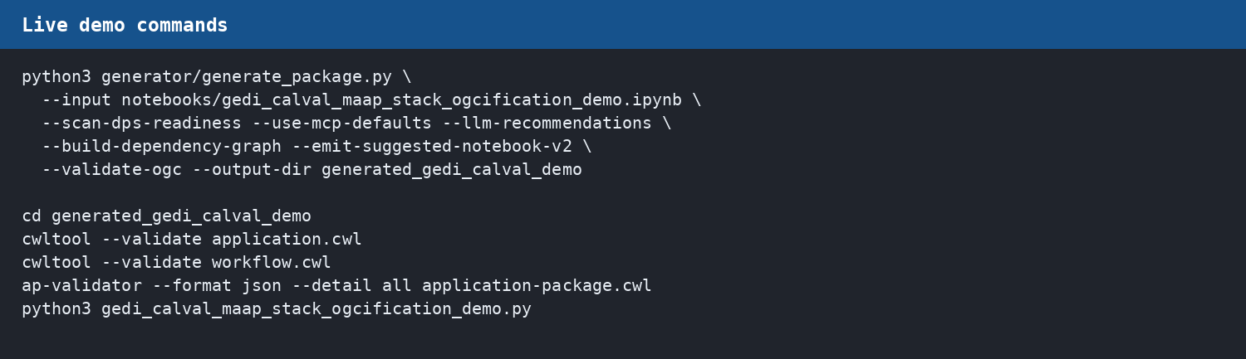
Live demonstration commands
15

Slide 16
What to show live
Open original notebook: show exploratory cells + visualization.
Run generator with readiness/MCP/dependency/LLM/V2/validation flags.
Open dps_readiness_report.md: show DPS-ready vs notebook-only cells.
Open suggested_notebook_v2.ipynb: show parameter cell, preserved helpers, output-writing path.
Validate application-package.cwl with ap-validator: valid: true.
Run generated script and show output files.
16

Slide 17
Important nuance: package validation vs data runtime
OGC-ready means package structure and CWL/Application Package metadata validate.
Runtime may still depend on live services: Earthdata, MAAP UAT, ASF S3 credentials, STAC/CMR endpoints.
Example: MAAP UAT 503 is an access-service issue, not an OGC package failure.
Reports separate structural readiness from runtime access risks.
17

Slide 18
Current limitations and next improvements
Automatic S3 → HTTPS fallback orchestration should be strengthened.
More dataset-specific output templates can improve scientific runtime correctness.
Live MCP metadata integrations can improve defaults and subset-cost estimates.
MAAP DPS sandbox submission/polling should be added for end-to-end cloud job proof.
CI should run ap-validator and representative notebook generation tests.
18

Slide 19
Takeaway
The repository now demonstrates an AI-assisted OGCification workflow.
It explains what is DPS-ready, what stays notebook-only, which dependencies are required, and why.
It generates MAAP DPS and OGC package artifacts and validates the packed OGC Application Package.
It preserves the original notebook and emits a suggested V2 notebook for review or packaging.
The system turns exploratory notebook work into a documented, reviewable, reproducible package candidate.
19

