Slide 1
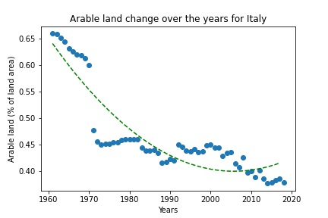
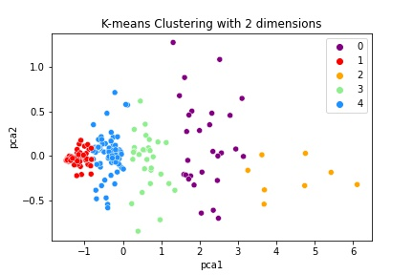
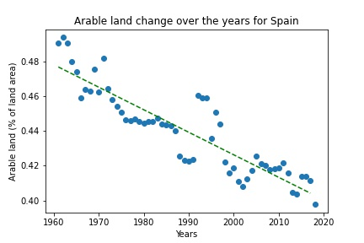
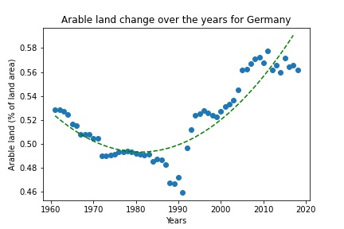
Arable land change for countries during 1961-2018
Introduction:
The study examines the arable land change of various nations from 1961 to 2018.
Countries are clustered using k means clustering based on the percentage of arable land.
Five clusters are created and their PCA plots are displayed. From one cluster, three countries are chosen.
All country-specific curves are fitted with a distinct objective function. For the curve of Italy and Germany, a second-order polynomial function is applied. For the plot of Spain, a linear objective function is applied.
Conclusion:
From the plots, for Italy, there is a decrease in the arable land percentage.
For Spain also there is a decrease, although it is not completely linear.
For Germany, however, there is an increase in the arable land percentage

