Slide 1
Time-Series Forecasting in Retail Industry using Bi-directional, Stacked and Vanilla LSTM
TEAM ID:
TEAM MEMBERS:
PROJECT GUIDE:

Slide 2
Table of Contents
Time-series
Abstract
Objectives
Motivation
Scope of the Project
Application of the Project
Literature Review
Existing System
Proposed model
Architecture
Modules
Results & Discussion
Conclusion & Future Scope
References

Slide 3
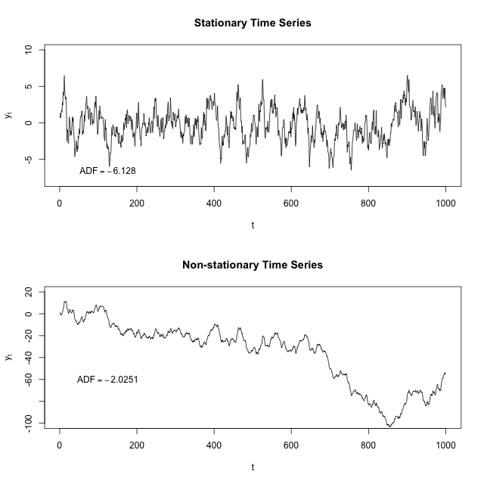
TIME - SERIES

Slide 4
ABSTRACT
Recently, there has been a rapidly growing interest in deep learning research and their applications to real-world problems. Sales prediction using financial data is crucial for any online or offline businesses and companies. This project aims to develop a time-series analysis model to understand the sales and the profits and losses made and predict values for the future. For this effective analysis, LSTM deep learning architectures such as Stacked LSTM, Bi-Directional LSTM and Vanilla LSTM have been chosen. Unlike traditional recurrent neural networks, LSTM supports time steps of arbitrary sizes and without the vanishing gradient problem. The three distinct LSTM models are used to train the dataset and also benchmark them with the existing model. The evaluations are conducted using a publicly available dataset for retail Industry.

Slide 5
MOTIVATION
The most popular methods for time-series forecasting is ARIMA & the Recurrent Neural Networks (RNN) approach. RNN's ability to keep events from the past in its memory can be very useful in time-series forecasting. The issue with RNN is that after passing many hidden layers due to the multiplication the result is going to vanish or in other words, vanishing gradient or exploding gradient will happen. ARIMA model has a limitation of Stationarity assumption. Long Short-Term Memory networks (LSTM) is a solution for short term memory of RNN & stationarity issues.

Slide 6
OBJECTIVE
The objective of this project is to use LSTM networks for time-series forecasting in the retail industry and compare its advantages with traditional methods.
The project aims to analyze the retail industry's time-series data using LSTM to identify patterns and long-term dependencies, including seasonality, trends, and other correlations between variables.
The model will be trained on historical data to forecast future sales for various products and services. The report will also discuss the limitations and potential future developments of LSTM models for forecasting in the retail industry.

Slide 7
ADVANTAGES
Existing models can handle only Stationary Dataset.
There are several advantages for doing a sales forecasting project for a retail business. Some of the advantages include:
Optimizing inventory management
Improving marketing strategies
Enhancing customer experience
Increasing profitability
Staying competitive

Slide 8
SCOPE & APPLICATIONS OF THE PROJECT
The scope of the project is to build a user – centric approach that relies solely on sales data to forecast future sales using LSTM neural network . This project can be implemented in various other domains such as
Healthcare
Weather
Stock Market
Financial
Sports

Slide 9
LITERATURE REVIEW
TITLE | PUBLISHER INFORMATION | METHODOLOGY | RESULT | DRAWBACKS
Prediction of Sales Value in online shopping using Linear Regression | Gopalakrishnan T, Ritesh choudhary, Sarada Prasad 2018 | Linear Regression, Cost function, Gradient Descent | Predicted values using LR are 84% accurate | Assumption of linearity between variables Sensitive to outliers
EVDHM-ARIMA-Based Time series Forecasting Model and its application for COVID-19 cases | Rishi Raj Sharma, Mohit Kumar, Shishir Maheshwari, Kamla Prasan Ray 2021 | Wavelet-ARIMA, EVDHM-ARIMA, PPT-Philips Perron Test | EVDHM-ARIMA gives better results | Performance is poor for long term forecasts Require large data

Slide 10
TITLE | PUBLISHER INFORMATION | METHODOLOGY | RESULT | DRAWBACKS
Stock closing price prediction using Machine Learning techniques | Mehar Vijh, Deeksha Chandola,Vinay Anand, Arun Kumar 2019 | ANN, Random Forest | Comparative analysis based on RMSE, MAPE, MBE indicate ANN gives better prediction of stock prices | High computational time Choosing ANN size and structure for accurate solution is critical
Analysis and Prediction of COVID-19 using Regression Models and Time series forecasting | Saud shaikh, Jaini Gala, Aishita Jain, Sunny Advani, Sagar Jaidhara, Mani Roja 2021 | Linear Regression, Polynomial Regression | Analysis metrics- Accuracy, MAPE, R-squared conclude that Polynomial Regression shows better performance | PR models might not generalize well outside of the data used Outliers can severely impact the results

Slide 11
TITLE | PUBLISHED INFORMATION | METHODOLOGY | RESULT | DRAWBACKS
Machine Learning approach for Big-Mart sales prediction framework | Sanjay. N Gunjal, D.B Kshirsagar, B.J Dange, H.E Khodke, C.S Kulkarni 2022 | Generalized Linear Model (GLM), Decision Tree (DT), Gradient Boost Tree (GBT) | Analysis on Metrics-RMSE, MSE, MAE indicate GBT performs better with 95.84% accuracy | Prone to overfitting Sensitive to outliers Computationally expensive
Predictive Analysis for Big Mart Sales using Machine Learning Algorithms | Nayana R, Chaithanya G, Meghana T, Narahari K S, Sushma M 2022 | Linear Regression, Polynomial Regression, Ridge Regression, XGBoost Regression | RMSE, MAE, MSE, Accuracy: XGBoost Regression gives a better prediction | Limited ability to model temporal dependencies. May overfit with noisy data Requires more feature engineering

Slide 12
TITLE | PUBLISHED INFORMATION | METHODOLOGY | RESULT | DRAWBACKS
An Analysis of Machine Learning Algorithms to Predict Sales | Varshini S, Dr. D. Preethi 2022 | XGBoost Regressor, Random Forest Regressor, ANN, and SVR | RMSE, R2_score, MAPE: Random Forest Regression performed better | Sensitivity to hyperparameters Limited interpretability
The propagation and identification of ARMA demand under simple exponential smoothing: forecasting expertise and information sharing. | Meng-Chen Hsieh, Avi Giloni, Clifford Hurvich, 2020 | ARMA: Autoregressive Moving Average, Suboptimal Exponential Smoothing | Mean Squared Forecasting Error(MSFE) : ARMA performs better than ES | Limited ability to handle non-linear Requires identifying model parameters Limited ability to handle long-term dependencies

Slide 13
TITLE | PUBLISHED INFORMATION | METHODOLOGY | RESULT | DRAWBACKS
Integrated Long-Term Stock Selection Models Based on Feature Selection and Machine Learning Algorithms for China Stock Market | Xianghui Yuan1, Jin Yuan 1, Tianzhao Jiang2 and Qurat Ul Ain1 2020 | Support Vector Machine, Random Forest Regression, Artificial Neural Network | AUC: Random Forest Regression performs better when compared to SVM & ANN | Training data limitations Interpretability Complexity
An optimized model using LSTM network for demand forecasting | Hossein Abbasimehra, Mostafa Shabani, Mohsen Yousefic 2020 | ETS, ARIMA, ANN, SVM, KNN, simple RNN, single layer LSTM | RMSE and SMAPE: LSTM performed better than all existing models | Limited scalability Difficulty in capturing long-term dependencies

Slide 14
EXISTING SYSTEM
The existing system has used ARIMA model to forecast the sales
ARIMA Statistical Model (p,d,q)
ARIMA: Autoregressive Integrated Moving Average
AR: Relationship between the current value and past values
I: Differences/Non-stationary
MA: the differences between the observed and predicted values

Slide 15
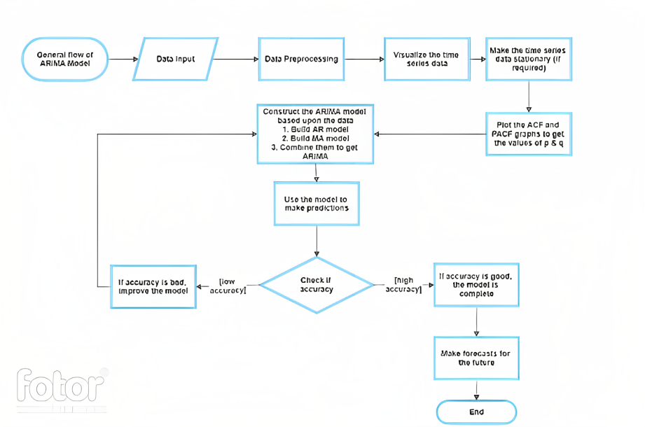

Slide 16
PROPOSED METHODOLOGY
LSTM: Long Short Term Memory networks
In this project, three different LSTM models for time-series forecasting have been used. The first one is Vanilla LSTM which consists of a single hidden layer of LSTM and one layer of output. The second LSTM model is called Stacked LSTM and consists of multiple LSTM on top of each other. The third LSTM model is called bidirectional LSTM and learns the input sequence forward and backward by wrapping the first hidden layer in a layer called Bidirectional.

Slide 17
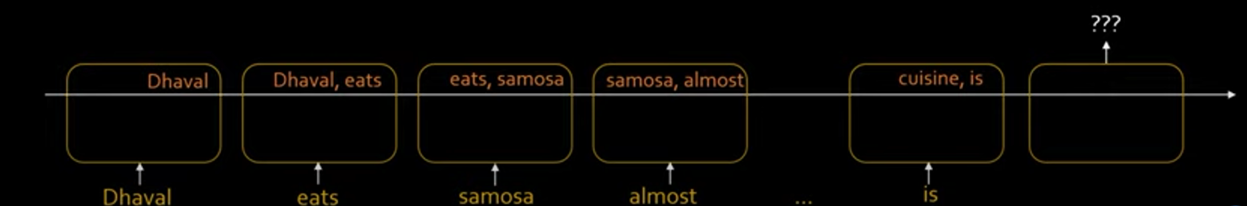
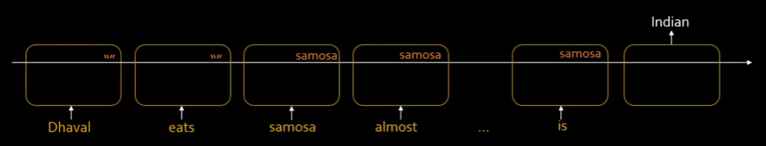
Traditional RNN
Long- Short Term Memory

Slide 18
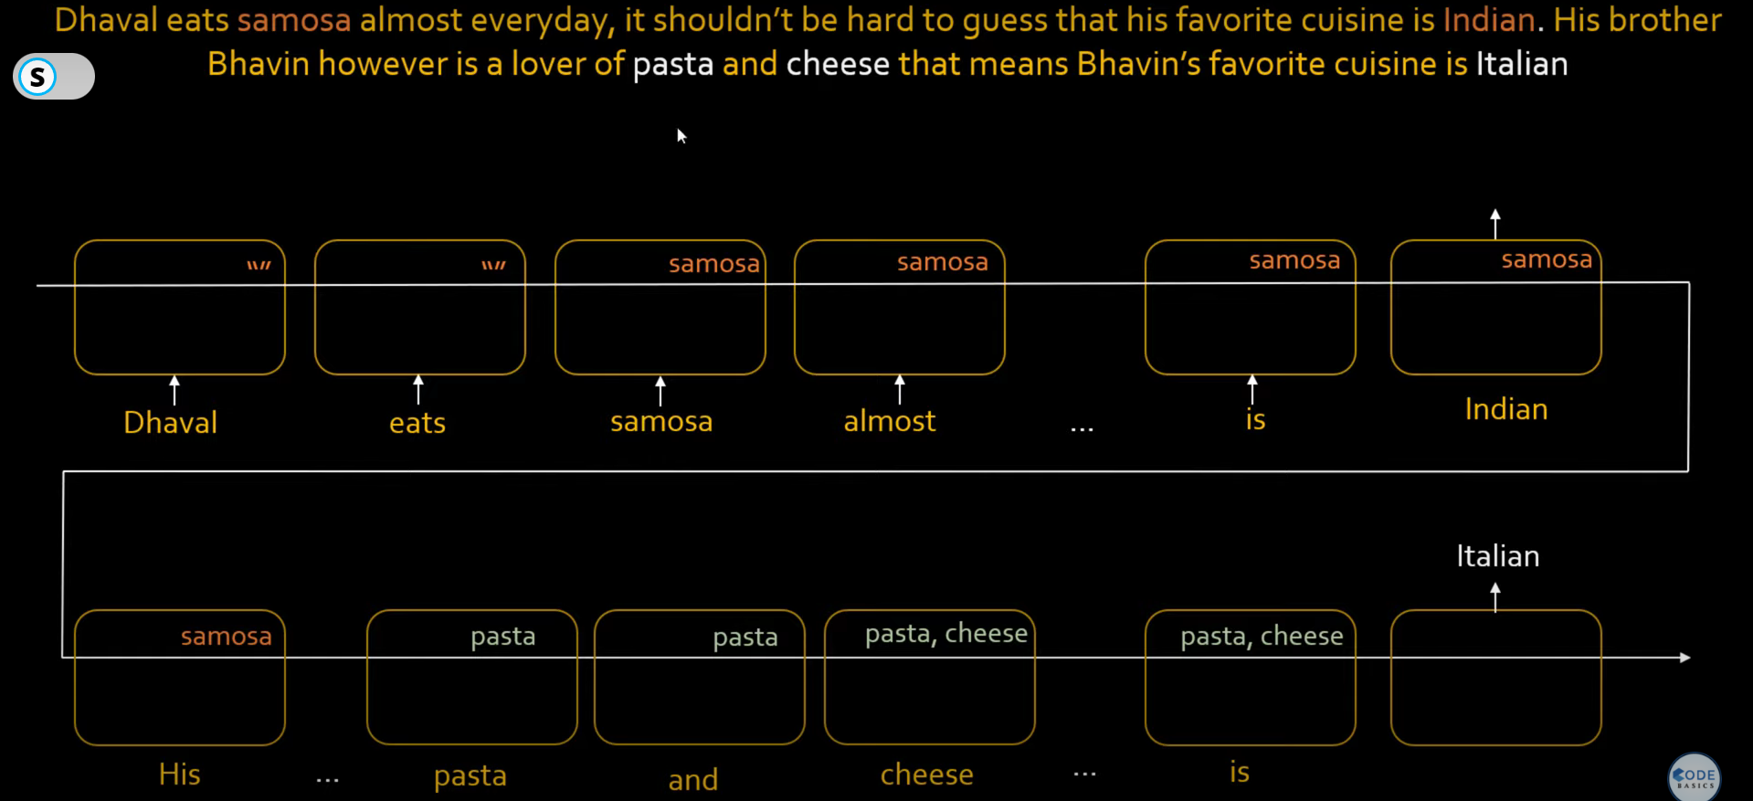


John

Slide 19
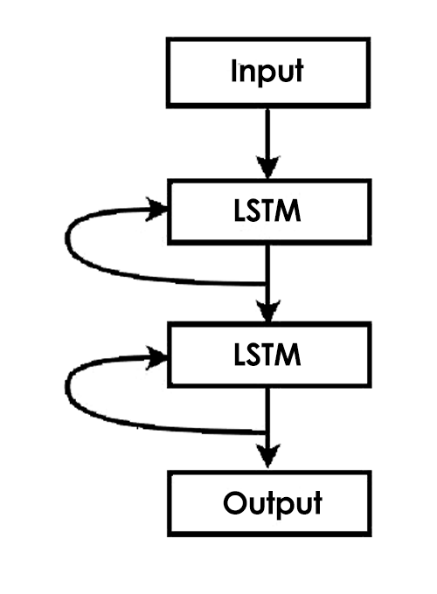
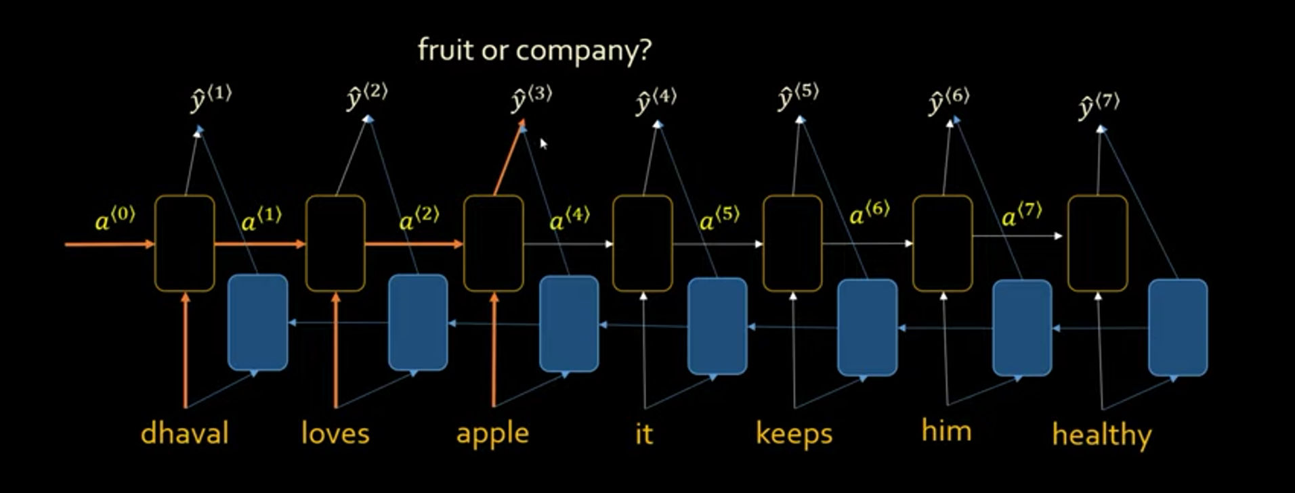
Stacked LSTM
Bi- Directional LSTM

Slide 20
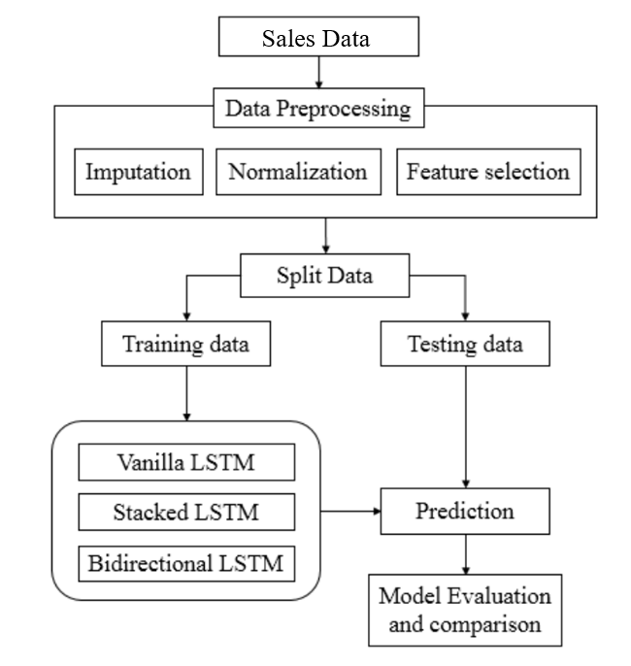
ARCHITECTURE

Slide 21
MODULES
Data Collection
Data Pre-processing
Exploratory Data Analysis
Model Training and Testing
Performance Measurement
Sales Forecasting

Slide 22
RESULTS AND DISCUSSION
In terms of performance, the Stacked LSTM model outperformed the other two models, as it had the lowest MSE and RMSE and MAPE. The Vanilla LSTM model had the highest MSE, RMSE and MAPE, indicating that it performed the worst of the three models. However, the Bi-LSTM model had a slightly lower MSE, RMSE and MAPE than the Vanilla LSTM model, indicating that it performed better in terms of relative error. Overall, the Stacked LSTM model is the most suitable for the given data and task.

Slide 23
RESULTS AND DISCUSSION
S. NO | MODEL | MSE | RMSE | MAPE
1 | VANILLA LSTM | 17428.60 | 132.02 | 7.83
2 | STACKED LSTM | 7419.42 | 86.17 | 5.16
3 | BI-LSTM | 14924.49 | 122.17 | 7.30

Slide 24
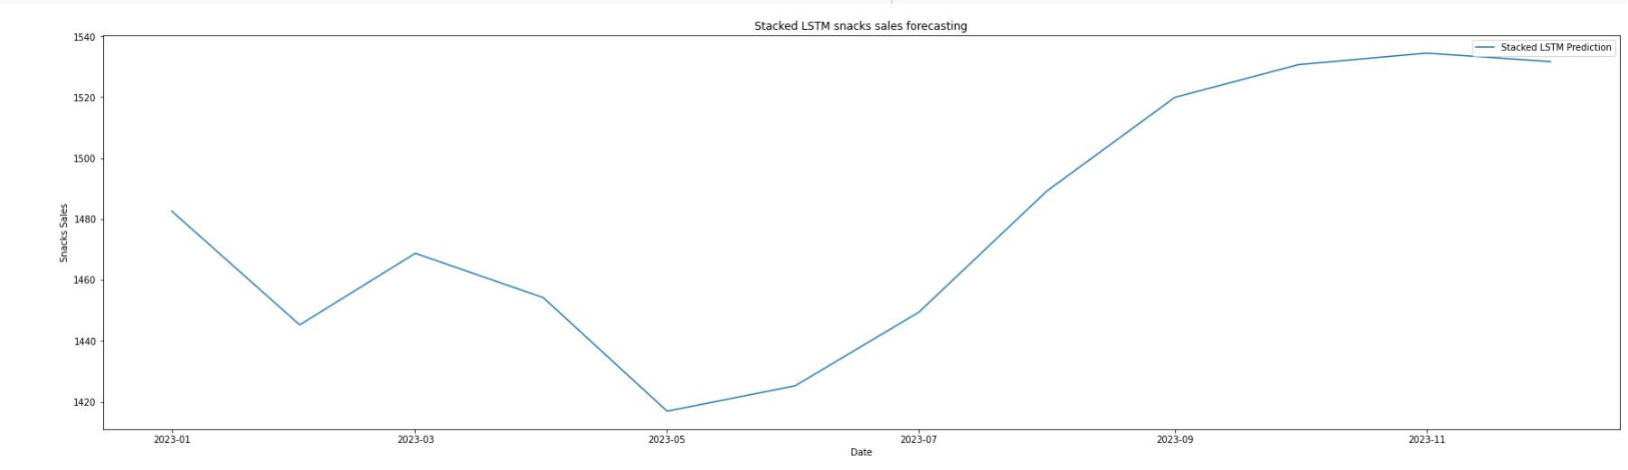
RESULTS AND DISCUSSION

Slide 25

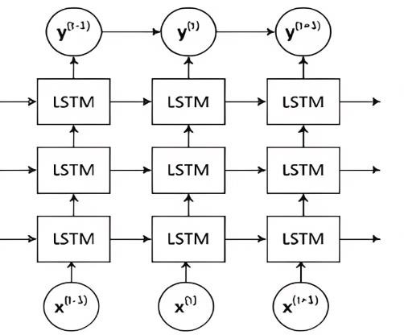
CONCLUSION

Slide 26
CONCLUSION AND FUTURE SCOPE
After evaluating the performance of the three different types of LSTM models (Bidirectional LSTM, Stacked LSTM, and Vanilla LSTM), it was observed that the Stacked LSTM model exhibited superior performance with higher accuracy based on the evaluation metrics. Therefore, for the sales forecast of the year 2023, the Stacked LSTM model was employed.
Future research could investigate alternative deep learning models or the combination of stochastic and deep learning models, depending on the data characteristics. To support sales forecasting decision-making, companies may consider developing a web or mobile application.

Slide 27
REFERENCES
G.T., R. Choudhary and S. Prasad, "Prediction of Sales Value in Online shopping using Linear Regression," 2018 4th International Conference on Computing Communication and Automation (ICCCA), Greater Noida, India, 2018, pp. 1-6, doi: 10.1109/CCAA.2018.8777620.
R. R. Sharma, M. Kumar, S. Maheshwari and K. P. Ray, "EVDHMARIMA-Based Time Series Forecasting Model and Its Application for COVID-19 Cases," in IEEE Transactions on Instrumentation and Measurement, vol. 70, pp. 1-10, 2021, Art no. 6502210, doi: 10.1109/TIM.2020.3041833.
Mehar Vijh, Deeksha Chandola, Vinay Anand Tikkiwal, Arun Kumar, Stock Closing Price Prediction using Machine Learning Techniques, Procedia Computer Science, Volume 167, 2020, Pp 599-606, ISSN 1877-0509, https://doi.org/10.1016/j.procs.2020.03.326.
S. Shaikh, J. Gala, A. Jain, S. Advani, S. Jaidhara and M. Roja Edinburgh, "Analysis and Prediction of COVID-19 using Regression Models and Time Series Forecasting," 2021 11th International Conference on Cloud Computing, Data Science & Engineering (Confluence), Noida, India, 2021, pp. 989-995, doi: 10.1109/Confluence51648.2021.9377137.
Nana, Dr & Kshirsagar, Dhananjay & Dange, Bapusaheb & Khodke, Dr & Kulkarni, Dr. (2022). Machine Learning Approach for Big-Mart Sales Prediction Framework. International Journal of Innovative Technology and Exploring Engineering. 11. 69-75. 10.35940/ijitee.F9916.0511622.

Slide 28
REFERENCES
Nayana R, Chaithanya G, Meghana T, Narahari K S, Sushma M, 2022, Predictive Analysis for Big Mart Sales using Machine Learning Algorithms, International Journal of Engineering Research & Technology (IJERT) RTCSIT – 2022 (Volume 10 – Issue 12)
Varshini S., Dr. D. Preethi, "An Analysis of Machine Learning Algorithms to Predict Sales", International Journal of Science and Research (IJSR), Volume 11 Issue 6, June 2022, pp. 462466, https://www.ijsr.net/get_abstract.php?paper_id=SR2260114494 6
M. -C. Hsieh, A. Giloni and C. Hurvich, "The propagation and identification of ARMA demand under simple exponential smoothing: forecasting expertise and information sharing," in IMA Journal of Management Mathematics, vol. 31, no. 1, pp. 307-344, Dec. 2019, doi: 10.1093/imaman/dpaa006.
X. Yuan, J. Yuan, T. Jiang and Q. U. Ain, "Integrated Long-Term Stock Selection Models Based on Feature Selection and Machine Learning Algorithms for China Stock Market," in IEEE Access, vol. 8, pp. 22672-22685, 2020, doi: 10.1109/ACCESS.2020.2969293.
Hossein Abbasimehr, Mostafa Shabani, Mohsen Yousefi, An optimized model using LSTM network for demand forecasting, Computers & Industrial Engineering, Volume 143, 2020, 106435, ISSN 0360-8352, https://doi.org/10.1016/j.cie.2020.106435.

Slide 29
THANK YOU

