Slide 1
Sales Dashboard Insights

Slide 2
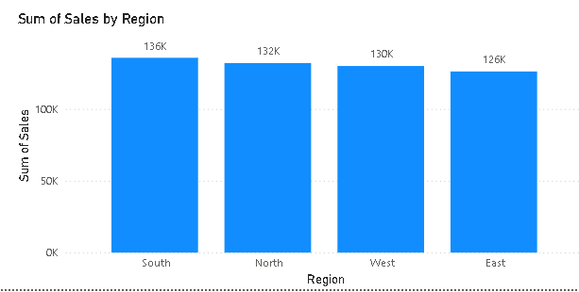
Key Insights
1. South region achieved the highest overall sales, closely followed by North and West.

Slide 3
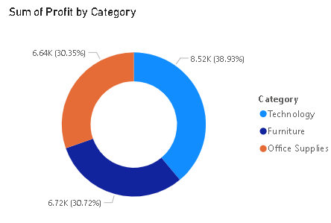
2. Technology category generated the largest share of profit (~39%).

Slide 4
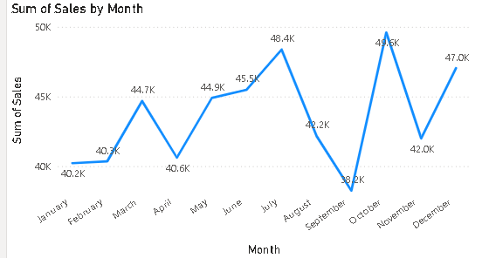
3. Sales showed a significant peak in October, indicating seasonal demand.

Slide 5
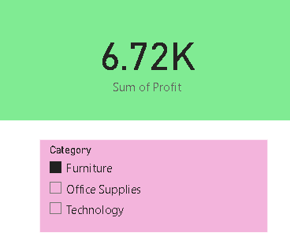
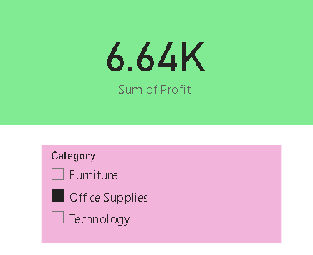
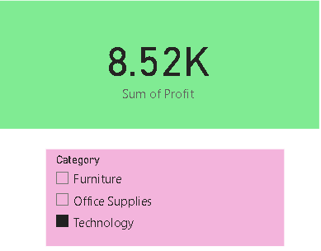
4. Profit remains positive across all categories, with balanced performance in Furniture and Office Supplies.

