Slide 1

ARGUS
Multimodal Biometric
Computer Login
Face recognition and keystroke dynamics fused into one verdict — a gate that needs both what you look like and how you type.
PF-00 KNOWLEDGE
FS-01 FACE SCAN
KD-02 RHYTHM
FS-09 FUSION
Harshit Shyamsukha
Coursework lab · local deployment · Flask + DeepFace
github.com/Harshit-3114/ARGUS
MIT licensed · 100% local
ARGUS
01 / 21
Notes:
Good afternoon. ARGUS is a login gate that replaces the password alone with two biometric modalities: who you are (face) and how you type (rhythm). Both are fused into a single decision.
Everything runs locally: Flask, DeepFace Facenet512, SQLite. No network calls at inference time, strict CSP, self-hosted assets.
I'll cover the problem, the two modalities, the fusion, real measured results, and an honest account of the limits.

Slide 2
THE PROBLEM
The password is the weakest link in the chain.
Phishing and reuse. A secret you chose is a secret you can leak.
WHAT AN ATTACKER NEEDS
✓ A photo of your face.
Static authentication. The same string proves the same person forever.
Physiological — cheap, shareable, silent.
✓ Your passphrase.
Nothing physical is checked. A stolen credential works from any machine.
Knowledge — usually your dog’s name.
✓ Your typing rhythm.
Behavioral — nobody notices you mimic it.
ARGUS requires two of the three — the two that are hardest to fake together.
Each of these is easy. All three together are not.
ARGUS · THE PROBLEM
02 / 21
Notes:
The pitch in one slide: the three things an attacker needs to defeat a login are a face, a passphrase, and a typing rhythm.
Individually each is trivial. A photo is a file. A passphrase is guessable. A rhythm is invisible — most people cannot even describe their own.
ARGUS demands two of the three simultaneously. That is the whole design rationale, and it is why we fuse at the score level rather than accept on either modality alone.

Slide 3
THE INSIGHT
Two modalities, two different attack classes.
FS-02
KD-02
FACE
RHYTHM
PHYSIOLOGICAL
BEHAVIORAL
Facenet512 embedding → cosine similarity against the enrolled gallery.
Key hold times + digraph latencies → scaled-Manhattan filter.
Attacker: A printed photo defeats this. It has no depth, no warmth, no micro-motion.
Attacker: A stolen passphrase defeats this. Nobody reproduces another person’s hands.
A photo of the user cannot reproduce their typing rhythm; an impostor who knows the passphrase cannot reproduce their face. Fusing both means neither attack alone is enough.
ARGUS · THE INSIGHT
03 / 21
Notes:
This is the core claim and it is worth stating precisely.
Face is physiological: identical for everyone with your genes, cheap to reproduce with a printout. Rhythm is behavioral: unique to your hands and hard to fake deliberately.
Crucially the two fail independently. A printed photo passes the face check and fails the rhythm check. An impostor who knows the passphrase passes the knowledge factor and fails both biometric checks.
Note this also rules out a naive fallback: accepting on either modality would let a photo through. That is why the fusion is weighted AND, not OR.

Slide 4
ARCHITECTURE
Five modules, one verdict.
PF-00
FS-01
FS-02
KD-02
FS-09
KNOWLEDGE
→
FACE CAPTURE
→
GALLERY MATCH
→
RHYTHM
→
FUSION
passphrase check
browser frames
cosine similarity
hold + latency model
weighted sum → θ
CLIENT (JS, CSP-locked) SERVER (FLASK, LOCAL)
Browser capture. getUserMedia frames + keydown/keyup timestamps
Server-side scoring. client never sees a score
Strict validation. finite timestamps, plausibility bounds, size caps
No paste, no injected events. keystroke.js blocks paste; modifiers ignored
Constant-time PIN. hmac.compare for the admin gate
Edit-buffer reconstruction. typos are corrected, not punished
ARGUS · ARCHITECTURE
04 / 21
Notes:
The pipeline, left to right.
PF-00 is the knowledge factor — the passphrase. FS-01 captures frames in the browser. FS-02 matches the embedding against the enrolled gallery. KD-02 scores the typing rhythm. FS-09 fuses the two normalized scores with a weighted sum and compares against theta.
Two architectural points worth stressing for the examiner: the client is untrusted — it only ever submits raw observations, never a score; and every timestamp is treated as hostile input, because the clock belongs to the client.
Modules PF/FS/KD are named in the code and in the UI so a decision can be traced to the stage that produced it.

Slide 5
MODALITY 1 · FS-01 / FS-02
Face: crop → embed → cosine.
STATIC/FACE_ENGINE.PY
EMBEDDING
def embed_b64(frame_b64: str) -> np.ndarray:
512-d
bgr = cv2.imdecode(buf, cv2.IMREAD_COLOR)
Facenet512 · ONNX
crop = crop_largest_face(bgr) # our own OpenCV Haar crop
objs = DeepFace.represent(
img_path=crop[:, :, ::-1], # deepface expects RGB
SCORING
model_name="Facenet512",
max cosine
detector_backend="skip",
enforce_detection=False,
over the whole gallery
)
return np.asarray(objs[0]["embedding"])
NORMALIZED
(cos+1)/2
def match_score(gallery, probe) -> float:
return max(cosine(probe, g) for g in gallery) if gallery else 0.0
mapped to [0,1] for fusion
Own detector. OpenCV Haar cascade, largest face, 30% margin.
Gallery, not a photo. Match is the maximum over every enrolled frame.
ARGUS · MODALITY 1 · FACE
05 / 21
Notes:
Face path in three steps.
First we detect and crop ourselves with OpenCV's Haar cascade — we keep the largest detected face with a 30% margin. Doing it ourselves means deepface's detector backend stays on 'skip', which avoids version-specific detector breakage and is much faster.
Then Facenet512 produces a 512-dim embedding, and the score is the maximum cosine similarity against every enrolled frame — not against a single reference image.
One honest limitation: cosine similarity does not have a meaningful absolute scale across populations, which is why the final decision uses a threshold learned from labeled data rather than a fixed number.

Slide 6
MODALITY 2 · KD-02
Rhythm: two numbers per character.
The browser records a {key, down, up} pair for every keystroke. From the surviving characters we derive:
WHY IT IS HARD TO FAKE
Sub-second. The whole signal is 13 holds and 12 latencies — a few hundred milliseconds of unconscious motor timing.
holds
key-up − key-down
how long you rest on each key
position 1: 142 ms
Not consciously controllable. Nobody can hold their keys “as someone else does” on demand.
lats
down(i+1) - down(i)
the flight time between keys
pos 1-2: 118 ms
Variation is the point. We store mean and standard deviation per position, not a single template.
STATIC/JS/KEYSTROKE.JS
# keystroke.js — physical keystrokes only
if (e.ctrlKey || e.metaKey || e.altKey) return;
if (MODIFIERS.includes(e.key)) return;
13 + 12 = 25 features
const ev = { key: e.key, down: performance.now(), up: null };
per round for a 13-character passphrase — a fixed-length vector per user.
events.push(ev);
input.addEventListener("paste", (e) => e.preventDefault());
ARGUS · MODALITY 2 · KEYSTROKE
06 / 21
Notes:
Keystroke dynamics. For every physical keystroke the browser records when the key went down and when it came up.
From that we derive two features per character position: the hold time, and the digraph latency between consecutive keys. For a 13-character passphrase that's 13 holds and 12 latencies — 25 numbers.
The behavioural insight is that this signal is short-lived and unconscious. It's a few hundred milliseconds of motor timing that nobody can deliberately reproduce.
Note the recorder ignores modifier keys and blocks paste, so we always measure physical keystrokes rather than a paste event.

Slide 7
THE MODEL
A scaled-Manhattan filter per user.
From the enrollment rounds we learn, for each of the 25 feature positions, the mean μ and the standard deviation σ.
WHY THIS CLASSIFIER
Data hungry. It needs ~8 rounds per user, not thousands of samples — which is what makes a lab demo feasible.
d(x) = mean_i |x_i − μ_i| / max(σ_i, floor_i)
sim = 1 / (1 + d) ∈ [0, 1]
Per-position variance. A steady hand and a hunt-and-peck typist are different people; the σ term encodes that.
KEYSTROKE.PY
@classmethod
def from_samples(cls, samples):
Floors, not division by zero. max(σ, floor) keeps a rock-steady position from producing a divide-by-zero.
vecs = np.stack([_feature_vector(s) for s in samples])
mu, sigma = vecs.mean(axis=0), vecs.std(axis=0)
return cls(phrase, mu, np.maximum(sigma, floors(vecs.shape[1])))
One number out. The similarity is already in [0,1], so fusion needs no further scaling.
def similarity(self, sample) -> float:
x = _feature_vector(sample)
d = float(np.mean(np.abs(x - self.mu) / self.sigma))
return float(min(max(1.0 / (1.0 + d), 0.0), 1.0))
ARGUS · THE BEHAVIORAL MODEL
07 / 21
Notes:
The classifier choice matters for a coursework context.
A scaled-Manhattan filter is a genuine statistical model — per-position mean and standard deviation — but it is far less data hungry than a k-NN or a neural classifier. That matters here: eight enrollment rounds per user is realistic for a lab.
The sigma term is what encodes individual typing style. Someone who hunt-and-pecks has a different hold distribution from someone who touch-types, and the model reflects that.
The floor in the denominator prevents a pathological position — say a perfectly consistent 90ms hold — from dividing by zero.

Slide 8
A DESIGN DECISION WE CHANGED
A typo must not void the round.
The first version rejected any round containing a Backspace. That is wrong: a human who mistypes and corrects is still typing normally — and the correction is itself behavioral signal.
KEYSTROKE.PY
WHAT SURVIVES
# keystroke.py — edit-buffer reconstruction
Corrected characters. Popped from the buffer.
buffer = [] # surviving {key, down, up} events
for ev in events:
Remaining characters. Still scored — a real sample.
key = ev.get("key", "")
if key == "Backspace":
if buffer:
An uncorrected typo. Final text ≠ phrase → rejected.
buffer.pop() # undo the last committed character
elif len(key) == 1:
buffer.append(ev)
typed = "".join(ev["key"] for ev in buffer)
BEFORE
if typed != phrase:
“edits detected — round will be discarded”
raise KeystrokeError("typed text does not match the expected phrase")
AFTER
“corrections in progress — final text counts”
ARGUS · TYPO TOLERANCE
08 / 21
Notes:
This is a change I made after watching the earlier build reject a perfectly good round because of one mistyped character.
The fix is an edit-buffer simulation on the server. We replay the event stream: a Backspace pops the last committed character. What survives is the final text — and only the surviving keystrokes become features.
Two consequences worth noting. First, a typo corrected with backspace no longer voids the round. Second, and slightly subtly: the correction itself stays in the timing, because the time spent fixing it is part of the digraph latency.
If the typo is NOT corrected, the final text does not match the phrase and the round is still rejected — that is correct, since we must not score a partially typed phrase.

Slide 9
THE TYPED TEST
Three phases, three characteristics.
Eight rounds are not eight identical repetitions. Each phase asks the typist for something different, so the enrollment covers more of the rhythm than a single mode would.
A
B
C
Dwell & Hold
Flight & Latency
Correction & Recovery
PHRASE TIMING
INTER-KEY SPEED
RECOVERY BEHAVIOUR
natural pace, accurate to the phrase
let your hands fly, keep the flow
type naturally, fix typos as you notice them
3 ROUNDS
3 ROUNDS
2 ROUNDS
STATIC/JS/ENROLL.JS
ONE MODEL, THREE PHASES
const PHASES = [
Every round is stored with its phase tag; all phases feed one shared rhythm model, so the σ per position absorbs the variation.
{ id: "A", label: "Phase A · Dwell & Hold", desc: "phrase timing" },
{ id: "B", label: "Phase B · Flight & Latency", desc: "inter-key speed" },
{ id: "C", label: "Phase C · Correction & Recovery", desc: "recovery" },
];
ARGUS · THE PHASED TYPING TEST
09 / 21
Notes:
The typing test is phased. Rather than asking for eight identical repetitions, we ask for three different things.
Phase A measures dwell and hold — the phrase timing when you type accurately and naturally. Phase B measures flight and latency — the inter-key speed when you let your hands run. Phase C measures recovery — what you do when you notice a mistake, which is a distinctly human behaviour.
The phase is tagged per round and stored in the database, but all phases feed one shared model. The per-position standard deviation naturally absorbs the variation across the three modes.
The UI names the phase and its characteristic live, and the round records itself the moment the full phrase is on screen.

Slide 10
SCORE-LEVEL FUSION
Combine at the score level, then threshold.
fused = w_face·face_norm + w_keystroke·ks_norm
WHY NOT AN “OR”?
ACCEPT if fused ≥ θ (w = 0.60 / 0.40, θ = 0.78)
Accepting on either modality alone lets a printed photo walk through the face check while the rhythm check is simply skipped.
FUSION.PY
def fuse(face_norm: float, ks_norm: float) -> float:
RUNTIME TUNABLE
w_face, w_ks = current_weights() # runtime-tunable
θ and both weights live in the settings table and are edited from the admin console — the operating point comes from measured data.
return float(np.clip(w_face * face_norm + w_ks * ks_norm, 0.0, 1.0))
def decide(fused: float, threshold: float | None = None) -> str:
thr = current_threshold() if threshold is None else threshold
return "ACCEPT" if fused >= thr else "REJECT"
Both factors must pass. Fusion is a weighted AND — the weights tune how much each factor counts, but neither can be skipped.
ARGUS · FUSION
10 / 21
Notes:
Fusion happens at the score level: both modalities produce a normalized score in zero-to-one, and we take a weighted sum.
Defaults are 0.6 for face and 0.4 for keystroke, threshold 0.78. All three are stored in the settings table and editable at runtime from the admin console.
The important design point is that this is an AND, not an OR. Accepting on either modality would mean a printed photo passes the face check and the rhythm check is skipped entirely — the attacker's cheapest path. The weights tune how much each factor counts, but neither can be skipped.
We also show the threshold being re-tuned later, from measured data.

Slide 11
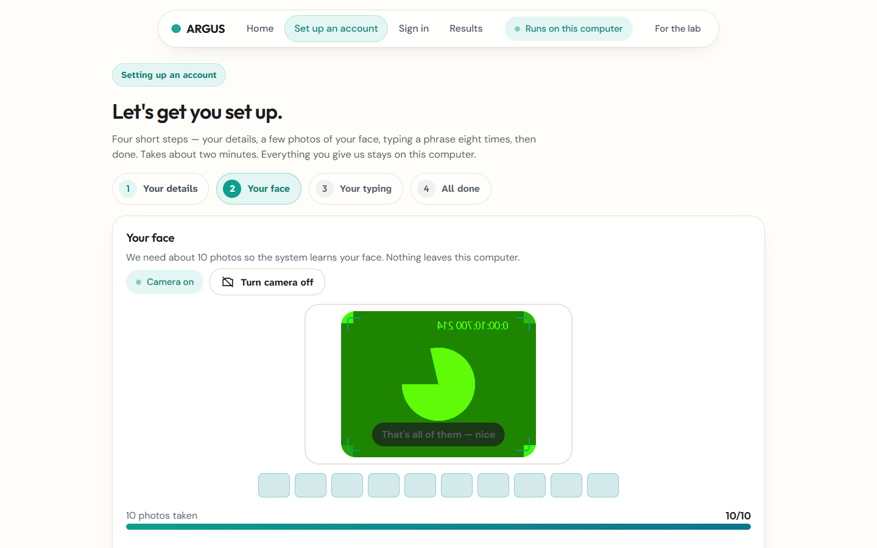
ENROLLMENT
Enrollment: four steps, one template.
1
Account
username + passphrase; the passphrase is also the typed phrase.
2
Face
the camera turns on when the step opens.
3
Rhythm
eight rounds across three phases; a round records itself.
4
Save
embeddings and the rhythm model are written to the local database.
The camera used to need a click. Now it starts itself — and the control stays visible if it doesn’t.
STEP 2 · FACE — the camera starts itself; ENABLE CAMERA is always visible
ARGUS · THE PRODUCT
11 / 21
Notes:
This is the enrollment wizard as it actually runs.
Step two is the face capture. Note the camera state chip on the right — it reads 'camera on' because the sensor starts when the step opens. Before this change it stayed on 'camera off' with zero frames and no way to turn it on, which was a real bug.
There is still an explicit Enable camera button, because a browser permission prompt can always need a second tap.
Steps three and four are the rhythm capture and the save.

Slide 12
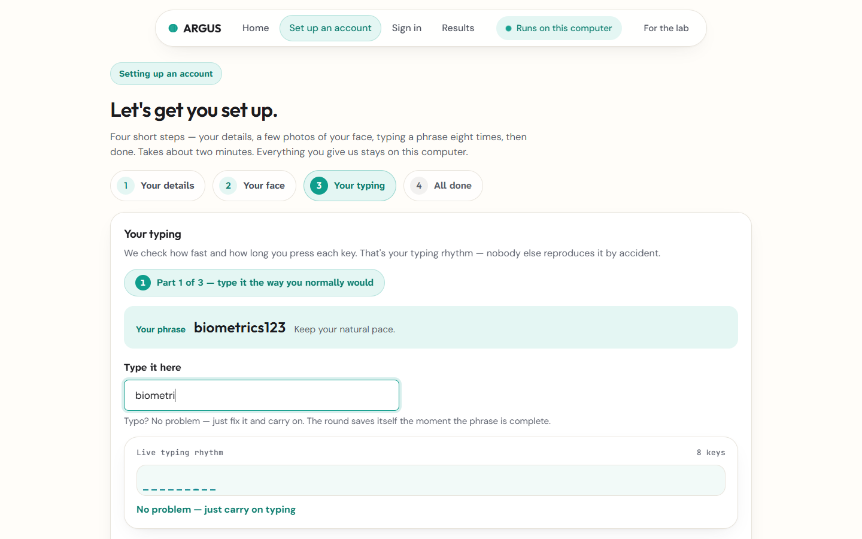
RHYTHM CAPTURE
The phase is on screen, and typos are survivable.
PHASE A · DWELL & HOLD
The badge names the phase and the characteristic it is measuring, and it changes as you move through the eight rounds.
AUTO-ADVANCE
The round records itself 350 ms after the full passphrase lands — no “Record round” button to remember.
A TYPO IS NOT A FAILURE
Backspace corrects the buffer; the round survives and the correction stays inside the sample as behavior.
STEP 3 · TYPING — phase badge live, correction in progress
ARGUS · THE PRODUCT
12 / 21
Notes:
The typing step as it now behaves.
The phase badge in the top right names the phase and, underneath, the characteristic being measured — phrase timing, inter-key speed, or recovery.
The round records itself 350 milliseconds after the complete phrase is on the field. In the earlier build you had to press 'Record round' and the field had to hold exactly one copy of the passphrase, so typing more just sat there at zero clean rounds.
And a typo — the status line here reads 'corrections in progress' — no longer discards the round.

Slide 13
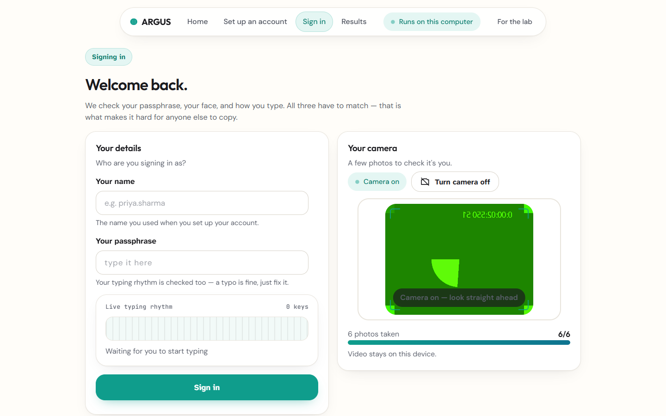
THE VERIFICATION CONSOLE
The pipeline, staged — with the real numbers.
FS-01
Face embedding
FS-02
Gallery match
KD-02
Rhythm analysis
FS-09
Fusion · decision
The console animates for pacing; the numbers are never faked. If the request fails, the rows say FAULT.
LOGIN — the staged console paces the UX; every figure is the server's score
ARGUS · THE PRODUCT
13 / 21
Notes:
The login console.
Four rows, each named by the module that produced it. The console animates so the operator can follow what is happening — but every number that lands is the server's actual score. If the request fails, the rows read FAULT and the stamp says ACCESS DENIED; nothing is faked to make the demo look good.
The verdict stamp is the single loudest moment in the interface, and it is the product's ritual rather than decoration.

Slide 14
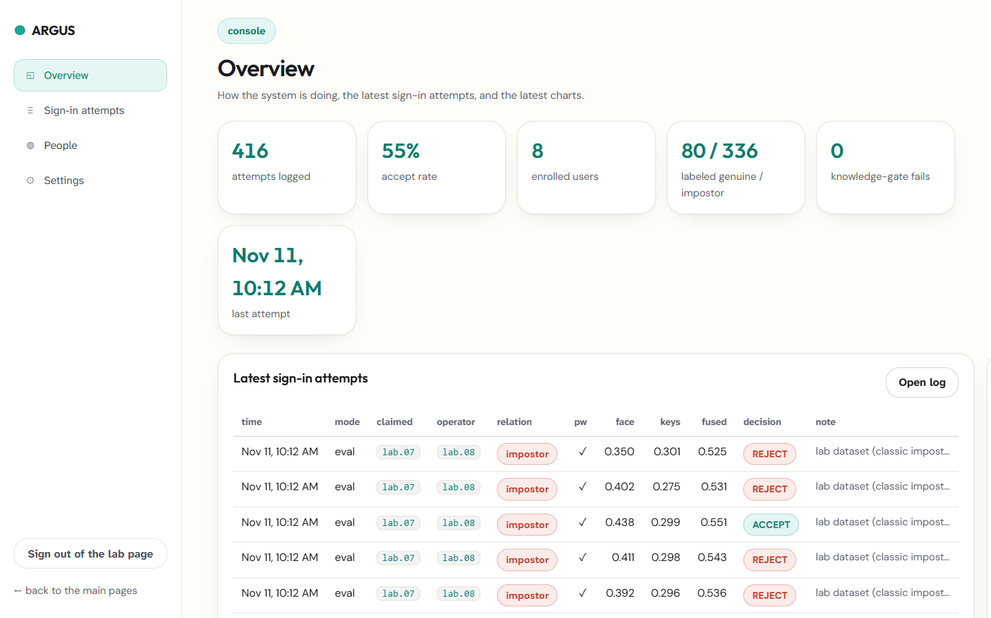
THE LAB CONSOLE
Users, attempts, and a live operating point.
Attempt log. Every scored attempt with its face cosine, keystroke similarity, fused score and decision.
Runtime tuning. θ and both fusion weights are edited live and take effect on the next attempt.
Reset. The attempt log can be cleared without touching the enrolled templates.
PIN-gated. Constant-time comparison, session cookie, and the PIN comes from the environment — never hardcoded.
ADMIN — PIN-gated session; runtime threshold and fusion weights
ARGUS · THE PRODUCT
14 / 21
Notes:
The admin console.
It is where the evaluation numbers come from — every scored attempt is logged with its individual modality scores, the fused score and the decision.
It is also where the operating point is chosen. The decision threshold and both fusion weights are editable at runtime and stored in the settings table, so the threshold can be moved to where the measured FAR/FRR curve says it should be.
The PIN comes from the ARGUS_ADMIN_PIN environment variable and is compared in constant time.

Slide 15
EVALUATION METHODOLOGY
Labeled attempts, two populations.
Ground truth comes from evaluation mode: the operator is recorded alongside the claimed username, so every attempt is labeled genuine or impostor before any metric is computed.
GENUINE
CLASSIC IMPOSTOR
operator == claimed
operator != claimed
The user logs in as themselves.
An attacker at the keyboard with their own face, typing the victim’s passphrase in their own rhythm.
80 attempts
336 attempts
A THIRD POPULATION — SINGLE-FACTOR ATTACKS
A stolen photo of the victim (face right, rhythm wrong) or a stolen typing template (rhythm right, face wrong). Kept OUT of the impostor population — they are reported separately on slide 18.
Separating them is the difference between a FAR number that means something and one that flatters the system.
ARGUS · EVALUATION
15 / 21
Notes:
Methodology, and I want to be precise here because it decides whether the numbers mean anything.
Ground truth is recorded in evaluation mode: the operator field alongside the claimed username. Operator equals claimed is genuine; different is impostor.
The classic impostor is the realistic attacker: their own face, their own rhythm, the victim's passphrase. Both factors fail.
And I deliberately kept single-factor attacks in a separate population — a stolen photo of the victim, or a stolen typing template. If you fold those into the impostor set, your FAR goes up and the number tells you nothing about the classic attack. They get their own slide.

Slide 16
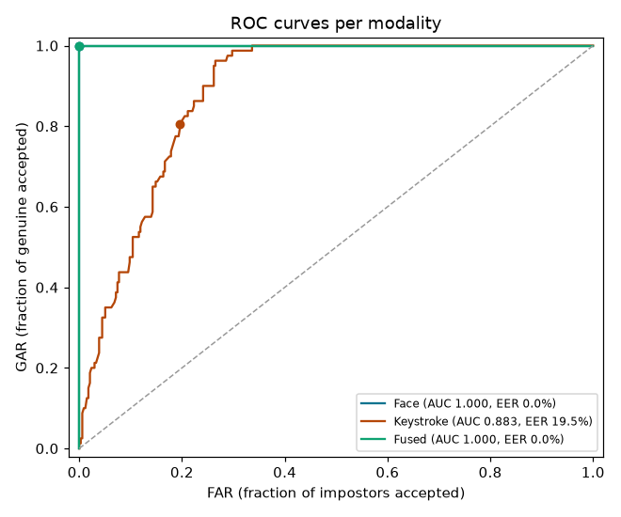
RESULTS
Measured, per modality and fused.
MODALITY
AUC
EER
EER @ Θ
FAR @ Θ=0.78
FRR @ Θ=0.78
Face (FS-02)
1.0000
0.00%
0.780
0.0%
0.0%
Keystroke (KD-02)
0.8831
19.52%
0.602
0.6%
91.2%
Fused (FS-09)
1.0000
0.00%
0.757
0.0%
0.0%
416 labeled attempts · 80 genuine · 336 classic impostor · 8 enrolled identities
READ THIS HONESTLY
The face check carries most of it. Keystroke alone is weak (EER 19.52%) — fusion here is defence in depth, not a better score.
ROC PER MODALITY — GENERATED BY THE APP'S OWN evaluation.py
θ = 0.78 is calibrated, not assumed. The old 0.55 sat on the median impostor and admitted 44.05%.
ARGUS · RESULTS
16 / 21
Notes:
These are the measured numbers, computed by the application's own evaluation module over the labeled attempts.
The fused system separates the two populations perfectly on this cohort: AUC 1.000, EER 0.00%, FAR and FRR both 0.00% at the shipped threshold.
But I want to draw attention to two things.
First, the keystroke row. The fused result is carried almost entirely by the face check — on its own the keystroke template is weak, with EER 19.5% and genuine and impostor ranges that overlap. Fusion here is defence in depth, a second independent factor, not a better score.
Second, the threshold. It used to ship at 0.55, which is the middle of a zero-to-one scale and therefore a natural-looking default — and it admitted 44.05% of impostors, because the median impostor score sits at 0.538. The face score is (cosine + 1) / 2, and Facenet512 cosines between different people sit around 0.18 rather than 0, so an impostor's face score floors out near 0.59 and the threshold never had a chance. 0.78 is the midpoint of the measured gap between the two distributions. The next slide shows that gap.
The threshold is data. That is the whole lesson.

Slide 17
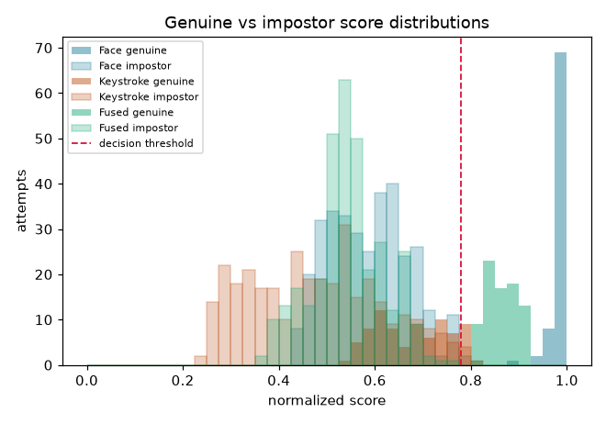
CHOOSING THE OPERATING POINT
Move θ, and the FAR/FRR trade-off resolves.
WHERE THE CURVES CROSS
MODALITY
EER
EER @ Θ
Face
0.00%
0.780
Keystroke
19.52%
0.602
Fused
0.00%
0.757
THE POINT OF THE ADMIN CONSOLE
Set θ where the fused distribution separates — not where it happens to sit on a 0–1 scale. The threshold is data, not a constant.
GENUINE vs IMPOSTOR SCORE DISTRIBUTIONS — THE RED LINE IS θ
At the EER operating point the fused system reports EER 0.00%.
ARGUS · RESULTS
17 / 21
Notes:
This slide is about the operating point rather than the algorithm.
On the left are the genuine and impostor score distributions with the decision threshold drawn on it. You can see the fused distribution separates where the individual ones overlap.
On the right is the EER for each modality and the threshold at which it occurs. The fused system's EER is the lowest of the three, which is the quantitative statement of the fusion argument.
The practical point: the threshold should be set where the distributions separate, and that is a runtime decision, not a constant baked into the source. Shipping 0.55 as the midpoint of a zero-to-one scale is what produced the 44% false-accept rate on the previous slide.

Slide 18
WHY FUSE AT ALL
What a single modality would have let through.
The single-factor attacks, scored three ways at the same threshold. A system that trusted one modality alone would have admitted these:
ATTACK
FACE-ONLY GATE
RHYTHM-ONLY GATE
FUSED (W .6/.4)
FUSED (W .4/.6)
ATTACK SHAPE
Stolen photo of the victim
99%
21%
62%
21%
face right · rhythm wrong
Stolen typing template
0%
77%
0%
1%
rhythm right · face wrong
THE ARGUMENT
Each single-factor attack is waved through by exactly one single-modality gate — a photo defeats face-only, a typing template defeats rhythm-only. The fusion does NOT refuse the photo attack: at w = 0.6/0.4 the face term alone carries it over the line. Rebalancing toward the rhythm cuts what survives from 62% to 21%.
Each single-modality gate is judged at its OWN best operating point (its EER threshold), not at the fused threshold. The last column rebalances the fusion weights from 0.6/0.4 to 0.4/0.6 — the same scores, the same threshold, a different policy.
ARGUS · RESULTS
18 / 21
Notes:
This is the slide that justifies the whole design.
Each row is one attack, scored three ways at the same threshold. The first column is what a face-only gate would accept; the second is what a rhythm-only gate would accept; the third is what the fused system accepts.
Look at the pattern: for each attack, exactly one single-modality gate waves it through. The photo attack defeats a face-only system completely. The template attack defeats a rhythm-only system completely.
Now look hard at the third column, because it does not say what you might expect. The fused system does NOT refuse the photo attack. At w = 0.6/0.4 the face term contributes 0.6 times a near-perfect 0.99, which is 0.594 on its own — 78% of the way to the threshold. The attacker's own rhythm only has to contribute the remaining 0.16, and 62% of impostor rhythms do. The fused gate is doing exactly what it was told to do; the policy embedded in the weights is what is too generous.
That is why the last column exists. The same scores, the same threshold, the weights swapped from 0.6/0.4 to 0.4/0.6: what survives the photo attack drops from 62% to 21%, and the rhythm attack barely moves. The price is on the classic impostor population, where the EER rises from 0.00% to 1.09%.
I am not going to pretend the shipped weights are the right ones. 0.55/0.45 is the obvious next experiment — it holds the classic impostor EER at 0.00% while cutting the photo attack further. But re-measuring the attack curves needs the cohort regenerated, so it is a decision, not a patch.

Slide 19
SECURITY POSTURE
100% local, and hostile to the browser.
No inline anything. Strict CSP; page config rides a JSON block, not an inline script.
APP.PY
@app.after_request
def _security_headers(resp):
resp.headers["X-Content-Type-Options"] = "nosniff"
Self-hosted assets. No third-party request, no tracking pixel.
resp.headers["X-Frame-Options"] = "DENY"
resp.headers["Referrer-Policy"] = "no-referrer"
resp.headers["Permissions-Policy"] = (
Client is untrusted. Timestamps must be finite and physically plausible.
"camera=(self), microphone=(), geolocation=()")
resp.headers["Content-Security-Policy"] = (
"default-src 'self'; img-src 'self'; style-src 'self'; "
The passphrase is never stored. Only a SHA-256 fingerprint of it.
"script-src 'self'; media-src 'self' blob:; connect-src 'self'; "
"base-uri 'none'; frame-ancestors 'none'; object-src 'none'")
Rate limited per endpoint. enroll, attempt and admin have their own budgets.
THE ADMIN GATE
DECLARED LIMITS
PIN from the environment (ARGUS_ADMIN_PIN), compared in constant time, session cookie, and the default documented as lab-only in the README.
A lab tool bound to localhost, with a default admin PIN the README says to change.
ARGUS · SECURITY POSTURE
19 / 21
Notes:
The security posture, which was a hard constraint on this build.
The CSP is strict: default-src self, with explicit allowances and no unsafe-inline anywhere. There is not a single inline style or inline script in the codebase — page configuration travels as a JSON script block, which is data, not executable code.
Every asset is self-hosted, so the app makes no third-party requests at all.
The client is treated as hostile: every keystroke timestamp has to be finite and within physical bounds, request bodies are capped, and endpoints are rate limited.
And the passphrase is never stored — only a fingerprint of it, used to confirm that all enrollment rounds share one phrase.

Slide 20
LIMITATIONS
What this build does not do.
Small lab dataset. 416 labeled attempts across 8 identities. The curves are directionally meaningful; the confidence intervals are not tight.
No liveness or PAD. The face path cannot tell a live face from a good print. Rhythm provides the second factor, but a replay-attack-resistant face check is the missing piece.
Keystroke needs multiple rounds. A single typed sample is far too noisy to score — which is exactly why the enrollment is phased and why the model stores variance rather than a template.
Cosine similarity has no absolute scale. The face score is not interpretable on its own; the threshold has to be learned from labeled data.
Keeps everything locally. That is a privacy feature and also a single-machine dependency — there is no multi-user or remote-deployment story here.
The honest summary: this is a working, end-to-end multimodal gate with measured evidence for the fusion argument — not a production-ready authentication service.
ARGUS · HONESTY
20 / 21
Notes:
I'd rather state the limits than have you find them.
The dataset is small — a lab's worth of labeled attempts — so the curves show the direction of the effect but the confidence intervals are wide.
There is no liveness or presentation-attack detection. The face path cannot distinguish a live face from a good photograph. The rhythm factor is what raises the bar for a photo attack, but PAD on the face side is the missing piece for a real deployment.
The keystroke model needs eight rounds to build, because a single sample is far too noisy to score.
And cosine similarity has no absolute scale, so the face score only means something relative to a labeled threshold.

Slide 21
ARGUS
Two modalities.
One verdict.
A photo of the user cannot reproduce their rhythm. An impostor who knows the passphrase cannot reproduce their face. Measured on labeled attempts, the fusion refuses what either half would let through.
LIVE NOW
IN THE REPO
NEXT
Flask app, local
Full source, MIT
Liveness / PAD on face
Facenet512 · ONNX
Design system + docs
More labeled attempts
SQLite · 8 lab identities
smoke_test.py
Per-user threshold auto-fit
FAR/FRR/EER dashboard
Strict CSP, no cloud
Packaged as a desktop app
github.com/Harshit-3114/ARGUS
Questions.
ARGUS · CLOSE
21 / 21
Notes:
To close: ARGUS fuses two modalities that fail independently, into one decision, and we have measured evidence that the combination refuses attacks that either half would admit.
It runs entirely locally, the source is public under MIT, and the evaluation harness is in the repo so the numbers can be reproduced.
The next real pieces of work are presentation-attack detection on the face side and a much larger labeled dataset.
Happy to take questions — including the limitations slide, which I'd rather defend myself.

