Slide 1
DeepFake Detection

Slide 2
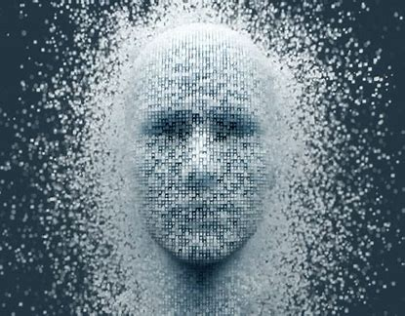
Content
Overview of Deepfake
Working and Models used
Best Model Choice
Use cases
Implementation

Slide 3
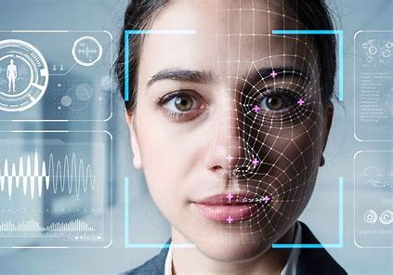
Overview
Definition: A deepfake is a type of synthetic media in which a person’s likeness, voice, or actions are manipulated or entirely generated by AI models, typically using a technique called Generative Adversarial Networks (GANs). Deepfakes can create highly realistic videos, images, and audio that are difficult to distinguish from real media.

Slide 4
Deepfakes have raised both intrigue and concern. While they showcase advances in AI, they also present risks, especially in spreading misinformation, creating fake news, and unauthorized use of people’s images.
Types of Deepfakes:
Video Deepfakes: These alter facial expressions, lip-sync, and even full-body movements in a video. Example: manipulated celebrity videos.
Audio Deepfakes: These involve replicating a person’s voice, useful in voice-activated assistants but also risky if used to impersonate individuals over the phone.
Image Deepfakes: These can create lifelike images of people who don’t exist or alter real photos.

Slide 5
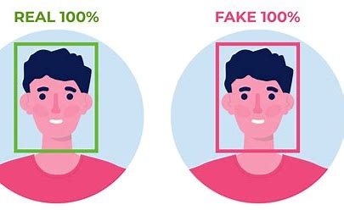
Real-World Examples:Entertainment: Deepfake technology is used for visual effects in movies.
Political and Social Concerns: Deepfakes are sometimes used to create fake statements from public figures, sparking ethical and privacy issues.
Humor and Satire: While some are created purely for entertainment, they illustrate the fine line between creativity and deception.

Slide 6
Working and Models Used
Detection Pipeline:
Input Processing: A user submits a video via WhatsApp. The system receives it and prepares it for analysis, extracting frames to examine individually.
Model Application: Frames are fed into the Xception model, which identifies patterns indicative of manipulation, such as inconsistencies in facial landmarks or lighting.
Result Processing: The system aggregates predictions from frames, determining whether the video is likely real or a deepfake.
Output: The user receives feedback on the authenticity of the video through the WhatsApp bot.

Slide 7
Model Selection:
The Xception model was chosen due to its strong performance in image classification and forgery detection tasks. It’s particularly efficient at recognizing subtle features, making it highly suitable for detecting deepfakes.
Model Architecture: Xception is based on depthwise separable convolutions, which reduce computation without losing detail. This allows it to examine fine details in frames, ideal for spotting minute inconsistencies typical in deepfakes.
Supporting Technologies:
Flask API: Provides a robust backend to handle asynchronous video processing requests.
Twilio API: Integrates WhatsApp for user interaction, making the system accessible.
Ngrok: Provides secure access to the server for the WhatsApp bot.

Slide 8
Best Model Choice
Why Xception?
Accuracy: The Xception model is highly accurate in detecting subtle facial inconsistencies, which is critical in distinguishing deepfakes from real videos.
Efficiency: Its depthwise separable convolutions make it faster and less computationally heavy compared to models like ResNet or EfficientNet, which helps in processing videos more quickly.
Validation Results: Through experiments, Xception consistently outperformed other models in both speed and accuracy for this specific task, showing fewer false positives.

Slide 9
Other Models Considered:
EfficientNet: While effective in general classification tasks, it showed lower performance in detecting the nuanced anomalies in deepfakes.
ResNet: While powerful, ResNet’s architecture is more resource-intensive, making it a less ideal choice for a real-time application like this.
Limitations:
Xception’s performance may vary if new, advanced deepfake techniques are introduced. Continuous model retraining and fine-tuning may be required to keep up with evolving deepfake technologies.

Slide 10
Use Cases
Practical Applications:
Media Verification: Journalists and media outlets can use this system to verify the authenticity of video footage, helping reduce the spread of misinformation.
Social Media Monitoring: Platforms can employ deepfake detection to identify and flag manipulated videos before they go viral, potentially reducing harm to public figures and users.
Law Enforcement: Police and other authorities can use deepfake detection to ensure the credibility of video evidence used in investigations.

Slide 11
Future Potential:
Authentication in Courts: As video evidence becomes more common, systems like yours can authenticate media submitted in legal contexts.
Personal Verification: Individuals may use similar technology to ensure that personal media has not been tampered with, especially as deepfakes become more accessible.
Corporate and Financial Security: Companies could use deepfake detection in cases where fake video/audio could affect stock prices, corporate reputations, or result in other economic damages.

Slide 12
Implementation
1. Video Input and Frame Extraction
Input Handling: The system receives video files sent by users via WhatsApp.
Frame Extraction: Videos are processed to extract frames, which are saved in folders for further analysis. This allows the model to analyze individual frames rather than the full video, enhancing detection accuracy.
2. Deepfake Detection Model
Model Choice: The Xception model is used, chosen for its effectiveness in image classification and forgery detection. The model was pre-trained on a relevant dataset for deepfake detection, so minimal fine-tuning was needed to adapt it to your use case.
Frame Analysis: Each extracted frame is passed through the Xception model, which identifies subtle inconsistencies that suggest a deepfake, such as unusual facial textures or unnatural lighting.

Slide 13
3. Backend Integration
Flask API: A Flask server handles incoming requests. It receives the video input, processes each frame, and aggregates model predictions to determine if the video is real or fake.
Async Processing: Flask processes frames asynchronously, allowing real-time analysis even with multiple requests.
4. User Communication via WhatsApp
Twilio API: Twilio’s WhatsApp API lets users interact with the system by sending videos for analysis and receiving results directly through WhatsApp.
Result Feedback: Once analysis is complete, the system sends back a message to the user indicating whether the video is likely authentic or a deepfake.

Slide 14
5. Secure Tunneling with Ngrok
Public Access: Ngrok is used to create a secure public URL for the Flask API, enabling external access to the backend while keeping the server safe.
Endpoint Management: Ngrok facilitates testing and deployment by simplifying access control and secure communication with the WhatsApp bot.
This setup provides an efficient, user-friendly deepfake detection system that integrates deep learning with a responsive messaging interface.

Slide 15
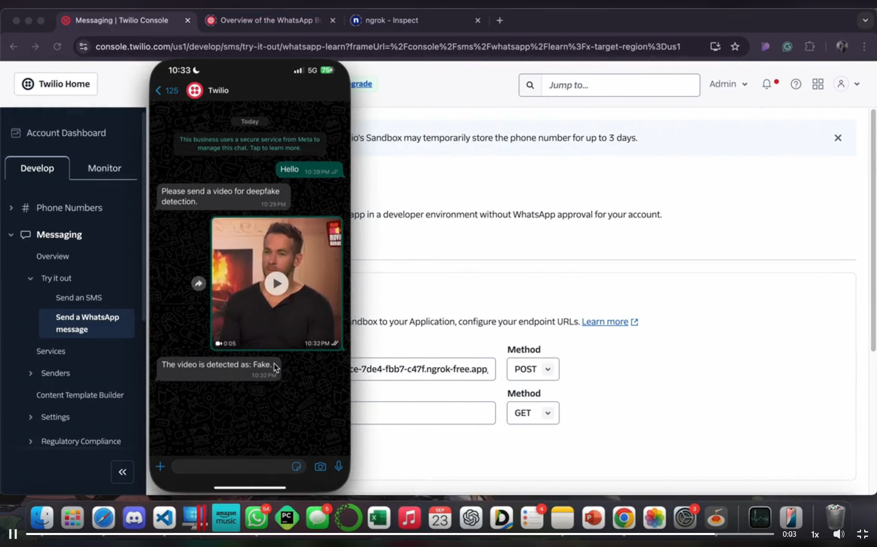
This video is a deepfake of an actor which has been identified correctly by our model.

