Slide 1
Comedy Sketch Creator

Slide 2
Research

Slide 3
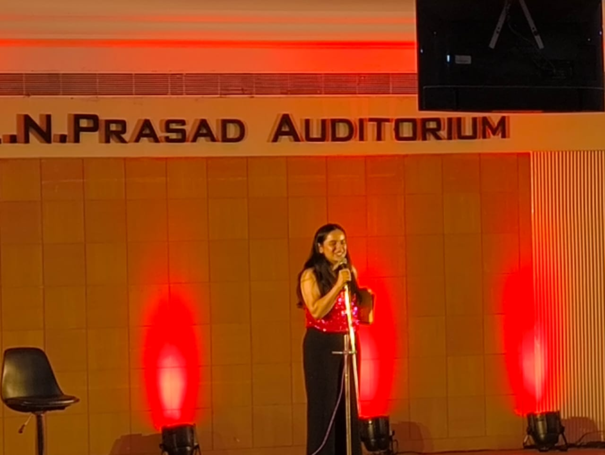

Slide 4
2. MVP
Mostly unfunny
No punchlines
Good premise setting and characters

Slide 5
3. More research
Add punchlines
Callbacks

Slide 6
4. Better product

Slide 7
5. Incomplete Aspirations
Emulation of environment
Use thinking modules for punchlines

