Slide 1

Edge–Fog–Cloud Task Placement Simulator
Simulating workload placement, resource use, and quality of service across three computing tiers
This presentation introduces a Python-based simulator for multi-tenant workloads that compares Latency-First and Capacity-Aware placement policies. The system tracks task placement, resource utilization, latency, and rejected tasks.
01 / WORKLOAD INPUT
02 / THREE-TIER SIMULATOR TOPOLOGY
03 / OUTPUT METRICS
Users & Tenants
Multi-tenant workload generator submitting task requests.
Task Parameters
CPU requirements
RAM requirements
Latency sensitivity
Placement Policies
• Latency-First
• Capacity-Aware
EDGE TIER
LATENCY: 10 ms | CPU: 4 Cores
RAM: 8 GB
Task Placement
Mapping of workload distribution per tier.
Resource Utilization
CPU and RAM usage profiles across simulation.
Latency QoS
Execution delay and response times.
Rejected Tasks
Success vs rejection rates under capacity bounds.
FOG TIER
LATENCY: 45 ms | CPU: 16 Cores
RAM: 32 GB
CLOUD TIER
LATENCY: 150 ms | CPU: 64 Cores
RAM: 128 GB

Slide 2
System Architecture & Workload Model
EDGE
FOG
CLOUD
COMPUTE TIER SPECIFICATIONS
EDGE TIER NODE
FOG TIER NODE
CLOUD TIER NODE
CAPACITY: Low / Constrained
LATENCY: Ultra-Low (Near Source)
TARGET: Traffic & Real-Time Tasks
CAPACITY: Balanced / Regional
LATENCY: Moderate Response
TARGET: Healthcare Services
CAPACITY: High / Scalable
LATENCY: Higher Network Overhead
TARGET: Heavy Analytics Tenants
WORKLOAD & TASK INPUT PARAMETERS
SIMULATOR EXECUTION & OUTPUTS
Heterogeneous Tasks: Processes 12 benchmark tasks from traffic, healthcare, and analytics tenants.
Resource Demands: Specifies CPU core and RAM capacity requirements per task.
Tenant Identification: Maps tasks to specific tenant IDs for isolation and tracking.
SLA Constraints: Encodes latency sensitivity parameters for tier allocation.
Node Selection: Evaluates tiers and dynamically allocates target compute nodes.
State Tracking: Logs task/VM status alongside real-time observed latency.
Placement Records: Generates detailed task-placement logs per execution cycle.
Analytics Engine: Exports node utilization, QoS metrics, summary charts, and tables.

Slide 3
Placement Algorithms
EDGE
FOG
CLOUD
LATENCY-FIRST ALGORITHM
CAPACITY-AWARE ALGORITHM
Prioritizes tier assignment strictly based on task sensitivity classification.
Evaluates candidate nodes based on available capacity balanced against weighted latency constraints.
TIER PRIORITY MAPPING
DECISION PIPELINE
HIGH: Edge → Fog → Cloud
1. ELIGIBILITY FILTER
Identifies nodes with adequate CPU and RAM.
MEDIUM: Fog → Edge → Cloud
2. CAPACITY SCORING
Scores available capacity against a latency penalty weighted by task sensitivity.
LOW: Cloud → Fog → Edge
3. NODE SELECTION
Selects the highest-scoring eligible node.
FALLBACK MECHANISM
If the preferred node lacks sufficient CPU or RAM, the algorithm automatically falls back to the next designated tier in the priority sequence.
OBJECTIVE FUNCTION
Score = Cap_avail - (Latency × Weight_sens)
Selects node n ∈ Eligible where Score(n) is maximized.

Slide 4
Experimental Setup & Validation
The simulator was tested using several experiments:
POLICY COMPARISON
OVERLOAD TEST
Workload Evaluation
Evaluated the same 12-task workload under both policies.
Capacity Stress Test
Submitted 19 tasks to assess spillover and rejection rates when capacity is insufficient.
SECURITY TEST
EDGE SCALING TEST
Multi-Tenant Isolation
Verified that a tenant cannot access another tenant’s task records.
Hardware Benchmark Comparison
Baseline: 4 CPU, 8 GB RAM, 10 ms
Upgraded: 8 CPU, 16 GB RAM, 5 ms

Slide 5
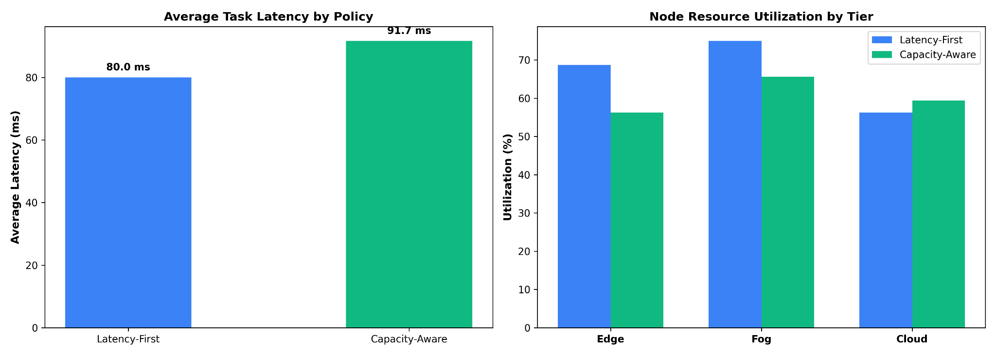
Policy Comparison Results
EDGE
FOG
CLOUD
Task Execution: Both policies completed all 12 tasks.
EXPERIMENTAL RESULTS VISUALIZATION
LATENCY-FIRST POLICY
AVG LATENCY
80.00 ms
TASK PLACEMENTS
3 Edge | 4 Fog | 5 Cloud
TIER RESOURCE UTILIZATION
Edge: 68.75% | Fog: 75.00% | Cloud: 56.25%
DETAILED METRIC COMPARISON
CAPACITY-AWARE POLICY
METRIC
LATENCY-FIRST
CAPACITY-AWARE
AVG LATENCY
91.67 ms
TASK PLACEMENTS
2 Edge | 4 Fog | 6 Cloud
Avg Latency
80.00 ms
91.67 ms
Edge Tier
3 tasks
68.75% util
2 tasks
56.25% util
TIER RESOURCE UTILIZATION
Edge: 56.25% | Fog: 65.62% | Cloud: 59.38%
Fog Tier
4 tasks
75.00% util
4 tasks
65.62% util
Latency-First achieved lower average latency, while Capacity-Aware spread utilization more evenly.
Cloud Tier
5 tasks
56.25% util
6 tasks
59.38% util

Slide 6
Findings & Next Steps
EDGE
FOG
CLOUD
01 / FINDINGS
02 / LIMITATIONS
03 / NEXT STEPS
Under overload, 13 of 19 tasks were admitted and 6 were rejected.
Upgrading the Edge node reduced average latency from 80.00 ms to 75.42 ms, increasing Edge VM count from 3 to 4.
The security experiment successfully blocked a cross-tenant access attempt with a 403 Forbidden error.
The simulation uses modeled VMs and fixed network latencies with one node per tier.
It does not account for energy use, operating costs, or dynamic network conditions.
Test larger workloads and task mixes.
Add multiple nodes per tier and variable network conditions.
Evaluate energy, cost, and fairness metrics.

