Slide 1


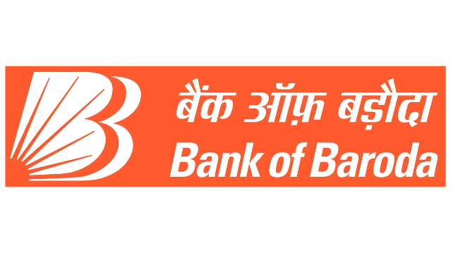
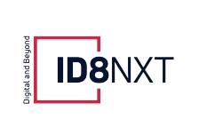
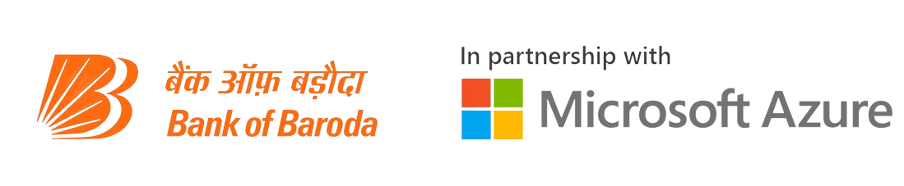
BOB-SAHAYAK
Bank of Baroda Hackathon 2024
A Gen AI powered Chatbot to harness customer experience by providing them the solution on the go personalized as Brand Ambassador Sumit Nagal.
by Harshit Singh

Slide 2

Problem Statement?
Customer-Centric Innovation
2
Operational Efficiency
Competitive Edge and
Security and Compliance
1
3
The banking sector, particularly Bank of Baroda, is ripe for a transformative approach to customer service. By leveraging generative AI, we can significantly enhance the customer experience, making it more personalized and efficient.
Automating customer inquiries and providing real-time, accurate responses can dramatically reduce the workload on human customer service representatives, allowing them to focus on more complex issues.
Gain a competitive edge in the banking industry with innovative service solutions.
And Reinforce security and compliance in an increasingly digital banking landscape.

Slide 3
Pre-Requisite
ADI- Bank of Baroda Chatbot
EVA- HDFC Bank
Mitra App-LIC
A generative AI-based chatbot produces more natural, contextually appropriate responses and can be personalized to individual users, while traditional NLP chatbots rely on predefined rules and patterns, limiting their flexibility and ability to handle novel queries or adapt to user preferences.
Learn about our products and services and get your banking-related queries resolved instantly. Our Electronic Virtual Assistance is powered by AI and analytics to reduce the time required to resolve queries, significantly. Get 24 x 7 assistance for all your banking queries with HDFC Bank’s EVA.
LIC Mitra is powered by Natural Language Processing (NLP), which enables it to understand and respond to users' queries in multiple languages, including voice interactions. The app addresses the main issues users face, including information on LIC products, past and upcoming premiums, and policy maturity dates.

Slide 4
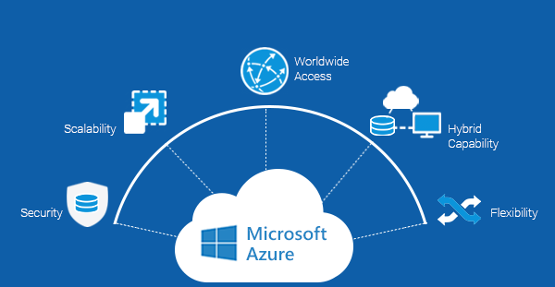

Tools or resources
Azure OpenAI Service
Azure Cognitive Search
Azure Bot Service
Azure Cognitive Services
Azure Active Directory
For the core generative AI capabilities such as GPT 4o or GPT 3.5 Turbo by Open AI.
To implement the RAG (Retrieval-Augmented Generation) technique for knowledge base integration.
For chatbot deployment and management.
Language: For natural language processing tasks.
For user authentication and data security.
Azure Machine Learning
Azure Functions
Azure Cosmos DB
for personalization models and fine-tuning.
To create serverless backend logic for the chatbot
To store and manage customer data and chat history.

Slide 5
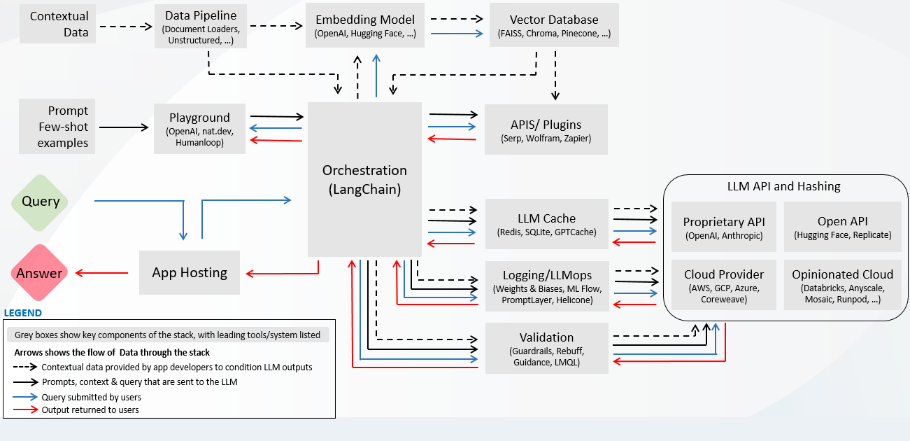
Any Supporting Functional Documents

Slide 6
Key Differentiators & Adoption Plan
Personalization by Gen AI
Flexibility
Continuous improvement
A generative AI-based chatbot produces more natural, contextually appropriate responses and can be personalized to individual users, while traditional NLP chatbots rely on predefined rules and patterns, limiting their flexibility and ability to handle novel queries or adapt to user preferences.
These chatbots handle diverse queries, even unexpected ones. They engage in dynamic conversations, adapting to new topics without being constrained by rigid scripts or decision trees.
These chatbots evolve through interactions, staying current with language trends and new information. They self-improve without constant manual updates, unlike traditional NLP chatbots requiring frequent programming.

Slide 7

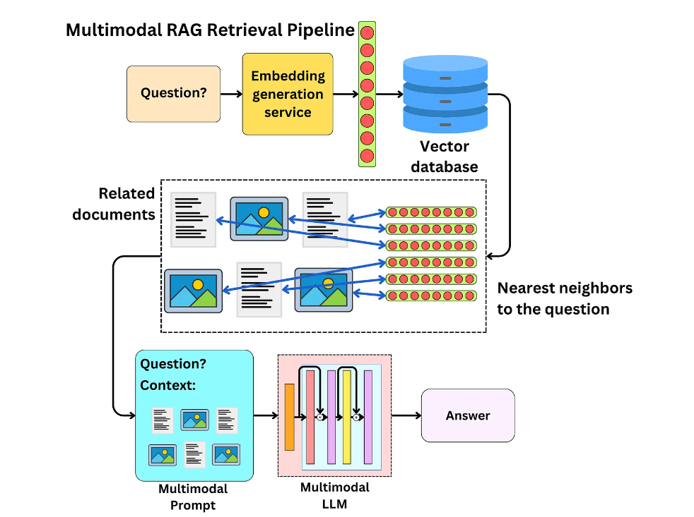

GitHub Repository Link & supporting diagrams, screenshots, if any
GitHub Link: https://github.com/Harshit-Singh-18/BOB-Sahayak

Slide 8
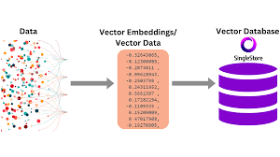





Business Potential and Relevance
Enhanced customer service
and Personalization
Data Embeddings
Robust security and compliance
The AI system collects and analyzes vast amounts of customer interaction data, providing valuable insights into customer behavior and preferences. This information can drive product development, inform marketing strategies, and increase cross-selling opportunities etc.
The AI-driven chatbot provides 24/7, tailored support based on each client's financial history. This personalized approach improves customer satisfaction, increases engagement, and potentially boosts customer loyalty and retention rates.
The system incorporates advanced verification protocols and security linters to protect against Common Vulnerabilities and Exposures (CVEs). This ensures data confidentiality, helps in fraud detection, and maintains compliance with banking regulations

Slide 9


Uniqueness of Approach and Solution
1
Brand Ambassador as AI avatar
The chatbot features a digital representation of brand ambassador Sumit Nagal, creating a unique and engaging interface. This celebrity-driven AI offers a novel blend of familiarity and advanced technology, potentially increasing user engagement and fostering stronger brand loyalty among customers.
2
RAG-enhanced knowledge base
The system utilizes Retrieval-Augmented Generation (RAG) to integrate comprehensive Bank of Baroda product information. This approach combines large language models with a curated knowledge base, ensuring highly accurate, up-to-date, and context-specific responses, surpassing standard chatbots in reliability and relevance.
3
Adaptive memory and cross-platform consistency
The AI remembers previous user interactions and maintains consistency across various platforms, creating a seamless omnichannel experience. This feature, combined with real-time personalization based on financial history

Slide 10
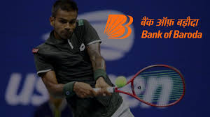
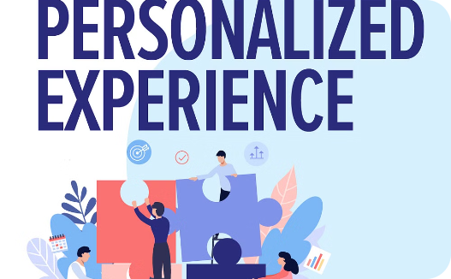
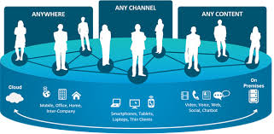
User Experience
24/7 celebrity-driven support
Personalized Experience
Seamless omnichannel experience
Sumit Nagal's digital avatar offers round-the-clock assistance, combining star appeal with AI efficiency. This unique interface makes banking more engaging and accessible.
AI analyzes financial history to provide tailored advice and product recommendations. This personalization enhances relevance and value of each interaction for users.
Consistent interactions across platforms with adaptive memory ensure users can pick up where they left off, creating a smooth, integrated banking experience.

Slide 11


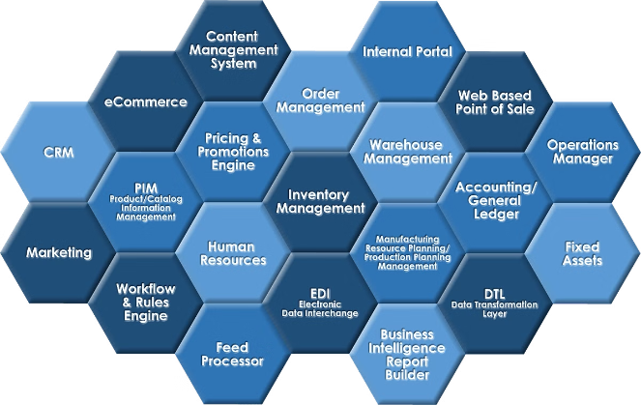


Scalability
Cloud-Based architecture
Utilizing Azure's scalable infrastructure allows the system to handle increased user load seamlessly. Resources can be dynamically allocated to maintain performance during peak times.
Modular Design
Components like chatbot, knowledge base, and personalization engine are designed as separate modules. This allows for independent scaling and updates without disrupting the entire system.
Distributed processing
Leveraging Azure's distributed computing capabilities enables efficient handling of multiple concurrent user interactions. This ensures consistent performance even as user base grows.

Slide 12


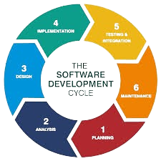
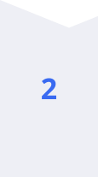
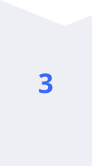
Ease of Deployment and Maintenance
Pre-built Azure services
Utilizes readily available Azure AI and cloud services, reducing development complexity. This approach simplifies initial implementation and enables easier ongoing maintenance and updates.
Automated learning and updates
AI continuously learns from interactions, automatically improving responses. The RAG system updates knowledge base, minimizing manual content management and ensuring up-to-date information.
Centralized management console
A unified dashboard for monitoring, analytics, and system adjustments. This streamlines maintenance tasks, allowing efficient oversight and quick issue resolution across the entire system.

Slide 13


Security Considerations
Multi-factor authentication
Implements robust user verification, including biometrics and OTPs. This ensures only authorized users can access sensitive financial information and perform transactions through the AI system.
End-to-end encryption
All data transmissions are encrypted using industry-standard protocols. This protects user information and financial data from interception or unauthorized access during communication.
Regular security audits
Conducts periodic vulnerability assessments and penetration testing. These proactive measures help identify and address potential security weaknesses, maintaining the system's integrity and user trust.

Slide 14

Thank You
We appreciate your time and consideration. Our team is excited to present our innovative solution and looks forward to the opportunity to collaborate with Bank of Baroda. Thank you for your support!
Team members: Harshit Singh

