Slide 1

Seasonal Agriculture Performance Analysis
Harshit Vaishnav
Lucky Institute of Professional Studies
AICTE STU ID : STU6a6c786a16f231785493610

Slide 2

PROBLEM STATEMENT
Agricultural activities are influenced by seasonal variations in environmental conditions, farming practices, resource availability and market conditions. As a result, agricultural performance may differ from one season to another. However, raw agricultural data does not clearly explain how agricultural performance changes across seasons or what patterns can be observed in different seasonal conditions. The problem is to analyze the given agricultural dataset and investigate seasonal differences in agricultural performance by identifying meaningful patterns, trends, relationships and variations within the available data.

Slide 3
Project Description
This project is about understanding how agriculture performs in different seasons. We analyzed the given agricultural data to compare crop yield, production, water usage, environmental conditions and profit across seasons.
We also looked at differences between crops, irrigation methods and states to find useful patterns in the data. Finally we used graphs and statistical analysis to identify important findings and give practical, data based recommendations for better agricultural planning.

Slide 4

WHO ARE THE END USERS?
Farmers : to understand seasonal crop performance and resource usage.
Agricultural Planners : to support better seasonal planning and decision-making.
Government and Agriculture Departments : to understand regional and seasonal agricultural patterns.
Agricultural Researchers : to study trends and relationships in agricultural data.
Data Analysts : to analyze agricultural performance and generate data-driven insights.

Slide 5

Technology Used
Python : Main programming language for data analysis
Jupyter Notebook : Used to write and execute the analysis
Pandas : Data cleaning, manipulation and analysis
NumPy : Numerical calculations
Matplotlib : Creating data visualizations
Seaborn : Creating statistical graphs and charts

Slide 6
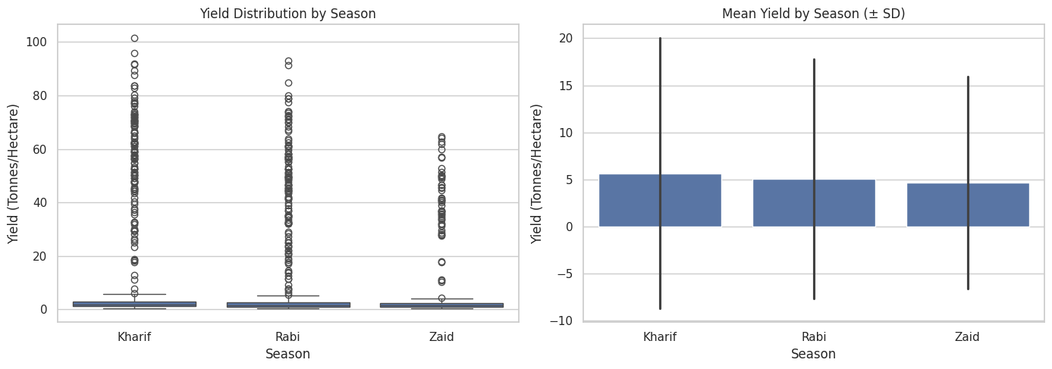
RESULTS
Yield Performance by Season
Kharif records the highest average yield at 5.63 t/ha, followed by Rabi (5.04 t/ha) and Zaid (4.64 t/ha).
Although Kharif has the highest average yield, the one-way ANOVA is not statistically significant (F = 1.554, p = 0.2116).
Therefore, the observed difference in average yield across seasons cannot be considered statistically significant.

Slide 7
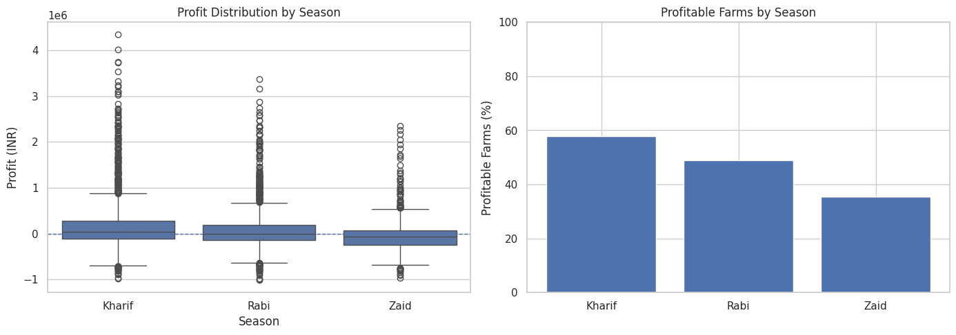
RESULTS
Economic Performance by Season
Kharif has the highest average profit of ₹1,78,915, followed by Rabi (₹87,690).
Zaid records an average loss of ₹24,805, making it the weakest season economically.
Average revenue is highest in Kharif (₹7,10,719) and lowest in Zaid (₹5,19,172).
ANOVA shows that the difference in profit across seasons is statistically significant (F = 34.292, p < 0.001).

Slide 8
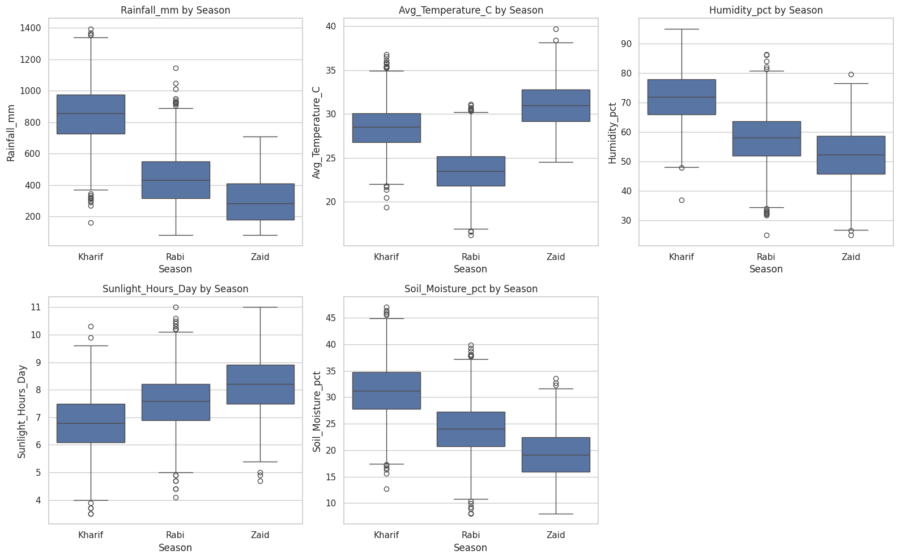
RESULTS
Environmental Conditions by Season
Kharif had the highest rainfall and soil moisture, while Zaid experienced the highest temperature and lowest rainfall and soil moisture.

Slide 9
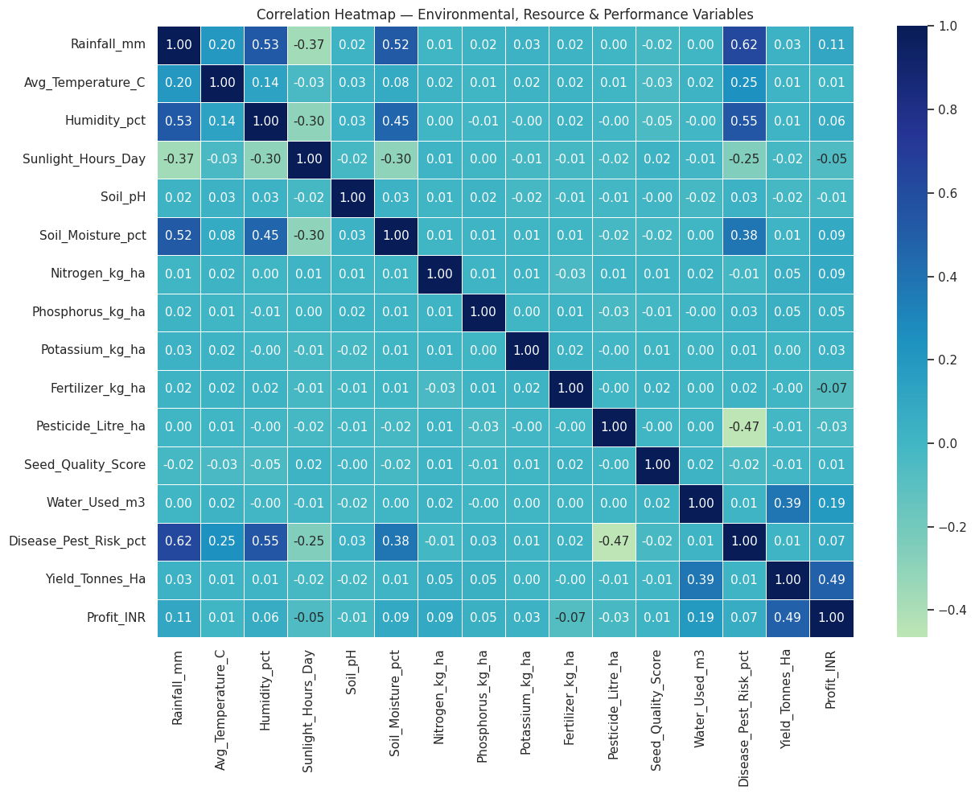
RESULTS
Relationships Between Key Variables
Water usage showed a positive relationship with yield (r = 0.386). Yield and profit also showed a positive relationship, indicating better production generally supports higher profitability.

Slide 10
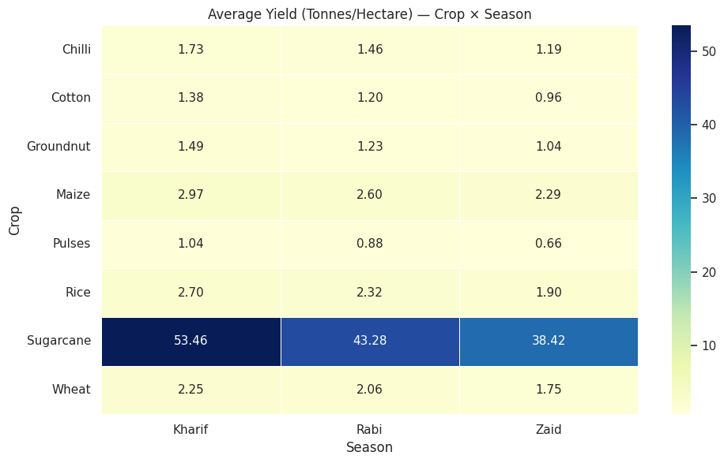
RESULTS
Crop Performance Across Seasons
Sugarcane achieved the highest average yield across all three seasons and showed the largest seasonal variation in yield.
For most crops, the yield follows the pattern Kharif > Rabi > Zaid.
Zaid has the lowest yield for every crop.

Slide 11
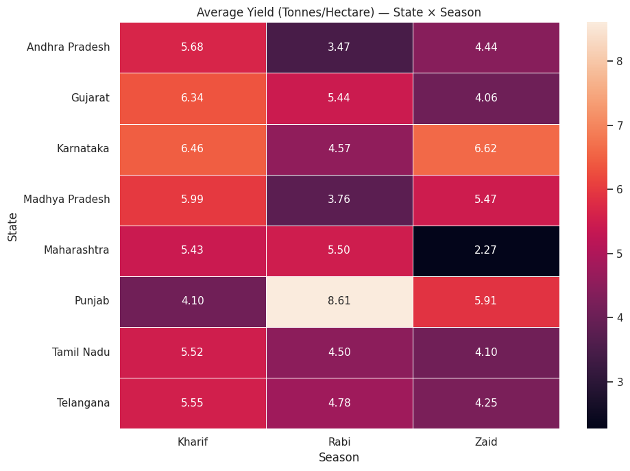
RESULTS
State Performance Across Seasons
Punjab records the highest Rabi yield (8.61 t/ha), while Karnataka has the highest Zaid yield (6.62 t/ha).
Kharif performs best in most states, but the best-performing season varies across regions, showing clear state level differences.

Slide 12
Future scope
Multi-year data: Analyze multiple years to identify consistent seasonal trends.
Predictive models: Use Machine Learning to forecast yield and profit by season.
Interactive dashboard: Develop a dashboard for real time seasonal performance monitoring.
Regional analysis: Extend analysis to district level climate and soil conditions.
Market forecasting: Integrate crop prices with seasonal production to support better selling decisions.

Slide 13
GitHub Link
https://github.com/Harshit-Vaishnav14/Seasonal-Agriculture-Performance-Analysis-.git

Slide 14

VOIS Course completion certificate - Course name- Data Visualization

Slide 15
Thank you
.
.

