Slide 1
BIOMIND AI
"What if drug repurposing wasn't a search problem, but a reasoning problem?"
BioMind: Connecting Disease Mechanisms, Drug-Target Relationships, & Real-World Safety
Biomedical data is vast but deeply fragmented. BioMind integrates literature, target databases, and post-market safety records into a unified, evidence-traceable reasoning pipeline to generate explainable therapeutic hypotheses.

Slide 2
1. START WITH THE REAL PROBLEM
The Efficiency Crisis in Drug Discovery
Traditional vs. Repurposing Approaches
High Innovation Costs: Developing a completely new drug takes over a decade and costs billions, with a staggering 90%+ clinical failure rate.
The Repurposing Shift: Instead of asking *'Can we invent a new molecule?'*, we ask *'Can an existing, safety-tested molecule be useful elsewhere?'*
Leveraging Existing Knowledge: Repurposed drugs arrive with completed clinical trials, known pharmacology, and established manufacturing pipelines.
The Real Bottleneck: The problem isn't a lack of biomedical data. The problem is connecting it to make safe, reliable repurposing decisions.
Comparison of Development Paths
TRADITIONAL DEVELOPMENT PATH
Disease ➔ Invent Molecule ➔ Preclinical ➔ Clinical Trials ➔ Approval (10-12 Years, High Cost)
REPURPOSING DEVELOPMENT PATH
Disease ➔ Screen Existing Approved Drugs ➔ Targeted Trials ➔ Approval (3-5 Years, Low Cost)
BioMind accelerates the screening phase by mapping target mechanisms and safety profiles instantly.

Slide 3
2. SHOW THE FRAGMENTATION PROBLEM
The Siloed Biomedical Ecosystem
Disconnected Evidence Layers
PubMed Literature: Contains millions of mechanistic findings, but they are unstructured and locked in prose.
ChEMBL Database: Over 18,500 targets, 2.9M compounds, and 24.5M activity records, yet requires genomic mappings to connect to disease pathways.
DrugBank: Rich drug-drug interaction and chemical profiles, but isolated from real-world adverse reports.
FDA FAERS: Post-marketing clinical safety reports from millions of patients, completely separate from target-discovery tools.
The Researcher's Manual Journey
1. Disease Identification: Look up ALS pathways in literature.
2. Mechanism Discovery: Identify genes/proteins involved.
3. Target Mapping: Cross-reference proteins in ChEMBL.
4. Drug Matching: Find approved compounds acting on targets.
5. Safety Screening: Query FAERS for real-world side effects.
6. Synthesis Decision: Hand-write a hypothesis report.
Integrating this fragmented stack is the core challenge.

Slide 4
3. EXISTING AI & LIMITATIONS
Prediction is Not an Explanation
Knowledge Graphs & Zero-Shot GNNs
**State-of-the-Art models:** Systems like **TXGNN** perform zero-shot indications over huge medical knowledge graphs (17k+ diseases).
The Prediction Focus: Most KG models are designed for link prediction (*'Will drug X treat disease Y?'*) showing connections.
Inherent Limitations: Graphs struggle with incomplete knowledge bases, stale source data, and high computational scale.
The Triage Gap: A pure prediction percentage is not a defensible hypothesis. Clinicians and researchers need to know *why* it works.
From Prediction to Evidence Synthesis
EXISTING GRAPH AI SYSTEMS ASK:
"Which drugs are associated with this disease node?"
BIOMIND ASKS:
"Why might this drug work, what biological mechanism connects it, and what does real-world safety say?"

Slide 5
4. THE SAFETY SCREENING GAP
The Crucial Safety Dimension
Drugs Do Not Work in a Vacuum
Multi-Target Effects: A candidate drug might target the correct disease protein but bind to secondary proteins, causing severe side effects.
Real-World Populations: Controlled clinical trials have narrow cohorts. Real-world patients are diverse, taking multiple medications concurrently.
Post-Marketing Insights: FDA FAERS tracks millions of post-market reports, revealing adverse reactions invisible during trials.
Early Warning Shield: Integrating FAERS data ensures high-risk drugs with severe contraindications are deprioritized immediately.
Unified Evidence Triage
CANDIDATE DRUG EVALUATION
🧬 BIOLOGICAL EVIDENCE
Disease ➔ Pathway ➔ Target (Literature + ChEMBL Mapping)
🛡️ SAFETY EVIDENCE
Adverse Events ➔ Contraindications (FDA FAERS Screening)
➔ Integrated Synthesis = Ranked, Cited Therapeutic Hypothesis

Slide 6
5. THE BIOMIND ARCHITECTURE
The 5-Agent Evidence Pipeline
Deconstructed Agent Roles
LEXIS (Lit Scout): Extracts disease pathways and target proteins from PubMed texts, enforcing strict citation matching.
HELIX (Target Match): Connects proteins to drugs deterministically via curated ChEMBL bioactivity and genomic records.
SHIELD (Safety Screen): Evaluates safety records in FDA FAERS, tagging candidates as CLEAR, CAUTION, or FLAGGED.
ORACLE (Candidate Scorer): Synthesizes literature strength, pathway relevance, and safety penalties into ranked tiers.
SYNAPSE (Synthesis): Formulates human-readable, cited reports explaining *exactly* why a candidate works.
Pipeline Data Flow

Slide 7
6. TECHNICAL FEASIBILITY & CHALLENGES
Real Engineering, Not Just Agents
Overcoming Production Obstacles
Entity Resolution: In testing ALS, LEXIS found *C9orf72* but HELIX's cache had exact-string mappings. We recognized this as a heterogeneous data integration challenge.
Retrieval Quality: COVID-19 searches originally surfaced public health/vaccine hesitancy papers. We added task-specific search restrictions for *molecular mechanisms*.
Zero Deployment Risk: Currently utilizes FastAPI, LangGraph, and sqlite3 cached databases to ensure a latency-free, reproducible demonstration.
The Deeper Research Gap
Link Prediction vs. Path Explanation: Conventional models predict a direct *Drug-Disease* link. BioMind builds the multi-hop path: *Drug ➔ Target ➔ Pathway ➔ Disease*.
Inspired by Explainable KG: We build on the interpretability patterns of TXGNN but package it as a workflow-driven, readable evidence synthesizer.
Defensible Scope: We don't claim to replace laboratory research; we aim to radically reduce the search space for first-pass human review.

Slide 8
7. FUTURE VISION & ROADMAP
Model Cross-Verification & DDI
Collaborative Agent Architectures
Agent Cross-Verification: In the next release, agents will have mutual awareness, cross-verifying each other's outputs to block logical anomalies.
Drug-Drug Interactions (DDI): Extending DrugBank mapping to identify adverse combinatorial risks when prescribing multiple repurposed drugs.
Adversarial Critics: An AI Critic agent will actively search for counter-evidence, challenging a candidate before ORACLE ranks it.
The Multi-Drug Synthesis Roadmap
Disease Model (e.g. ALS)
➔ Candidate Drug A (Target X Action) ➔ CLEAR
➔ Candidate Drug B (Target Y Action) ➔ CLEAR
➔ Combined DDI Check (A + B Interaction) ➔ CAUTION/RISK
By layering Drug-Drug Interaction checks into SHIELD, BioMind will support combinatorial drug repurposing.

Slide 9
8. SUMMARY & TAKEAWAY
BioMind: The Synthesizing Layer
Summary of BioMind's Core Value
BioMind is the Integrator: We do not compete with PubMed, ChEMBL, or FAERS; we are the layer that reasons across them.
Explainability Over Raw Score: Every hypothesis is generated with transparent evidence mappings, allowing immediate expert audit.
Realistic Boundaries: We generate prioritized hypotheses to dramatically reduce human review time, rather than claiming to replace physical lab testing.
Collaborative Roadmap: Upgrading our linear DAG to support cross-agent verification and drug-drug interaction safety screens.

Slide 10
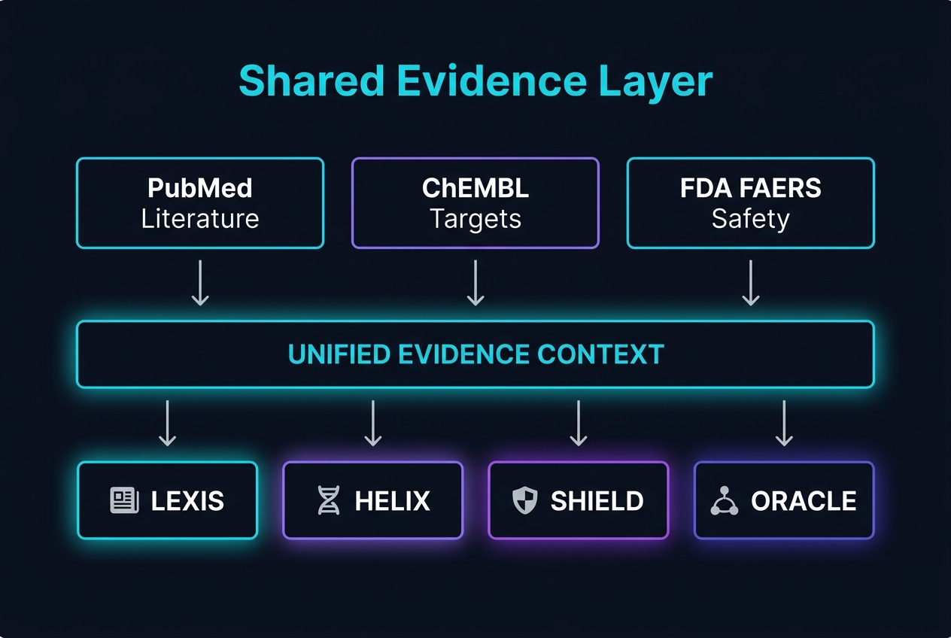
9. CROSS-VERIFICATION ARCHITECTURE
Shared Evidence Layer: All Agents Know Everything
From Linear Chain to Shared Intelligence
Old Architecture: Agents only see their own outputs. HELIX does not know what LEXIS found. SHIELD does not know what HELIX matched.
New Architecture: All agents are initialized with the same full evidence dataset — literature, target data, and safety records — before any agent produces output.
Why It Matters: A drug that looks valid to HELIX may already be flagged in LEXIS literature as ineffective in vivo. SHIELD now catches this before ranking.
Shared State: A single evidence context object is broadcast to LEXIS, HELIX, SHIELD, and ORACLE simultaneously, eliminating information asymmetry.

Slide 11
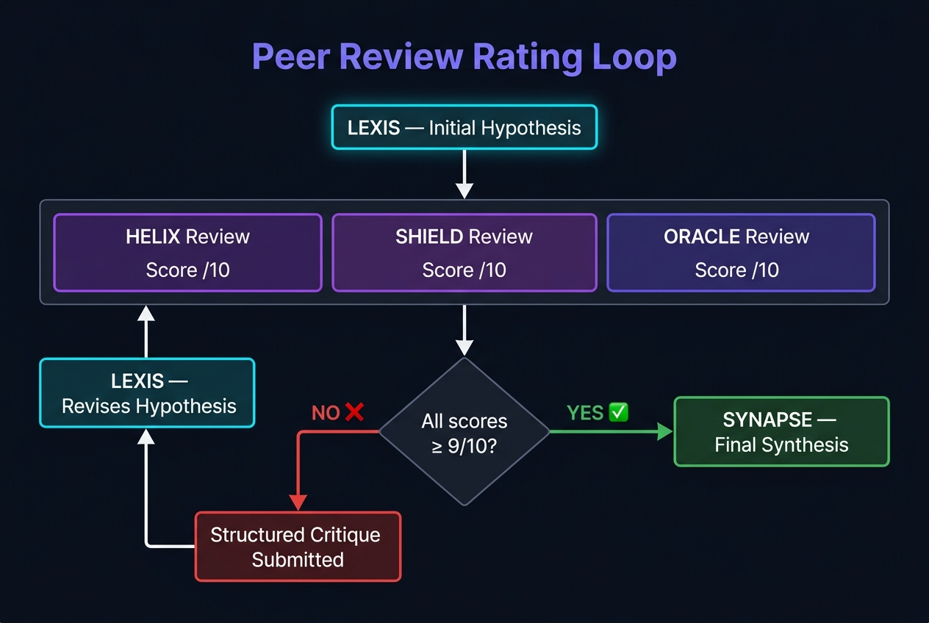
10. AGENT RATING & ITERATIVE REFINEMENT
Peer Review Loop: Quality Gate Before Final Synthesis
The 9/10 Quality Gate
Step 1 — LEXIS Produces Initial Hypothesis: The Literature Scout generates the first disease-to-target reasoning chain with citations.
Step 2 — Parallel Peer Review: HELIX, SHIELD, and ORACLE each independently rate the initial hypothesis on a 1–10 scale using the shared evidence layer.
Step 3 — Quality Gate (score ≥ 9): If ALL reviewers rate ≥ 9/10, the hypothesis passes directly to SYNAPSE for final synthesis.
Step 4 — Critique & Refinement (score < 9): Any agent rating below 9 must submit a structured critique specifying exactly what is missing or incorrect.
Step 5 — LEXIS Revises: The critiques are returned to LEXIS, which updates the hypothesis. The revised output re-enters peer review. Loop continues until consensus ≥ 9.

