Slide 1
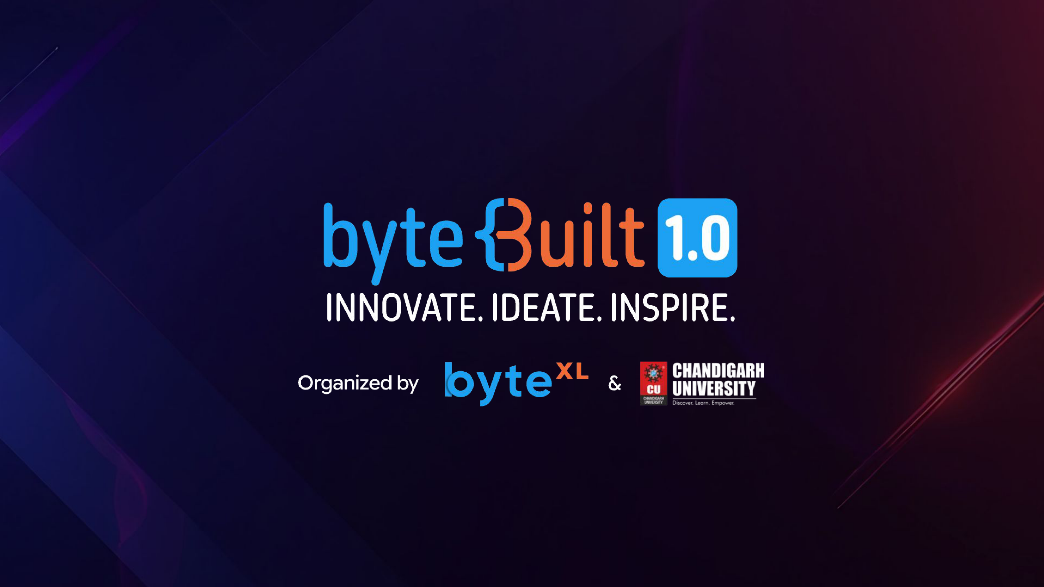
SkillPath — Autonomous Inclusive Workforce Orchestrator
Closing the $5.5T Skills Gap with Skills-First Intelligence & SAP Talent Intelligence Hub Alignment

Slide 2
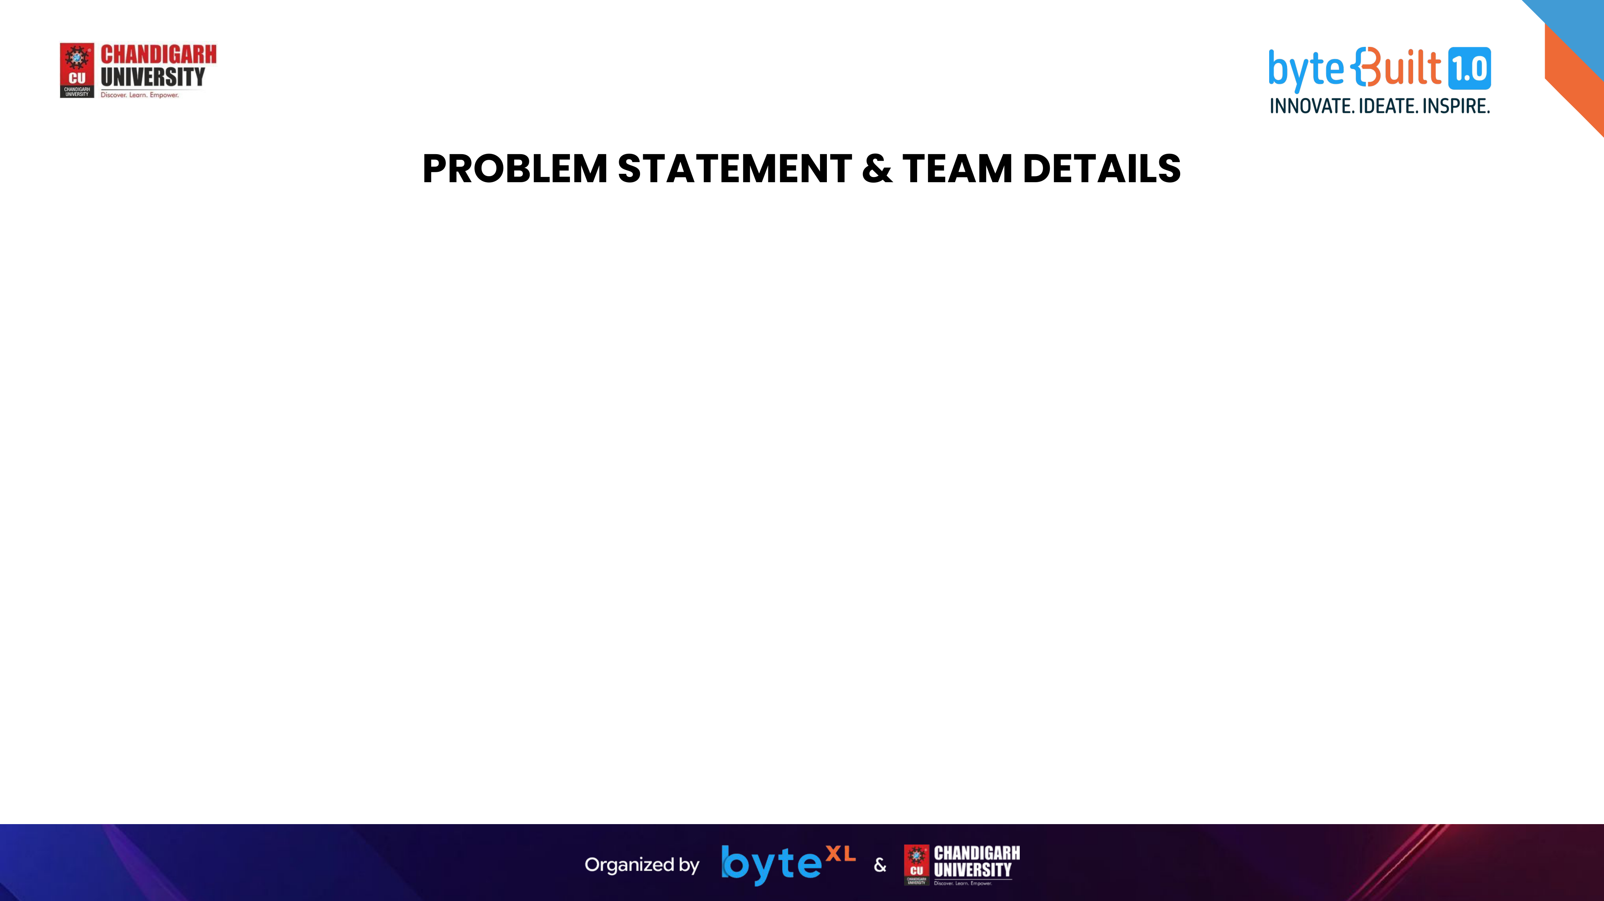
TEAM NAME (AS SUBMITTED ON PORTAL)
Team SkillPath
HACKATHON THEME & PROBLEM STATEMENT
Inclusive Workforce: AI Multi-Agent Career Orchestrator & Fair Reskilling
S.No | NAME | GENDER | AREA OF EXPERTISE
1 | Shaurya | Male | AI Multi-Agent Architect, DAG Swarm & SAP Integration
2 | Harshit | Male | Frontend Engineering, Inclusive UI/UX & Cloud Infrastructure
3
4

Slide 3

SkillPath — The Inclusive Workforce Orchestrator
Proposed Solution Architecture:
🌟 Gap Alchemy & Skills Discovery
• Translates informal lived experience (caregiving, operations, self-study) into high-value tech skills.
• Enforces a 0% Career Break Penalty policy, surfacing latent ability over institution pedigree.
• Connects adjacent capabilities through a multi-dimensional skills knowledge graph.
🤖 6-Agent Autonomous Swarm
• Skills Discovery, Market Intelligence, Learning Pathway, Inclusive Matcher, Employer Court, Bias Auditor.
• Stepped Bridge Role Ladders: builds viable stepping-stones rather than unrealistic career leaps.
• Real-time doubt resolution with Human-in-the-Loop decision agency.
🏢 SAP SuccessFactors & Joule Bridge
• Standard Skills Portfolio JSON export matching SAP Talent Intelligence Hub taxonomy.
• Pre-packaged handoff payloads for SAP Joule Career, HR Service, and People Intelligence Agents.
• Certified 10-Dimension Fairness & Bias Audit Ledger with verifiable A+ grade.

Slide 4
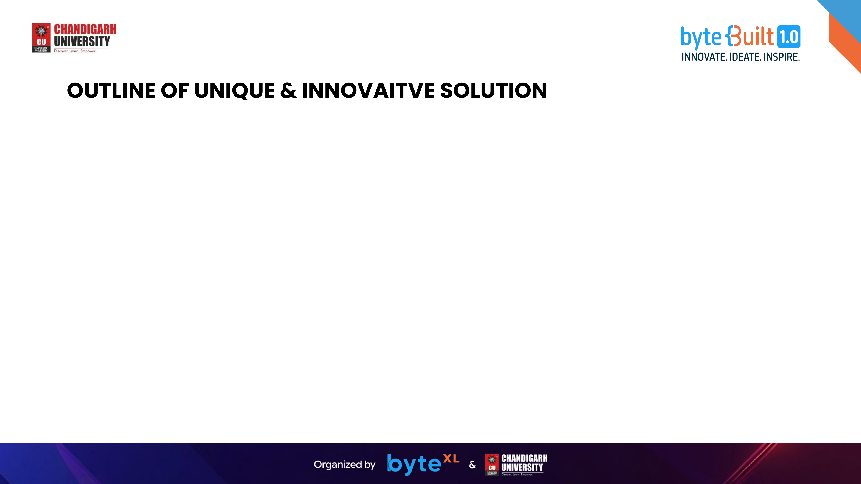
🛡️ 10-Dimension Bias & Gap Immunity Engine
Evaluates recommendations against 10 fairness dimensions including PwD accessibility, tier-2/3 access, caregiving break protection, and degree-blind skills verification.
🗺️ Stepped Bridge-Role Ladders (Dijkstra Graph)
Rather than demanding an impossible 6-month jump from back-office data entry to Senior AI, Pathfinder builds stepped, paid bridge roles (Data Associate ➔ IT Support ➔ Cloud QA).
⚖️ Employer Court / JD Accessibility Audit
Scans employer job postings for exclusionary jargon ('rockstar', 'ivy league mandate', 'unbroken tenure') and generates actionable HR accommodation recommendations.
⚡ DAG Wave Parallel Execution (< 2.5s)
Executes 14 specialized sub-agents in 4 parallel waves using SHA-256 caching and fallback resilience, delivering enterprise speed with deep agentic reasoning.

Slide 5

🖥️ Frontend & UI Layer
• Next.js 15 App Router & React 19
• TypeScript 5 Strict (End-to-End)
• Tailwind CSS + Glassmorphic UI
• Interactive Copilot & Dynamic Re-run
• 4 One-Click Live Persona Presets
🤖 6-Agent Swarm Core
• DAG Parallel Wave Scheduler (<2.5s)
• Gap-Skill Translation Sub-Engine
• Dijkstra Shortest Bridge Pathfinder
• 10-Dimension Inclusion Rules Engine
• Employer Readiness Jargon Auditor
🏢 Enterprise & SAP Bridge
• SAP Talent Intelligence Hub JSON Export
• SAP Joule Agent Handoff Simulation
• Certified Bias Audit Certificate Export
• Key Pool Rotation & Model Fallback
• Zero-Trust Serverless Security
📊 Datasets & Intelligence
• 5,000+ JD MVC Frequency Models
• Indian Tier-1/2/3 Regional Hub Matrix
• Live Skill Freshness & Decay Vectors
• Curated Returnship Programs DB
• WCAG 2.1 PwD Accessibility Mappings

Slide 6

🏢 SAP SuccessFactors Synergy
Native architectural alignment with SAP Talent Intelligence Hub and Joule Agents (Career & Talent Development, HR Service, People Intelligence) enables seamless enterprise talent deployment.
⚡ Production Feasibility
Fully functional Next.js 15 application with sub-2.5s multi-agent execution, local deterministic reflex layer, and SHA-256 in-memory caching.
💰 Cost & Latency Optimization
Hybrid deterministic + LLM wave architecture reduces API operational costs by >65% compared to monolithic LLM chains while preventing rate limit failures.
🛡️ Governance & Ethical AI
Certified 10-dimension Bias Audit Agent enforces verifiable compliance with equal-opportunity standards and zero career break penalties.

Slide 7

🌟 Women Returners & Gaps
• Caregiving and family breaks protected with 0% penalty.
• Lived operations & budgeting translated into IT project skills.
• Automatic matching with Microsoft LEAP, IBM & TCS returnships.
🚀 Tier-2/3 & First-Gen Talent
• Demystifies the hidden curriculum of career navigation.
• Regional scouting for candidates in Lucknow, Jaipur, Gorakhpur.
• Replaces institution prestige filters with verified skills.
♿ Displaced Workers & PwD
• Stepped 8-week bridge ladders for automated routine workers.
• Factor screen-reader & async remote accommodations.
• Salary ROI modeling for realistic reskilling upside.

Slide 8

👤 Free B2C Candidate Lifeline
Lifelong free access for job seekers, returners, and first-gen students to discover skills, get gap protection, and access curated free roadmaps.
🏢 Enterprise SAP Ecosystem SaaS
Integration subscription for global enterprises (Grundfos, Capgemini, IBM) deploying SAP SuccessFactors to ingest verified inclusive candidate portfolios.
🏛️ University & State Placement SaaS
Cohort analytics and batch readiness monitoring for tier-2/3 universities and state skill development missions (PMKVY, NSDC).
⚖️ Employer Bias Audit & HR API
Automated compliance API auditing corporate job postings for exclusionary filters, promoting ESG and DEI hiring benchmarks.

Slide 9

📊 IDC Enterprise Research 2026
Over 90% of global enterprises face critical skills shortages, creating a $5.5 trillion loss risk rooted in knowledge mismatches rather than labor shortages.
🇮🇳 India Skills Report 2026 & TCS
Employability reached 56.35% with tier-2/3 talent emergence, juxtaposed against 12,000 TCS layoffs citing AI-driven skill mismatches.
💼 PwC & Anthropic Impact Reports
Workers with AI fluency command a 56% wage premium, while non-AI workers risk medium-term obsolescence without accessible reskilling.
🌐 World Economic Forum (WEF)
170M new roles vs 92M displaced (78M net gain), but 59% of the workforce requires urgent, targeted retraining to prevent displacement.

