Slide 1

Department of Computer Science and Engineering
Graphic Era (Deemed to be University)
Dehradun, Uttarakhand
Mini Project Presentation PHASE-1 on
Image Classification using Deep Learning
Under the Mentorship of
Dr. Ashwini Kumar
Associate Professor
Department of Computer Science and Engineering
Submitted by:
Name Harshit Jain
University Roll No. – 2018827

Slide 2
INTRODUCTION
The automated identification of defects in printed circuit boards (PCBs) is a critical facet of modern manufacturing processes. In response to this need, machine learning techniques offer a promising solution.
Data Prep & Exploration:
Parse filenames to extract 'good' or 'bad' labels.
Use Pandas for data processing.
Visualize label distribution with Matplotlib for dataset insights.
Model Architecture & Training:
Utilize transfer learning with MobileNet pretrained on ImageNet.
Add dense layers to enhance pattern recognition.
Employ training strategies like freezing layers, progressive unfreezing, and callbacks for optimization.

Slide 3
INTRODUCTION
3. Data Augmentation & Validation:
Augment training data (rotation, shearing, flipping) to prevent overfitting.
Use separate validation set for model performance evaluation.
4. Model Evaluation & Testing:
Evaluate performance using accuracy and loss metrics.
Test model on an independent dataset to assess real-world predictive capabilities.
5. Visualizing Model Predictions:
Visualize model predictions on test images, displaying predicted defect categories.
Overall, this methodology utilizes machine learning to automate defect detection in PCBs, aiming to enhance quality control in manufacturing environments.

Slide 4
Literature Survey
The field of PCB inspection faces challenges due to limited public datasets and concerns about protecting design confidentiality. Some open-source PCB datasets exist for supervised learning. Table 1 summarizes recent models' limitations in PCB defect detection:
Hand-Crafted Methods:
Elimination-Subtraction & Image Wavelet-based Methods: Simple but struggle with intricate defects and binary image limitations.
Automated Optical Inspection (AOI): Uses predefined criteria but suffers from noise issues and high false detections.
Statistical & Logical Methods:
Hypothesis Testing & Boolean Functions: Time-consuming, limited to binary classification, and struggle with varied circuit designs.
Mathematical Expression: Utilizes logical operations but faces challenges in real production scenarios.

Slide 5
Literature Survey
3. Deep Learning Models:
CNNs, U-Net, YOLOv3, etc.: Offer better defect detection but might trade speed, accuracy, or real-time applicability. They demand significant computational resources and may not cover all defect types.
Hand-crafted methods are simple but struggle with detecting diverse defects accurately. Deep learning models provide better performance but have challenges such as computational demands and trade-offs between speed and accuracy.

Slide 6
METHODOLOGY
The code employs transfer learning by utilizing the MobileNet architecture pretrained on ImageNet for defect detection in printed circuit boards (PCBs). Initially, the data undergoes preprocessing steps, including data loading, labeling, and splitting into training and validation sets. Augmentation techniques are applied using ImageDataGenerator. The model is constructed by leveraging MobileNet as the base, appending additional dense layers for classification, and compiling it with categorical cross-entropy loss and Adam optimizer. Training proceeds with fit_generator, incorporating early stopping and learning rate reduction callbacks for efficiency. The trained model is evaluated through plotted training and validation metrics, saved for future use, and then employed for testing on unseen test data. Predictions are generated and visualized using bar graphs and sample images, depicting the model's performance in classifying 'good' and 'bad' PCBs.
This encapsulates the key steps involved in data processing, model construction, training, evaluation, and testing for defect detection in PCBs using a deep learning approach.

Slide 7
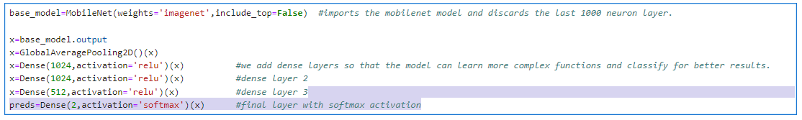
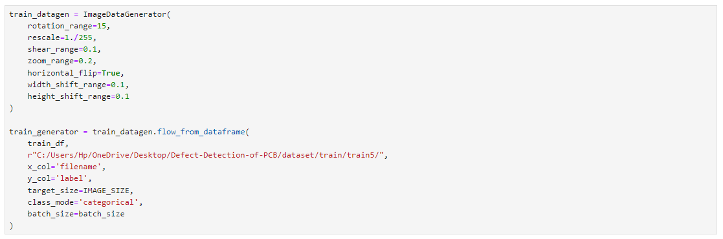
METHODOLOGY

Slide 8
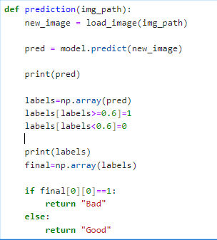
METHODOLOGY

Slide 9
REFERENCES
[1] Vikas Chaudhary, Ishan R. Dave, and Kishor P. Upla. Automatic visual inspection of printed circuit board for defect detection and classification. Proceedings of the 2017 International Conference on Wireless Communications, Signal Processing and Networking, WiSPNET 2017, 2018-Janua:732–737, 2018.
[2] Rafael C. Gonzalez, Richard E. Woods, and Steven L. Eddins. Digital Image Processing Using Matlab. Publishing House of Electronics Industry, 2009.
[3] Kaiming He, Xiangyu Zhang, Shaoqing Ren, and Jian Sun. Deep residual learning for image recognition. pages 770–778, 06 2016.
[4] https://researchgate.net/publication/346580234_Defect_Detection_in_PCB_Using_Image_Processing

Slide 10
Thank You

