Slide 1
Learning to Generalize Kinematic Models to Novel Objects (Abbatematteo et. al.)
Paper Presentation
Harshit Goyal: 2021MT10143

Slide 2
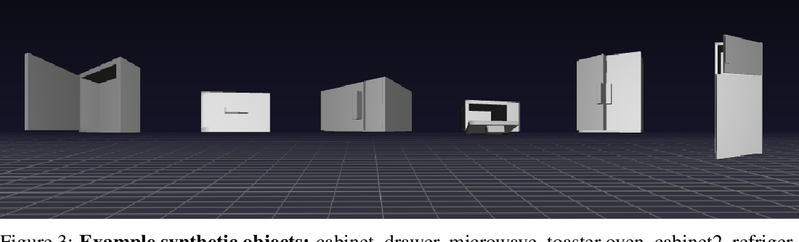
Problem Statement
[Task] Agentic interaction with articulated objects (motion of moving parts governed by joints) objects like cabinets, refrigerators, and drawers.
[Related Work] Human Demonstration (IL) or minutes of Interaction (RL).
[Related Work] Tracking sub-parts with fiducial markers or by clustering feature trajectories.
[Related Work] Requires learning each object from scratch. Can’t exploit similarity. For example, two different microwave will have similar kinematics.
[This Work] One shot learning of kinematics using shared structure on unseen objects, conditioned on object type.

Slide 3
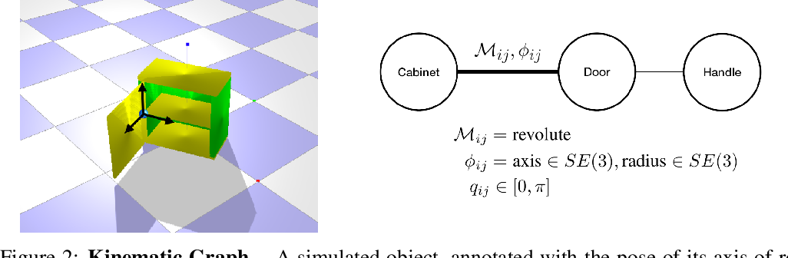
Background: Kinematic Graph
Nodes represent sub-parts. Edges represent joints.
(M): Revolute (cabinet hinge), Prismatic (drawer).
(𝜙): 6-DoF pose of the axis of rotation/translation in the camera frame, 6-DoF pose of the articulated sub-part’s origin in the axis frame.
(𝜃): Object geometry (length, width, height, and chirality).
(𝘲ₜ): Angles (revolute) or (Displacements) prismatic.
(𝘲ₜ) varies while articulating. Others don’t.

Slide 4
Technical Approach: Assumptions
An object’s kinematic structure (M) is directly specified by its category (c). Graph connectivity is shared among all instances of that class.
Kinematic graph structure of each object class is known a priori.
Hence object-recognition directly gives the Kinematic Graph.
[Here] 6 classes (cabinet, drawer, microwave, toaster oven, two-door cabinet, refrigerator).

Slide 5
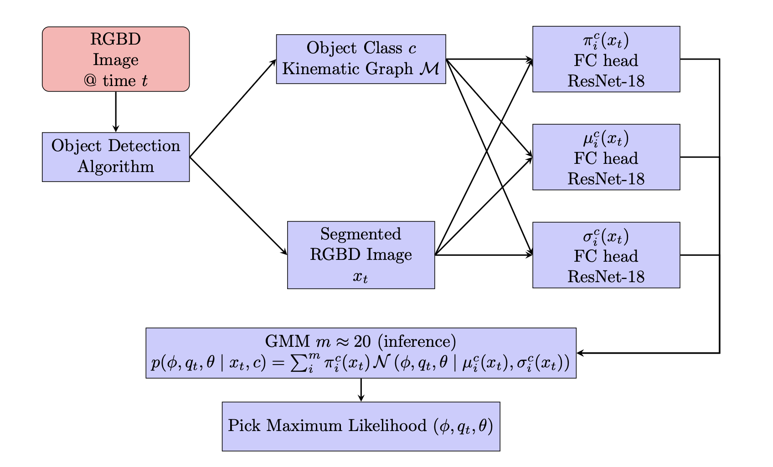
Technical Approach: Overall Inference Pipeline

Slide 6
Technical approach: Training GMM: Dataset
[Training: Synthetic Dataset] Class-wise sampled object pose (𝜙) and geometry (𝜃), computed (𝘲ₜ) while articulation is simulated. For RGBD images, object position and orientations sampled uniformly. Kinematic graph for each of these classes, known a priori.
[Evaluation] Withheld simulated objects, Real Objects observed with a Kinect sensor.

Slide 7

Technical approach: Training GMM
Trained to maximise Likelihood on training (RGBD image, gt (𝜙 𝘲ₜ 𝜃)).
Sampled batches of individual image-label pairs rather than training on full object articulation demonstrations to enable one-shot model inference with new objects.

Slide 8
Results: Evaluation Metrics
Estimates are produced from a single depth image, and are not accumulated.
(𝜙) Euclidean distance between position of axis, orientation error of the axis of rotation/translation about the z-axis.
(𝘲ₜ) Degrees (revolute) and Centimeters (prismatic).
[Baseline Mean] Mean of (𝜙), (𝘲ₜ) respectively from training data.
[Baseline NN] (𝜙), (𝘲ₜ) of training depth image Nearest test depth image.
[Baseline ICP (Iterative Closest Point): Each test RGBD is calibrated to the mean model (point cloud of 16 RGBD training images) to find best match (ICP). From output 6-DoF transformation error about the z-axis is reported.
[Real Data] Recognition and segmentation were performed using Mask. R-CNN pretrained on the MS COCO dataset for the microwave and refrigerator object classes, and manually for the others.

Slide 9
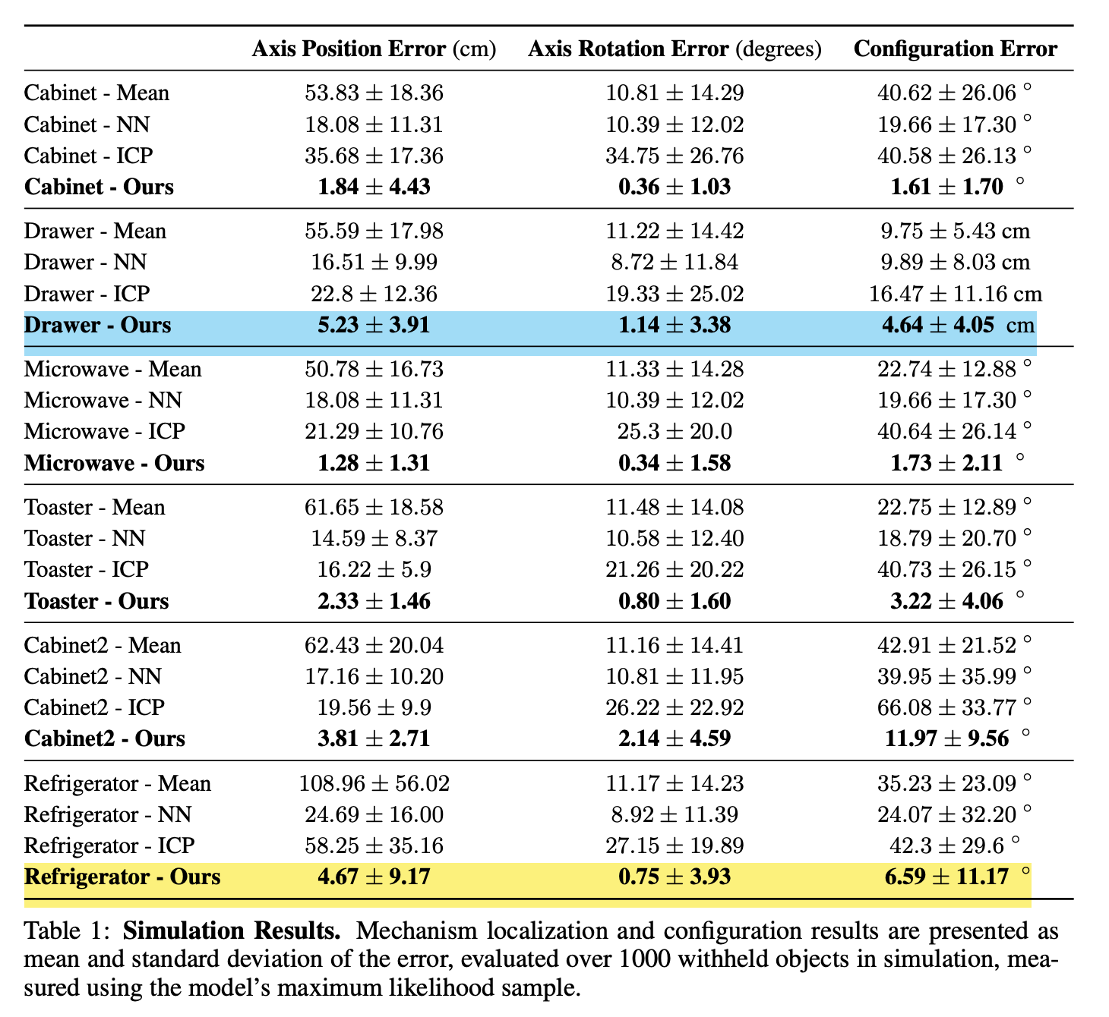
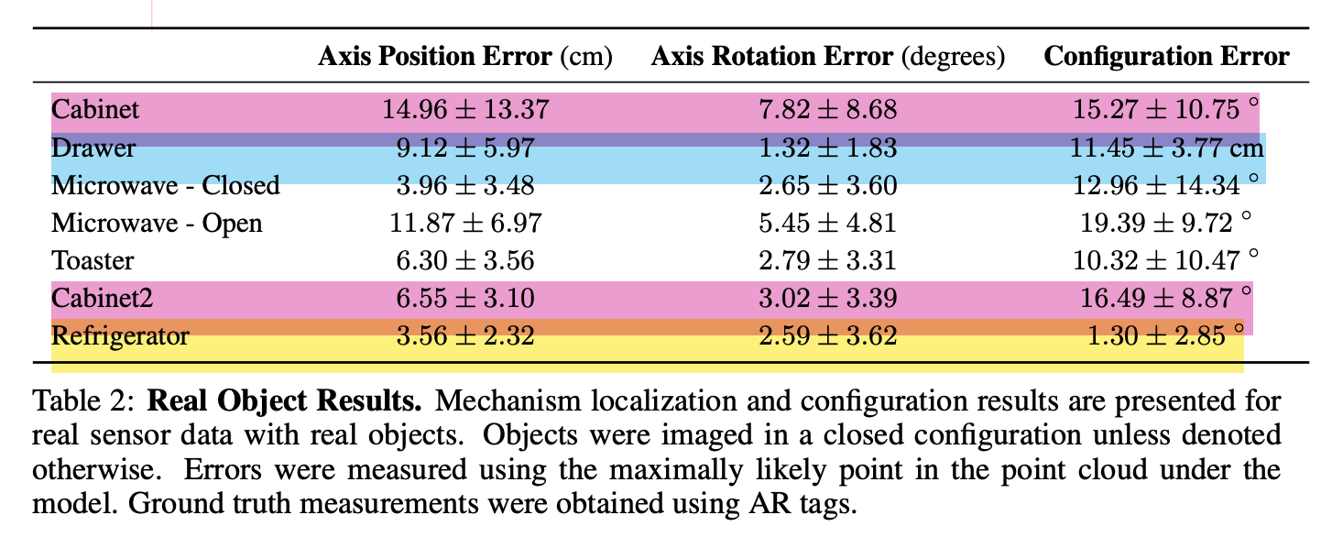
Results: Tables
The framework learns to accurately generalize kinematic models to real, novel objects after being trained exclusively in simulation.

Slide 10
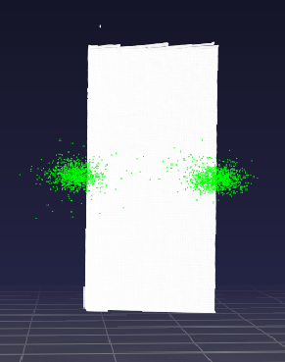
Results: Analysis
[Simulated Refrigerator] Performance is relatively low due to more pose variation in the dataset in order to accommodate for the refrigerator’s size, and more samples with only partial views of the object.
[Drawer Simulation + Real] Challenging due to occlusion of the mechanism’s pose during actuation. this affects the accuracy of the model on the real data of the open microwave, as well.
[1-DoF cabinet Real] Error rate is higher due to ambiguity in which side of the object the mechanism resides on. Figures shows estimated hing positions.

Slide 11
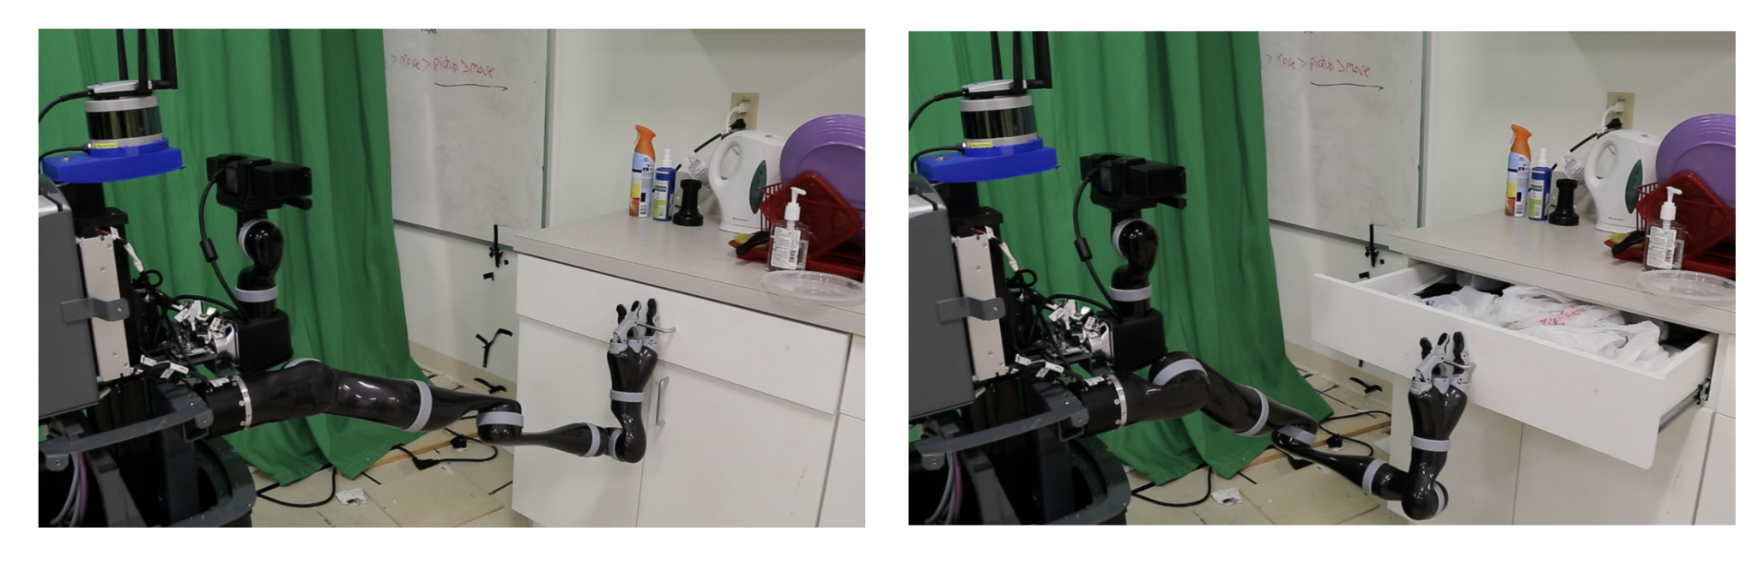
Results: One Shot Learning and Manipulation
The robot, a Kinova MOVO mobile manipulator, was driven around the area in front of each object, and recorded observations of the object and its own pose in a pre-computed map of the room.
Agent is provided with a fixed grasp on the object’s handle, and computed a series of waypoints as a function of the estimated (𝜙 𝘲ₜ 𝜃), end-effector pose, and desired object configuration.

Slide 12
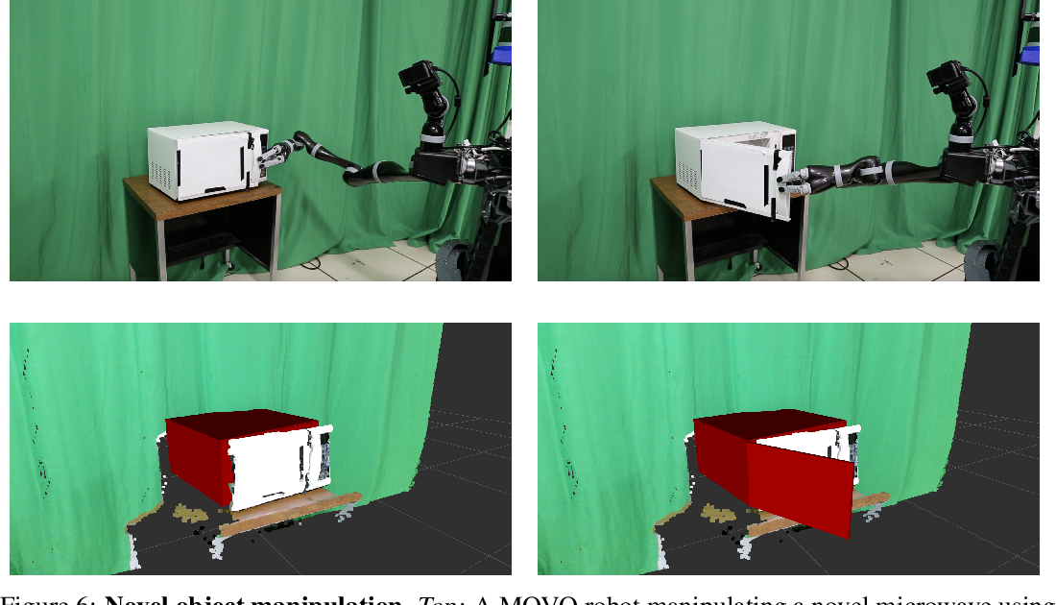
Results: Manipulation: Rendered State

